Slide 1
What is Amazon Organizations ?
Amazon Organizations is an account management service that enables you to consolidate multiple AWS accounts into an organization that you create and centrally manage.
Amazon Organizations includes account management and consolidated billing capabilities that enable you to better meet the budgetary, security, and compliance needs of your business.
As an administrator of an organization, you can create accounts in your organization and invite existing accounts to join the organization.
Amazon Organizations features
Centralized management of all of your Amazon Web Services accounts
Consolidated billing for all member accounts
Hierarchical grouping of your accounts to meet your budgetary, security, or compliance needs
Policies to centralize control over the Amazon services and API actions that each account can access
Policies that configure automatic backups for the resources in your organization's accounts
Global access - Amazon Organizations is a global service with a single endpoint that works from any and all Amazon Web Services Regions
Free to use - Amazon Organizations is a feature of your Amazon Web Services account

Slide 2
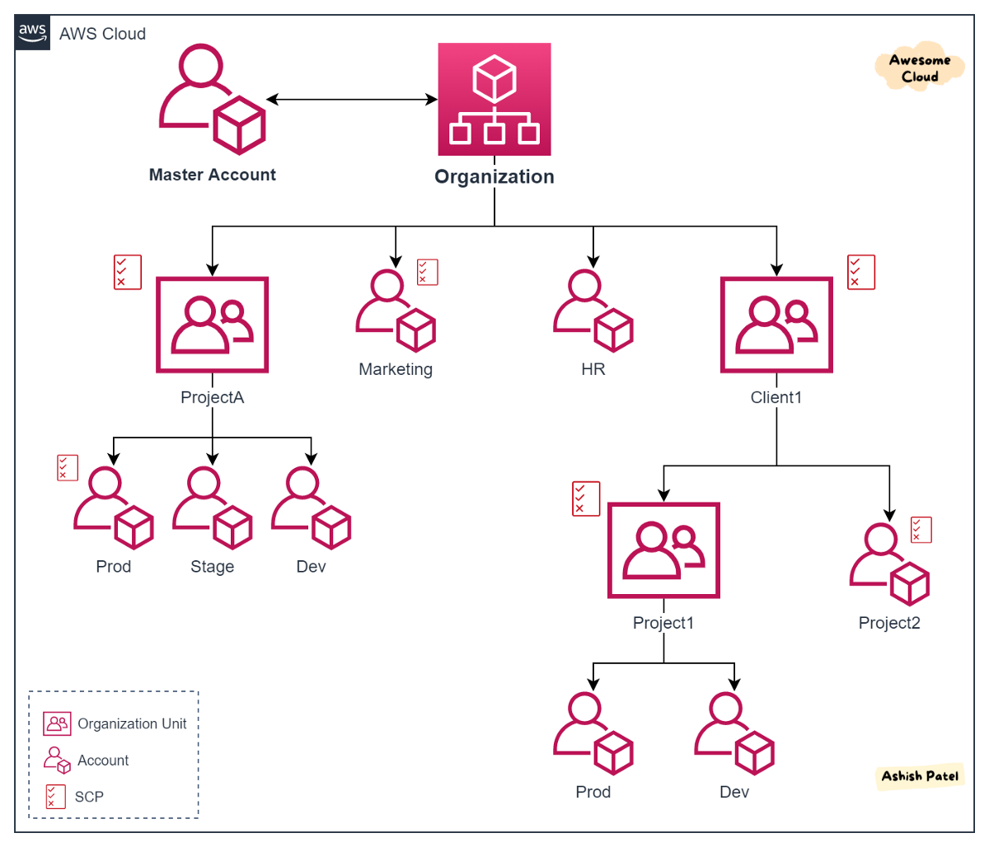
Amazon Organizations

