Slide 1
SNS

Slide 2
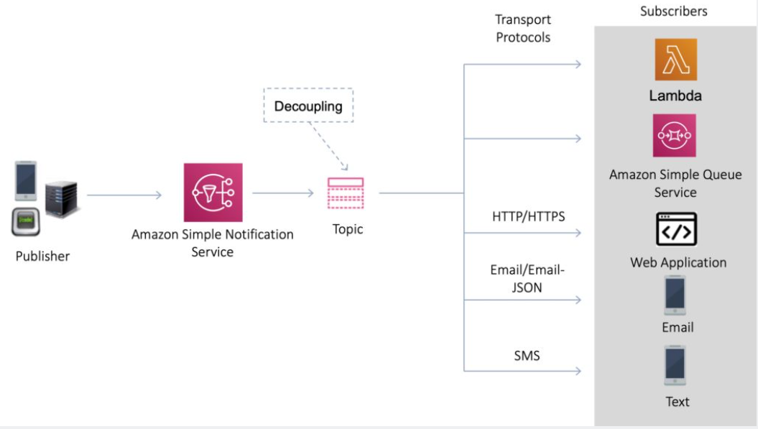
What is Amazon SNS?
Amazon Simple Notification Service (Amazon SNS) is a fully managed messaging service for both application-to-application (A2A) and application-to-person (A2P) communication.
The pub/sub functionality provides messaging for high-throughput, push-based, many-to-many use cases.
Amazon SNS is used for sending notifications between distributed systems, microservices, and event-driven serverless applications.
Amazon SNS can also send notifications via SMS text message, email, SQS queues or to any HTTP endpoint.
Amazon SNS notifications can also trigger Lambda functions.
Amazon SNS is inexpensive and based on a pay-as-you-go model with no upfront costs.
SNS uses a pub-sub model whereby users or applications subscribe to SNS topics.

Slide 3
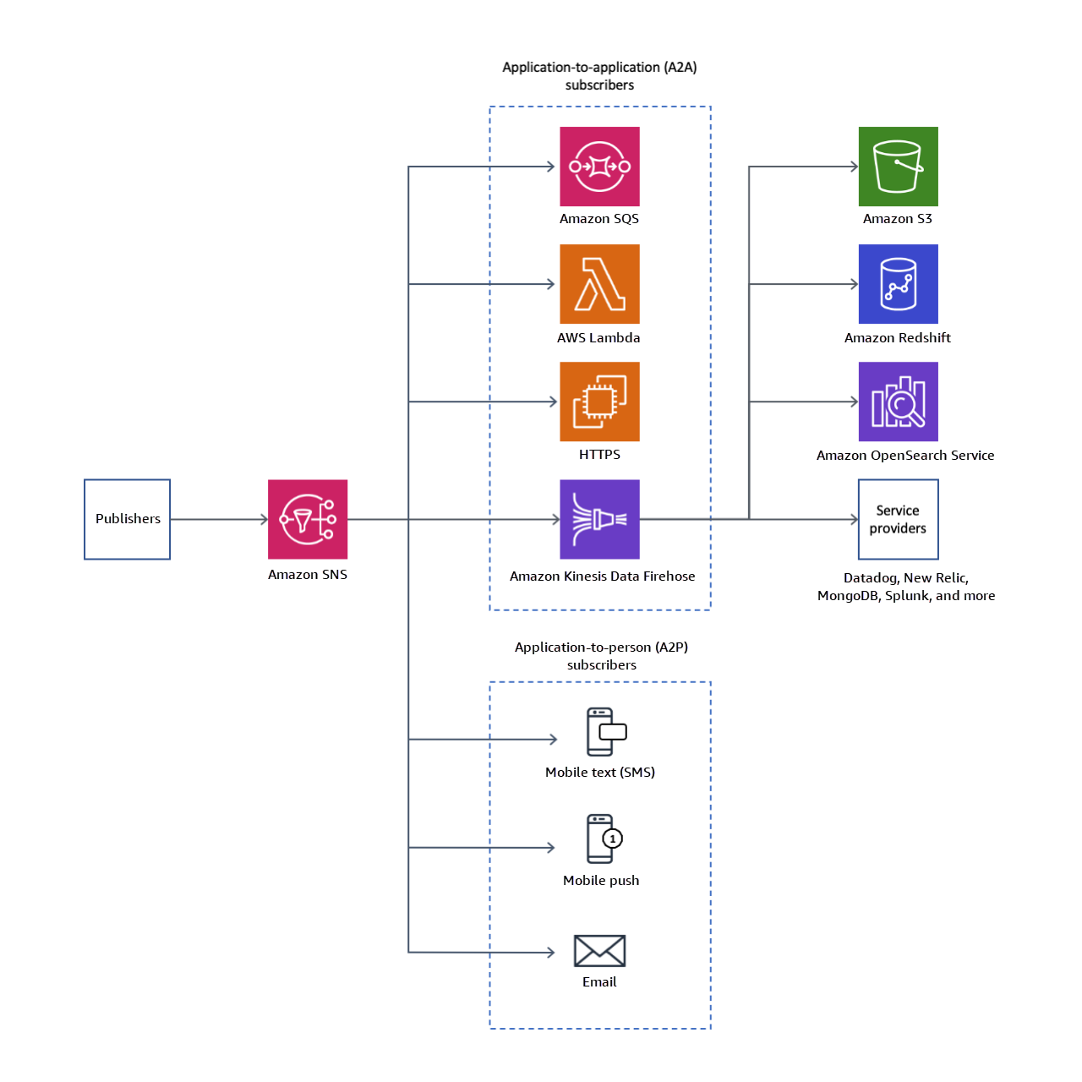

Slide 4
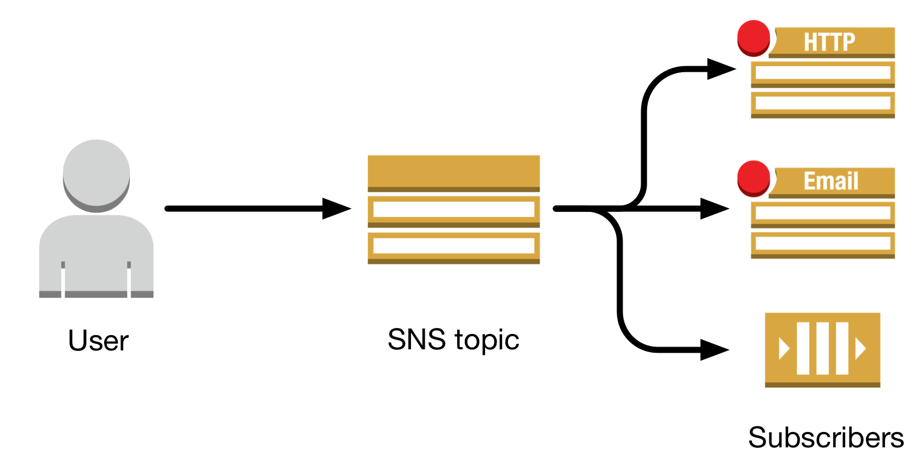
SNS Topics
Multiple recipients can be grouped using Topics.
A topic is an “access point” for allowing recipients to dynamically subscribe for identical copies of the same notification.
One topic can support deliveries to multiple endpoint types.
All messages are stored redundantly across multiple availability zones.
Provides instantaneous, push-based delivery.
Flexible message delivery is provided over multiple transport protocols.

Slide 5
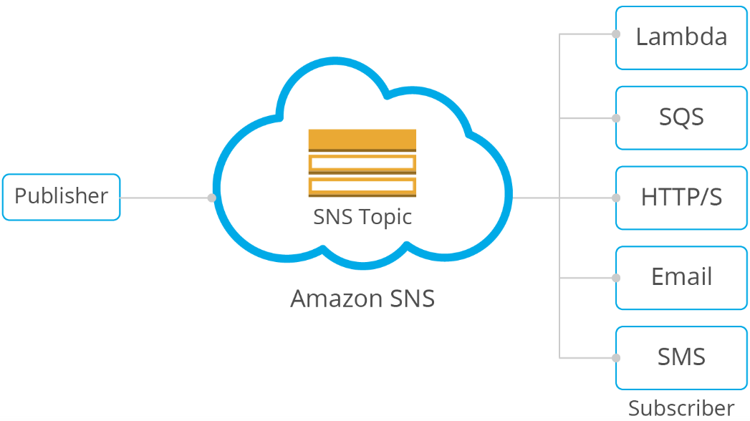
SNS Subscribers and Endpoints
When subscribing to an SNS topic the following endpoint types are supported:
HTTP/HTTPS.
Email/Email-JSON.
Amazon Kinesis Data Firehose.
Amazon SQS.
AWS Lambda.
Platform application endpoint (mobile push).
SMS.

Slide 6
SNS FIFO topics use case. Serverless Architecture
Inventory managers use a price management application to set the price for each item in stock.
The price management application uses an AWS Lambda function that publishes price updates to an SNS FIFO topic whenever prices change.
A wholesale application provides the backend for a website where auto body shops and car manufacturers can buy the company's auto parts in bulk
A retail application provides the backend for another website where car owners and car tuning enthusiasts can purchase individual auto parts for their vehicles

Slide 7
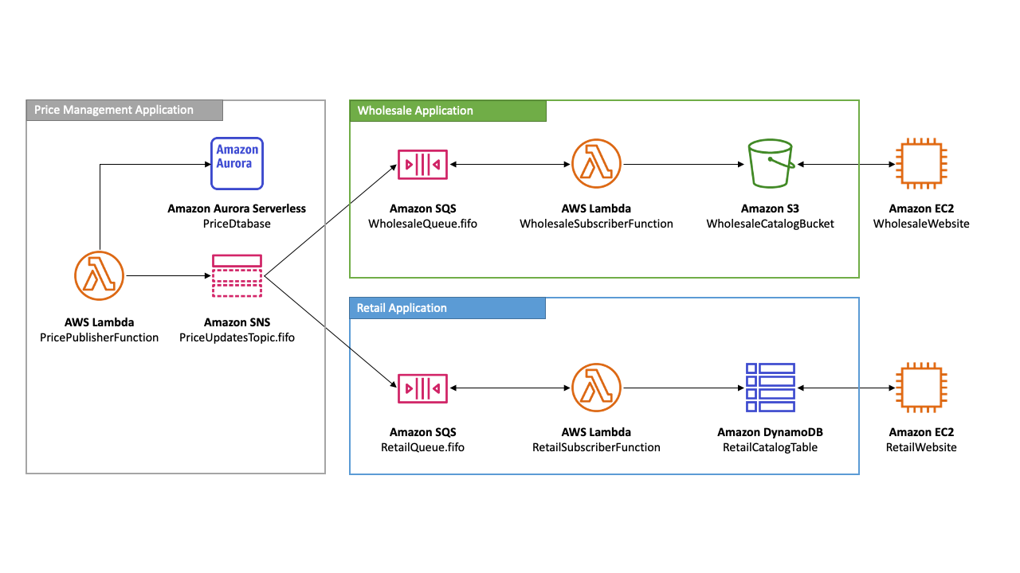
SNS FIFO topics use case. Serverless Architecture

Slide 8
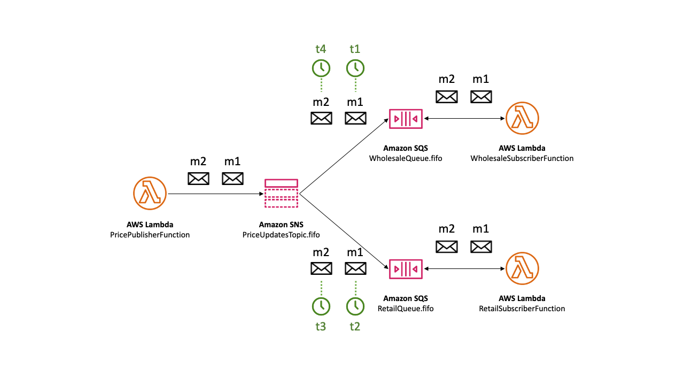
SNS Message Ordering Details (Happy path)
An Amazon SNS FIFO topic delivers messages to subscribed Amazon SQS FIFO queues in the exact order that the messages are published to the topic. Note that we do not have exact order of subscribers.

Slide 9
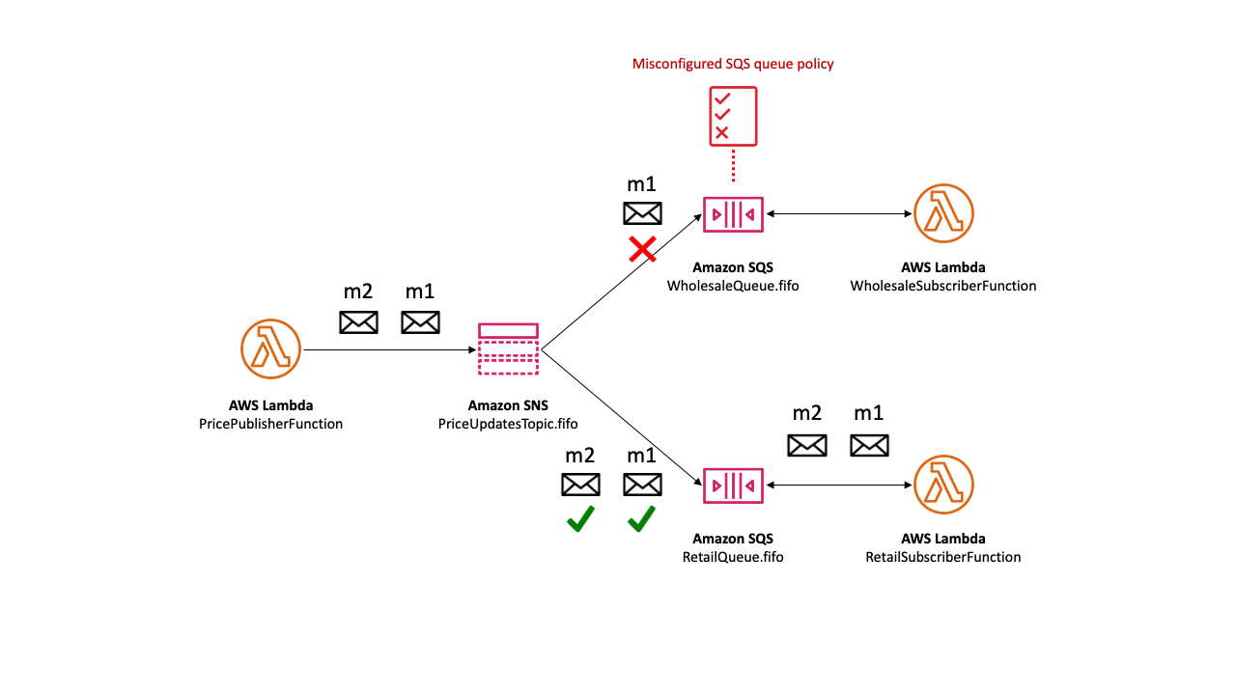
SNS Message Ordering Details (Unreachable subscriber)

Slide 10
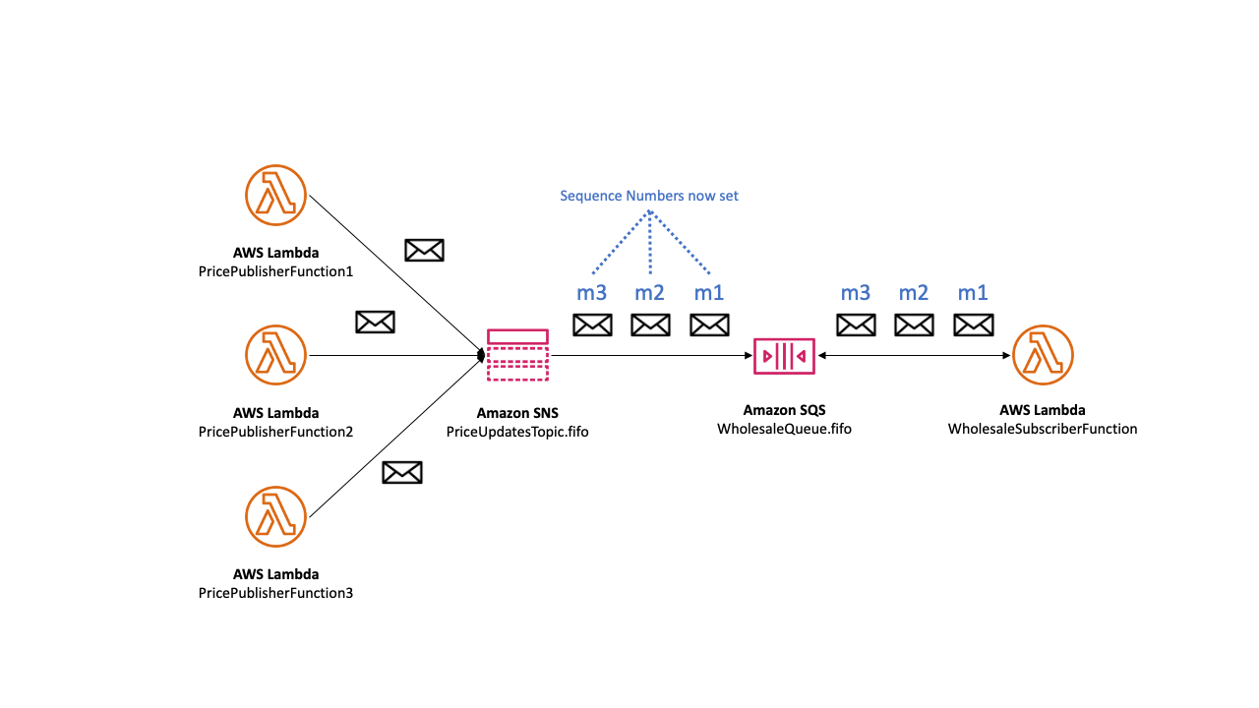
SNS Message Ordering Details: Multiple writers
We are effectively delegate message sequencing to the Amazon SNS service.
To determine the established sequence of messages, you can check the sequence number.
The sequence number is a large, non-consecutive, ever-increasing number that Amazon SNS assigns to each message that you publish.
The sequence number is passed to the subscribed SQS FIFO queues as part of the message body.
No metadata with raw message delivery

Slide 11
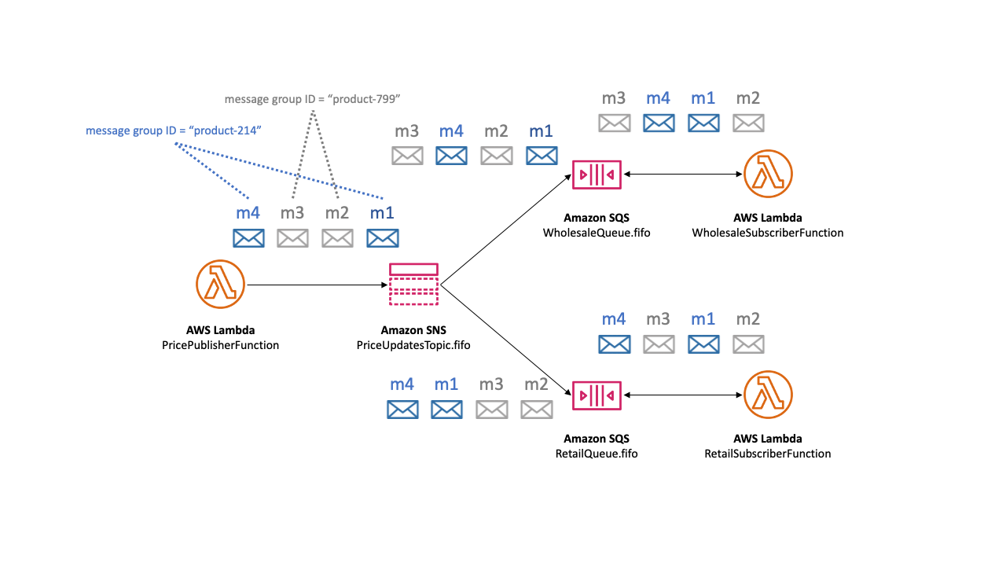
SNS Message grouping for FIFO topics
Messages that belong to the same group are processed one by one, in a strict order relative to the group.
When you publish messages to an Amazon SNS FIFO topic, you set the message group ID.
The group ID is a mandatory token that specifies that a message belongs to a specific message group
The SNS FIFO topic passes the group ID to the subscribed Amazon SQS FIFO queues
There's no affinity between a message group and a subscription

Slide 12
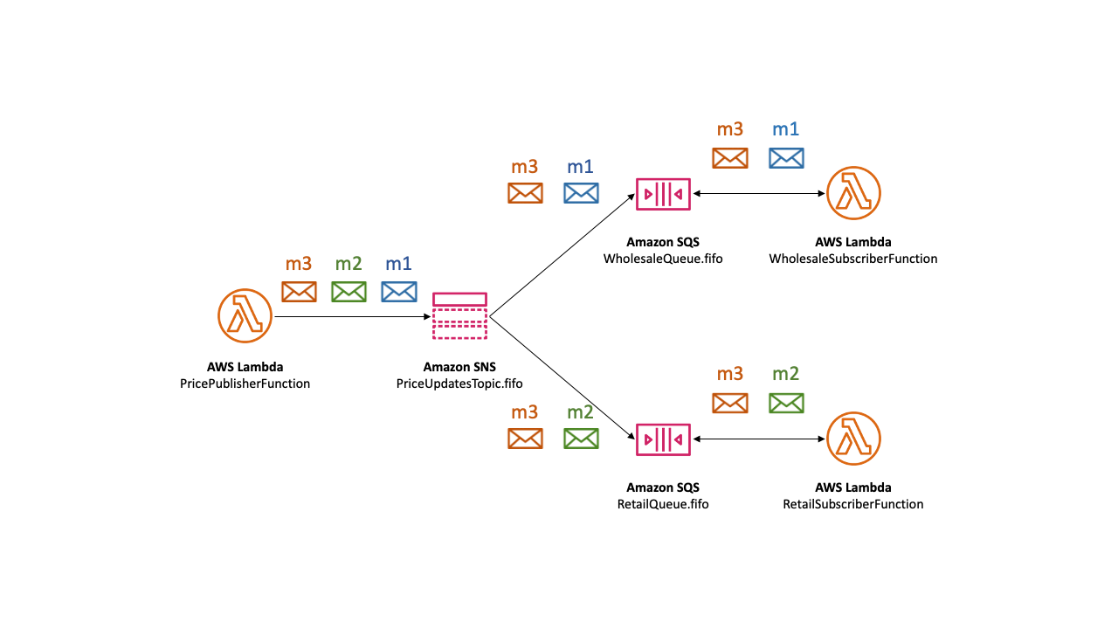
Message filtering for FIFO topics
Amazon SNS FIFO topics support message filtering.
Using message filtering simplifies your architecture by offloading the message routing logic from your publisher systems and the message filtering logic from your subscriber systems.
When you subscribe an Amazon SQS FIFO queue to an SNS FIFO topic, you can use message filtering to specify that the subscriber receives a subset of messages, rather than all of them.
Each subscriber can set its own filter policy as subscription attributes.

Slide 13
SNS Message deduplication for FIFO topics
Amazon SNS FIFO topics and Amazon SQS FIFO queues support message deduplication, which provides exactly-once message delivery and processing as long as the following conditions are met:
The subscribed SQS FIFO queue exists and has permissions that allow the Amazon SNS service principal to deliver messages to the queue.
The SQS FIFO queue consumer processes the message and deletes it from the queue before the visibility timeout expires.
The Amazon SNS subscription topic has no message filtering. When you configure message filtering, SNS FIFO topics support at-most-once delivery, as messages can be filtered out based on your subscription filter policies.
There are no network disruptions that prevent acknowledgment of the message delivery. (Network is stable)
!!! Message deduplication applies to an entire SNS FIFO topic, not to an individual message group.

Slide 14
SNS Message deduplication for FIFO topics: Flow
When you publish a message to an SNS FIFO topic, the message must include a deduplication ID.
This ID is included in the message that the SNS FIFO topic delivers to the subscribed SQS FIFO queues.
If a message with a particular deduplication ID is successfully published to an SNS FIFO topic, any message published with the same deduplication ID, within the five-minute deduplication interval, is accepted but not delivered.
The SNS FIFO topic continues to track the message deduplication ID, even after the message is delivered to subscribed endpoints.
Unique Body. SNS + SQS
If the message body is guaranteed to be unique for each published message, you can enable content-based deduplication for an Amazon SNS FIFO topic and the subscribed SQS FIFO queues.
Amazon SNS uses the message body to generate a unique hash value to use as the deduplication ID for each message, so you don't need to set a deduplication ID when you send each message.

Slide 15
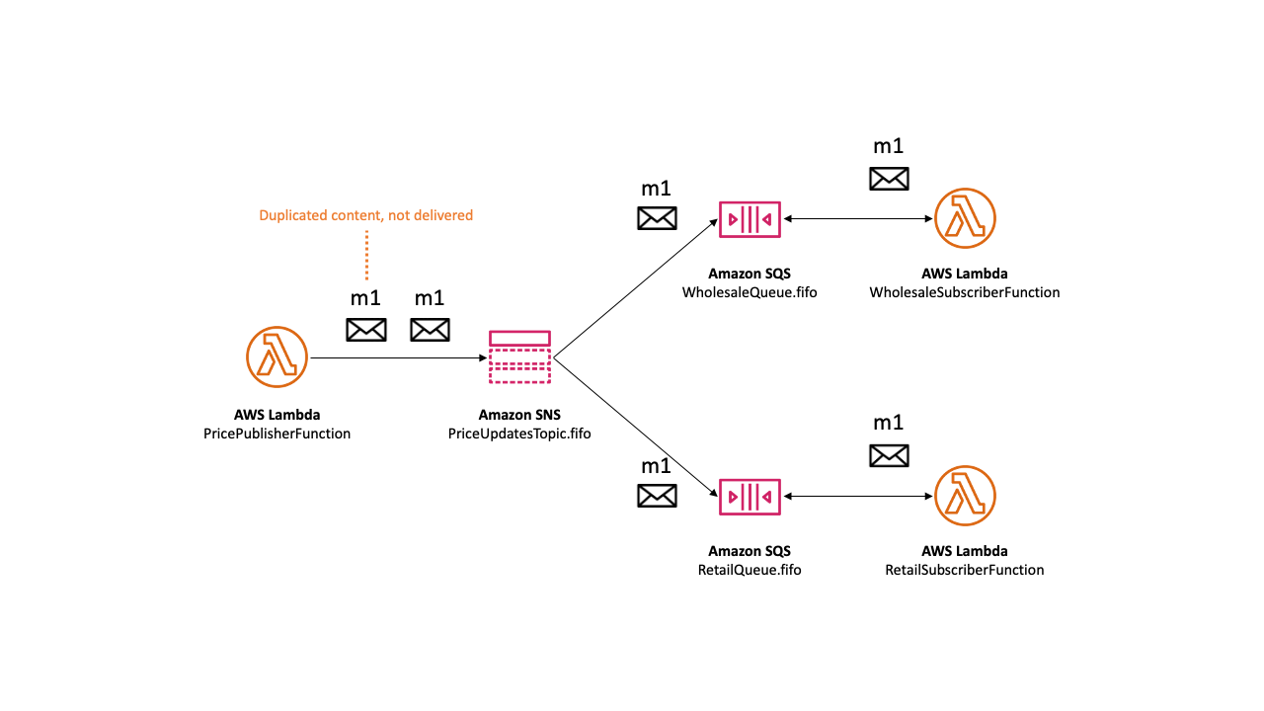
SNS Message deduplication for FIFO topics: Example

Slide 16
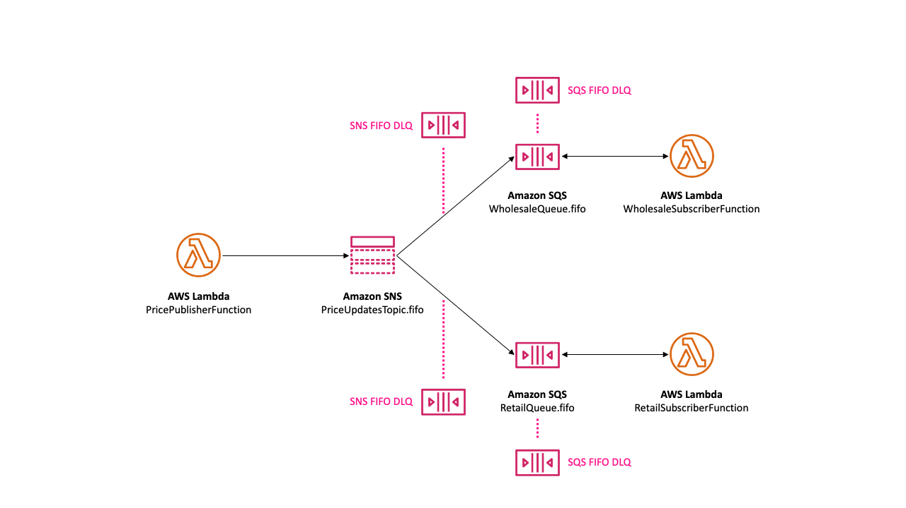
SNS Message Durability

Slide 17
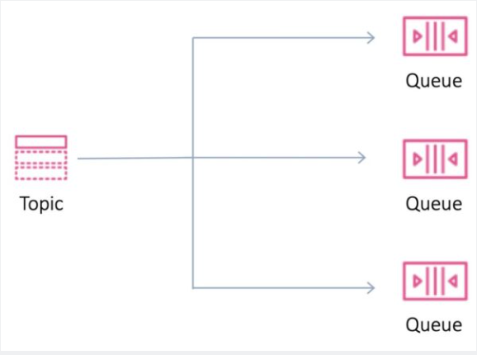
SNS - Fanout
Your publisher systems can fanout messages to many subscriber systems including Amazon SQS queues, AWS Lambda functions and HTTPS endpoints, for parallel processing, and Amazon Kinesis Data Firehose.
You can subscribe one or more Amazon SQS queues to an Amazon SNS topic from a list of topics available for the selected queue.
Amazon SQS manages the subscription and any necessary permissions.
When you publish a message to a topic, Amazon SNS sends the message to every subscribed queue.
Fanout is supported for application-to-application (A2A) messaging

Slide 18
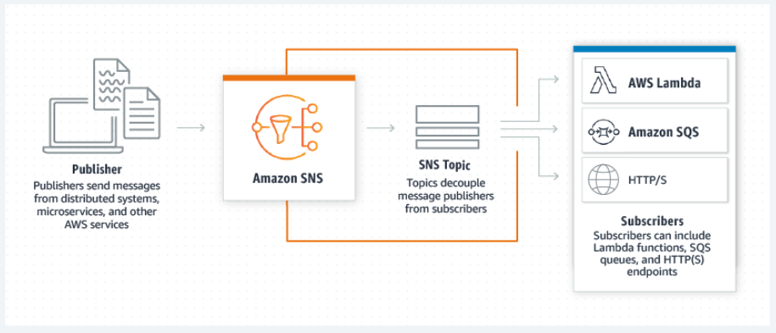
SNS - Application-to-application (A2A)
Amazon SNS is a managed messaging service that lets you decouple publishers from subscribers.
This is useful for application-to-application messaging for microservices, distributed systems, and serverless applications.
Options:
Fanout to Kinesis Data Firehose delivery streams
Fanout to Lambda functions
Fanout to Amazon SQS queues
Fanout to HTTP/S endpoints
Fanout to AWS Event Fork Pipelines

Slide 19
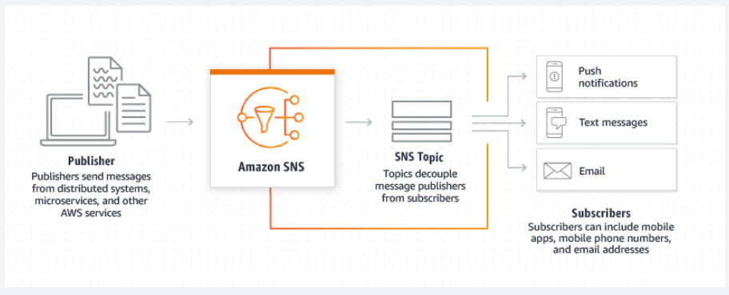
SNS - Application-to-person (A2P)
Amazon SNS lets you send push notifications to mobile apps, text messages to mobile phone numbers, and plain-text emails to email addresses.
You can fan out messages with a topic, or publish to mobile endpoints directly.
Options:
Mobile text messaging (SMS)
Mobile push notifications
Email notifications

Slide 20
Common Amazon SNS scenarios
The Fanout scenario is when a message published to an SNS topic is replicated and pushed to multiple endpoints, such as Kinesis Data Firehose delivery streams, Amazon SQS queues, HTTP(S) endpoints, and Lambda functions. This allows for parallel asynchronous processing.
Amazon SNS can send push email messages and text messages (SMS messages) to individuals or groups. For example, you could send e-commerce order confirmations as user notifications
Mobile push notifications enable you to send messages directly to mobile apps. For example, you can use Amazon SNS to send update notifications to an app.
Application and system alerts are notifications that are triggered by predefined thresholds. Amazon SNS can send these notifications to specified users via SMS and email. For example, you can receive immediate notification when an event occurs, such as a specific change to your Amazon EC2 Auto Scaling group, a new file uploaded to an Amazon S3 bucket, or a metric threshold breached in Amazon CloudWatch.

Slide 21
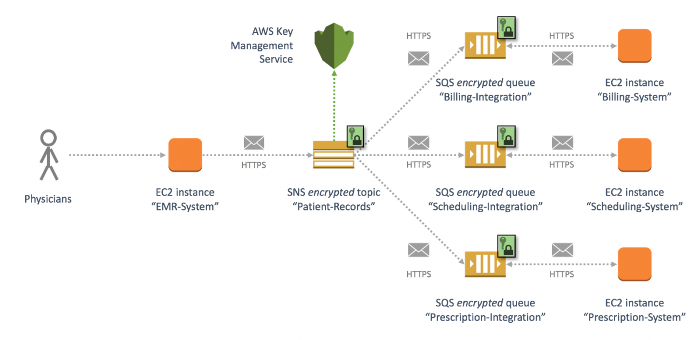
SNS Encryption
Encryption at rest
Server-side encryption (SSE) lets you store sensitive data in encrypted topics. SSE protects the contents of messages in Amazon SNS topics using keys managed in AWS Key Management Service (AWS KMS).
SSE encrypts messages as soon as Amazon SNS receives them. The messages are stored in encrypted form and Amazon SNS decrypts messages only when they are sent.
Encryption scope
SSE encrypts the body of a message in an Amazon SNS topic.
SSE doesn't encrypt the following:
Topic metadata (topic name and attributes)
Message metadata (subject, message ID, timestamp, and attributes)
Per-topic metrics

Slide 22
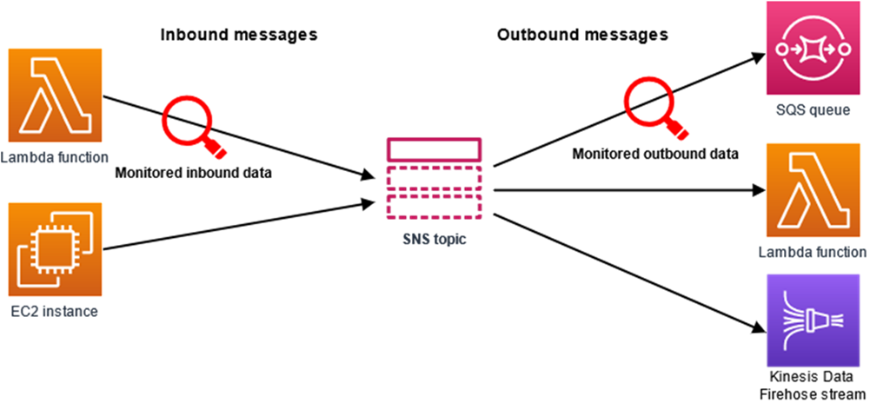
SNS Data protection policies
What is message data protection?
Message data protection safeguards the data that's published to your Amazon SNS topics by using data protection policies to audit, mask, redact or block the sensitive information that moves between applications or AWS services.
Message data protection scans data in motion for personally identifiable information (PII) and protected health information (PHI) using predefined data identifiers (name, address, etc.)
Using the scanned information, message data protection provides detailed audit logs, and allows you to take action to protect that data.

Slide 23
SQS

Slide 24
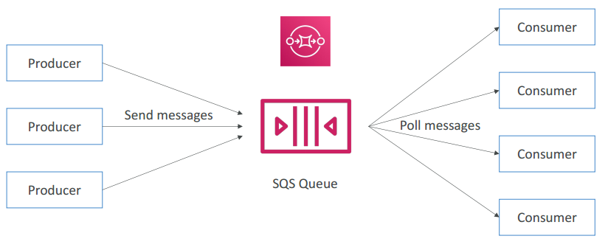
SQS
Amazon Simple Queue Service (Amazon SQS) offers a secure, durable, and available hosted queue that lets you integrate and decouple distributed software systems and components.
Amazon SQS enables you to send, store, and receive messages between software components.
An Amazon SQS queue is a temporary repository for messages that are awaiting processing.
Amazon SQS supports two types of queues – standard queues and FIFO queues.

Slide 25
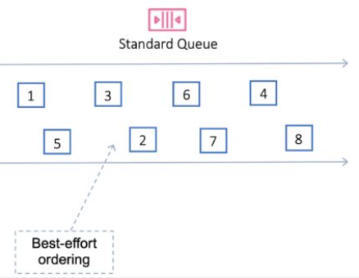
SQS Standard
Amazon SQS offers standard as the default queue type.
Standard queues support a nearly unlimited number of API calls per second, per API action (SendMessage, ReceiveMessage, or DeleteMessage).
Standard queues support at-least-once message delivery.
However, occasionally (because of the highly distributed architecture that allows nearly unlimited throughput), more than one copy of a message might be delivered out of order.
Standard queues provide best-effort ordering which ensures that messages are generally delivered in the same order as they're sent.

Slide 26
SQS Standard Scenarios
You can use standard message queues in many scenarios, as long as your application can process messages that arrive more than once and out of order, for example:
Decouple live user requests from intensive background work – Let users upload media while resizing or encoding it.
Allocate tasks to multiple worker nodes – Process a high number of credit card validation requests.
Batch messages for future processing – Schedule multiple entries to be added to a database.

Slide 27
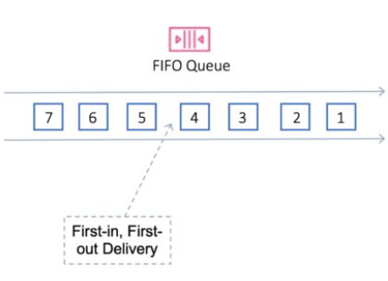
SQS FIFO
Amazon SQS FIFO (First-In-First-Out) queues have all the capabilities of the standard queues, but are designed to enhance messaging between applications when the order of operations and events is critical, or where duplicates can't be tolerated.
Examples of situations where you might use FIFO queues include the following:
E-commerce order management system where order is critical
Integrating with a third-party systems where events need to be processed in order
Processing user-entered inputs in the order entered
Communications and networking – Sending and receiving data and information in the same order
Computer systems – Making sure that user-entered commands are run in the right order
Educational institutes – Preventing a student from enrolling in a course before registering for an account
Online ticketing system – Where tickets are distributed on a first come first serve basis

Slide 28
FIFO Example with SNS & SQS

Slide 29
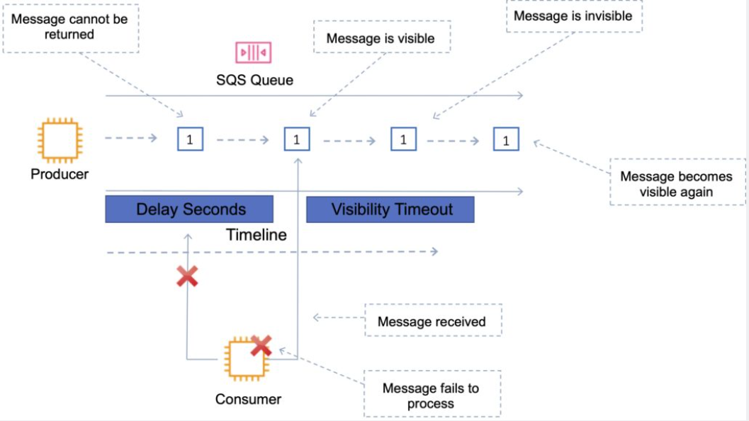
SQS - Visibility timeout
The amount of time a message is invisible in the queue after a reader picks it up.
Provided the job is processed before the visibility timeout expires, the message will then be deleted from the queue.
If the job is not processed within the visibility timeout, the message will become visible again and another reader will process it.
This could result in the same message being delivered twice.
The default visibility timeout is 30 seconds.
Increase it if your task takes > 30 seconds.
The maximum is 12 hours.

Slide 30
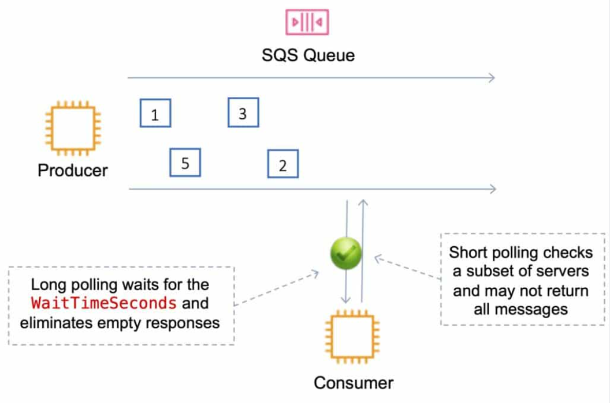
SQS Polling: Short and Long polling
SQS uses short polling and long polling:
Amazon SQS long polling is a way to retrieve messages from SQS queues.
Short polling returns immediately (even if the message queue is empty).
Long polling doesn’t return a response until a message arrives in the message queue or the long poll times out.
Long polling can be enabled at the queue level or at the API level using WaitTimeSeconds.
Long polling is in effect when the Receive Message Wait Time is a value greater than 0 seconds and up to 20 seconds.

Slide 31
SQS Polling
Short polling:
Does not wait for messages to appear in the queue.
It queries only a subset of the available servers for messages (based on weighted random execution).
Short polling is the default.
ReceiveMessageWaitTime is set to 0.
More requests are used, which implies higher cost.
Long polling:
Uses fewer requests and reduces cost.
Eliminates false empty responses by querying all servers.
SQS waits until a message is available in the queue before sending a response.
Requests contain at least one of the available messages up to the maximum number of messages specified in the ReceiveMessage action.
Shouldn’t be used if your application expects an immediate response to receive message calls.
ReceiveMessageWaitTime is set to a non-zero value (up to 20 seconds).
Same charge per million requests as short polling.

Slide 32
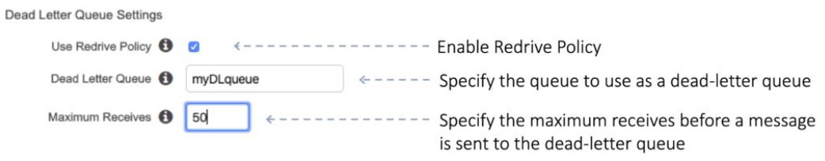
SQS - Dead-Letter Queue
The main task of a dead-letter queue is handling message failure.
A dead-letter queue lets you set aside and isolate messages that can’t be processed correctly to determine why their processing didn’t succeed.
It is not a queue type; it is a standard or FIFO queue that has been specified as a dead-letter queue in the configuration of another standard or FIFO queue.

Slide 33
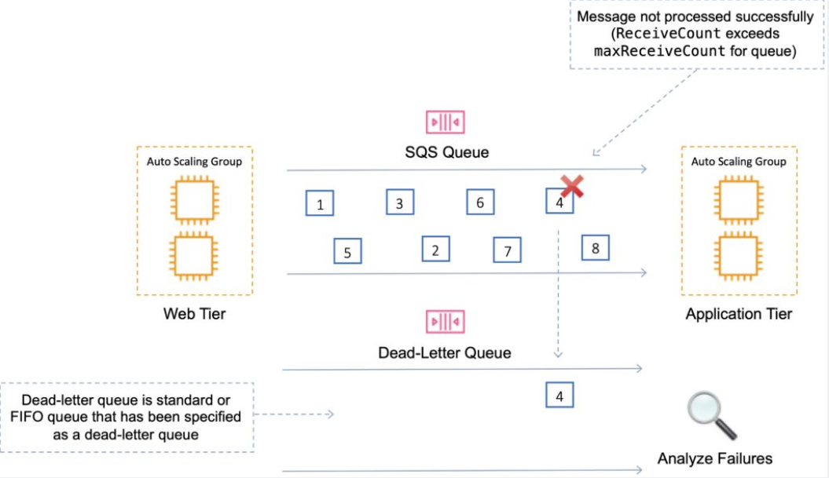
SQS - Dead-Letter Queue
Messages are moved to the dead-letter queue when the ReceiveCount for a message exceeds the maxReceiveCount for a queue.
Dead-letter queues should not be used with standard queues when your application will keep retrying transmission.
Dead-letter queues will break the order of messages in FIFO queues.

Slide 34
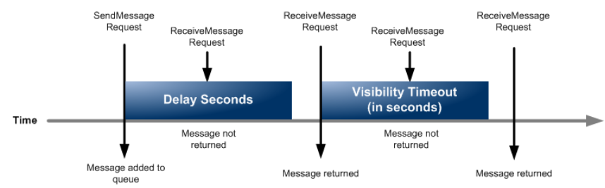
SQS Delay Queues
A delay queue postpones delivery of new messages to a queue for a number of seconds.
Messages sent to the Delay Queue remain invisible to consumers for the duration of the delay period.
Default delay is 0 seconds, maximum is 900 seconds (15 minutes).
For standard SQS queues, changing this setting doesn’t affect the delay of messages already in the queue, only new messages.
For FIFO queues, this affects the delay of messages already in the queue.
When to use a delay queue:
Large distributed applications which may need to introduce a delay in processing.
You need to apply a delay to an entire queue of messages.
For example, adding a delay of a few seconds to allow updates to sales or stock control databases before sending a notification to a customer confirming an online transaction.
DLQs must be the same type as the source.

Slide 35
SQS Monitoring
CloudWatch is integrated with SQS and you can view and monitor queue metrics.
CloudWatch metrics are automatically collected every 5 minutes.
CloudWatch considers a queue to be active for up to 6 hours if it contains any messages or if any API action accesses it.
No charge for CloudWatch (no detailed monitoring).
CloudTrail captures API calls from SQS and logs to a specified S3 bucket.

Slide 36
SQS Security
You can use IAM policies to control who can read/write messages.
Authentication can be used to secure messages within queues (who can send and receive).
SQS is PCI DSS level 1 compliant and HIPAA eligible.
In-flight security is provided using HTTPS.
Can enable server-side encryption (SSE) using KMS.
Can set the CMK you want to use.
Can set the data key reuse period.
SSE only encrypts the message body not the message attributes.
IAM policy must allow usage of SQS.
You can also specify permissions in an SQS queue access policy:
Providers finer grained control.
Control over the requests that come in.

Slide 37
SQS Recap
Standard queues:
Unlimited Throughput – Standard queues support a nearly unlimited number of API calls per second, per API action (SendMessage, ReceiveMessage, or DeleteMessage).
At-Least-Once Delivery – A message is delivered at least once, but occasionally more than one copy of a message is delivered.
Best-Effort Ordering – Occasionally, messages are delivered in an order different from which they were sent.
FIFO queues:
High Throughput – If you use batching, FIFO queues support up to 3,000 calls per second, per API method (SendMessageBatch, ReceiveMessage, or DeleteMessageBatch). The 3,000 calls per second represent 300 API calls, each with a batch of 10 messages. To request a quota increase, submit a support request. Without batching, FIFO queues support up to 300 API calls per second, per API method (SendMessage, ReceiveMessage, or DeleteMessage).
Exactly-Once Processing – A message is delivered once and remains available until a consumer processes and deletes it. Duplicates aren't introduced into the queue.
First-In-First-Out Delivery – The order in which messages are sent and received is strictly preserved.

Slide 38
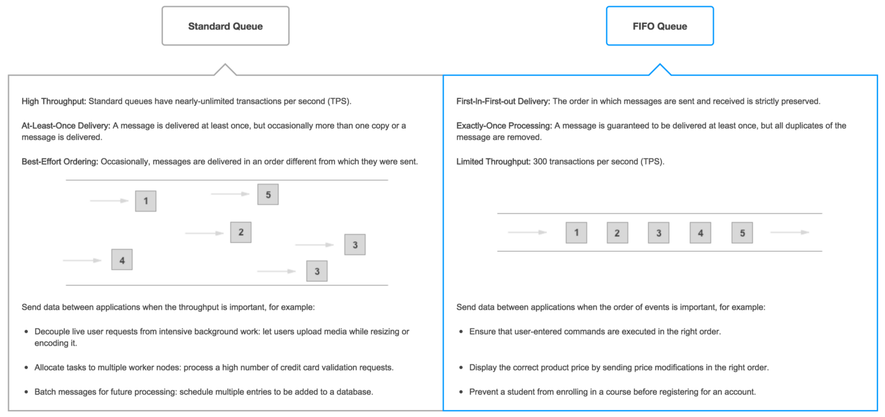
FIFO VS Standard

Slide 39
Hands one!!!
Goal: We have an order processing system.
Some system uploads json order in s3 bucket
On file uploading lambda A should be invoked and publish event into SNS topic OrderReceiverTopic
OrderReceiverTopic in SNS
OrderReceiverTopic invokes lambda Bfor order processing
On fail message should go to DLQ. OrdersQueqeDLQ
On success message should go to SNS and send email

Slide 40
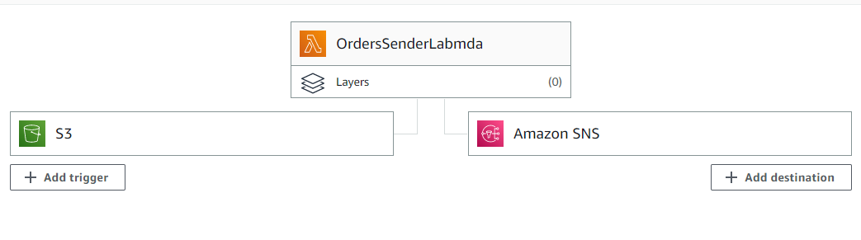
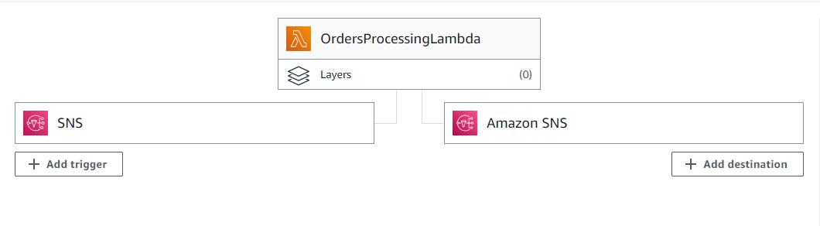
Hands On

Slide 41
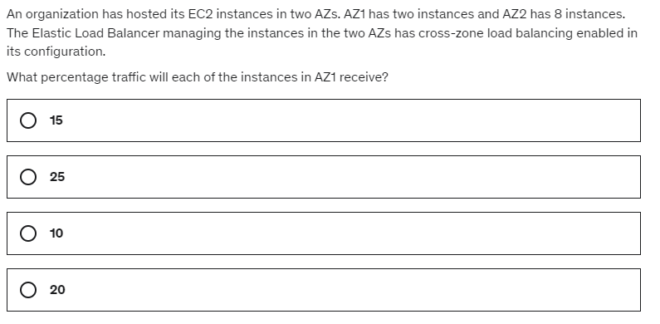
Questions Section

Slide 42
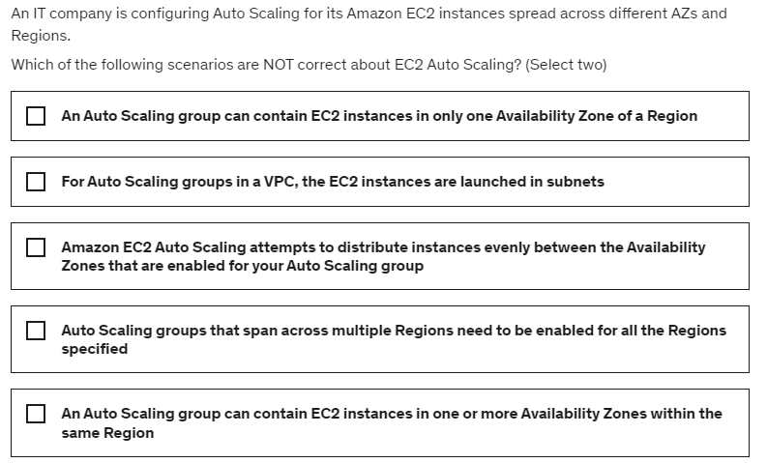
Questions Section

Slide 43
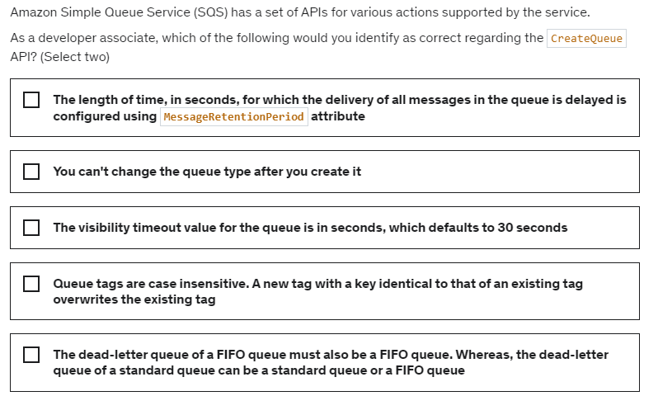
Questions Section

Slide 44
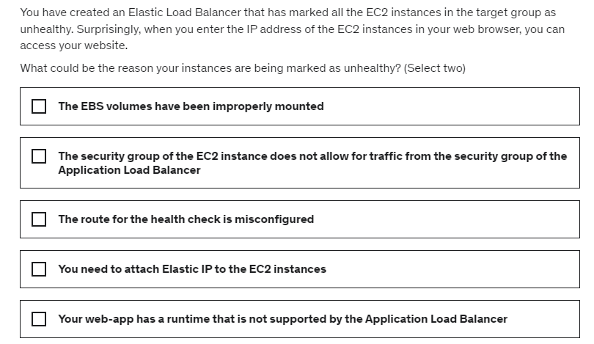
Questions Section

Slide 45
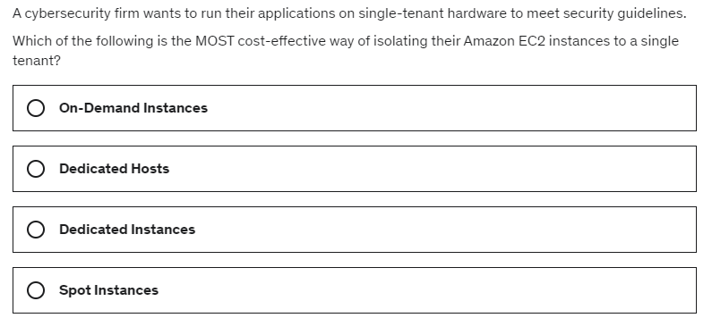
Questions Section

Slide 46
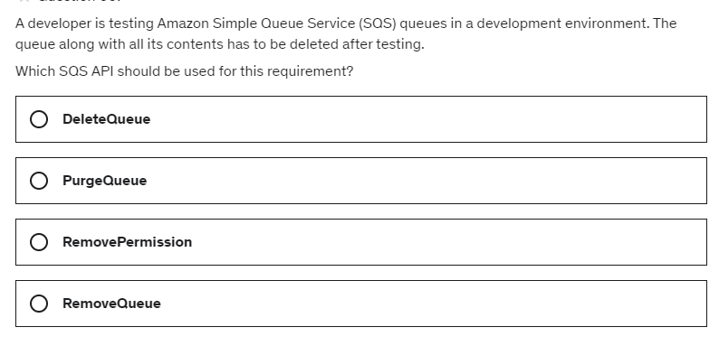
Questions Section

Slide 47
