Slide 2
AWS Cognito

Slide 3
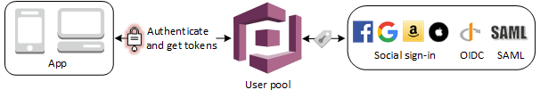
Cognito User pool
A user pool is a user directory in Amazon Cognito. With a user pool, your users can sign in to your web or mobile app through Amazon Cognito.
Your users can also sign in through social identity providers like Google, Facebook, Amazon, or Apple, and through SAML identity providers.
Whether your users sign in directly or through a third party, all members of the user pool have a directory profile that you can access through a Software Development Kit (SDK).
User pools provide:
Sign-up and sign-in services.
A built-in, customizable web UI to sign in users.
Social sign-in with Facebook, Google, Login with Amazon, and Sign in with Apple, as well as sign-in with SAML identity providers from your user pool.
User directory management and user profiles.
Security features such as:
multi-factor authentication (MFA)
checks for compromised credentials
account takeover protection
phone and email verification.
Customized workflows and user migration through AWS Lambda triggers.
After successfully authenticating a user, Amazon Cognito issues JSON web tokens (JWT) that you can use to secure and authorize access to your own APIs, or exchange for AWS credentials.

Slide 4
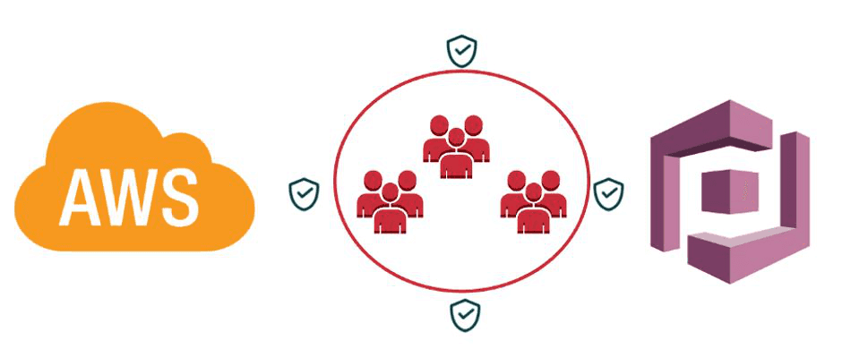
Cognito Identity pool
With Amazon Cognito identity pools, you can create unique identities and assign permissions for users.
Your identity pool can include:
Users in an Amazon Cognito user pool
Users who authenticate with external identity providers such as:
Facebook
Google
Apple
OIDC
SAML
Users authenticated via your own existing authentication process
With an identity pool, you can obtain temporary AWS credentials with permissions you define to directly access other AWS services or to access resources through Amazon API Gateway.

Slide 5
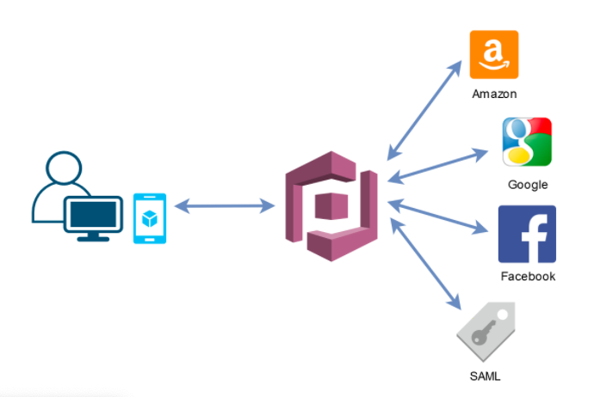
Cognito identity providers
Using the logins property, you can set credentials received from an identity provider (IdP).
You can associate an identity pool with multiple IdPs.
For example, you can set both the Facebook and Google tokens in the logins property to associate the unique Amazon Cognito identity with both IdP logins.
The user can authenticate with either account, but Amazon Cognito returns the same user identifier.
Supported providers and setup instructions:
Facebook
Amazon
Google
Apple
Open ID Connect
SAML

Slide 6
Cognito identity pool authentication flow
External provider authflow
A user authenticating with Amazon Cognito goes through a multi-step process to bootstrap their credentials.
Amazon Cognito has two different flows for authentication with public providers: enhanced and basic.
Once you complete one of these flows, you can access other AWS services as defined by your role`s access policies.
By default, the Amazon Cognito console creates roles with access to the Amazon Cognito Sync store and to Amazon Mobile Analytics.

Slide 7
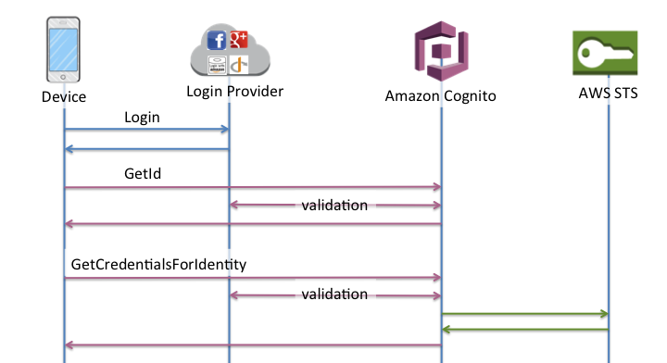
Cognito identity pool authentication flow
Enhanced (simplified) authflow
When you use the enhanced authflow, your app:
Presents an ID token from an authorized Amazon Cognito user pool or third-party identity provider in a GetID request.
Exchanges the token for an identity ID in your identity pool.
The identity ID is then used with the same identity provider token in a GetCredentialsForIdentity request.
The enhanced workflow simplifies credential retrieval by performing GetOpenIdToken and AssumeRoleWithWebIdentity in the background for you.
GetCredentialsForIdentity returns AWS API credentials.
GetId
GetCredentialsForIdentity

Slide 8
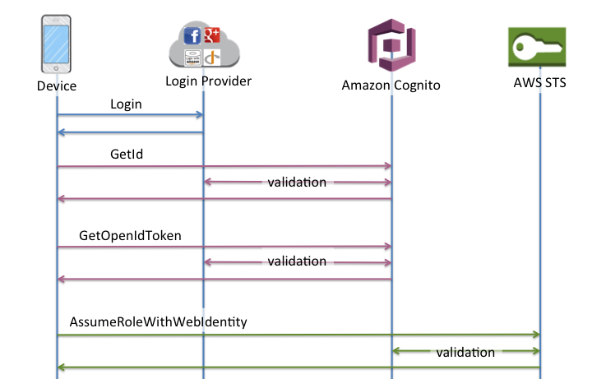
Cognito identity pool authentication flow
Basic (classic) authflow
When you use the basic authflow, your app:
Presents an ID token from an authorized Amazon Cognito user pool or third-party identity provider in a GetID request.
Exchanges the token for an identity ID in your identity pool.
The identity ID is then used with the same identity provider token in a GetOpenIdToken request.
GetOpenIdToken returns a new OAuth 2.0 token that is issued by your identity pool.
You can then use the new token in an AssumeRoleWithWebIdentity request to retrieve AWS API credentials.
The basic workflow gives you more granular control over the credentials that you distribute to your users.
The GetCredentialsForIdentity request of the enhanced authflow requests a role based on the contents of an access token.
The AssumeRoleWithWebIdentity request in the classic workflow grants your app a greater ability to request credentials for any AWS Identity and Access Management role that you have configured with a sufficient trust policy.

Slide 9
Cognito identity pool authentication flow
Developer authenticated identities authflow
When using Developer authenticated identities (identity pools), the client uses a different authflow that includes code outside of Amazon Cognito to validate the user in your own authentication system.

Slide 10
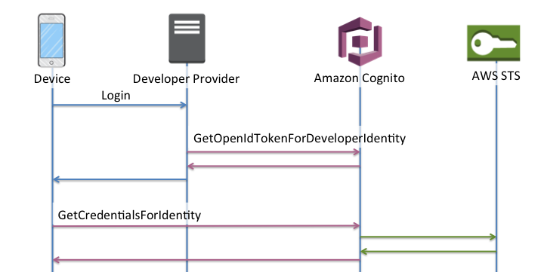
Cognito identity pool authentication flow: Enhanced
Enhanced authflow
Login via Developer Provider (code outside of Amazon Cognito)
Validate the user login (code outside of Amazon Cognito)
GetOpenIdTokenForDeveloperIdentity
GetCredentialsForIdentity

Slide 11
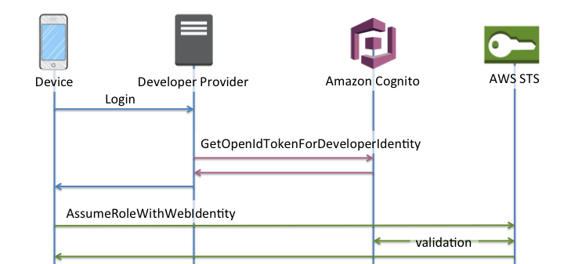
Cognito identity pool authentication flow: Basic
Basic authflow
Login via Developer Provider (code outside of Amazon Cognito)
Validate the user login (code outside of Amazon Cognito)
GetOpenIdTokenForDeveloperIdentity
AssumeRoleWithWebIdentity

Slide 12
Which authflow should I use?
For most customers, the Enhanced Flow is the correct choice, as it offers many benefits over the Basic Flow:
One fewer network call to get credentials on the device.
All calls are made to Amazon Cognito, meaning it is also one less network connection.
Roles no longer need to be embedded in your application, only an identity pool id and Region are necessary to start bootstrapping credentials.
Since February 2015, the Amazon Cognito console has displayed example code that used the Enhanced Flow.
Additionally, if your identity pool does not have the role association necessary to use the Enhanced Flow, the console displays a notification.
The following are the minimum SDK versions where the Enhanced Flow is supported: ( SDK minimum version )
AWS SDK for iOS (2.0.14)
AWS SDK for Android (2.1.8)
AWS SDK for JavaScript (2.1.7)
AWS SDK for Unity (1.0.3)
AWS SDK for Xamarin (3.0.0.5)

Slide 13
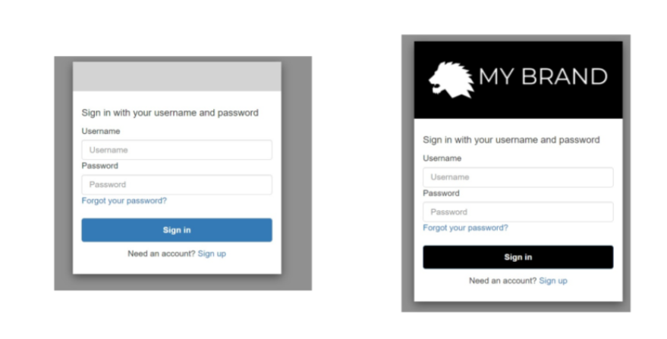
Customizing the built-in sign-in and sign-up webpages
For the built-in app UI experience customization settings you can use:
AWS Management Console
the AWS CLI
API
You can upload a custom logo image to be displayed in the app.
You can also use cascading style sheets (CSS) to customize the look of the UI.
You can specify app UI customization settings for:
A single client (with a specific clientId)
If you specify UI customization settings for a particular client, it will no longer fall back to the ALL configuration.
All clients (by setting the clientId to ALL)
If you specify ALL, the default configuration will be used for every client that has no UI customization set previously.

Slide 14
Data protection in Amazon Cognito
The AWS shared responsibility model applies to data protection in Amazon Cognito (Amazon Cognito).
AWS is responsible for protecting the global infrastructure that runs all of the AWS Cloud.
You are responsible for maintaining control over your content that is hosted on this infrastructure.
This content includes the security configuration and management tasks for the AWS services that you use.
For data protection purposes, better to protect AWS account credentials and set up individual user accounts with IAM. That way each user is given only the permissions necessary to fulfill their job duties.
Recommended to secure your data in the following ways:
Use multi-factor authentication (MFA) with each account.
Use SSL/TLS to communicate with AWS resources.
Set up API and user activity logging with AWS CloudTrail.
Use AWS encryption solutions, along with all default security controls within AWS services.
Use advanced managed security services such as Amazon Macie, which assists in discovering and securing personal data that is stored in Amazon S3.
Good to know:
Never put sensitive identifying information, such as your customers' account numbers, into free-form fields such as a Name field.
Any data that you enter into Amazon Cognito or other services might get picked up for inclusion in diagnostic logs.
When you provide a URL to an external server, don't include credentials information in the URL to validate your request to that server.

Slide 15
Data-encryption
Data encryption typically falls into two categories: encryption at rest and encryption in transit.
Encryption at rest
Data within Amazon Cognito is encrypted at rest in accordance with industry standards.
Encryption in transit
All requests to Amazon Cognito must be made over the Transport Layer Security protocol (TLS).
Clients must support Transport Layer Security (TLS) 1.0 or later. AWS recommend TLS 1.2 or later.
Clients must also support cipher suites with perfect forward secrecy (PFS) such as Ephemeral Diffie-Hellman (DHE) or Elliptic Curve Ephemeral Diffie-Hellman (ECDHE).
Most modern systems such as Java 7 and later support these modes.

Slide 16
Quotas in Amazon Cognito
Amazon Cognito has default quotas, formerly referred to as limits, for the maximum number of operations that you can perform in your account.
Amazon Cognito also has quotas for the maximum number and size of Amazon Cognito resources.
Each Amazon Cognito quota represents a maximum volume of requests in one AWS Region, in one AWS account.
For example:
Your apps can make API requests at up to the Default quota (RPS) rate for UserAuthentication operations against all of your user pools in US East (N. Virginia).
Your apps in Asia Pacific (Tokyo) can produce the same volume of requests against all of your user pools in their own Region.
AWS can only grant a quota increase request in one Region at a time.
A successful quota increase in US East (N. Virginia) has no effect on your maximum request rate in Asia Pacific (Tokyo).

Slide 17
Understanding API request rate quotas

Slide 18
Quota categorization
Amazon Cognito sets a maximum request rate for API operations.
For user pools, these operations are grouped into categories of common use cases like UserAuthentication or UserCreation.
You can track your user pool quota usage, and request increases, by category in the Service Quotas console.
Operation quotas are defined as the maximum number of requests per second (RPS) for all operations within a category. The Amazon Cognito user pools service applies quotas to all operations in each category.
For example:
The category UserCreation includes four operations: SignUp, ConfirmSignUp, AdminCreateUser, and AdminConfirmSignUp.
It's allocated with a combined quota of 50 RPS.
If multiple operations take place at the same time, each operation within this category can call up to 50 RPS separately or combined.

Slide 19
Amazon Cognito user pools API operations with special request rate handling
Operation quotas are measured and enforced for the combined total requests at the category level.
Except for the AdminRespondToAuthChallenge and RespondToAuthChallenge operations, where special handling rules are applied.
The UserAuthentication category includes four operations:
AdminInitiateAuth
InitiateAuth
AdminRespondToAuthChallenge
RespondToAuthChallenge
The InitiateAuth and AdminInitiateAuth operations are measured and enforced per category quota.
The matching operations RespondToAuthChallenge and AdminRespondToAuthChallenge are subject to a separate quota that is three times the UserAuthentication category limit.
This elevated quota accommodates multiple authentication challenges set up in developers’ apps.
The quota is sufficient to cover the large majority of use cases. Beyond the three-times-per-authentication-call threshold, the excess rate counts towards the UserAuthentication category quota.
For example:
If your quota for the UserAuthentication category is 80 RPS, you can call RespondToAuthChallenge or AdminRespondToAuthChallenge up to 240 RPS (80 RPS x 3).
If the app is set up to have four rounds of challenge per authentication call and you have 70 sign-ins per second, then the total RespondToAuthChallenge is 280 RPS (70 x 4), which is 40 RPS above the quota.
The extra 40 RPS is added to 70 InitiateAuth calls, making the total usage of UserAuthentication category 110 RPS (40 + 70). This value exceeds the category quota set at 80 RPS by 30 RPS, so this app is throttled.

Slide 20
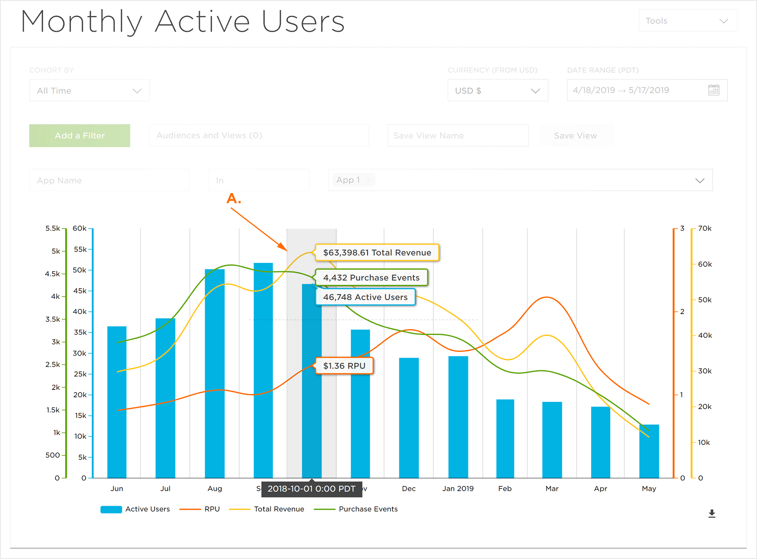
Monthly active users
Monthly active users (MAUs) are the benchmark by which Amazon Cognito user pools billing is calculated.
MAUs are also used to determine if your user pool is eligible for a quota increase.
A user is counted as a MAU if, within a calendar month, there is an identity operation related to that user, such as:
sign-up
sign-in
token refresh
password change
user account attribute is updated.
Amazon Cognito also counts a user as active in the month that you take an action that deactivates or deletes the user or its attributes.

Slide 21
Managing API request rate quotas

Slide 22
Identify quota requirements
To calculate quota requirements, determine how many active users will interact with your application in a specific time period.
For example:
If you expect your application to sign in an average of one million active users within an eight-hour period, then you must be able to authenticate an average of 35 users per second.
In addition, if you assume that the average user session is two hours, and you configure tokens to expire after an hour, each user must refresh their tokens once during their session. The required average quota for the UserAuthentication category to support this load is 70 RPS.
If you assume a peak-to-average ratio of 3:1 by accounting for the variance of user sign-in frequency during the eight-hour period, then you need the desired UserAuthentication quota of 200 RPS.

Slide 23
Optimize quotas
Follow one of the following methods to handle a peak call rate.
Retry the attempt after a back-off waiting period
You can catch errors with each API call, and then re-try the attempt after a back-off period. You can adjust the back-off algorithm according to business needs and load. Amazon SDKs have built-in retry logic.
For more information, see Tools to Build on AWS.
Use an external database for frequently updated attributes
If your application requires several calls to a user pool to read or write custom attributes, use external storage. You can use your preferred database to store custom attributes or use a cache layer to load a user profile during sign-in. You can reference this profile from the cache when needed, instead of reloading the user profile from a user pool.
Validate JWT tokens on the client side
Applications must validate JWT tokens before trusting them. You can verify the signature and validity of tokens on the client side without sending API calls to a user pool. After the token is validated, you can trust claims in the token and use the claims instead of making more getUser API calls.
For more information, see Verifying a JSON Web Token.
Throttle traffic to your web application with a waiting room
If you expect traffic from a large number of users signing in during a time-bound event, such as taking an exam or attending a live event, you can optimize request traffic with self-throttling mechanisms. You can, for example, set up a waiting room where users can stand by until a session is available, allowing you to process requests when you have available capacity.
See the AWS Virtual Waiting Room solution for a reference architecture of a waiting room.

Slide 24
Track quota usage
Amazon Cognito generates CallCount and ThrottleCount metrics in Amazon CloudWatch for each API operation category at the account level.
You can use CallCount to track the total number of calls customers made related to a category.
You can use ThrottleCount to track the total number of throttled calls related to a category.
You can use the CallCount and ThrottleCount metrics with the Sum statistic to count the total number of calls in a category.
When monitoring service quotas, utilization is the percentage of a service quota in use. For example, if the quota value is 200 resources, and 150 resources are in use, the utilization is 75%. Usage is the number of resources or operations in use for a service quota.
Tracking usage through CloudWatch metrics
You can track and collect Amazon Cognito user pools utilization metrics using CloudWatch. The CloudWatch dashboard displays metrics about every AWS service that you use. With CloudWatch, you can create metric alarms to notify you or change a specific resource that you are monitoring. For more information about CloudWatch metrics, see Track your CloudWatch usage metrics.
Tracking utilization through Service Quotas metrics
Amazon Cognito user pools are integrated with Service Quotas, which is a browser-based interface that you can use to view and manage your service quota usage. In the Service Quotas console, you can look up the value of a specific quota, view monitoring information, request a quota increase, or set up CloudWatch alarms. After your account has been active a while, you can view a graph of your resource utilization.

Slide 25
Requesting a quota increase
Amazon Cognito has a quota for the maximum number of user pool operations that you can perform in your account.
You can request an increase to the adjustable API request rate quotas in Amazon Cognito.
To request a quota increase, use the Service Quotas console, the Service limit increase form, or the RequestServiceQuotaIncrease or ListAWSDefaultServiceQuotas API operations.
To request a quota increase using the Service Quotas console, see Requesting a API quota increase.
If the quota isn't available in Service Quotas, use the Service limit increase form.

Slide 26
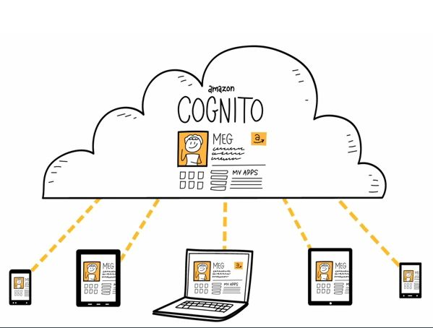
Synchronizing data
With Amazon Cognito, you can save user data in datasets that contain key-value pairs.
Amazon Cognito associates this data with an identity in your identity pool so that your app can access it across logins and devices.
To sync this data between the Amazon Cognito service and an end user’s devices, invoke the synchronize method.
Each dataset can have a maximum size of 1 MB.
You can associate up to 20 datasets with an identity.
The Amazon Cognito Sync client creates a local cache for the identity data.
When your app reads and writes keys, it communicates with this local cache.
This communication guarantees that all changes you make on the device are immediately available on the device, even when you are offline.
When the synchronize method is called, changes from the service are pulled to the device, and any local changes are pushed to the service. At this point, the changes are available to other devices to synchronize.

Slide 27

Amazon App Sync
Amazon Cognito Sync is an AWS service and client library that makes it possible to sync application-related user data across devices.
Amazon Cognito Sync can synchronize user profile data across mobile devices and the web without using your own backend.
The client libraries cache data locally so that your app can read and write data regardless of device connectivity status.
When the device is online, you can synchronize data.
If you set up push sync, you can notify other devices immediately that an update is available.

Slide 28
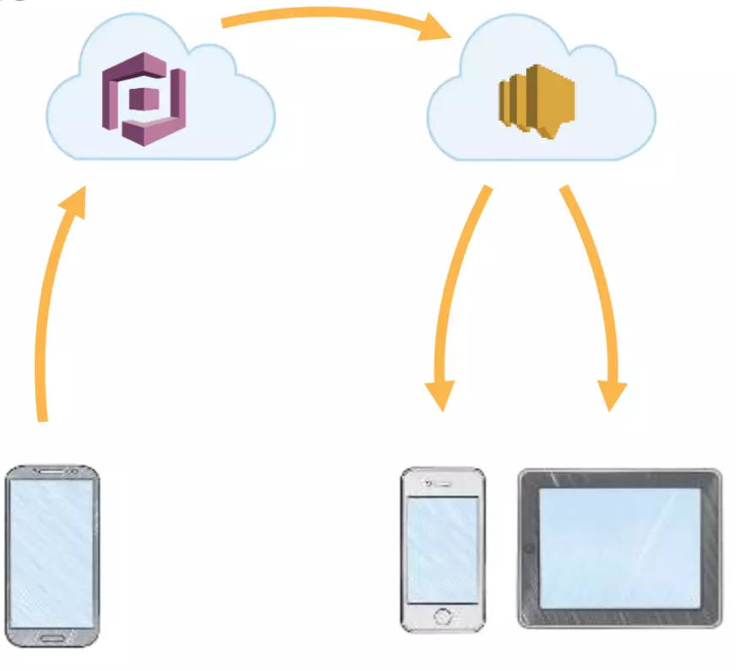
Push sync
Amazon Cognito automatically tracks the association between identity and devices.
Using the push synchronization, or push sync, feature, you can ensure that every instance of a given identity is notified when identity data changes.
Push sync ensures that, whenever the sync store data changes for a particular identity, all devices associated with that identity receive a silent push notification informing them of the change.
Before you can use push sync, you must first set up your account for push sync and enable push sync in the Amazon Cognito console.
Note:
Push sync is not supported for JavaScript, Unity, or Xamarin.

Slide 29
Amazon Cognito Streams
Amazon Cognito Streams gives developers control and insight into their data stored in Amazon Cognito.
Developers can now configure a Kinesis stream to receive events as data is updated and synchronized.
Amazon Cognito can push each dataset change to a Kinesis stream you own in real time.
Using Amazon Cognito Streams, you can move all of your Sync data to Kinesis, which can then be streamed to a data warehouse tool such as Amazon Redshift for further analysis.

Slide 30
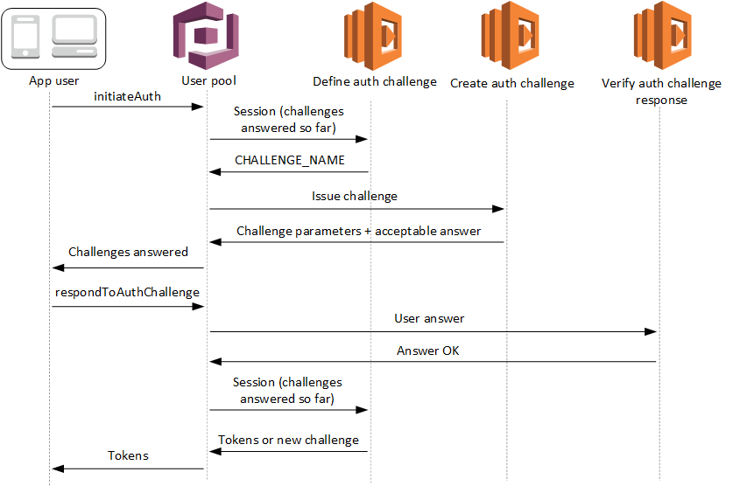
Amazon Cognito Events
Amazon Cognito Events allows you to execute an AWS Lambda function in response to important events in Amazon Cognito.
Amazon Cognito raises the Sync Trigger event when a dataset is synchronized.
You can use the Sync Trigger event to take an action when a user updates data.
The function can evaluate and optionally manipulate the data before it is stored in the cloud and synchronized to the user's other devices.
This is useful to:
Validate data coming from the device before it is synchronized to the user's other devices
Update other values in the dataset based on incoming data such as issuing an award when a player reaches a new level.

Slide 31
SAML

Slide 32
How SAML Works
SAML is an open standard for authentication (and authorization, if required) that provides SSO access to web applications through identity federation.
SAML relays user credentials from an IdP that owns and maintains identities to verify access rights and SPs.
Service providers require authentication prior to granting users access to the resource.
Each user (or group) has attributes that outline profile information and assert what exactly they’re authorized to access.
SAML uses extensible markup language (XML) metadata documents (SAML tokens) for an assertion process to verify a user’s identity and access privileges.
Developers use SAML plugins within apps or resources for an SSO login experience that assures security practices are being followed and credentials/assertions determine who can access an application.
Additionally, SAML can be used to control what resources an identity can access in an application.
SAML is comprised of several core components that make it possible to exchange user information for access control, including IdP, client, attributes, to the SP.

Slide 33
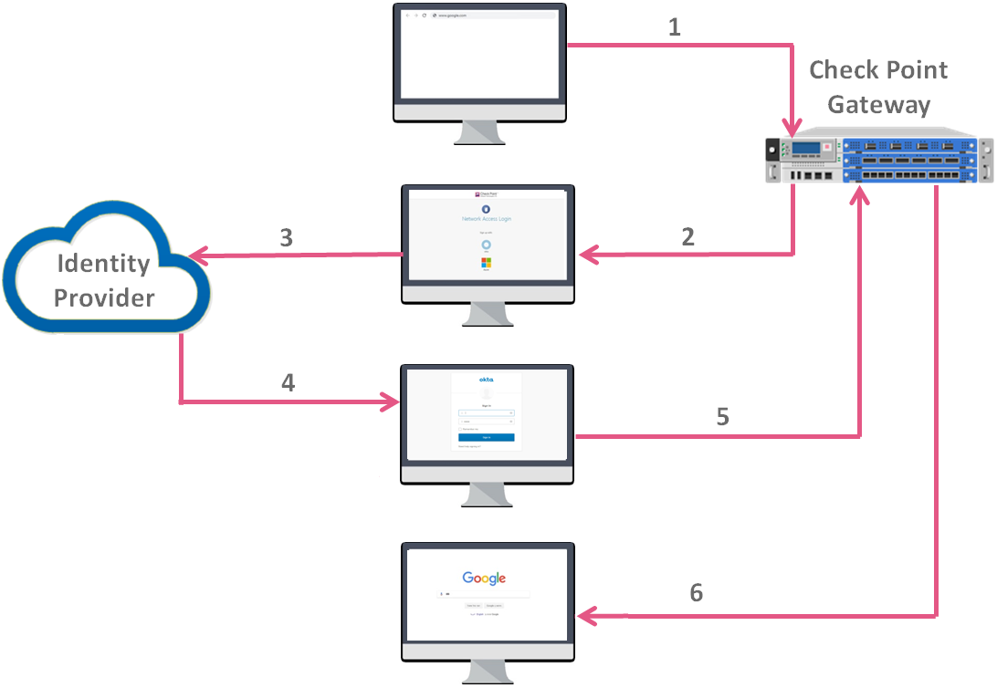
Identity Provider (IdP)
An IdP is a service that maintains and manages digital identities to verify user credentials throughout:
applications
networks
web services.
It’s primary role is to safeguard the integrity of user credentials and federate user identity where SSO logins are desired.

Slide 34
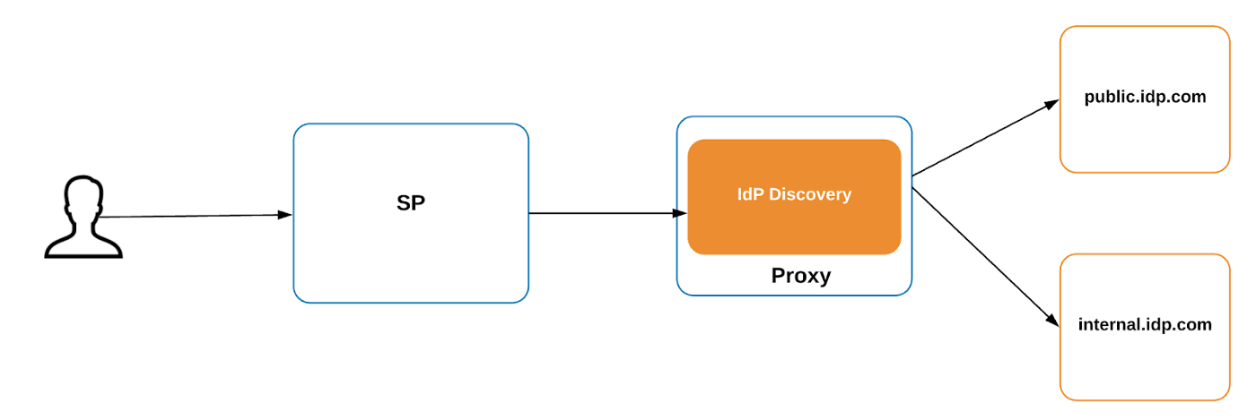
Client
Clients are your users who will authenticate into a service using the credentials that are being managed by an IdP.
For example, your employer may use SAML for SSO access into the services that you need to work, using your company email address and password.

Slide 35
Attribute
SAML transfers messages, called assertions, from an IdP to a service provider.
These assertions set all relevant security requirements for the transaction by authenticating, authorizing, and determining the level of permissions a client will receive.
Attributes such as:
dept
email
role
are used to enforce access management and access control.
Sometimes, custom attributes are used so that SAML can be extended for use with custom software.

Slide 36
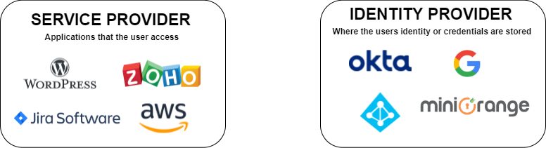
Service Provider (SP)
Service providers are a resource that users authenticate into using SAML SSO, usually a private website or application.
They receive, accept, or deny assertions from IdPs for each client profile prior to granting users access.
SPs send requests to IdPs to begin the authentication process, and the client’s assertion is received in response.
The process is sometimes reversed when an IdP initiates the sign-in flow to assert user identity. It can be initiated either way.

Slide 37
OpenId Connect

Slide 38
How OIDC Works
OIDC extends the OAuth protocol so that client services (your applications) verify user identities and exchange profile information through OpenID providers via RESTful APIs that dispatch JSON web tokens (JWTs) to share information during the authentication process.
The providers are essentially authentication servers.
Many developers are attracted to this approach because it’s highly scalable, flexible across platforms, and is relatively simple to implement.
Its main components are a unique user ID workflow with OAuth underpinnings.

Slide 39
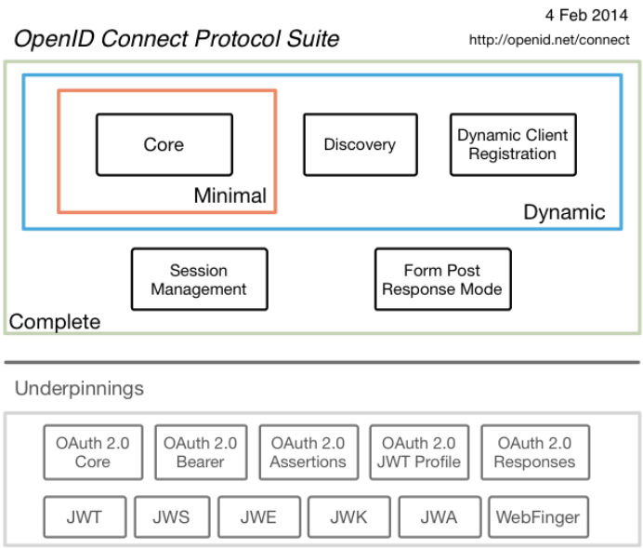
User Authentication
A resource owner (your users) authenticates and is authorized to access a client application by way of an authorization server that grants an access token that allows apps to receive consented information from a UserInfo endpoint.
A UserInfo endpoint is a protected resource found on an OpenID server that contains claims (assertions) about each user in a JSON object. Authentication information is then encoded within an ID Token that’s received by the app.
This information is cached for scalable performance and personalizes the end-user experience.

Slide 40
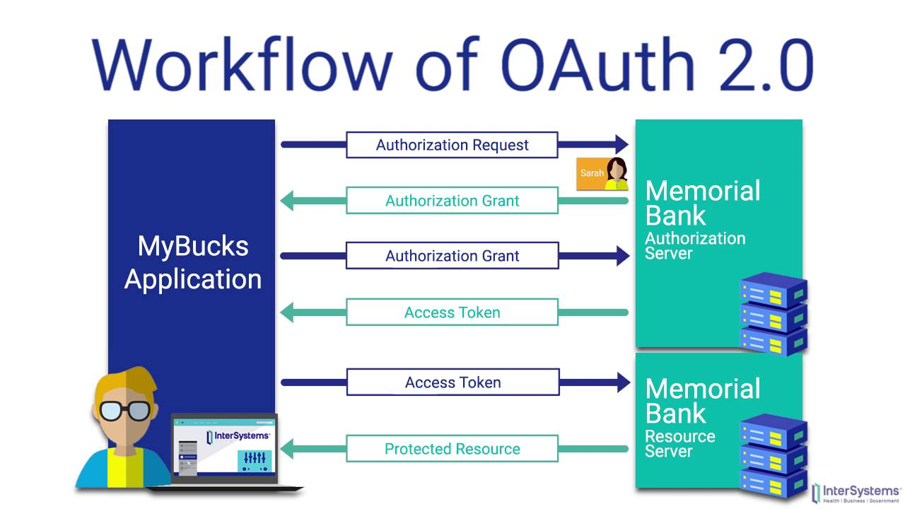
Built on OAuth 2.0 Protocol
OIDC is built on top of the OAuth 2.0 framework, which is a standard that grants third-party apps and service access to user ID resources.
No user credentials are sent over the wire or stored on third-party servers, which increases security and ease of use for IT administrators.

Slide 41
Similarities
Both frameworks are identity protocols that make SSO possible.
Both frameworks are secure, well-documented, and mature.
Users authenticate via an IdP, typically once, and then can access other applications that “trust” the IdP.
Some Zero Trust services will authenticate at each point down the chain and periodically verify access using another authentication method.
The login workflow appears very similar to the end user, who doesn’t have any visibility into the various technical differences that occur behind the scenes.

Slide 42
Differences
Many developers believe that OpenID Connect is simpler to implement because there’s no XML handling.
OpenID lacks user authorization data (such as permissions) and focuses primarily on identity assertion.
SAML is an identity data exchange and is very feature-rich.
Authentication is decentralized with OpenID.
SAML uses assertions versus the OpenID and OAuth architecture of ID tokens.
OIDC is designed for API workloads and can be used to secure APIs.

Slide 43
Use Cases
Developers and IT organizations should select the solution that works best for their particular use case(s).
However, it’s sometimes possible to utilize more than one simultaneously. Regardless, use cases have developed organically with OIDC being utilized for back channel web and mobile applications that request access tokens.
SAML is nearly always used for front channel website access where users are the ones who are triggering the app to authenticate.
The latter assumes that client applications (a web service) are operating from separate devices than the resource owner (you). Below are some general guidelines for use cases:
A mobile app typically uses a service such as OIDC, because it’s lighter weight, and many of the facilities that developers use are pre-built or available from add-on libraries.
Apps that have SAML built-in are a no-brainer, just use SAML.
Use SAML for accessing enterprise apps via a portal.
Protecting APIs or exposing APIs are services that will require OAuth 2.0 or OIDC.
Enterprises sometimes favor SAML due to its capacity for customization and prioritization of secure data exchange. Regulated industries should almost always opt for SAML to protect sensitive user information.

Slide 44
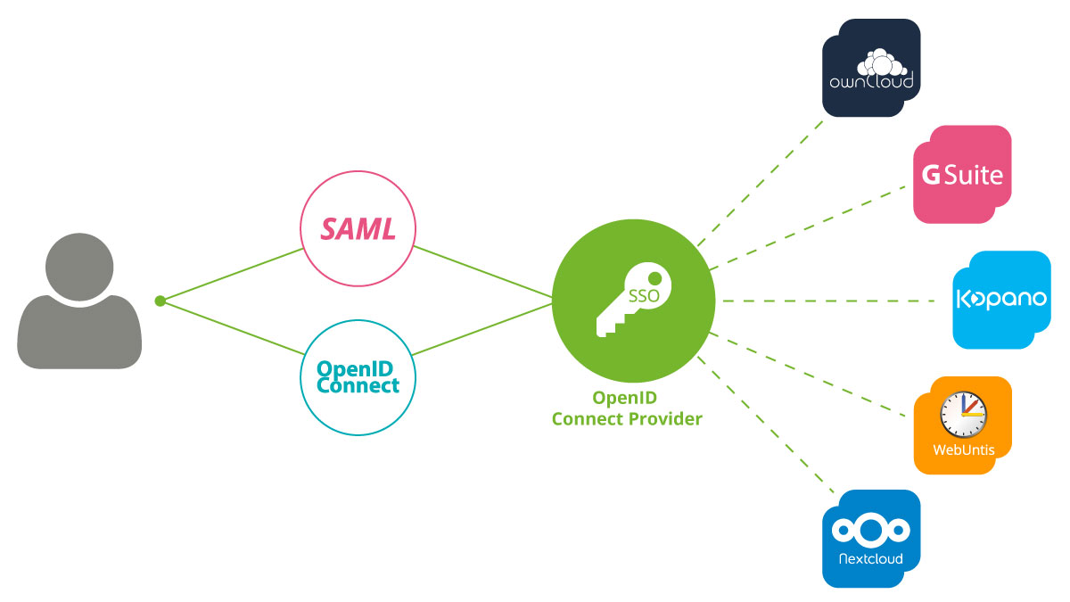
Using OIDC and SAML Together
These protocols aren’t mutually exclusive. Consider using SAML for enterprise SSO to secure access to your organization’s resources and OIDC for mobile use cases that have high scalability requirements.
Each has its own inherent advantages and either can provide SSO services.

Slide 45
LAB 1
Create user pool
Sign-in experience:
Provider types: Cognito user pool
Sign-in options: User name
User name req-ts: case sensitive
Security requirements:
Password policy: Cognito defaults
Multi-factor authentication: No MFA
User account recovery: Enable self-service account recovery (Email only)
Sign-up experience:
Leave default settings
Message delivery:
Send email with Cognito
App:
Use the Cognito hosted UI
Use a Cognito domain
Public client
Generate a client secret
Callback & Sign-out URLs:
https://www.amazon.com
OpenID Connect scopes:
All of them
Launch hosted UI (App client -> Hosted UI -> View Hosted UI)
sign up
sign in

Slide 46
LAB 2
Create Identity pool:
Enable access to unauthenticated identities
Providers:
cognito userpool from prev step
create new IAM roles
Edit IAMs policies:
Cognito_POOLNAMEAuth_Role:
S3
list
All resources
Create Identity
Check Identity in console
Get temporary credentials for our identity
Check that temp creds

Slide 47
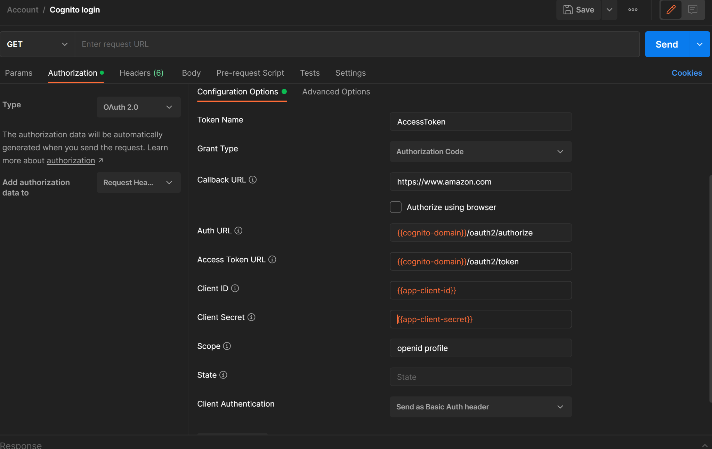
How to get id_token to create identity
Proceed this configuration to get id_token.
In the login pop up just log in with your user
Проверяйте скоуп, мб
Надо просто openid

Slide 48
How to create identity
Endpoint: POST https://cognito-identity.us-east-1.amazonaws.com/
Additional headers:
CONTENT-TYPE : application/x-amz-json-1.1
X-AMZ-TARGET : com.amazonaws.cognito.identity.model.AWSCognitoIdentityService.GetId
Json body:
{
"IdentityPoolId": "YOUR_IDENTITY_POOL_ID",
"Logins": {
"cognito-idp.eu-north-1.amazonaws.com/YOUR_USERPOOL_ID”: "ID_TOKEN"
}
}

Slide 49
How to get temp credentials
Endpoint: POST https://cognito-identity.us-east-1.amazonaws.com/
Additional headers:
CONTENT-TYPE : application/x-amz-json-1.1
X-AMZ-TARGET : com.amazonaws.cognito.identity.model.AWSCognitoIdentityService.GetCredentialsForIdentity
Json body:
{
"IdentityId": "YOUR_IDENTITY_ID",
"Logins": {
"cognito-idp.eu-north-1.amazonaws.com/YOUR_USERPOOL_ID”: "ID_TOKEN"
}
}

Slide 50
AWS STS

Slide 51
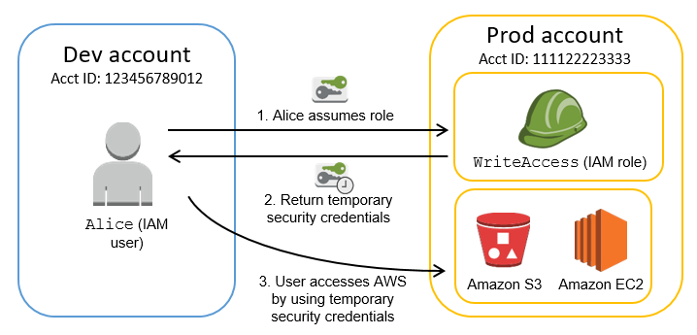
AWS STS - Temporary security credentials in IAM
AWS provides AWS Security Token Service (AWS STS) as a web service that enables you to request temporary, limited-privilege credentials for AWS Identity and Access Management (IAM) users or for users you authenticate (federated users).
By default, AWS Security Token Service (AWS STS) is available as a global service, and all AWS STS requests go to a single endpoint at https://sts.amazonaws.com. Global requests map to the US East (N. Virginia) Region. AWS recommends using Regional AWS STS endpoints instead of the global endpoint to reduce latency, build in redundancy, and increase session token validity
AWS STS supports AWS CloudTrail, a service that records AWS calls for your AWS account and delivers log files to an Amazon S3 bucket. By using information collected by CloudTrail, you can determine the requests successfully sent to AWS STS, as well as who sent the request, and when it was sent.
Request comparison

Slide 52
AWS STS - Temporary security credentials in IAM
AssumeRole - Returns a set of temporary security credentials that you can use to access AWS resources that you might not normally have access to. These temporary credentials consist of an access key ID, a secret access key, and a security token.
GetFederationToken - Returns a set of temporary security credentials (consisting of an access key ID, a secret access key, and a security token) for a federated user. A typical use is in a proxy application that gets temporary security credentials on behalf of distributed applications inside a corporate network. You must call the GetFederationToken operation using the long-term security credentials of an IAM user. As a result, this call is appropriate in contexts where those credentials can be safely stored, usually in a server-based application.
The temporary credentials are valid for the specified duration, from 900 seconds (15 minutes) up to a maximum of 129,600 seconds (36 hours). The default session duration is 43,200 seconds (12 hours). Temporary credentials obtained by using the AWS account root user credentials have a maximum duration of 3,600 seconds (1 hour).
GetSessionToken - Returns a set of temporary credentials for an AWS account or IAM user. The credentials consist of an access key ID, a secret access key, and a security token.
The GetSessionToken operation must be called by using the long-term AWS security credentials of the AWS account root user or an IAM user. Credentials that are created by IAM users are valid for the duration that you specify. This duration can range from 900 seconds (15 minutes) up to a maximum of 129,600 seconds (36 hours), with a default of 43,200 seconds (12 hours). Credentials based on account credentials can range from 900 seconds (15 minutes) up to 3,600 seconds (1 hour), with a default of 1 hour.
DecodeAuthorizationMessage - Decodes additional information about the authorization status of a request from an encoded message returned in response to an AWS request. The message is encoded because the details of the authorization status can contain privileged information that the user who requested the operation should not see. To decode an authorization status message, a user must be granted permissions through an IAM policy to request the DecodeAuthorizationMessage (sts:DecodeAuthorizationMessage) action.

Slide 53
Questions

Slide 54
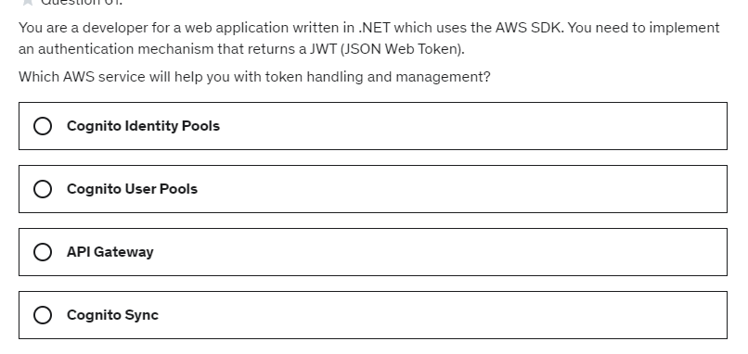

Slide 55
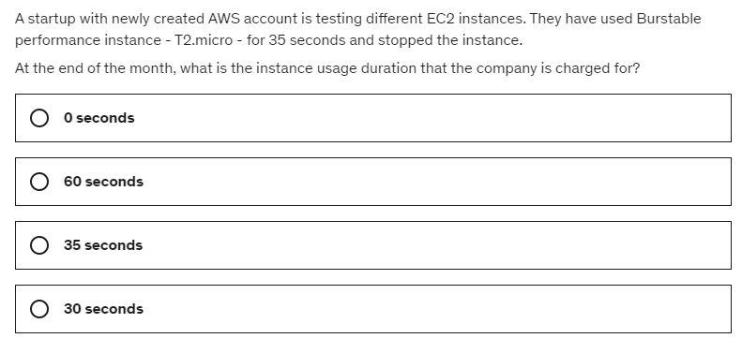

Slide 56
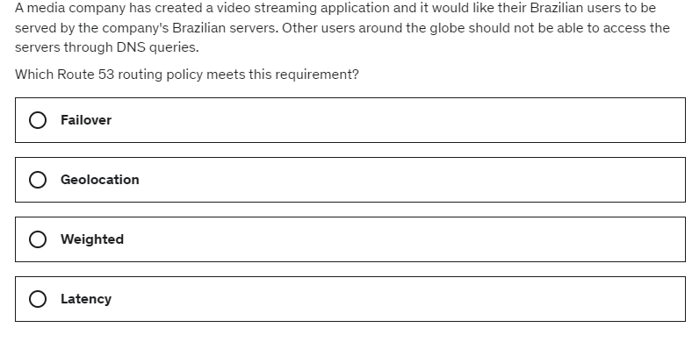

Slide 57
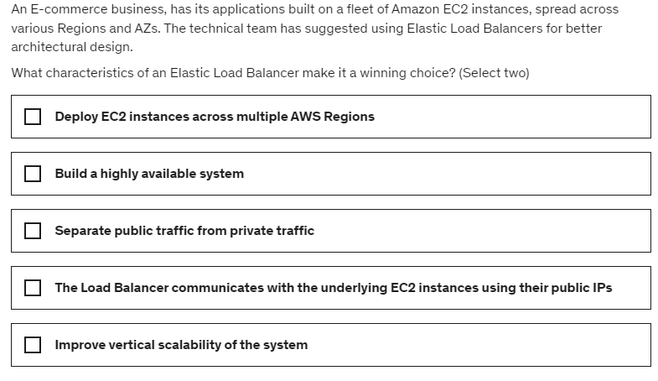

Slide 58
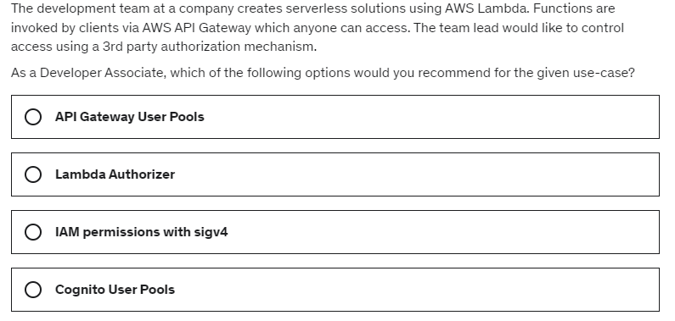

Slide 59
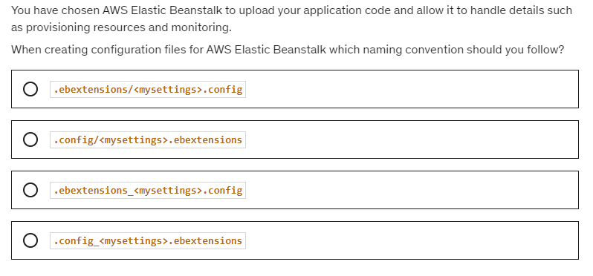

Slide 60
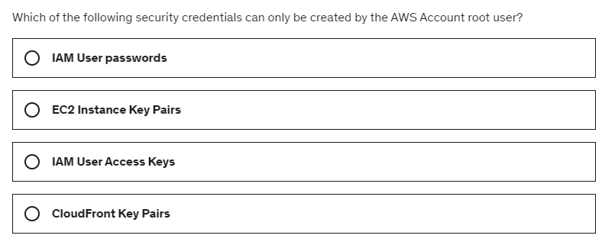

Slide 61
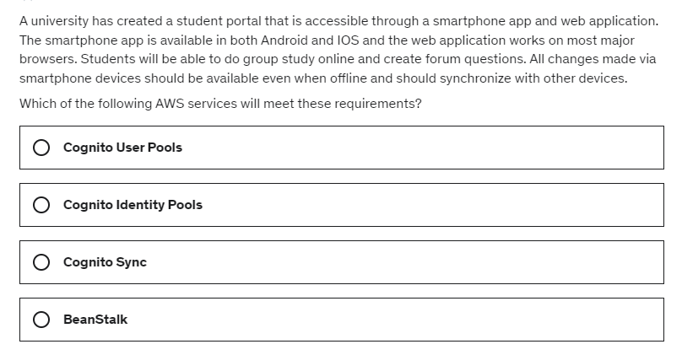

Slide 62
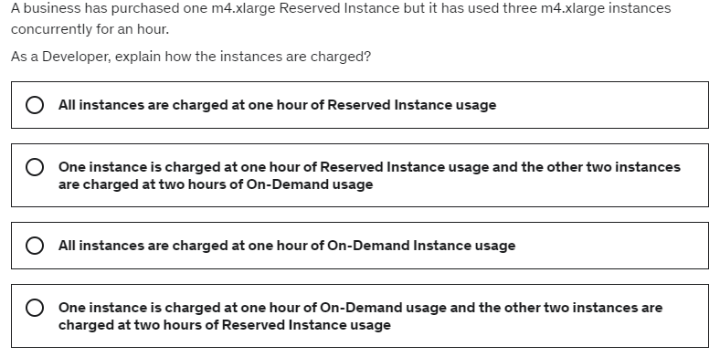

Slide 63
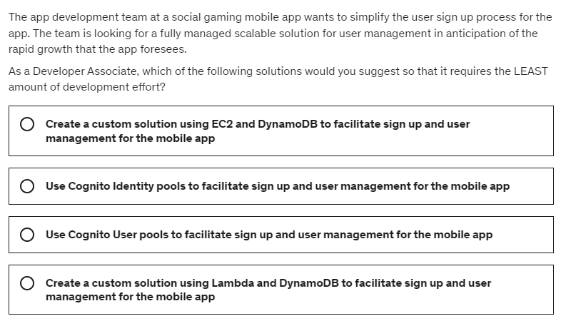

Slide 64
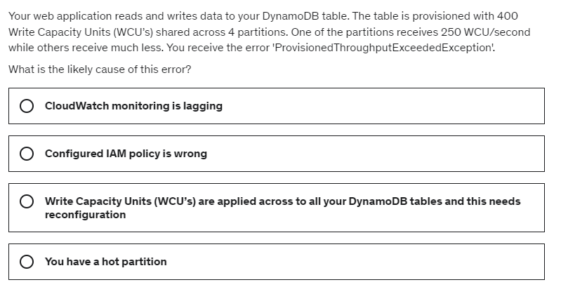

Slide 65
