Slide 1
AWS ELB

Slide 2
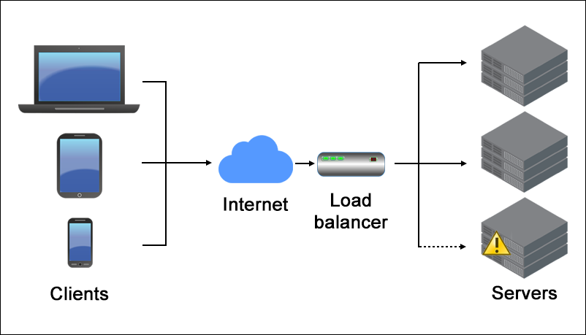
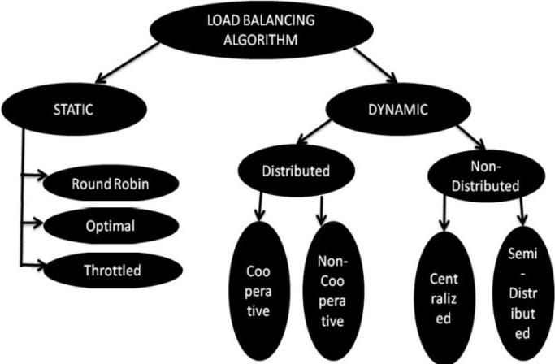
What is Load balancing?
Load balancing refers to efficiently distributing incoming network traffic across a group of backend servers.
Load balancers are used to increase capacity, (concurrent users) and reliability of applications.
They improve the overall performance of applications, by decreasing the burden on servers associated with managing and maintaining application and network sessions, as well as by performing application-specific tasks.
Some industry standard algorithms are:
Weighted
Round robin Scheduling
Least Connection
First Scheduling

Slide 3
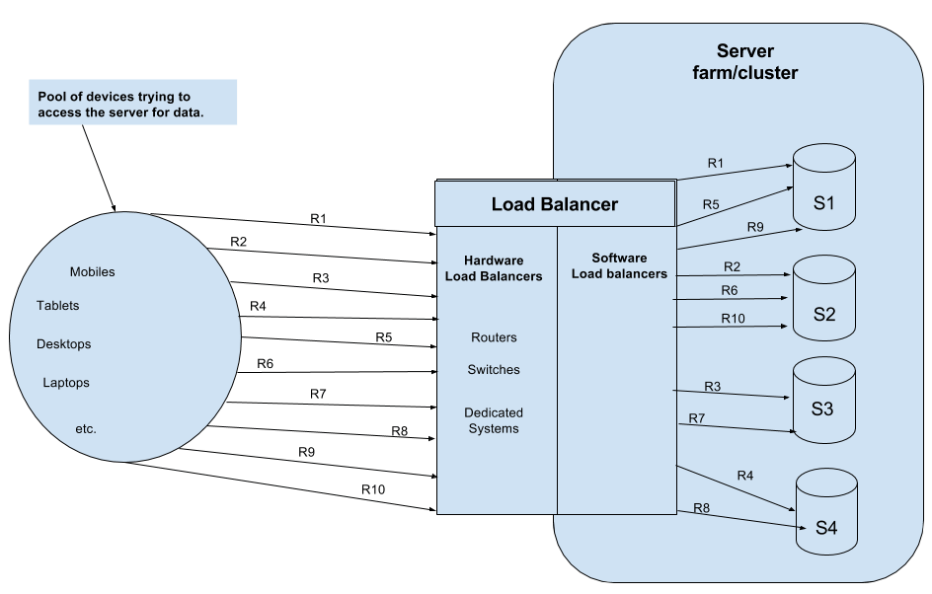
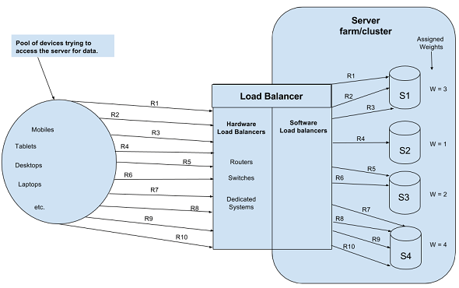
Load Balancing Algorithms
Round robin Scheduling - Requests are served by the server sequentially one after another. After sending the request to the last server, it starts from the first server again.
Least Connection First Scheduling - Requests are served first to the server which is currently handling least number of persistent connections.
Weighted - Work is assigned to the server according to the weight assigned to the server

Slide 4
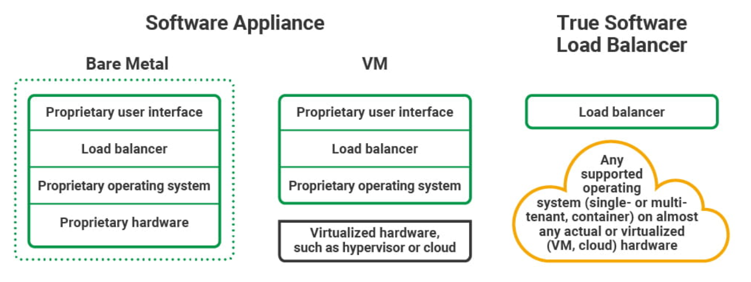
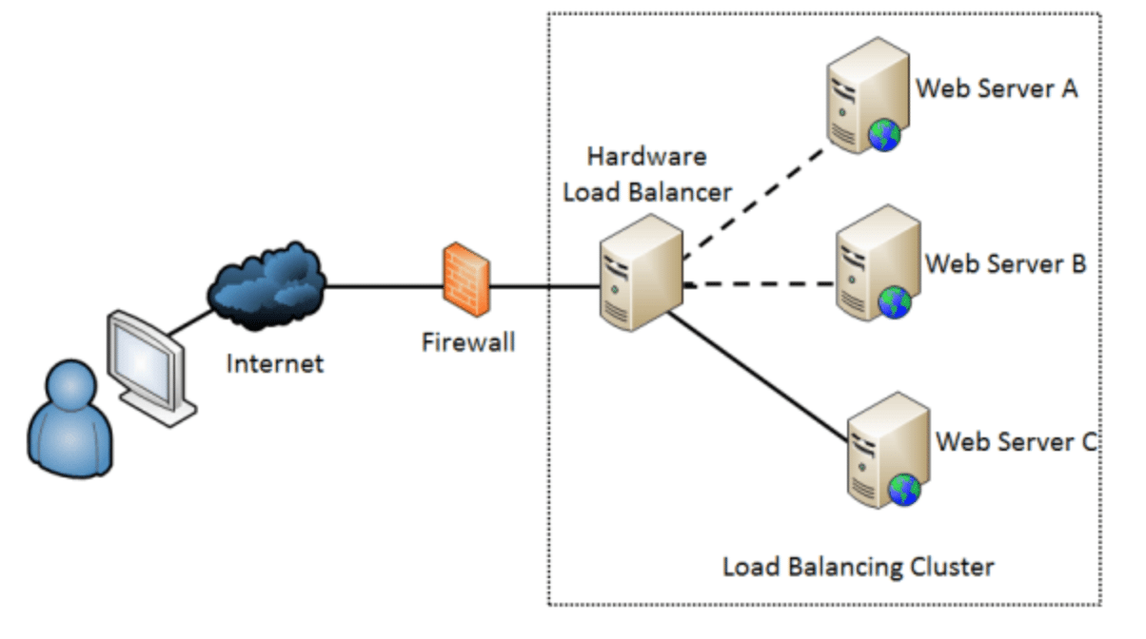
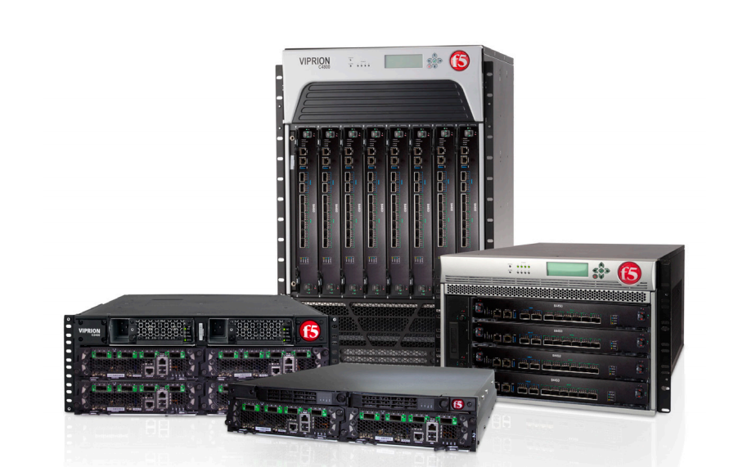
Hardware vs Software Load Balancing
Software Load Balancer - generally implements a combination of one or more scheduling algorithms.
Hardware Load Balancer - is a hardware device with a specialized operating system that distributes web application traffic across a cluster of application servers.

Slide 5
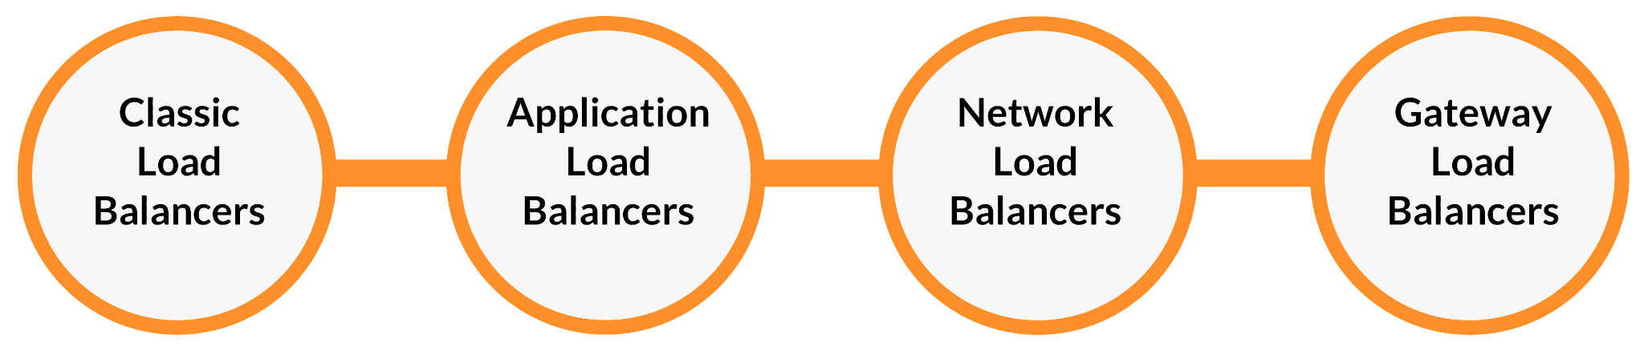
AWS Elastic Load Balancers
Elastic Load Balancing supports the following types of load balancers:
Application Load Balancers, Network Load Balancers, and Classic Load Balancers.
Application Load Balancers are used to route HTTP/HTTPS (or Layer 7) traffic. Network Load Balancers and Classic Load Balancers are used to route TCP (or Layer 4) traffic.

Slide 6
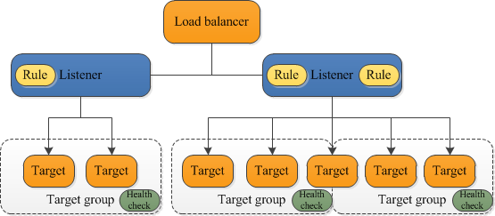
AWS ELB: Application Load Balancer
An Application Load Balancer functions at the application layer, the seventh layer of the Open Systems Interconnection (OSI) model. After the load balancer receives a request, it evaluates the listener rules in priority order to determine which rule to apply, and then selects a target from the target group for the rule action.
You can configure health checks, which are used to monitor the health of the registered targets so that the load balancer can send requests only to the healthy targets.

Slide 7

AWS ALB Listeners
Rule actions
Each rule action has a type, an order, and the information required to perform the action
Default rules
When you create a listener, you define actions for the default rule. Default rules can't have conditions. If the conditions for none of a listener's rules are met, then the action for the default rule is performed.
Rule priority
Each rule has a priority. Rules are evaluated in priority order, from the lowest value to the highest value. The default rule is evaluated last. You can change the priority of a nondefault rule at any time. You cannot change the priority of the default rule.
Rule conditions
Each rule condition has a type and configuration information. When the conditions for a rule are met, then its actions are performed.

Slide 8
AWS ALB Listeners
Forward actions
You can use forward actions to route requests to one or more target groups. If you specify multiple target groups for a forward action, you must specify a weight for each target group.
Each target group weight is a value from 0 to 999. Requests that match a listener rule with weighted target groups are distributed to these target groups based on their weights.
For example, if you specify two target groups, each with a weight of 10, each target group receives half the requests. If you specify two target groups, one with a weight of 10 and the other with a weight of 20, the target group with a weight of 20 receives twice as many requests as the other target group.
Redirect actions
You can use redirect actions to redirect client requests from one URL to another. You can configure redirects as either temporary (HTTP 302) or permanent (HTTP 301) based on your needs.
A URI consists of the following components:
protocol://hostname:port/path?query
You must modify at least one of the following components to avoid a redirect loop: protocol, hostname, port, or path. Any components that you do not modify retain their original values.

Slide 9
AWS ALB: HTTP headers
X-Forwarded-For
The X-Forwarded-For request header helps you identify the IP address of a client when you use an HTTP or HTTPS load balancer. Because load balancers intercept traffic between clients and servers, your server access logs only contain the IP address of the load balancer. To see the IP address of the client, use the routing.http.xff_header_processing.mode attribute. This attribute enables you to modify, preserve, or remove the X-Forwarded-For header in the HTTP request before the Application Load Balancer sends the request to the target. The possible values for this attribute are append, preserve, and remove. The default value for this attribute is append.
X-Forwarded-Proto
The X-Forwarded-Proto request header helps you identify the protocol (HTTP or HTTPS) that a client used to connect to your load balancer.
X-Forwarded-Port
The X-Forwarded-Port request header helps you identify the destination port that the client used to connect to the load balancer.
Append
By default, the Application Load Balancer stores the IP address of the client in the X-Forwarded-For request header and passes the header to your server
Preserve
The preserve mode in the attribute ensures that the X-Forwarded-For header in the HTTP request is not modified in any way before it is sent to targets.
Remove
The remove mode in the attribute removes the X-Forwarded-For header in the HTTP request before it is sent to targets.

Slide 10
Target group

Slide 11
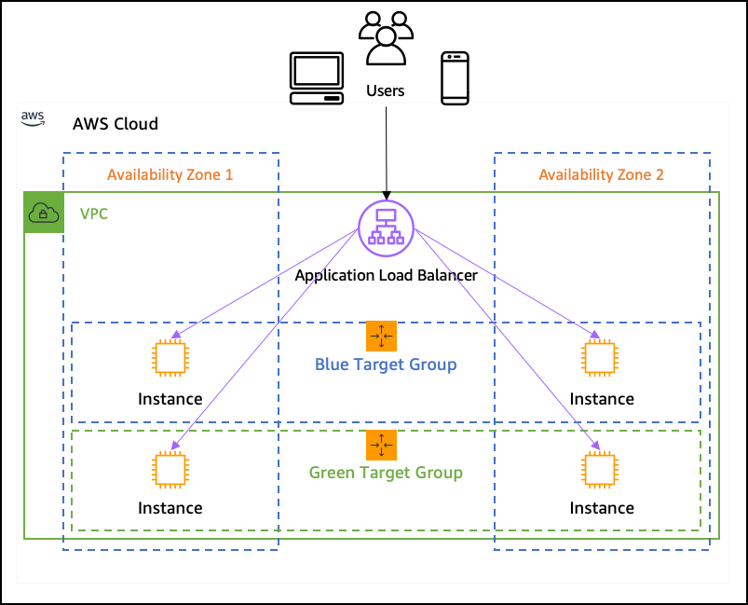
AWS Target Group
Routing based on:
hostname
Url
Query string
ALB supports port mapping feature for dynamic port mapping (ecs).
A target group tells a load balancer where to direct traffic to : EC2 instances, fixed IP addresses; or AWS Lambda functions, ECS task
Important
You can't specify publicly routable IP addresses.
Slow start mode
Target starts to receive its full share of requests as soon as it is registered with a target group and passes an initial health check. Using slow start mode gives targets time to warm up before the load balancer sends them a full share of requests.

Slide 12
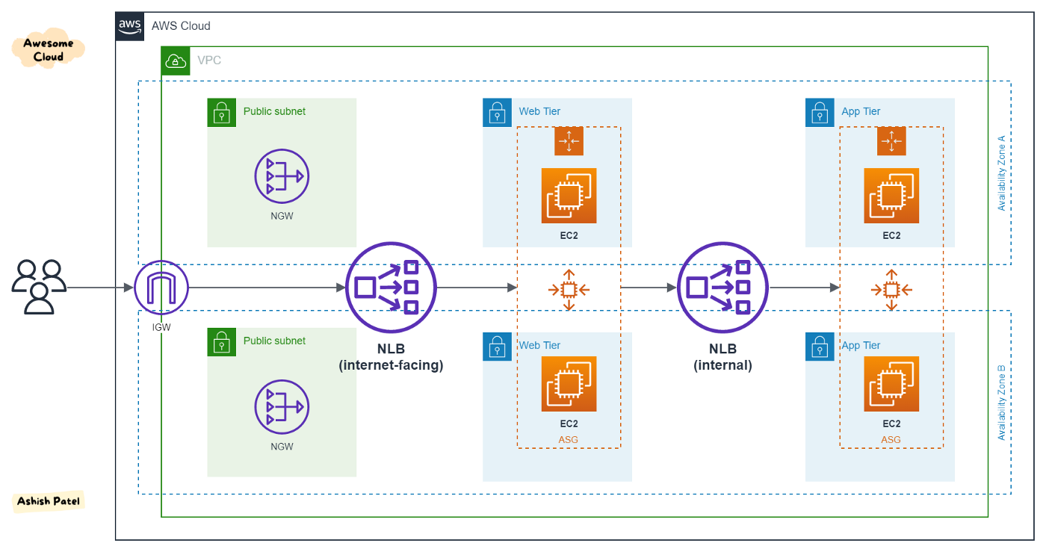
AWS ELB - Network load balancer
A Network Load Balancer functions at the fourth layer of the Open Systems Interconnection (OSI) model. It can handle millions of requests per second.
After the load balancer receives a connection request, it selects a target from the target group for the default rule. It attempts to open a TCP connection to the selected target on the port specified in the listener configuration.
When you enable an Availability Zone for the load balancer, Elastic Load Balancing creates a load balancer node in the Availability Zone.
By default, each load balancer node distributes traffic across the registered targets in its Availability Zone only.
If you enable cross-zone load balancing, each load balancer node distributes traffic across the registered targets in all enabled Availability Zones.
To increase the fault tolerance of your applications, you can enable multiple Availability Zones for your load balancer and ensure that each target group has at least one target in each enabled Availability Zone.

Slide 13
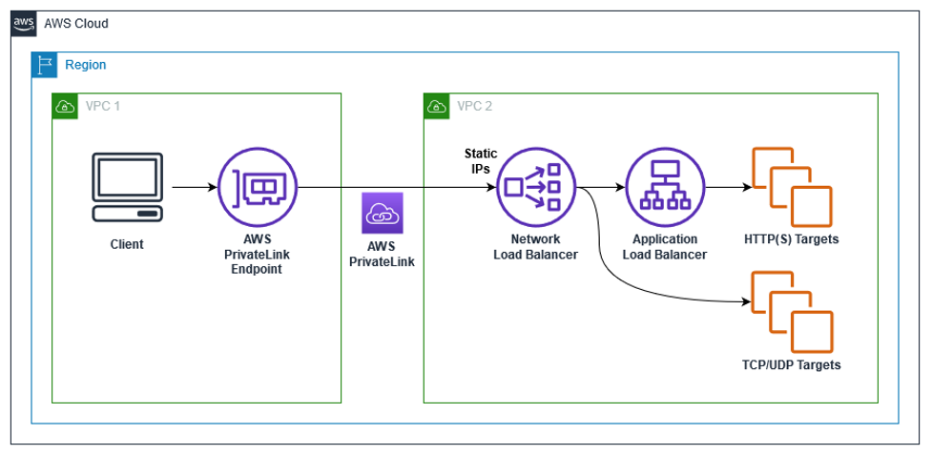
AWS ELB - Network load balancer
For TCP and UDP traffic, the load balancer selects a target using a flow hash algorithm based on the protocol, source IP address, source port, destination IP address, destination port, and TCP sequence number.
The TCP connections from a client have different source ports and sequence numbers, and can be routed to different targets. Each individual TCP connection is routed to a single target for the life of the connection.
A UDP flow has the same source and destination, so it is consistently routed to a single target throughout its lifetime. Different UDP flows have different source IP addresses and ports, so they can be routed to different targets.
Elastic Load Balancing creates a network interface for each Availability Zone you enable. Each load balancer node in the Availability Zone uses this network interface to get a static IP address. When you create an Internet-facing load balancer, you can optionally associate one Elastic IP address per subnet.
When you create a target group, you specify its target type, which determines how you register targets. For example, you can register instance IDs, IP addresses, or an Application Load Balancer.

Slide 14
Autoscaling group

Slide 15
Autoscaling group Scaling policies

Slide 16
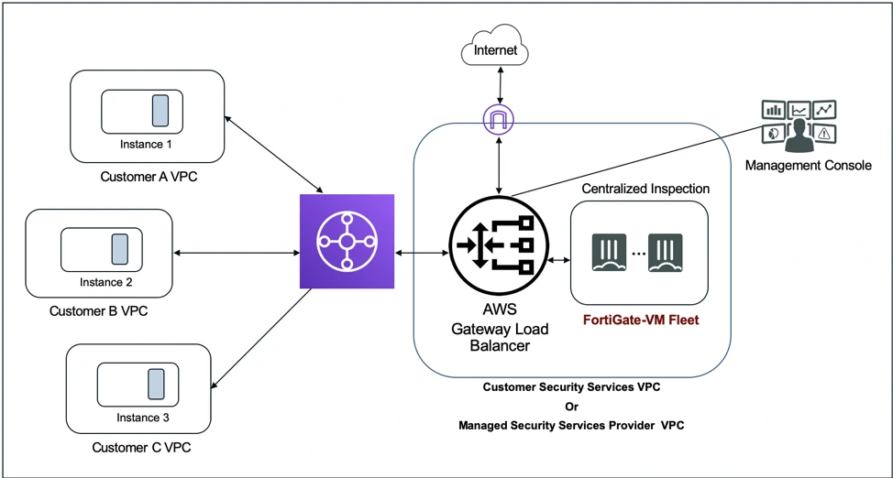
AWS GWLB - Gateway Load Balancer

Slide 17
GW lb detailed in VPC section

