Slide 2
What is a DDoS Attack?

Slide 3
The Anatomy of a DDoS Attack
Story of Burger Instead of delving into technical details, let’s instead consider an analogy. Suppose that you run a takeaway burger joint. Customers place their orders by phone and pick them up when they are ready. One day, a prankster makes multiple calls to your place, ordering 100 burgers in total.
This is enough to keep all your cooks occupied, so you stop taking new orders. However, the prankster never picks up the burgers. Not only were all your resources wasted on entertaining fake orders, you were also not able to cater to real customers.
This can be annoying but easy to prevent since it’s just one person placing all the false orders. You can simply block their number, and the problem is solved. The same situation can happen on a server. One malicious client can send tons of fake requests to a server, hampering its ability to respond to real users.
But just like in our example, detecting one fake client is easy; the server can just block all incoming requests from it. This type of attack is known as a denial-of-service (DoS) attack, the precursor of modern DDoS attacks.
Now, let’s suppose there are multiple pranksters calling your burger joint.
Your landline never stops ringing, and it’s virtually impossible to tell a real customer from a fake one. You can’t just block numbers either, as some of them may belong to actual customers. Your entire operation is paralyzed. This is exactly what happens when a server experiences a DDoS attack. Hackers make fake traffic coming in from multiple machines, look just like real, and a server/network/website inevitably breaks down.

Slide 4
Why do DDoS Attacks Happen?
Some of the main reasons for DDoS attacks are:
Ransom: Attackers usually demand ransom after conducting DDoS attacks. However, at times, a ransom note threatening an attack can also be sent beforehand.
Hacktivism: DDoS attacks are also used to voice opinion. Hacktivists can carry out a DDoS attack to show their support or opposition to a regulation, person, or company.
Competition: A 2017 survey revealed that over 40% of companies that were hit by a DDoS attack blame their competition for it. This seems even more plausible considering that you can now buy a week-long DDoS attack for a mere $150.

Slide 5
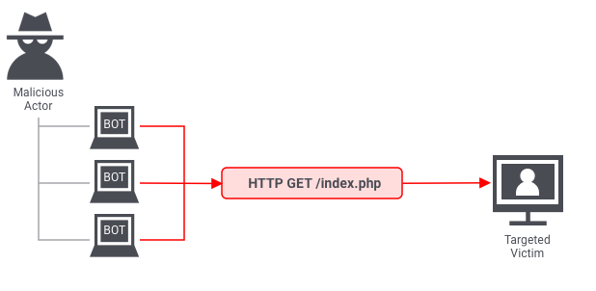
Types of DDoS Attacks
Even though the end goal of a DDoS attack is always to overwhelm the system, the means to achieve the goal can differ. Three broad types of DDoS attacks are as follows.
1. Application layer attacks
The application layer is where the server generates the response to an incoming client request. For example, if a user enters http://www.xyz.com/learning/ on their browser, an HTTP request is sent to the server, requesting the learning page. The server will fetch all the information related to the page, package it in a response, and send it back to the browser.
This information fetching and packaging happens on the application layer. An application layer attack occurs when a hacker uses different bots/machines to repeatedly request the same resource from the server, eventually overwhelming it.
The most common type of application layer attacks are the HTTP flood attacks in which malicious actors just keep sending various HTTP requests to a server using different IP addresses. One example of this is asking a server to generate PDF documents over and over again. Since the IP address and other identifiers change in every request, the server can’t detect that it’s being attacked.

Slide 6
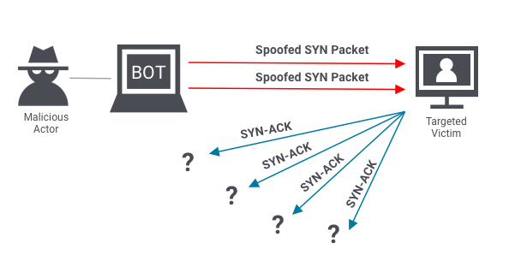
2. Protocol attacks
Protocol attacks look to exhaust resources of a server or those of its networking systems like firewalls, routing engines, or load-balancers. An example of a protocol attack is the SYN flood attack.
Before two computers can initiate a secure communication channel – they must perform a TCP handshake. A TCP handshake is a means for two parties to exchange preliminary information. A SYN packet is typically the first step of the TCP handshake, indicating to the server that the client wants to start a new channel.
In a SYN flood attack, the attacker floods the server with numerous SYN packets, each containing spoofed IP addresses. The server responds to each packet (via SYN-ACKs), requesting the client to complete the handshake. However, the client(s) never respond, and the server keeps waiting. Eventually, it crashes after waiting too long for too many responses.

Slide 7
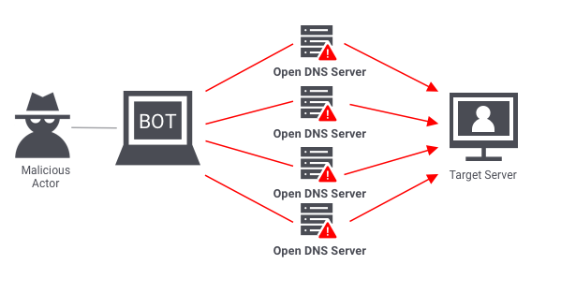
3. Volumetric attacks
Volumetric attacks are conducted by bombarding a server with so much traffic that its bandwidth gets completely exhausted. The most common example of a volumetric attack is the DNS amplification attack.
In such an attack, a malicious actor sends requests to a DNS server, using the spoofed IP address of the target. The DNS server then sends its response to the target server. When done at scale, the delugeof DNS responses can wreak havoc on the target server.

Slide 8
Stopping an In-Progress DDoS Attack
To be able to stop a DDoS attack, you must know the most common symptoms.
Usual DDoS symptoms
Large amounts of traffic coming from clients with same or similar characteristics. E.g. device type, browser type/version, IP or IP range, and location etc.
An exponential, unexpected rise in traffic at a single endpoint/server.
A server starts repeatedly crashing for no reason.
Your website is taking too long to respond to requests.
Responding to a DDoS attack
Once you have identified a DDoS attack, it’s important to act quickly as it gives you an opportunity to prevent serious downtime. If you wait too long, your server may start crashing, and full recovery may take hours.
The hardest part about mitigating a DDoS attack is that often it’s virtually impossible to do so without impacting legitimate traffic. This is because attackers go to great lengths to masquerade fake traffic as real. With that said, here are some ways you can respond:
Blackhole filtering: Go through incoming traffic and determine a limitation criterion. Use the criterion to route malicious traffic into a blackhole, essentially dropping it.
Casting: Distribute the traffic across multiple servers, increasing your capacity, and decreasing the chances of individual servers getting overwhelmed.
IP Blocking: If you are noticing unexpectedly high traffic from the same range of IP addresses, block them.

Slide 9
Preventing a DDoS Attack
Stopping an active DDoS attack can be hard and may affect your legitimate users. This is why it’s important to take a preemptive approach. In addition to the preventive measures mentioned below, you should also create an emergency DDoS incident response plan, as even the best defenses can sometimes succumb to sophisticated attacks.
Real-time packet analysis: Analyze packets based on different rules, as they enter your system, discarding the potentially malicious ones.
DDoS defense system (DDS): A DDS can detect legitimate-looking content with malicious intent. It protects against both protocol and volumetric attacks, without requiring any human intervention.
Web application firewall: Web application firewalls (WAF) are a great tool to mitigate application layer DDoS attacks. They give you a way to filter incoming requests, based on different rules, which can also be added on-the-fly, in response to an attack.
Rate limiting: Limit the number of requests a server can entertain over a certain time period.

Slide 10

AWS Shield
AWS Shield is a managed Distributed Denial of Service (DDoS) protection service that safeguards applications running on AWS.
AWS Shield provides always-on detection and automatic inline mitigations that minimize application downtime and latency, so there is no need to engage AWS Support to benefit from DDoS protection.
There are two tiers of AWS Shield – Standard and Advanced.

Slide 11
AWS Shield Standard
All AWS customers benefit from the automatic protections of AWS Shield Standard, at no additional charge.
AWS Shield Standard defends against most common, frequently occurring network and transport layer DDoS attacks that target web sites or applications.
When using AWS Shield Standard with Amazon CloudFront and Amazon Route 53, you receive comprehensive availability protection against all known infrastructure (Layer 3 and 4) attacks.

Slide 12
AWS Shield Advanced
Optional DDoS mitigation service ($3,000 per month per organization)
Protect against more sophisticated attack on Amazon EC2, Elastic Load Balancing (ELB), Amazon CloudFront, AWS Global Accelerator, and Route 53
24/7 access to AWS DDoS response team (DRP)
Protect against higher fees during usage spikes due to DDoS
Shield Advanced automatic application layer DDoS mitigation automatically creates, evaluates and deploys AWS WAF rules to mitigate layer 7 attacks

Slide 13
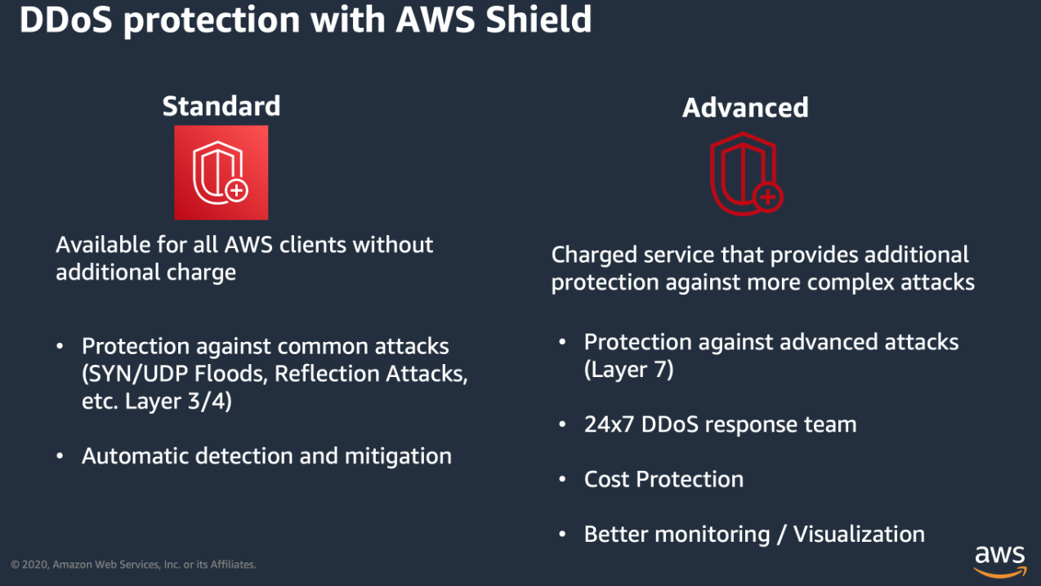
AWS Shield take away

Slide 14
AWS Web Application Firewall (WAF)
About WAF
Web Traffic Filtering
Full feature API
Real-time visibility

Slide 15
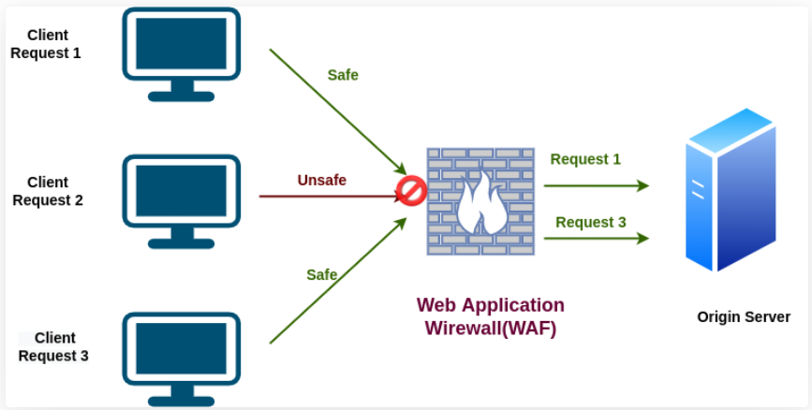
AWS Web Application Firewall (WAF)
AWS WAF is a web application firewall that helps protect your web applications from common web exploits that could affect application availability, compromise security, or consume excessive resources.
AWS WAF helps protect web applications from attacks by allowing you to configure rules that allow, block, or monitor (count) web requests based on conditions that you define.
These conditions include IP addresses, HTTP headers, HTTP body, URI strings, SQL injection and cross-site scripting.
Can allow or block web requests based on strings that appear in the requests using string match conditions.

Slide 16
AWS Web Application Firewall (WAF)
AWS WAF can match values in the following request parts:
Header – A specified request header, for example, the User-Agent or Referer header.
HTTP method – The HTTP method, which indicates the type of operation that the request is asking the origin to perform. CloudFront supports the following methods: DELETE, GET, HEAD, OPTIONS, PATCH, POST, and PUT.
Query string – The part of a URL that appears after a ? character, if any.
URI – The URI path of the request, which identifies the resource, for example, /images/daily-ad.jpg.
Body – The part of a request that contains any additional data that you want to send to your web server as the HTTP request body, such as data from a form.
Single query parameter (value only) – Any parameter that you have defined as part of the query string.
All query parameters (values only) – As above buy inspects all parameters within the query string.

Slide 17
AWS Web Application Firewall (WAF)
Protects your web applications from common web exploits (Layer 7)
Layer 7 is HTTP (vs Layer 4 is TCP/UDP)
Deploy on :
Application Load Balancer
API Gateway
CloudFront
AppSync GraphQL API
Cognito User Pool

Slide 18
AWS Web Application Firewall (WAF)
Define Web ACL (Web Access Control List) Rules:
IP Set: up to 10,000 IP addresses – use multiple Rules for more IPs
HTTP headers, HTTP body, or URI strings Protects from common attack - SQL
injection and Cross-Site Scripting (XSS)
Size constraints, geo-match (block countries)
Rate-based rules (to count occurrences of events) – for DDoS protection
Web ACL are Regional except for CloudFront
A rule group is a reusable set of rules that you can add to a web ACL

Slide 19
AWS Web Application Firewall (WAF) - Web Traffic Filtering
AWS WAF lets you create rules to filter web traffic based on conditions that include IP addresses, HTTP headers and body, or custom URIs.
This gives you an additional layer of protection from web attacks that attempt to exploit vulnerabilities in custom or third-party web applications.
In addition, AWS WAF makes it easy to create rules that block common web exploits like SQL injection and cross site scripting.
AWS WAF allows you to create a centralized set of rules that you can deploy across multiple websites.
This means that in an environment with many websites and web applications you can create a single set of rules that you can reuse across applications rather than recreating that rule on every application you want to protect.

Slide 20
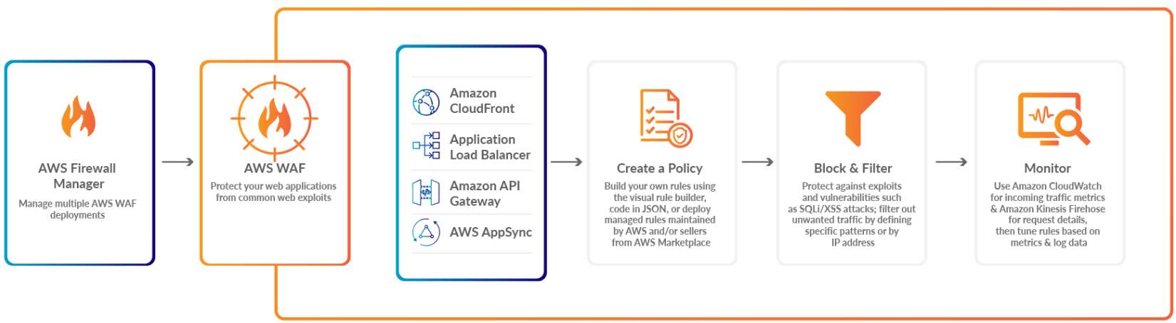
AWS Web Application Firewall (WAF)
How It Works
AWS Web Application Firewall protects the applications from malicious attacks.
AWS Firewall Manage: It Manages multiple AWS Web Application Firewall Deployments
AWS WAF: Protect deployed applications from common web exploits.
Create a Policy: Now you can build your own rules using the visual rule builder.
Block Filter: Block filters protect against exploits and vulnerabilities attacks.
Monitor: Use Amazon CloudWatch for incoming traffic metrics & Amazon kinesis firehose for request details, then tune rules based on metrics and log data.

Slide 21
AWS Web Application Firewall (WAF) - Full feature API
AWS WAF can be completely administered via APIs.
This provides organizations with the ability to create and maintain rules automatically and incorporate them into the development and design process.
For example, a developer who has detailed knowledge of the web application could create a security rule as part of the deployment process.
This capability to incorporate security into your development process avoids the need for complex handoffs between application and security teams to make sure rules are kept up to date.
AWS WAF can also be deployed and provisioned automatically with AWS CloudFormation sample templates that allow you to describe all security rules you would like to deploy for your web applications delivered by Amazon CloudFront.
AWS WAF is integrated with Amazon CloudFront, which supports custom origins outside of AWS – this means you can protect web sites not hosted in AWS.
Support for IPv6 allows the AWS WAF to inspect HTTP/S requests coming from both IPv6 and IPv4 addresses.

Slide 22
AWS Web Application Firewall (WAF) - Real-time visibility
AWS WAF provides real-time metrics and captures raw requests that include details about IP addresses, geo locations, URIs, User-Agent and Referers.
AWS WAF is fully integrated with Amazon CloudWatch, making it easy to setup custom alarms when thresholds are exceeded, or attacks occur.
This information provides valuable intelligence that can be used to create new rules to better protect applications.

Slide 23
Types of rules
AWS Managed rules
Custom rules
You can write custom rules specific to your web application/database to block undesired patterns in parts of the HTTP/HTTPS request, such as headers, method, query string, URI, body and IP address. These custom rules can be used together with AWS Managed Rules.
AWS Marketplace Rules
You can also find rules created by security vendors that have built their own rule sets on an AWS WAF on the AWS Marketplace.
Advanced Automated Mitigations
AWS provides the AWS WAF Security Automations Solution which automatically deploys a set of AWS WAF rules that filter common web-based attacks, but also provide advanced log analysis. This automated solution leverages AWS WAFs APIs to react to threats detected from logs, honeypot URLs, and more to automatically update rules and block malicious IP addresses. An example of this is shown below.

Slide 24
AWS Managed Rules rule groups list
Baseline rule groups
Baseline managed rule groups provide general protection against a wide variety of common threats.
Use-case specific rule groups
Use-case specific rule groups provide incremental protection for many diverse AWS WAF use cases.
IP reputation rule groups
IP reputation rule groups block requests based on their source IP address.
AWS WAF Bot Control rule group
The Bot Control managed rule group provides rules to block and manage requests from bots. Bots can consume excess resources, skew business metrics, cause downtime, and perform malicious activities.
AWS WAF Fraud Control account takeover prevention (ATP) rule group

Slide 25
Baseline rule groups
Core rule set (CRS) managed rule group
VendorName: AWS, Name: AWSManagedRulesCommonRuleSet, WCU: 700
The Core rule set (CRS) rule group contains rules that are generally applicable to web applications. This provides protection against exploitation of a wide range of vulnerabilities, including some of the high risk and commonly occurring vulnerabilities.
Admin protection managed rule group
VendorName: AWS, Name: AWSManagedRulesAdminProtectionRuleSet, WCU: 100
The Admin protection rule group contains rules that allow you to block external access to exposed administrative pages. This might be useful if you run third-party software or want to reduce the risk of a malicious actor gaining administrative access to your application.
Known bad inputs managed rule group
VendorName: AWS, Name: AWSManagedRulesKnownBadInputsRuleSet, WCU: 200
The Known bad inputs rule group contains rules to block request patterns that are known to be invalid and are associated with exploitation or discovery of vulnerabilities. This can help reduce the risk of a malicious actor discovering a vulnerable application.

Slide 26
Use-case specific rule groups
SQL database managed rule group
VendorName: AWS, Name: AWSManagedRulesSQLiRuleSet, WCU: 200
The SQL database rule group contains rules to block request patterns associated with exploitation of SQL databases, like SQL injection attacks. This can help prevent remote injection of unauthorized queries. Evaluate this rule group for use if your application interfaces with an SQL database.
Linux operating system managed rule group
VendorName: AWS, Name: AWSManagedRulesLinuxRuleSet, WCU: 200
The Linux operating system rule group contains rules that block request patterns associated with the exploitation of vulnerabilities specific to Linux, including Linux-specific Local File Inclusion (LFI) attacks. This can help prevent attacks that expose file contents or run code for which the attacker should not have had access.
POSIX operating system managed rule group
VendorName: AWS, Name: AWSManagedRulesUnixRuleSet, WCU: 100
The POSIX operating system rule group contains rules that block request patterns associated with the exploitation of vulnerabilities specific to POSIX and POSIX-like operating systems, including Local File Inclusion (LFI) attacks.

Slide 27
Use-case specific rule groups
Windows operating system managed rule group
VendorName: AWS, Name: AWSManagedRulesWindowsRuleSet, WCU: 200
The Windows operating system rule group contains rules that block request patterns associated with the exploitation of vulnerabilities specific to Windows, like remote execution of PowerShell commands. This can help prevent exploitation of vulnerabilities that permit an attacker to run unauthorized commands or run malicious code.
PHP application managed rule group
VendorName: AWS, Name: AWSManagedRulesPHPRuleSet, WCU: 100
The PHP application rule group contains rules that block request patterns associated with the exploitation of vulnerabilities specific to the use of the PHP programming language, including injection of unsafe PHP functions. This can help prevent exploitation of vulnerabilities that permit an attacker to remotely run code or commands for which they are not authorized.
WordPress application managed rule group
VendorName: AWS, Name: AWSManagedRulesWordPressRuleSet, WCU: 100
The WordPress application rule group contains rules that block request patterns associated with the exploitation of vulnerabilities specific to WordPress sites. This rule group should be used in conjunction with the SQL database and PHP application rule groups.

Slide 28
IP reputation rule groups
Amazon IP reputation list managed rule group
VendorName: AWS, Name: AWSManagedRulesAmazonIpReputationList, WCU: 25
The Amazon IP reputation list rule group contains rules that are based on Amazon internal threat intelligence. This is useful if you would like to block IP addresses typically associated with bots or other threats. Blocking these IP addresses can help mitigate bots and reduce the risk of a malicious actor discovering a vulnerable application.
Anonymous IP list managed rule group
VendorName: AWS, Name: AWSManagedRulesAnonymousIpList, WCU: 50
The Anonymous IP list rule group contains rules to block requests from services that permit the obfuscation of viewer identity. These include requests from VPNs, proxies, Tor nodes, and hosting providers. This rule group is useful if you want to filter out viewers that might be trying to hide their identity from your application. Blocking the IP addresses of these services can help mitigate bots and evasion of geographic restrictions.

Slide 29
AWS WAF Bot Control rule group
VendorName: AWS, Name: AWSManagedRulesBotControlRuleSet, WCU: 50
The Bot Control managed rule group provides rules to block and manage requests from bots. Bots can consume excess resources, skew business metrics, cause downtime, and perform malicious activities.
Protection levels
The Bot Control managed rule group provides two levels of protection that you can choose from:
Common – Detects a variety of self-identifying bots, such as web scraping frameworks, search engines, and automated browsers. Bot Control protections at this level identify common bots using traditional bot detection techniques, such as static request data analysis. The rules label traffic from these bots and block the ones that they cannot verify.
Targeted – Includes the common-level protections and adds detection for advanced bots that do not self identify. Targeted protections use advanced detection techniques such as browser interrogation, fingerprinting, and behavior heuristics to identify bad bot traffic. The protections target these bots using a combination of rate limiting and CAPTCHA and background browser challenges. The rules that provide targeted protection have names that begin with TGT_.

Slide 30
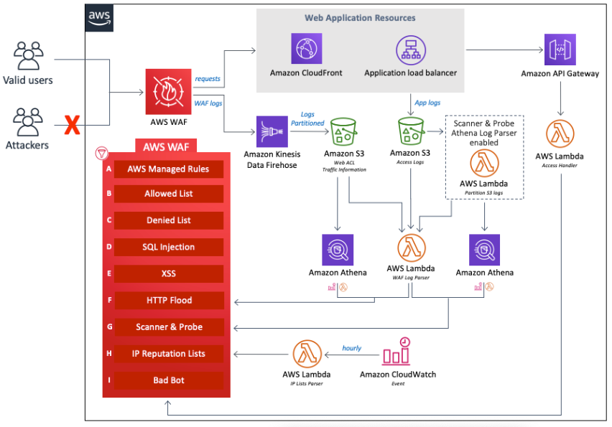
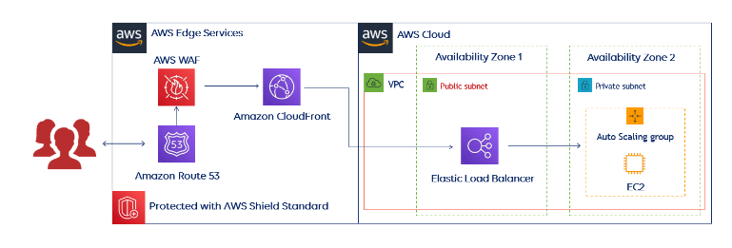
AWS WAF Architecture diagram

Slide 31
AWS WAF Features
Protection Against Web Attacks: With minimum latency impact on incoming traffic, WAF AWS offers many rules to inspect any element of a web request. WAF AWS protects web applications against threats by filtering traffic according to the rules created.
Establish Rules Accordingly: WAF AWS is a versatile and valuable tool for protecting the infrastructures of applications. And this is because it allows users to establish rules according to their needs and vulnerabilities that they wish to stop. We can consider it a great solution to protect any web application environment at the enterprise level.
Web traffic filtering: WAF allows users to create rules to filter web traffic. It filters IP addresses, HTTP headers, HTTP bodies, or URI strings from a web request.
Flexible Integration With AWS Services: AWS Firewall offers easy integration with other AWS services like Amazon EC2, CloudFront, Load balancer, etc.
Monitor Rules: Web Application Firewall AWS allows us to create rules and review and customize them to prevent unknown attracts.

Slide 32
AWS Exam take away
Request parts
Layer 7 is HTTP (vs Layer 4 is TCP/UDP)
Deploy on :
Application Load Balancer
API Gateway
CloudFront
AppSync GraphQL API
Cognito User Pool
Types of rules
WAF Features
AWS WAF Bot Control rule group!
IP reputation rule groups!

Slide 33
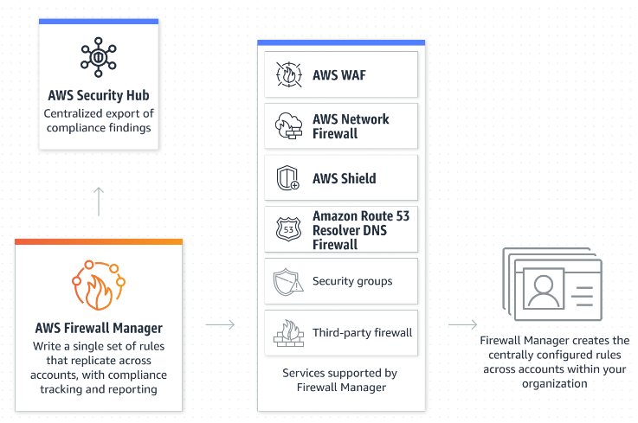
AWS Firewall Manager
AWS Firewall Manager simplifies your administration and maintenance tasks across multiple accounts and resources for a variety of protections, including AWS WAF, AWS Shield Advanced, Amazon VPC security groups, AWS Network Firewall, and Amazon Route 53 Resolver DNS Firewall.

Slide 34
AWS Firewall Manager
Firewall Manager provides these benefits:
Helps to protect resources across accounts
Helps to protect all resources of a particular type, such as all Amazon CloudFront distributions
Helps to protect all resources with specific tags
Automatically adds protection to resources that are added to your account
Allows you to subscribe all member accounts in an AWS Organizations organization to AWS Shield Advanced, and automatically subscribes new in-scope accounts that join the organization
Allows you to apply security group rules to all member accounts or specific subsets of accounts in an AWS Organizations organization, and automatically applies the rules to new in-scope accounts that join the organization
Lets you use your own rules, or purchase managed rules from AWS Marketplace
Firewall Manager is particularly useful when you want to protect your entire organization rather than a small number of specific accounts and resources, or if you frequently add new resources that you want to protect. Firewall Manager also provides centralized monitoring of DDoS attacks across your organization.

