Slide 1
CloudTrail

Slide 2
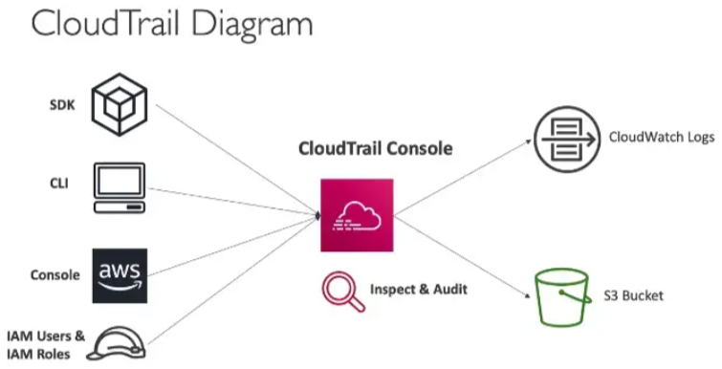
What Is AWS CloudTrail?
AWS CloudTrail is a web service that records activity made on your account.
CloudTrail is about logging and saves a history of API calls for your AWS account.
CloudTrail enables governance, compliance, and operational and risk auditing of your AWS account.
CloudTrail provides visibility into user activity by recording actions taken on your account.
API history enables security analysis, resource change tracking, and compliance auditing.

Slide 3
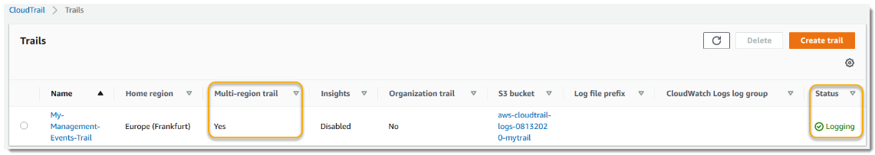
Trails
You can create two types of trails for an AWS account:
A trail that applies to all regions (default) – records events in all regions and delivers to an S3 bucket.
A trail that applies to a single region – records events in a single region and delivers to an S3 bucket. Additional single trails can use the same or a different S3 bucket.

Slide 4
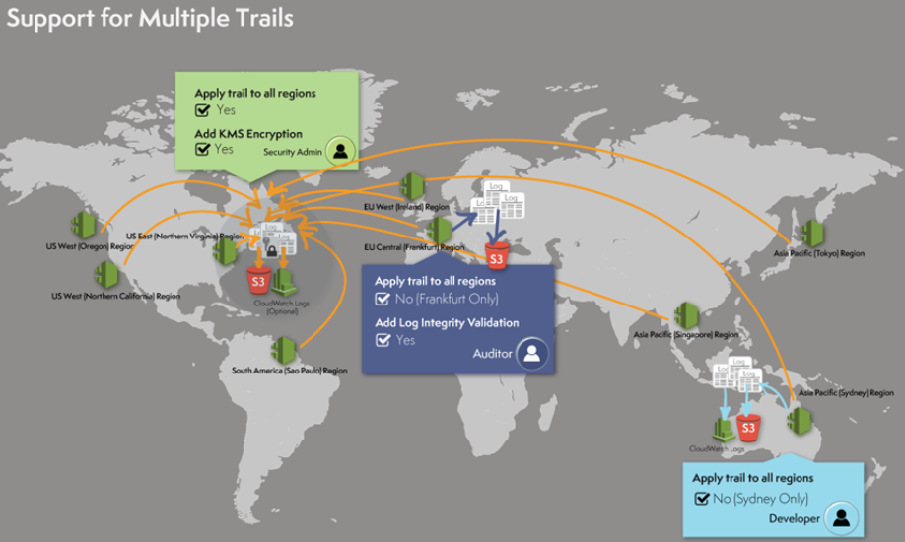
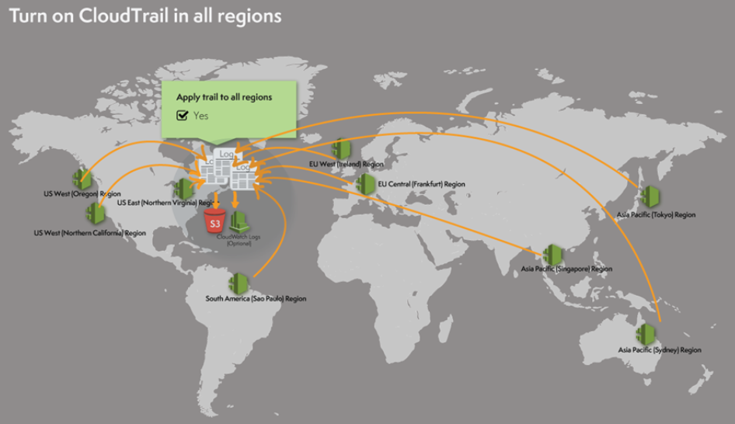
Trails diagram

Slide 5
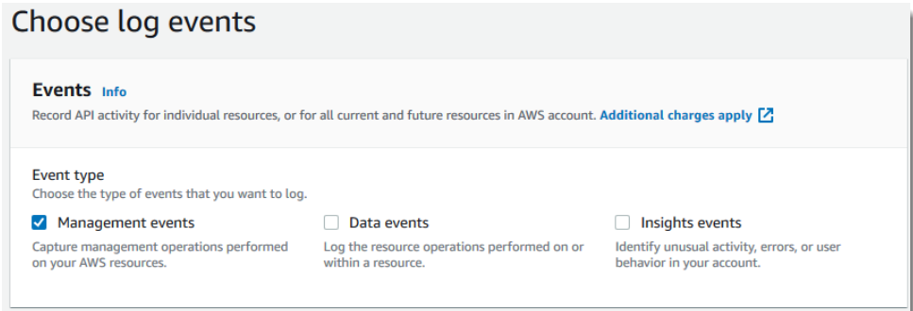
Events
Trails can be configured to log data events, management events, Insight events:
Data events: These events provide insight into the resource operations performed on or within a resource.
Examples :
Lambda(invoke)
S3 Object access(GET, PUT, DELETE)
Management events: Management events provide insight into management operations that are performed on resources in your AWS account.
Management events can also include non-API events that occur in your account.

Slide 6
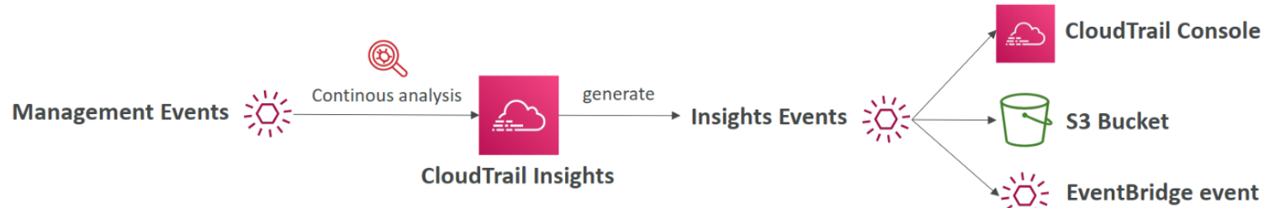
Events examples
Examples :
Console sign-in
Changes to a Security Group
Launching a new instance
Insight events:
Can detect unusual activity in your account:
Inaccurate resource provisioning
Hitting service limits
Bursts of AWS IAM actions
Gaps in periodic maintenance activity

Slide 7
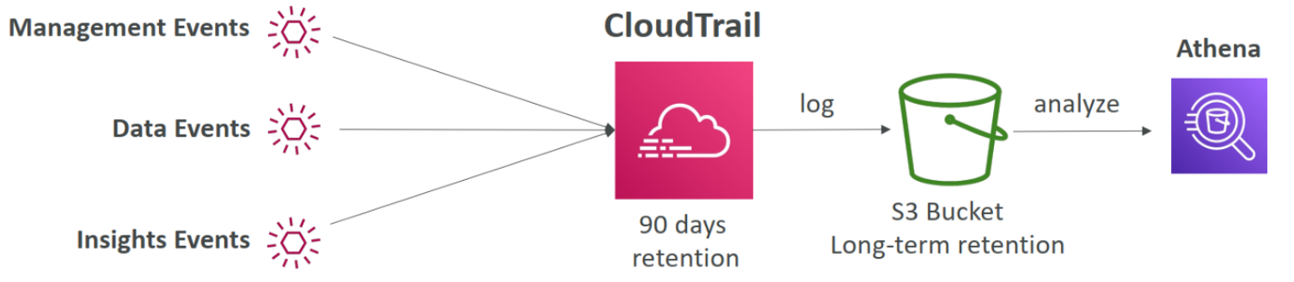
CloudTrail Events Retention
Events are stored for 90 days in CloudTrail.
To keep events more persistent, log them to S3 (and use Athena) or CloudWatch.

Slide 8
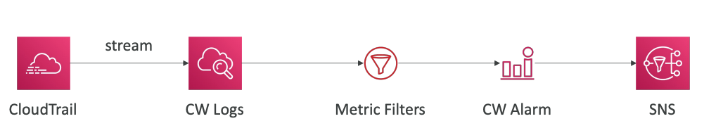
CloudTrail Alerts API

Slide 9
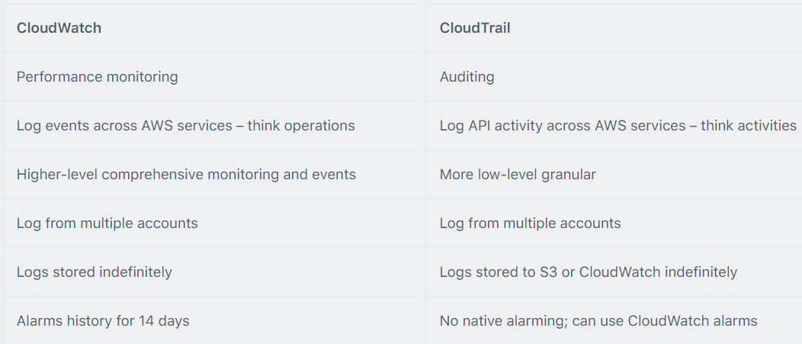
CloudWatch vs CloudTrail:
You can integrate CloudTrail with CloudWatch Logs to deliver data events captured by CloudTrail to a CloudWatch Logs log stream.
CloudTrail log file integrity validation feature allows you to determine whether a CloudTrail log file was unchanged, deleted, or modified since CloudTrail delivered it to the specified Amazon S3 bucket.

Slide 10
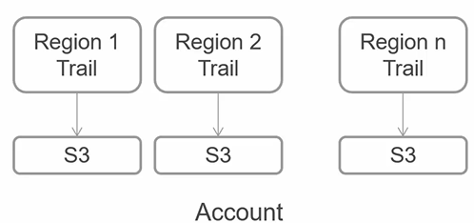
CloudTrail - Best practices (Multi-Region)
API activities are logged under each region
However, configuring separately for each region is not recommended
Inconsistency between regions
Handle new regions

Slide 11
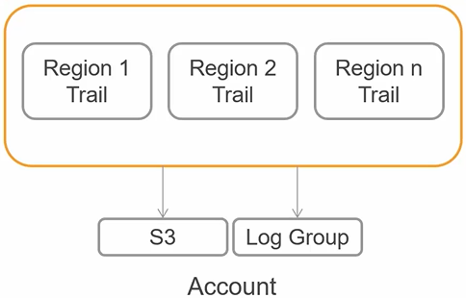
CloudTrail - Best practices (Trail for all regions)
Use CloudTrail provided “Enable trail for all regions” in an account
Centrally manage configuration
Automatically handle new regions
Consolidate to single S3 bucket, Log Group
Monitor for activity in unused regions
CloudTrail log file integrity

Slide 12
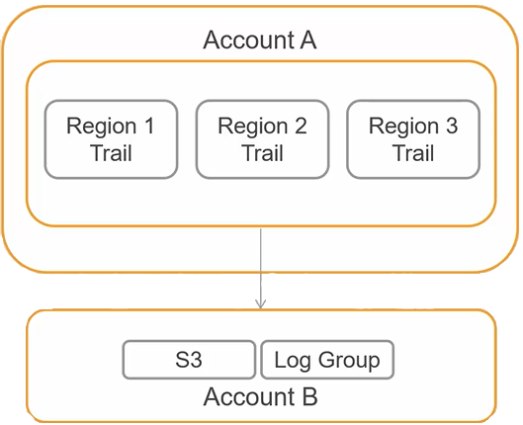
CloudTrail - Best practices (Separate Account for Logs)
Log to S3 bucket, Log Group in a separate account
Use SSE-KMS encryption
Implement least privilege access
Enable MFA delete
Manage lifecycle using S3
Archive older files to Glacier (for long term retention)

Slide 13
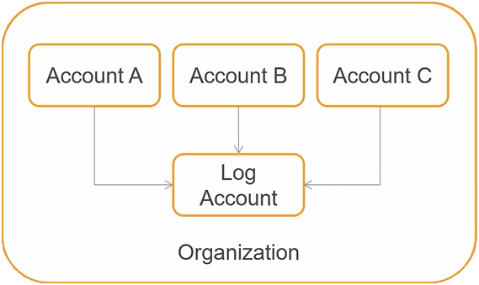
CloudTrail - Best practices (AWS Organizations)
Enable Organizations Trail
Uniform event logging strategy for the entire organization
Consolidate to a single S3 bucket, CloudWatch Log Group

