Slide 1
AWS System Manager

Slide 2
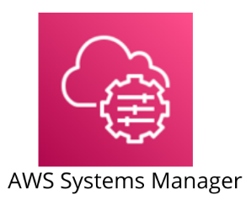
AWS Systems Manager
AWS Systems Manager is an AWS service that provides visibility and control of infrastructure on AWS.
AWS Systems Manager provides a unified interface through which you can view operational data from multiple AWS services.
AWS Systems Manager allows you to automate operational tasks across your AWS resources.
Formally known as SSM, AWS Systems Manager is a central hub to control and view your entire AWS infrastructure.
AWS Systems manager is a powerful service which allows you to have a holistic view of all of the services you are using to view and control your infrastructure on AWS.

Slide 3
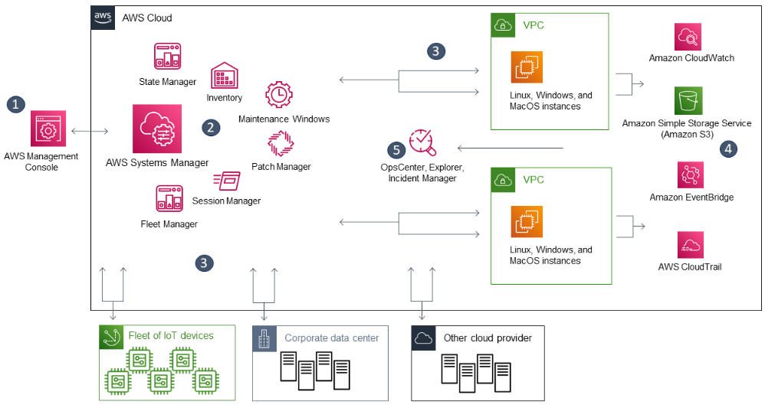
How Systems Manager works diagram

Slide 4
How Systems Manager works diagram description
Access Systems Manager – Use one of the available options for accessing Systems Manager.
Choose a Systems Manager capability – Determine which capability can help you perform the action you want to perform on your resources.
Verification and processing – Systems Manager verifies that your user, group, or role has the required AWS Identity and Access Management (IAM) permissions to perform the action you specified.
Reporting – Systems Manager, SSM Agent, and other AWS services that performed an action on behalf of Systems Manager report status. Systems Manager can send status details to other AWS services, if configured.
Systems Manager operations management capabilities – If enabled, Systems Manager operations management capabilities such as Explorer, OpsCenter, and Incident Manager aggregate operations data or create artifacts in response to events or errors with your resources. These artifacts include operational work items (OpsItems) and incidents.

Slide 5
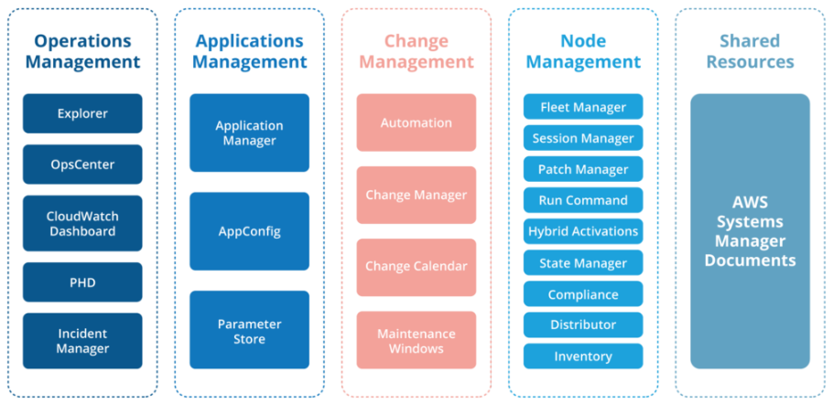
Systems Manager Capabilities
AWS Systems Manager contains several tools which are organized into the five ‘Capability Categories’ shown below.
These tools allow us to perform operational tasks swiftly against various resource objects.
Resources such as EC2 Instances, Amazon S3 buckets and even on-premises servers can be associated with resource tags.
These tags define membership of a Resource Group, against which we can then view operational and troubleshooting data.

Slide 6
Systems Manager Capabilities description
Operations Management:
OpsCenter to view and resolve issues related to AWS resourcesExplorer, Cloudwatch, and PHD (Personal Health Dashboard) to visualize reports
Application Management:
Application Manager to manage multiple applications from a single consoleAppConfig to quickly deploy your applications Parameter to store secret and configuration data
Change Management:
Automation to simplify the maintenance and deployment tasks.Maintenance windows to schedule your maintenance timeChange calendar to set the date and time for actions or events
Node Management:
Compliance to detect non-compliant resources Hybrid activations to set up VMs in Hybrid environments Patch Manager to automate patching Session Manager to connect and manage your EC2 instances Run command to configure managed instances remotely Distributor lets you package your software Fleet Manager to give you a global view of the health and performance of your entire fleet of servers.
Shared Resources:
Pre-configured documents to define actions that Systems Manager can perform

Slide 7
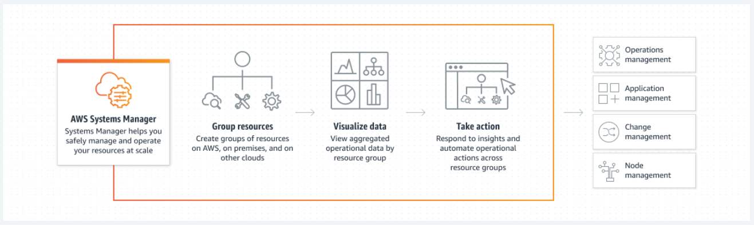
Systems Manager Capabilities diagram

Slide 8
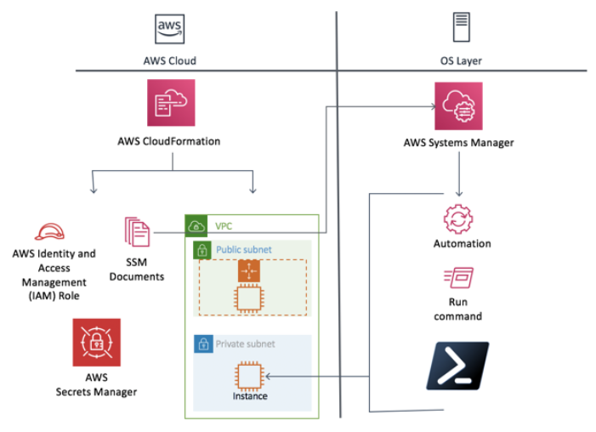
Systems Manager Capabilities important parts
AWS Systems Manager Automation
AWS Systems Manager allows you to safely automate common and repetitive IT operations and management tasks across AWS resources.
With Systems Manager, you can create JSON/YAML documents that specify a specific list of tasks or use community published documents.
These documents can be executed directly through the AWS Management Console, CLIs, and SDKs, scheduled in a maintenance window, or triggered based on changes to AWS resources through Amazon CloudWatch Events.
You can track the execution of each step in the documents as well as require approvals for each step.
You can also incrementally roll out changes and automatically halt when errors occur.
https://docs.aws.amazon.com/systems-manager/latest/userguide/systems-manager-automation.html

Slide 9
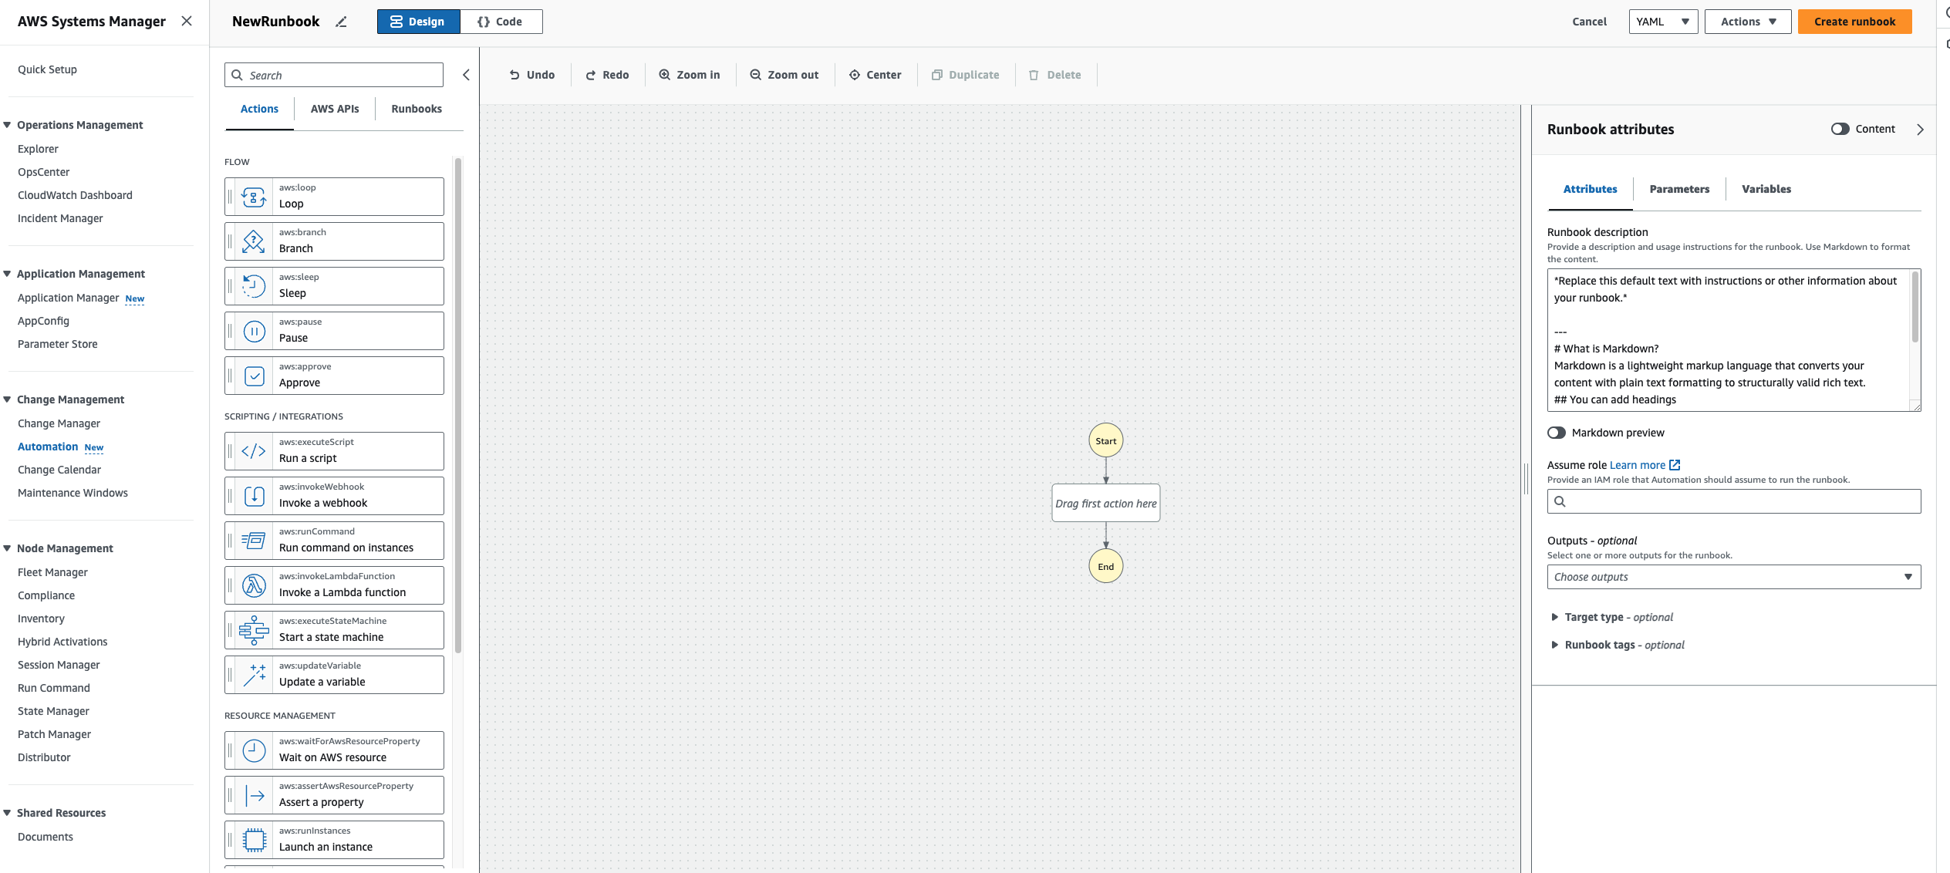
AWS Systems Manager Automation

Slide 10
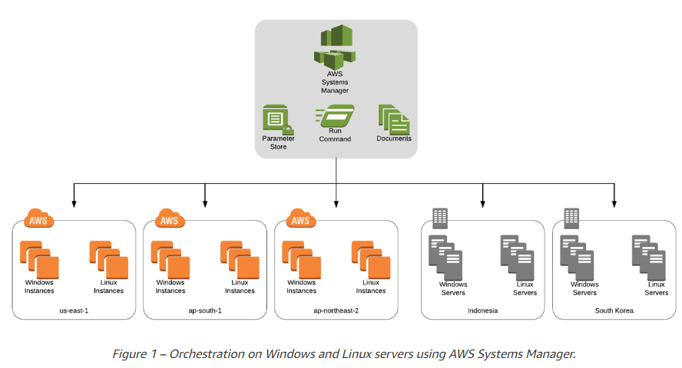
AWS Systems Manager Run Command
By using Run Command, you can automate common administrative tasks and make one-time configuration changes in bulk, and at enterprise scale.
This essentially prevents you from having to jump into every one of your instances and run the same command hundreds of times.
It is all actively managed within the console and there is an easy to use console in which to administer your commands, as well as a CLI or through the AWS SDK.
Example tasks include: stopping, restarting, terminating, and resizing instances.
Attaching and detaching EBS volumes, creating snapshots and you can install or bootstrap an application, build a deployment pipeline etc.

Slide 11
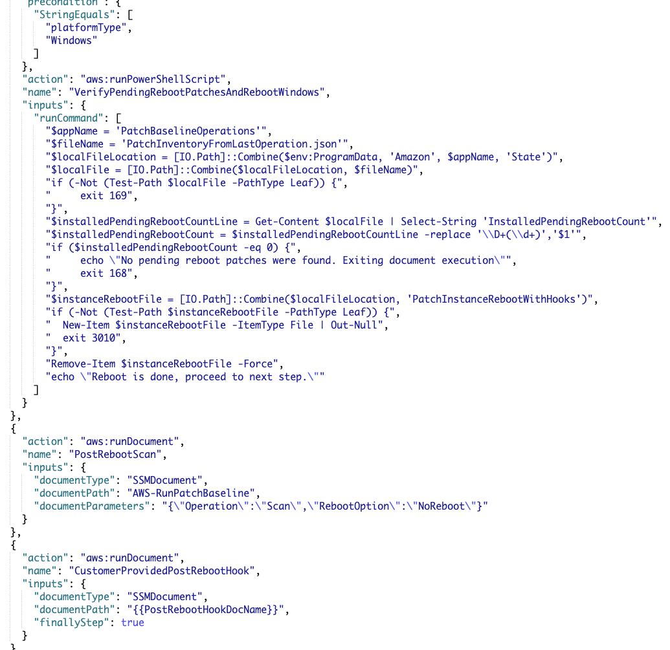
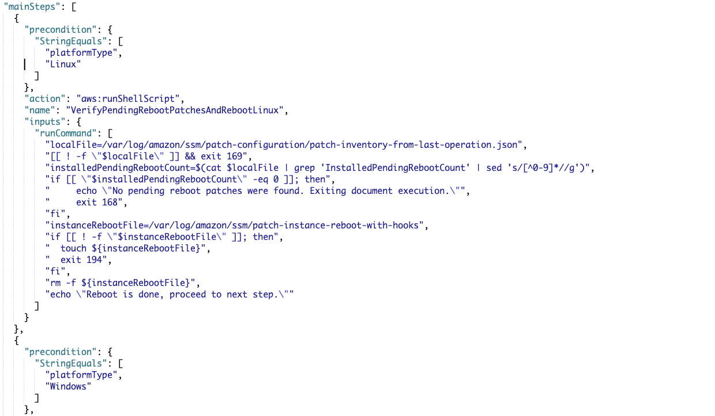
AWS Systems Manager Document Example

Slide 12
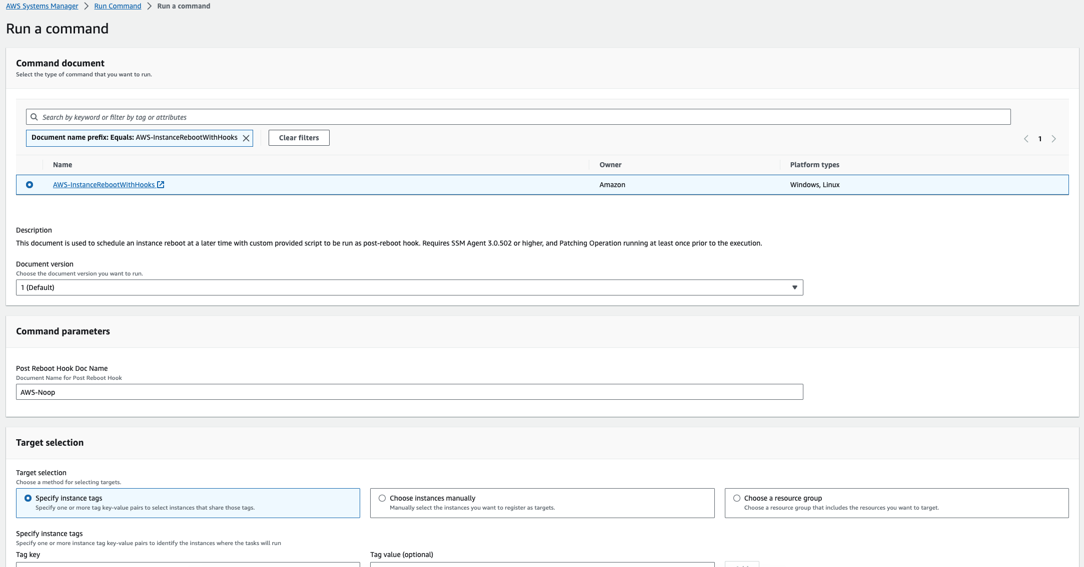
AWS SSM Run Command Interface

Slide 13
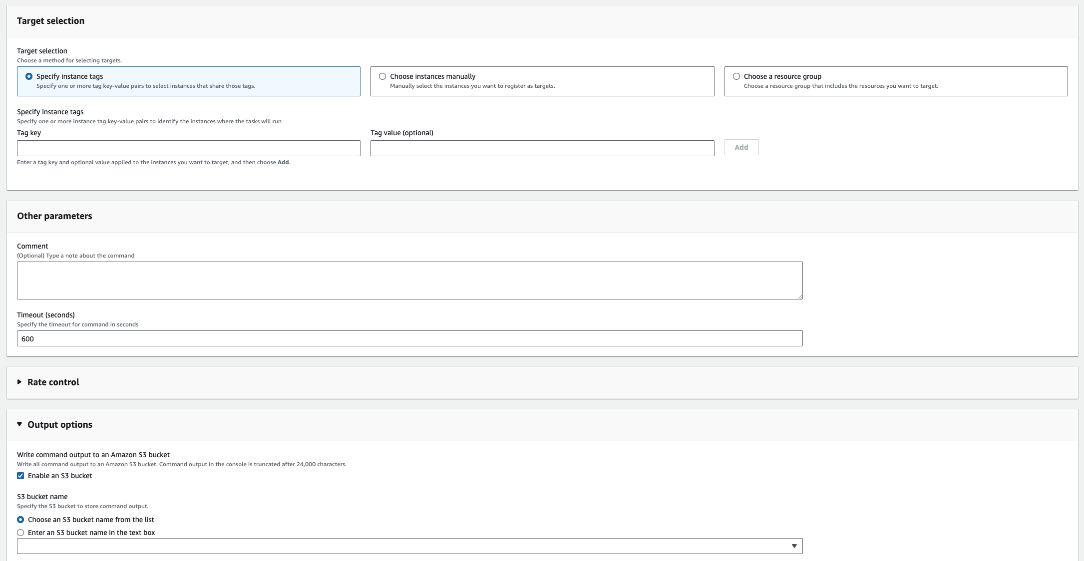
AWS SSM Run Command Interface

Slide 14
AWS Systems Manager Session Manager
AWS Systems Manager provides safe; secure and remote management of your instances at scale without logging into your servers, replacing the need for bastion hosts, SSH, or remote PowerShell.
It provides a simple way of automating common administrative tasks across groups of instances such as registry edits, user management, and software and patch installations.
Session Manager provides a command terminal for Linux instances and Windows PowerShell terminal for Windows instances.
Session Manager not only provides a fully auditable terminal environment, but you can administer access to SSH sessions without having to open any ports, strongly enhancing your security posture.
You can simply enable the least privileged IAM permissions to the Session Manager console and allow your developers to maximize their efficiency and effectiveness.
All actions taken with AWS Systems Manager are recorded by AWS CloudTrail, allowing you to audit changes throughout your environment.
CloudTrail can intercept StartSession events using Session Manager.
Compared to SSH:
Do not need to open port 22.
Do not need bastion hosts for management.
All commands are logged to S3 / CloudWatch.
Secure shell access is authenticated using IAM user accounts, not key pairs.

Slide 15
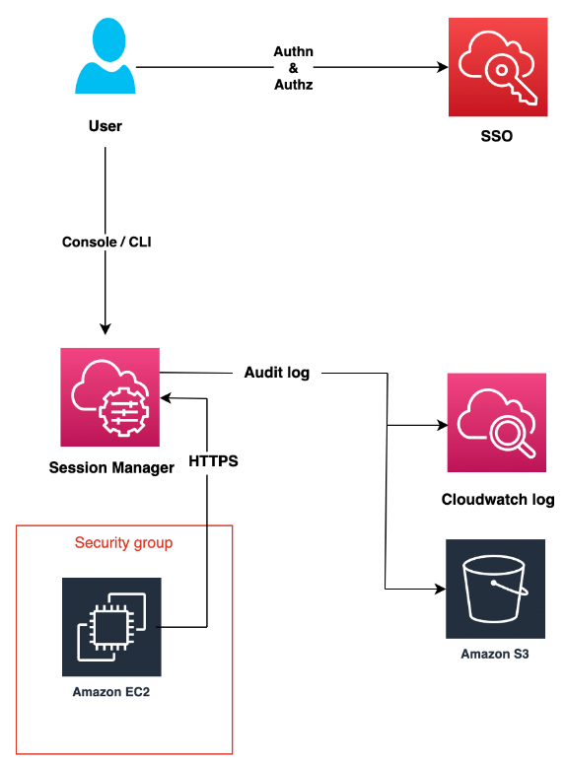
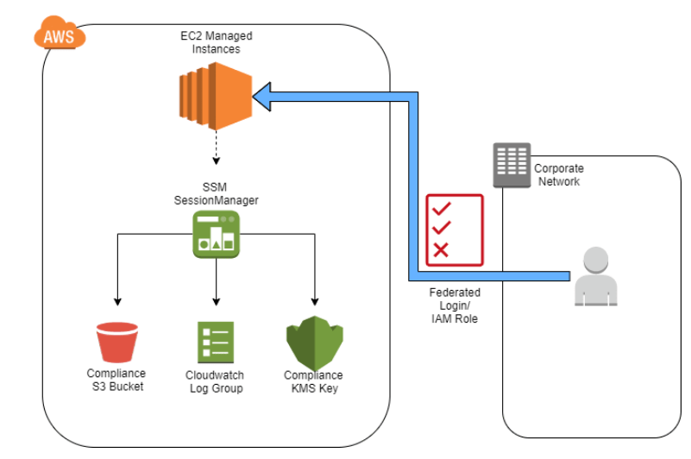
AWS Systems Manager Session Manager diagram

Slide 16
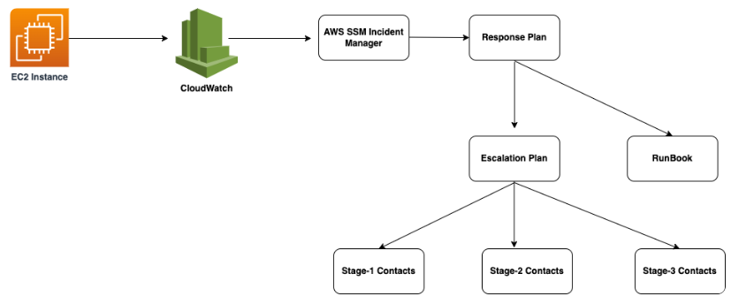
Incident Manager
You can automate solutions in the Incident Manager console to help bring the appropriate internal resources to your attention.
AWS Chatbot links designated chat channels to AWS Incident Manager, and Automation runbooks are executed for AWS Systems Manager using the Incident Manager.
Responders are engaged via SMS and phone calls in predefined response plans.
By suggesting action items based on Amazon’s post-incident analysis template, Incident Manager helps you improve service reliability.
For example, you can automate a runbook step or add a new alarm after an incident.

Slide 17
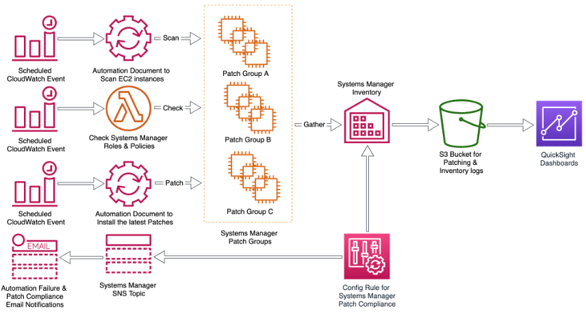
Systems Manager Patch Manager
Patch Manager enables the automated patching your EC2 instances.
It includes security patches, as well as other patches for both your applications and your operating systems.
Patch Manager uses what are known as patch baselines, which involve the definition of rules for auto-approving patches, as well as declined patches.
By scheduling patching as a maintenance window task in Systems Manager, you can easily install patches on a regular basis.
Understanding the state of your servers that are part of your Systems Manager fleet is paramount to enabling a compliant and secure workload of your applications and your servers.

Slide 18
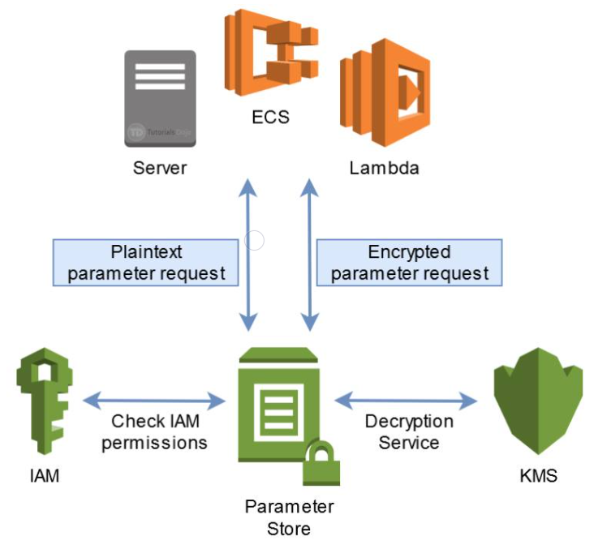
AWS Systems Manager Parameter Store
AWS Systems Manager provides a centralized store to manage your configuration data, whether plain-text data such as database strings or secrets such as passwords.
This allows you to separate your secrets and configuration data from your code.
Parameters can be tagged and organized into hierarchies, helping you manage parameters more easily.
For example, you can use the same parameter name, “db-string”, with a different hierarchical path, “dev/db-string” or “prod/db-string”, to store different values.
AWS Systems Manager is integrated with AWS Key Management Service (KMS), allowing you to automatically encrypt the data you store.

Slide 19
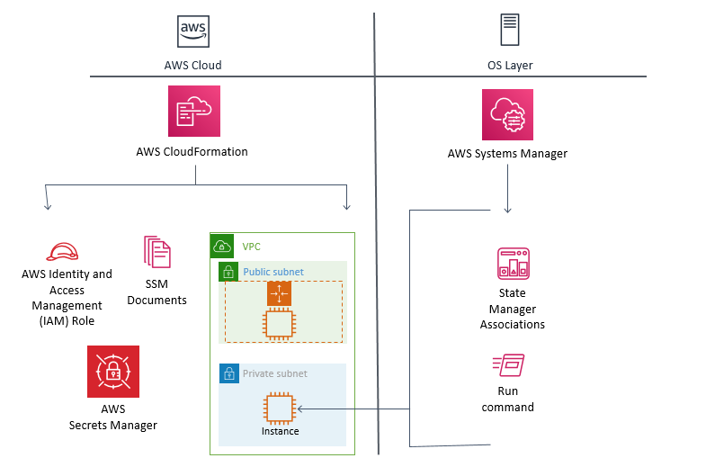
AWS Systems Manager State manager
If you need to manage the state of your AWS EC2 resources, AWS Systems Manager State Manager enables you to maintain your instances in whichever state you like.
There are three steps in using Systems Manager State Manager:
Decide which state to apply to your resources
You may be able to create the desired state for your AWS resources with a pre-configured SSM document – you need to figure this out.
You then create an association between your instance and the state you have defined.
You can query AWS Systems Manager at any time to view the status of your instance configurations, giving you on-demand visibility into your compliance status.
Pattern: Cloudformation to populate resources, State Manager to manage actual state

Slide 20
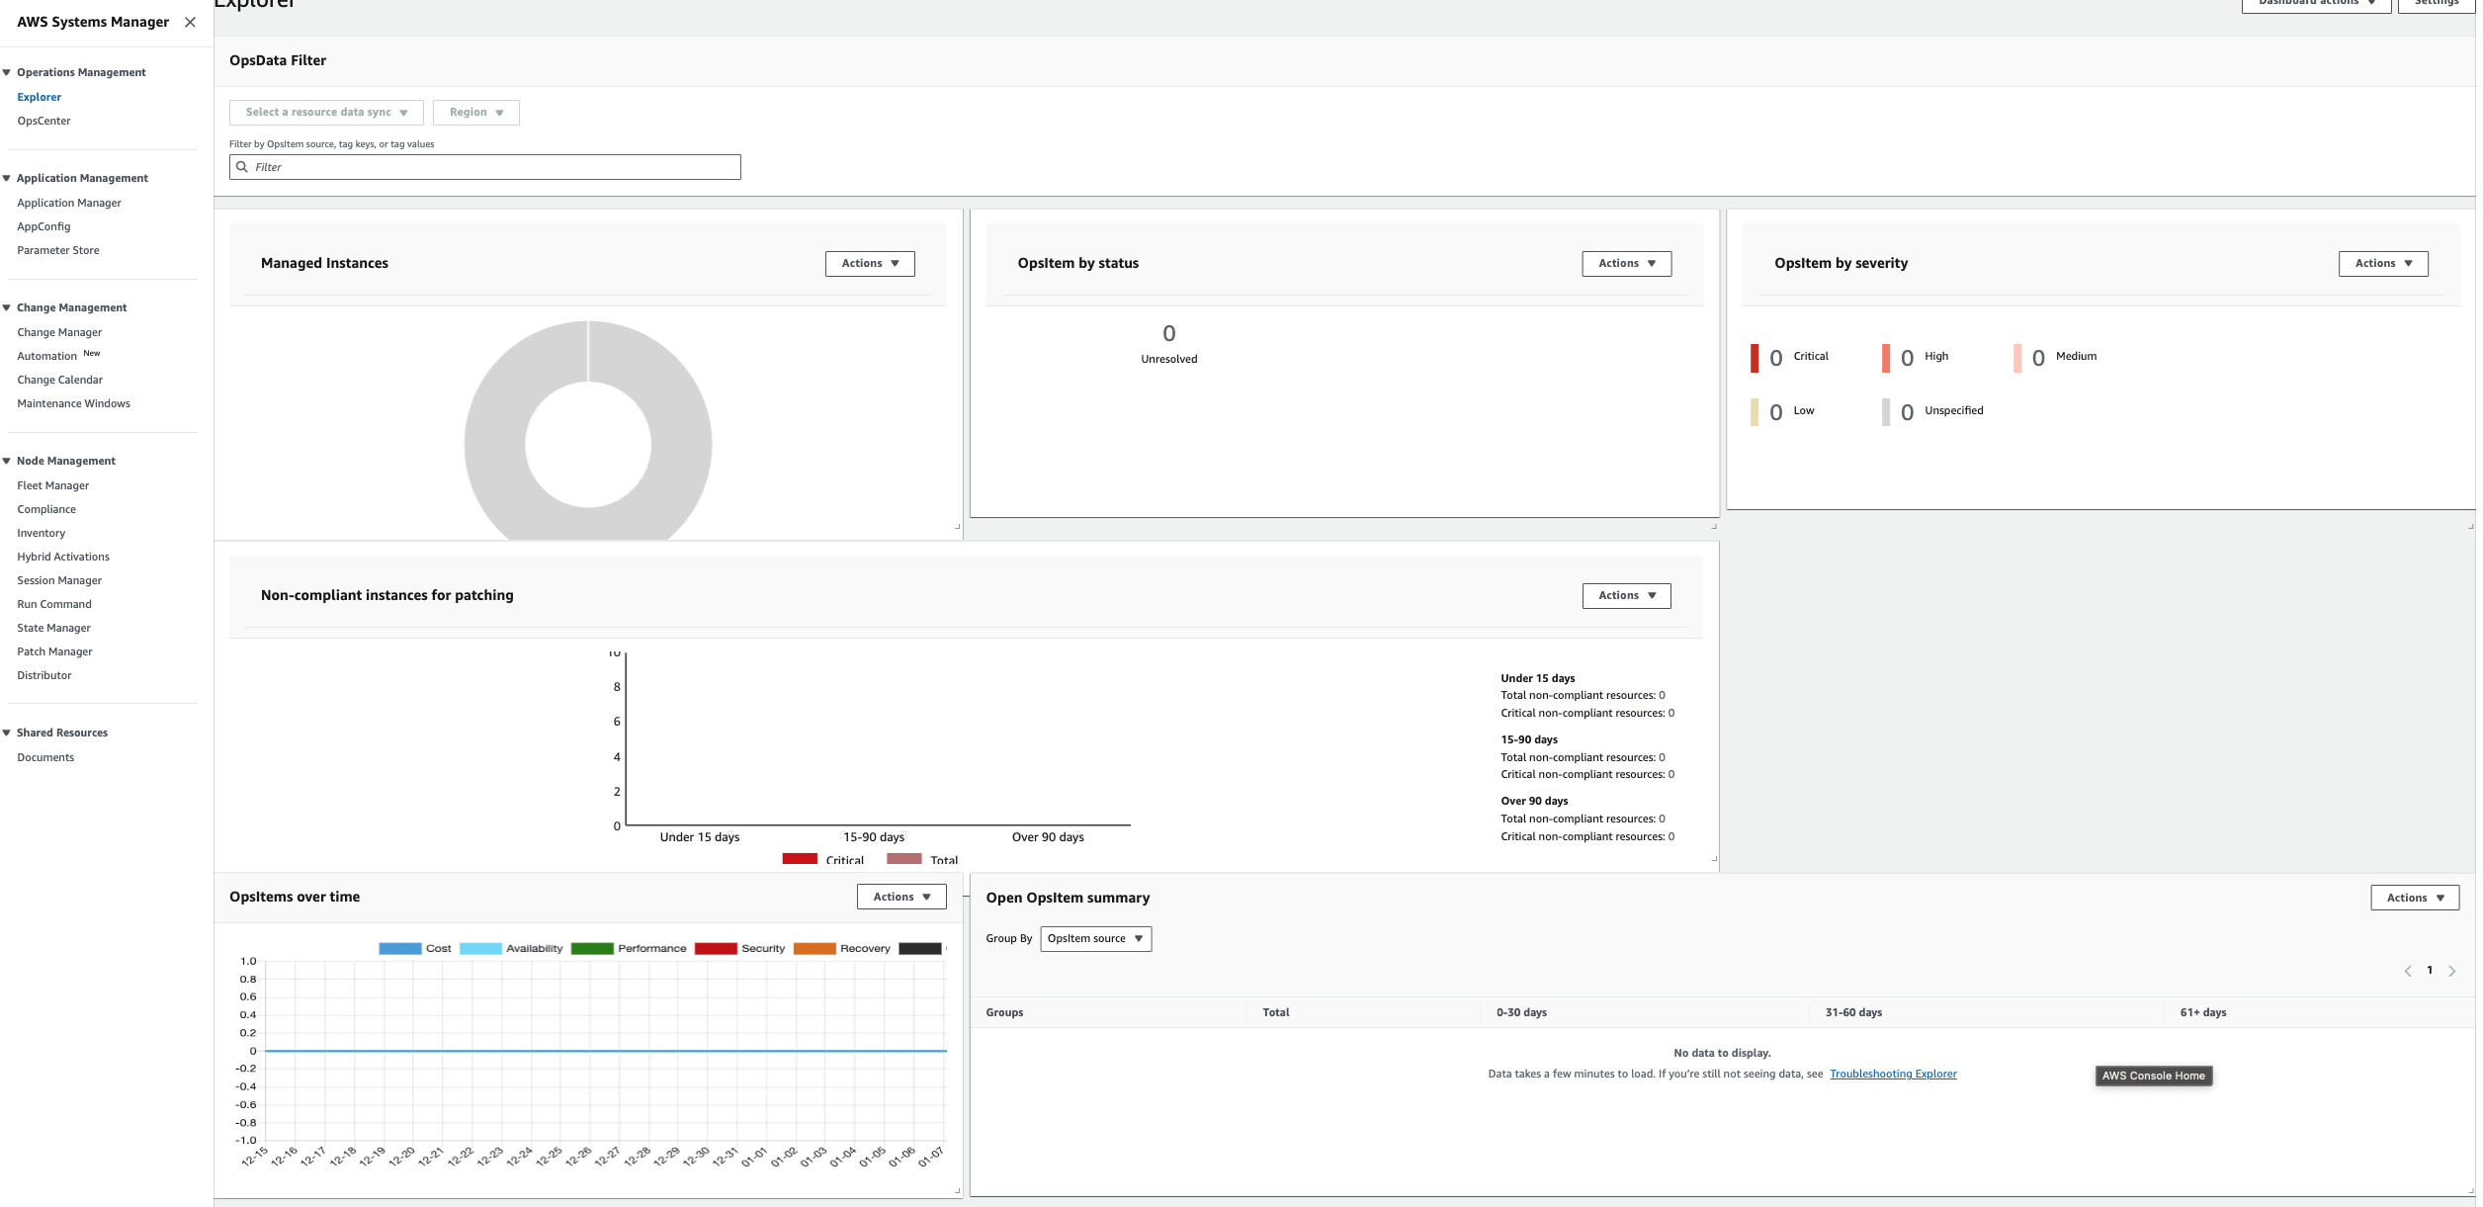
Monitoring and Reporting: Insights Dashboard
Insights Dashboard
AWS Systems Manager automatically aggregates and displays operational data for each resource group through a dashboard.
Systems Manager eliminates the need for you to navigate across multiple AWS consoles to view your operational data.
With Systems Manager you can view API call logs from AWS CloudTrail, resource configuration changes from AWS Config, software inventory, and patch compliance status by resource group.
You can also easily integrate your AWS CloudWatch Dashboards, AWS Trusted Advisor notifications, and AWS Personal Health Dashboard performance and availability alerts into your Systems Manager dashboard.
Systems Manager centralizes all relevant operational data, so you can have a clear view of your infrastructure compliance and performance.

Slide 21
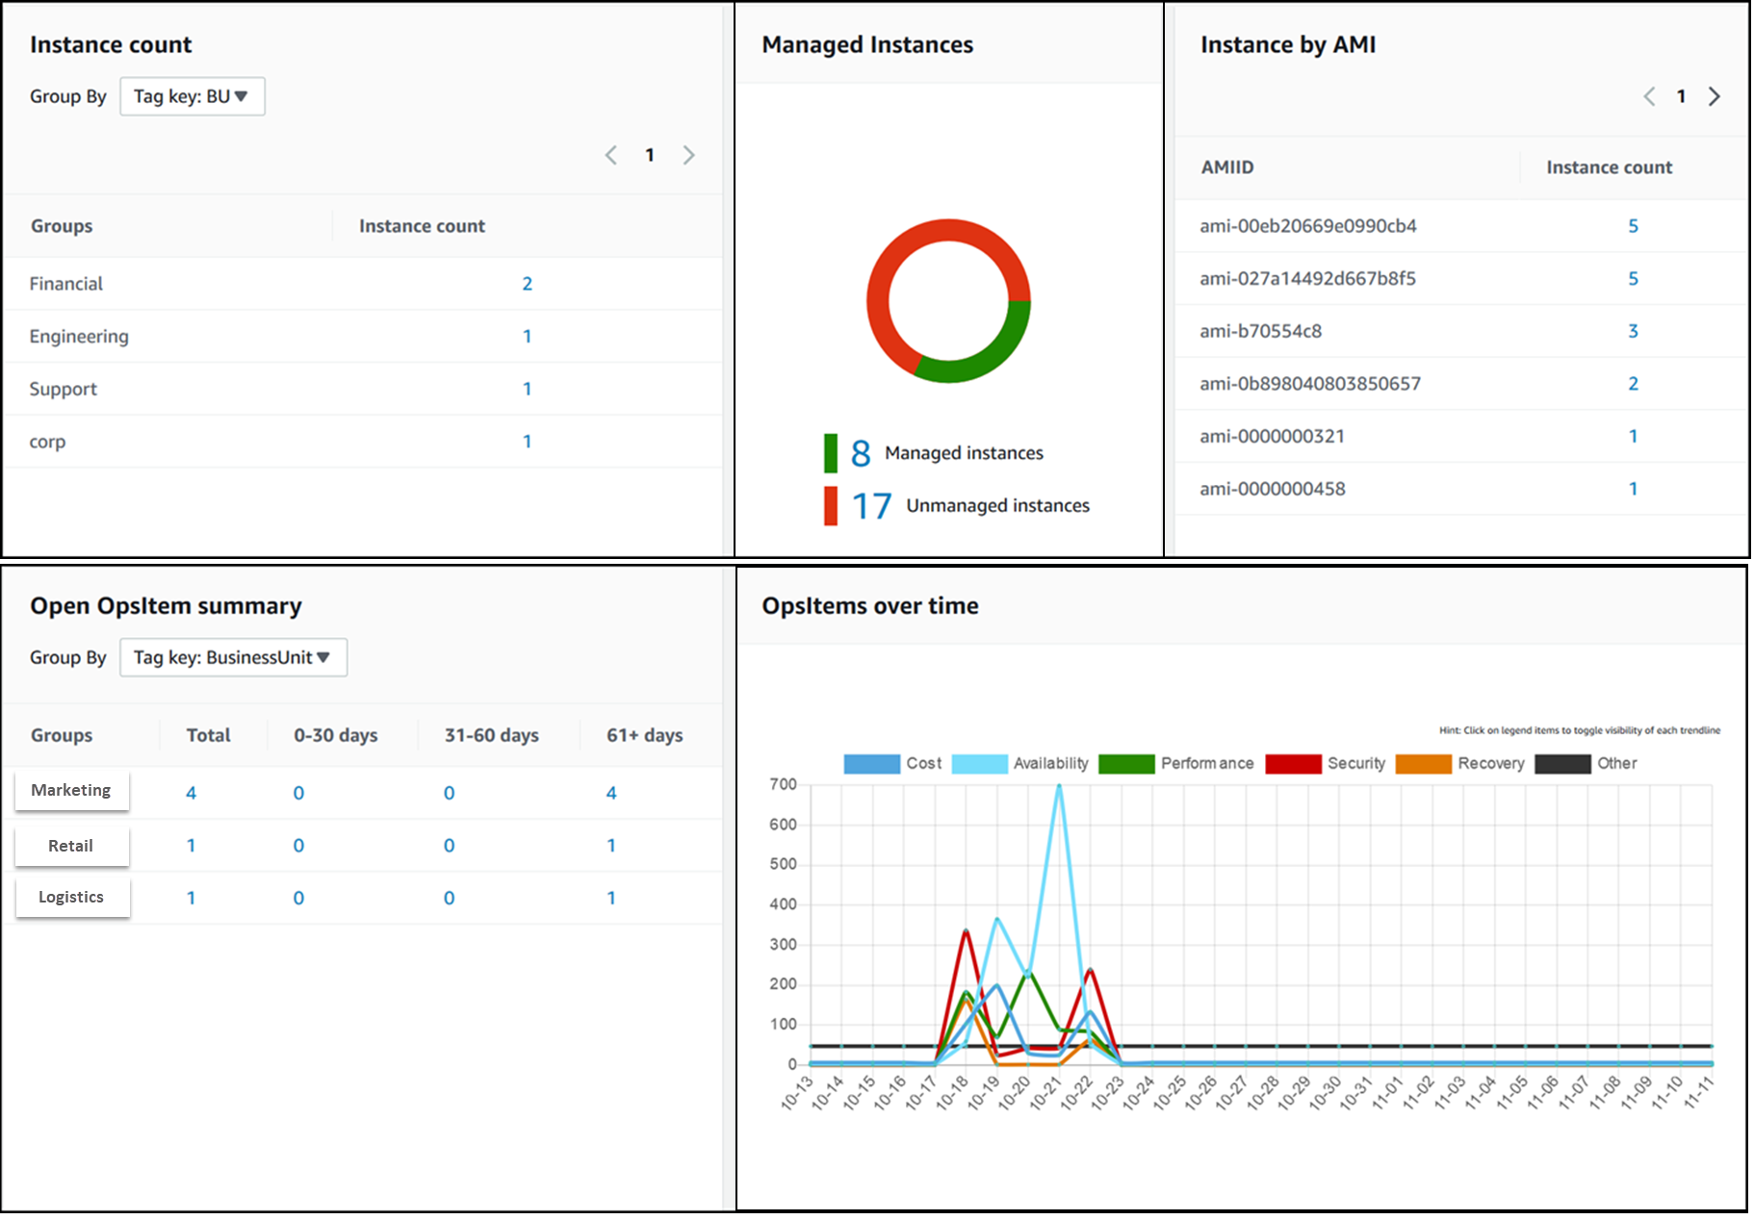
Monitoring and Reporting: Insights Dashboard

Slide 22
Monitoring and Reporting: CloudWatch instead of SSM Agent
Amazon CloudWatch
You can configure and use the Amazon CloudWatch agent to collect metrics and logs from your instances instead of using SSM Agent for these tasks.
The CloudWatch agent enables you to gather more metrics on EC2 instances than are available using SSM Agent.
In addition, you can gather metrics from on-premises servers using the CloudWatch agent.

Slide 23
System Manager: SMM Agent
Agent-Based Management: The SSM Agent is a software application that must be installed and running on EC2 instances (and on-premises servers) to enable management and operations tasks through AWS Systems Manager.
Executing Remote Commands:
It allows Systems Manager to execute management and administrative tasks remotely. Without the agent, AWS has no way to perform operations inside your instances.
Fetching Instance Configuration:
The agent collects and sends configuration information about the instance to Systems Manager, enabling features like Inventory Management.
Applying Patches and Updates:
It facilitates Patch Manager to apply patches for both operating systems and installed software.
Running Automation Workflows:
Enables execution of automation workflows, which are essential for tasks like instance creation, software installation, and other automated tasks.
Managing State with State Manager:
The agent allows State Manager to ensure that your instances maintain a defined state or configuration.
Secure Parameter Store Access:
It can access parameters stored in Systems Manager Parameter Store, allowing secure storage and retrieval of configuration data and secrets.
Pre-installed on Some AMIs: The SSM Agent comes pre-installed on certain Amazon Machine Images (AMIs), like Amazon Linux.
Cross-Platform Compatibility: Available for multiple operating systems including Windows, Linux, and macOS.
Manual Installation: For instances where it's not pre-installed or for on-premises servers, you need to manually install the agent.

Slide 24




System Manager: Logging and Auditing
Systems Manager is integrated with AWS CloudTrail, a service that provides a record of actions taken by a user, role, or an AWS service in Systems Manager.
CloudTrail captures all API calls for Systems Manager as events, including calls from the Systems Manager console and from code calls to the Systems Manager APIs.
SSM Agent writes information about executions, commands, scheduled actions, errors, and health statuses to log files on each instance.
You can view log files by manually connecting to an instance, or you can automatically send logs to Amazon CloudWatch Logs by configuring ssm agent to do this.

Slide 25











