Slide 1
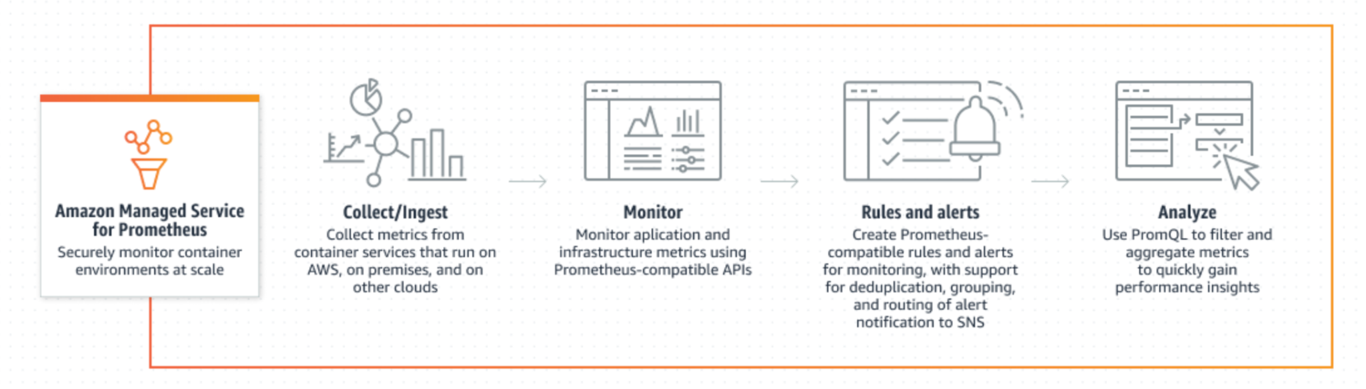
Amazon Managed Service for Prometheus
Amazon Managed Service for Prometheus is a serverless, Prometheus-compatible monitoring service for container metrics that makes it easier to securely monitor container environments at scale.

Slide 2
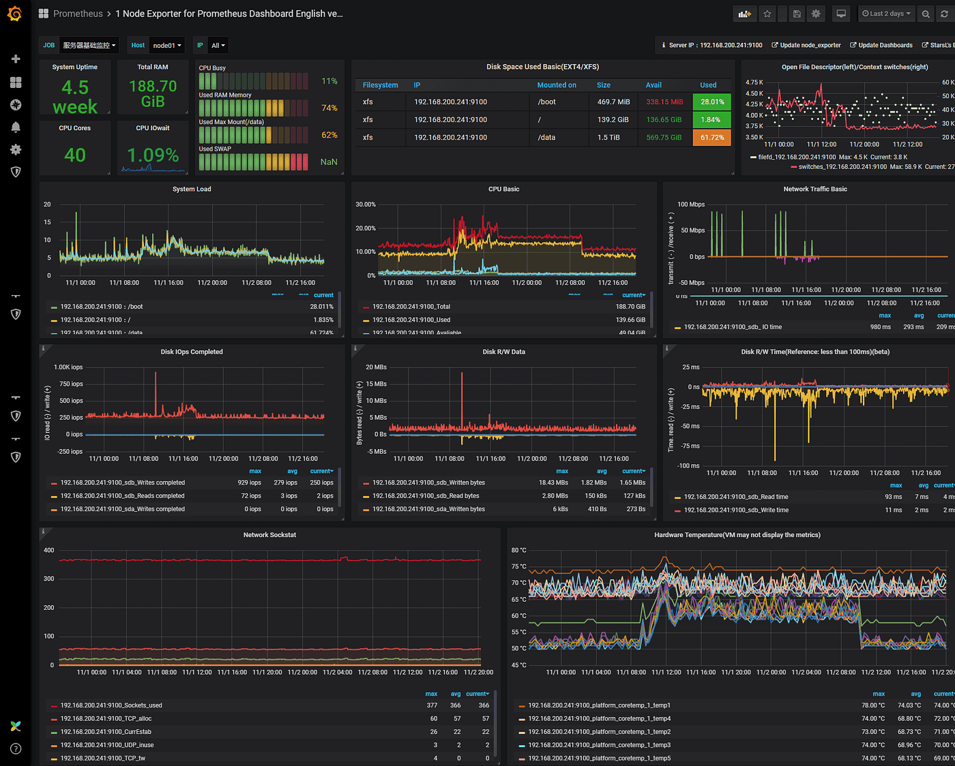
Prometheus monitoring with Grafana

Slide 3
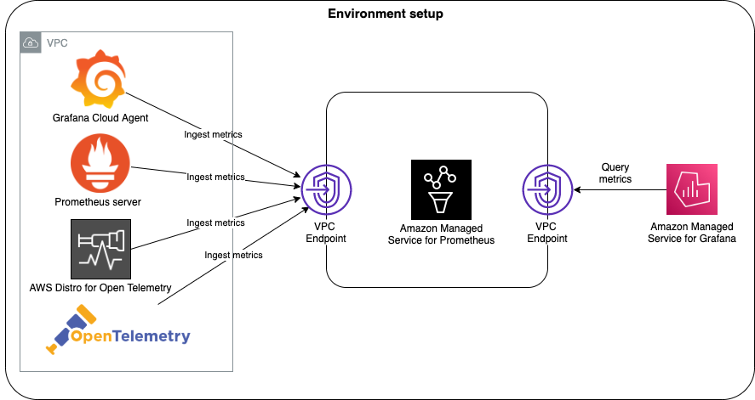
Getting Started with Amazon Managed Service for Prometheus

Slide 4
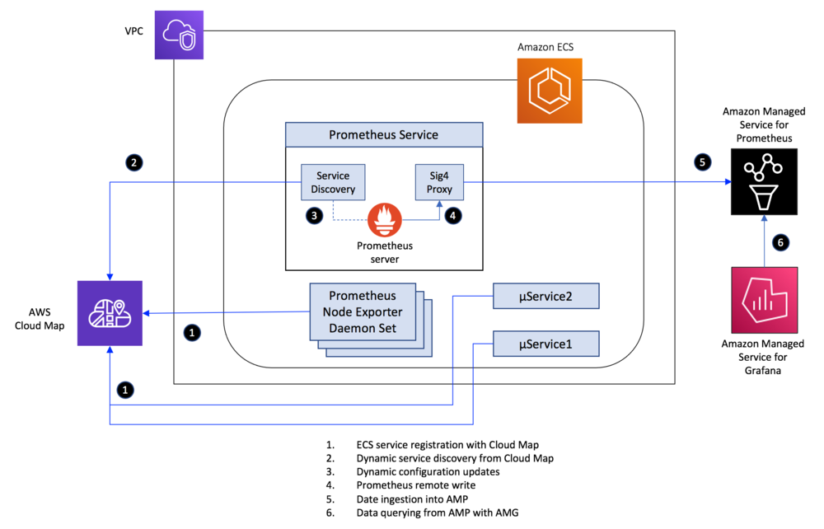
Metrics collection from Amazon ECS using Amazon Managed Service for Prometheus
AWS Cloud Map is a cloud resource discovery service

