Slide 1
AWS Grafana

Slide 2
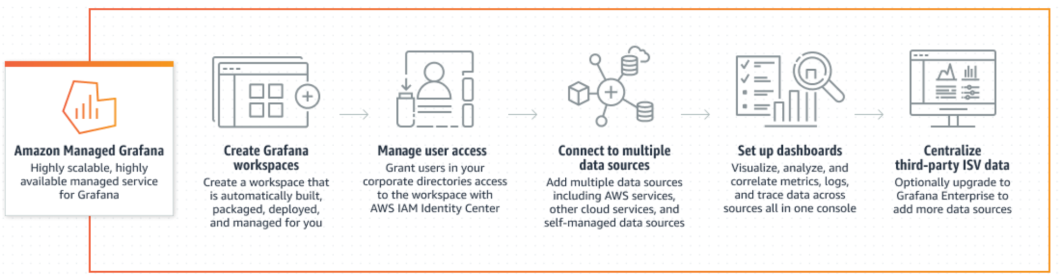
Amazon Managed Grafana
Amazon Managed Grafana is a fully managed service for Grafana, a popular open source analytics platform that lets you query, visualize, and alert on metrics, logs, and traces.
Grafana is a multi-platform open source analytics and interactive visualization web application. It provides charts, graphs, and alerts for the web when connected to supported data sources.

Slide 3
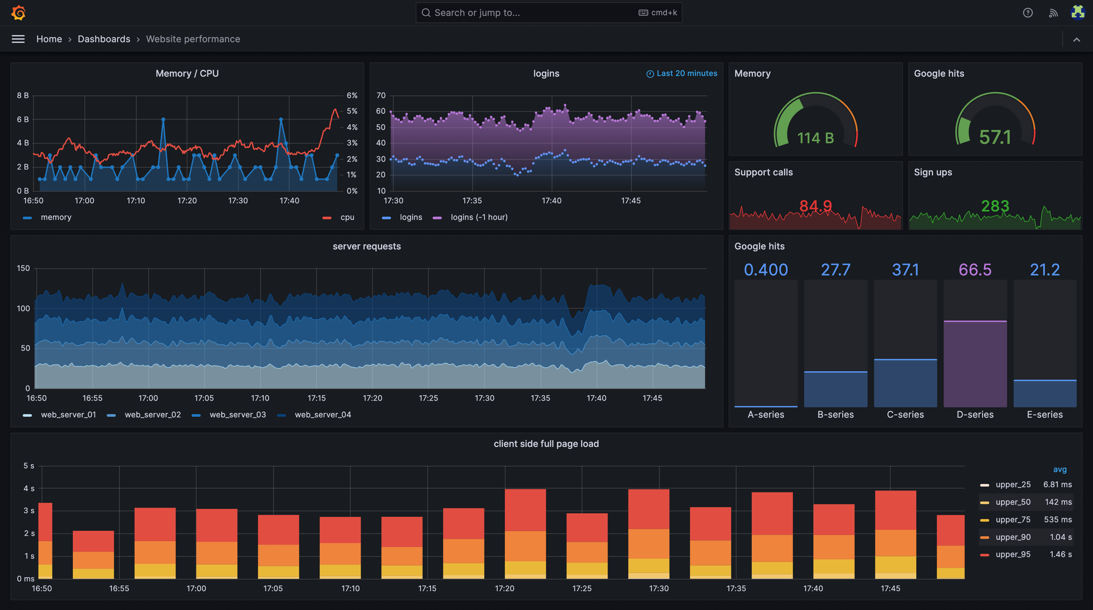
Grafana view example

Slide 4
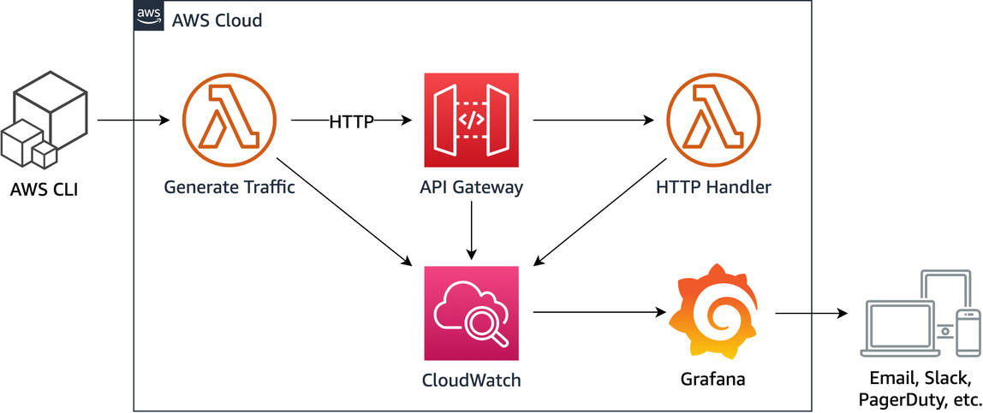
Using Amazon Managed Grafana to troubleshoot a serverless application

