Slide 1

AWS Personal Health Dashboard

Slide 2
AWS Personal Health Dashboard Overview
The AWS Personal Health Dashboard is a service provided by AWS that offers a personalized view of the health of AWS services and the status of AWS resources in your account.
It's designed to give AWS customers insights into service disruptions, scheduled maintenance, and other important events that might affect their AWS infrastructure.
Personalized Notifications:
The dashboard provides alerts and guidance for AWS events like service disruptions or scheduled maintenance activities that might impact your resources.
Automated Alerts:
You can set up automated alerts to be notified via email or through other channels when there are issues that affect your AWS services.
Integration with AWS Services:
It's integrated with other AWS services, such as CloudWatch and AWS Organizations, allowing for a more comprehensive monitoring solution.
Detailed Information:
Provides detailed information and recommendations for remediation when issues are detected, helping in faster resolution.
Service Health Overview:
Alongside personalized information, it also shows the general status of all AWS services in the form of AWS Service Health Dashboard.

Slide 3
Health Dashboard events types
Your account events – This page shows events that are specific to your account. You can view open, recent, and scheduled changes. You can also view notifications and an event log that shows all events from the past 90 days.
Your organization events – This page shows events that are specific to your organization in AWS Organizations. You can view open, recent, and scheduled changes for your organization. You can also view notifications, as well as an event log that shows all organization events from the past 90 days.
If you don't have an AWS account, you can use the AWS Health Dashboard – Service health to learn about general service availability.

Slide 4
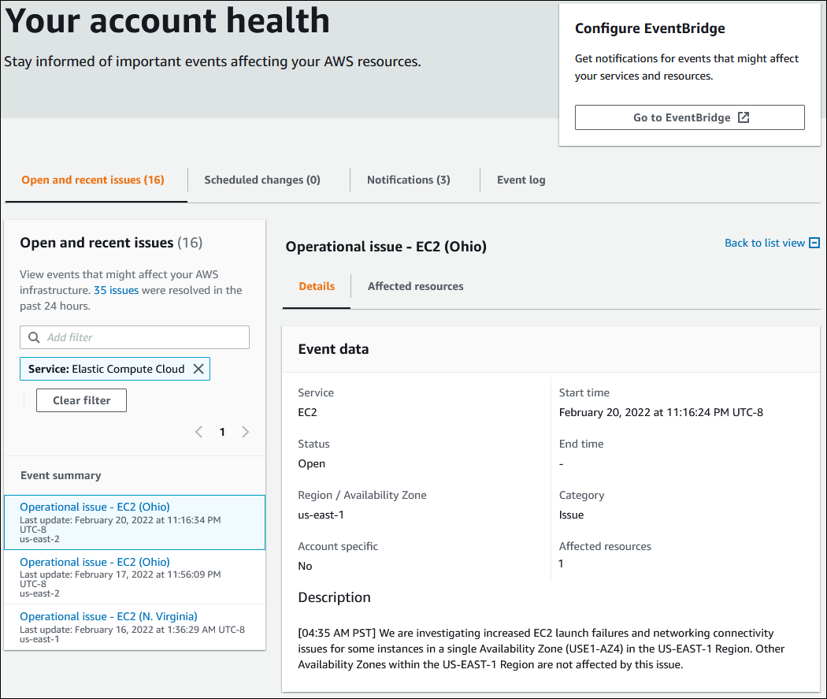
AWS Health Dashboard
Example : Operational issue event for Amazon Elastic Compute Cloud (Amazon EC2)
The following image shows an event for launch failures and connectivity issues for Amazon EC2 instances.
Scheduled changes
Use the Scheduled changes tab to view upcoming events that might affect your account. These events can include scheduled maintenance activities for services and planned lifecycle events that require action to resolve.

Slide 5
AWS Health API
AWS Health is a RESTful web service that uses HTTPS as a transport and JSON as a message serialization format.
Your application code can make requests directly to the AWS Health API
Note: You must have a Business, Enterprise On-Ramp, or Enterprise Support plan from AWS Support to use the AWS Health API.
If you call the AWS Health API from an AWS account that doesn't have a Business, Enterprise On-Ramp, or Enterprise Support plan, you receive a SubscriptionRequiredException error.

Slide 6
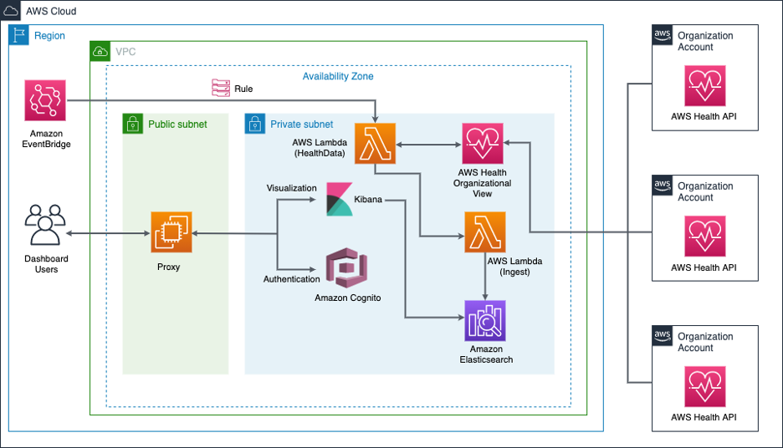
How to aggregate and visualize AWS Health events using AWS Organizations and Amazon Elasticsearch Service
Lambda is used to aggregate the AWS Health events across Organizations and ingest the response JSON to Amazon Elasticsearch Service.
After the data is ingested, you can access it securely using an NGINX proxy and Amazon Cognito authentication for visualization using Kibana.
In this secure architecture, the proxy is in the public subnet and Lambda and Amazon Elasticsearch Service with Kibana are deployed in the private subnet.
The right side of the architecture diagram shows the existing AWS Organizations accounts.
Amazon EventBridge is used to trigger the Lambda function at a fixed interval.

Slide 7
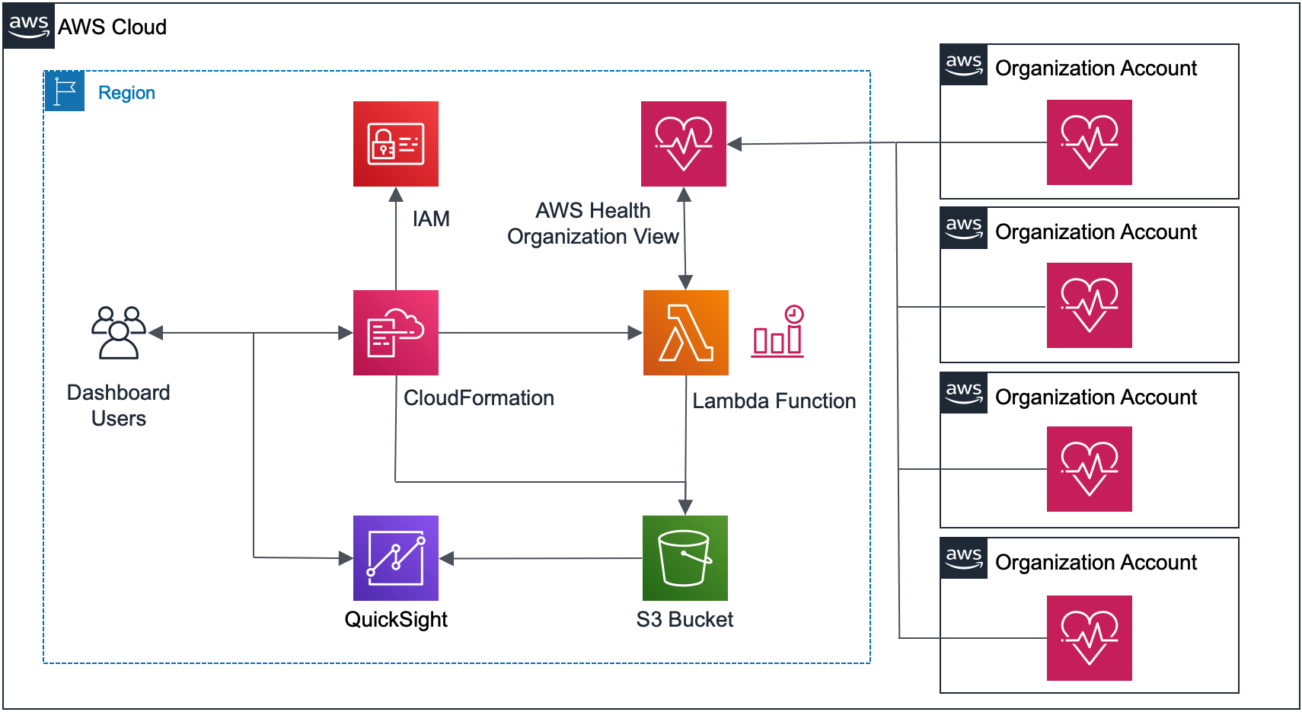
Use AWS Lambda and Amazon QuickSight to Build a Dashboard for AWS Health Events in Organizational View
The dashboard user signs into the AWS master account in your AWS organization as an admin user, and then uses AWS CloudFormation to launch the stack.
The QuickSight dashboard must be created manually.
After the stack has been deployed, the Lambda function regularly queries the AWS Health API endpoint and retrieves health service status for your AWS organization, including service event information and, for account-specific events, impacted accounts and entities.
Service health status data is consolidated into CSV format and stored in a user-specified S3 bucket.
You can access QuickSight to create a dashboard to visualize the service health status data and create reports (for example, for event region distribution).

