Slide 1
AWS CloudWatch

Slide 2
Metric Types
CloudWatch Metrics
Provided by many AWS services
EC2 standard: 5 minutes, detailed monitoring: 1 minute
EC2 RAM is not a built-in metric
Can create custom metrics: standard resolution 1 minute, high resolution 1 sec
CloudWatch Alarms
Can trigger actions: EC2 action (reboot, stop, terminate, recover), Auto Scaling, SNS
Alarm events can be intercepted by Amazon EventBridge
CloudWatch Dashboards
Display metrics and alarms
Can show metrics of multiple regions

Slide 3
AWS CloudWatch Logs - Sources
SDK, CloudWatch Logs Agent, CloudWatch Unified Agent
Elastic Beanstalk: collection of logs from application
ECS: collection from containers
AWS Lambda: collection from function logs
VPC Flow Logs: VPC specific logs
API Gateway
CloudTrail based on filter
CloudWatch log agents: for example on EC2 machines
Route53: Log DNS queries

Slide 4
CloudWatch Logs destinations
Log groups: arbitrary name, usually representing an application
Log stream: instances within application / log files / containers
Can define log expiration policies (never expire, 30 days, etc..)
Optional KMS encryption
CloudWatch Logs can send logs to:
Amazon S3 (exports)
Kinesis Data Streams
Kinesis Data Firehose
AWS Lambda
ElasticSearch

Slide 5
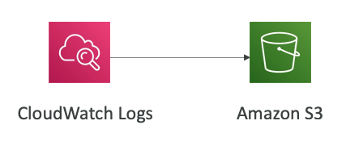
CloudWatch Logs – S3 Export
S3 buckets must be encrypted with AES-256 (SSE-S3) or SSE-KMS
Log data can take up to 12 hours to become available for export
The API call is CreateExportTask
Not near-real time or real-time
For real-time use must Logs Subscriptions instead

Slide 6
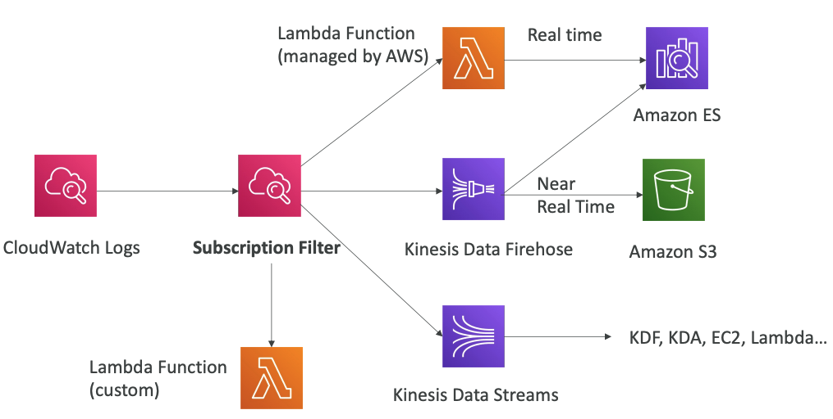
CloudWatch Logs Subscriptions

Slide 7
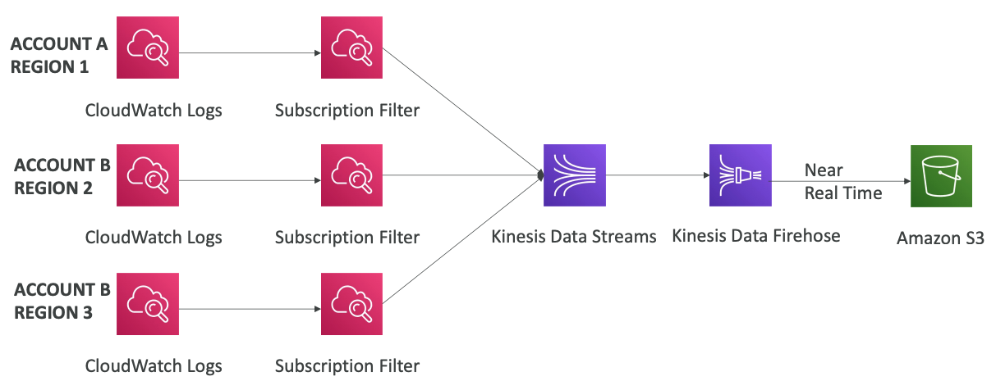
CloudWatch Aggregation Multi Account

Slide 8
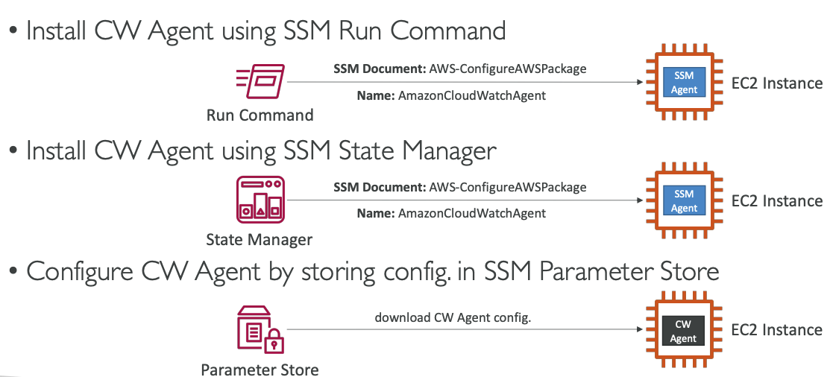
CloudWatch Agent – Integration with SSM

Slide 9
CloudWatch Synthetics Canary
Configurable script that monitor your APIs
Reproduce what your customers do programmatically to find issues before customers are impacted
Checks the availability and latency of your endpoints and can store load time data and screenshots of the UI
Integration with CloudWatch Alarms
Scripts written in Node.js or Python
Programmatic access to a headless Google Chrome browser
Can run once or on a regular schedule

Slide 10
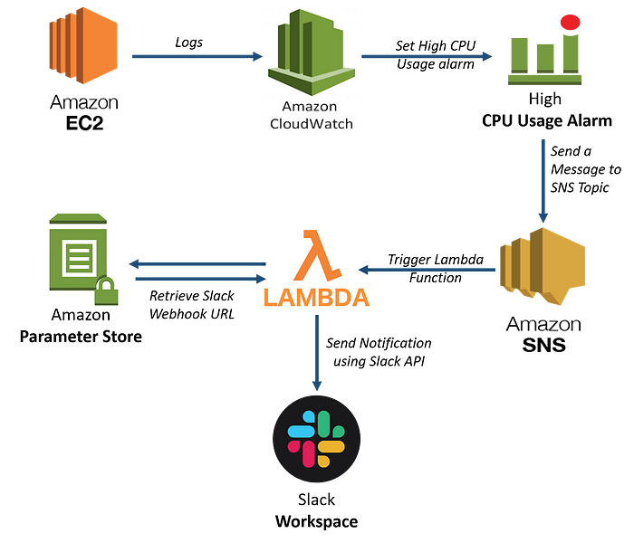
CloudWatch Alarm Slack Notification

Slide 11
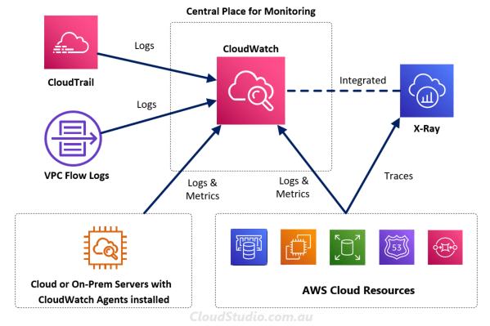
CloudWatch as source of all events

Slide 12
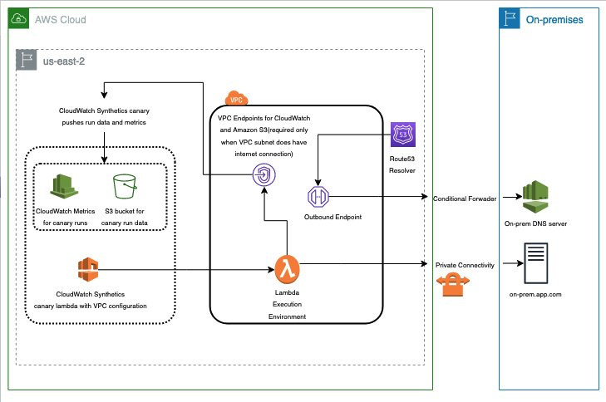
Monitoring the availability and health of on-premises application using AWS CloudWatch Synthetics

