Slide 1
AWS Resource Access Manager
AWS RAM

Slide 2
AWS RAM Intro
AWS Resource Access Manager (AWS RAM) helps you securely share your resources across AWS accounts, within your organization or organizational units (OUs), and with AWS Identity and Access Management (IAM) roles and users for supported resource types.
If you have multiple AWS accounts, you can create a resource once and use AWS RAM to make that resource usable by those other accounts.
If your account is managed by AWS Organizations, you can share resources with all the other accounts in the organization or only those accounts contained by one or more specified organizational units (OUs).
You can also share with specific AWS accounts by account ID, regardless of whether the account is part of an organization.
Reduces your operational overhead – Create a resource once, and then use AWS RAM to share that resource with other accounts.
This eliminates the need to provision duplicate resources in every account, which reduces operational overhead.
Within the account that owns the resource, AWS RAM simplifies granting access to every role and user in that account without having to use identity-based permission policies.
Provides security and consistency – Simplify security management for your shared resources by using a single set of policies and permissions.
If you were to instead create duplicate resources in all your separate accounts, you would have the task of implementing identical policies and permissions, and then have to keep them identical across all those accounts.
Instead, all users of an AWS RAM resource share are managed by a single set of policies and permissions.
AWS RAM offers a consistent experience for sharing different types of AWS resources.
Provides visibility and auditability – View the usage details for your shared resources through the integration of AWS RAM with Amazon CloudWatch and AWS CloudTrail.
AWS RAM provides comprehensive visibility into shared resources and accounts.

Slide 3
List of Services which you can share using AWS RAM
Amazon Virtual Private Cloud (VPC):
Subnets
Traffic Mirror targets
Transit Gateway
Amazon Route 53:
Resolver rules
AWS License Manager:
License configurations
AWS Transit Gateway:
Transit Gateway attachments (including VPC attachments and VPN connections)
AWS Outposts:
Outpost resources
Amazon EC2:
EC2 resource share created for AMI sharing
AWS Resource Groups:
Resource groups
AWS RoboMaker:
Simulation applications
AWS Service Catalog:
Portfolios
AWS App Mesh:
Meshes
Amazon Route 53 Resolver:
Resolver query logging configurations
Amazon S3:
Access points
**AWS CodeBuild
**: - Build project (This capability is region-specific)
AWS Key Management Service (KMS):
Customer managed keys
AWS Network Firewall:
Firewall policies
https://docs.aws.amazon.com/ram/latest/userguide/shareable.html

Slide 4
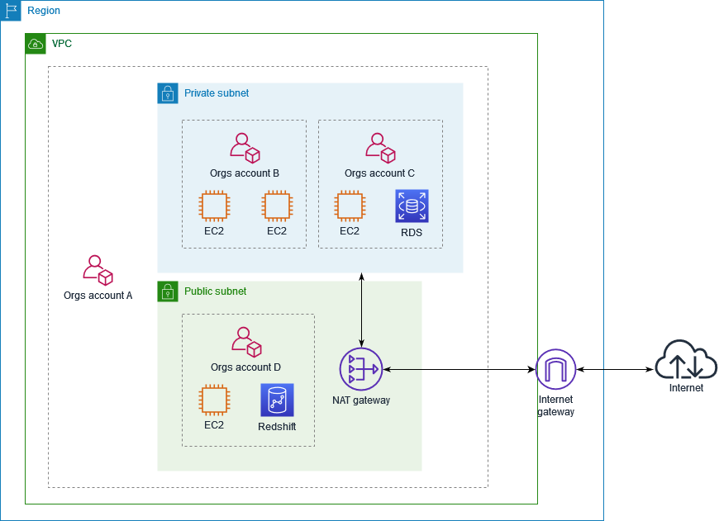
Example of sharing public subnets and private subnets

Slide 5
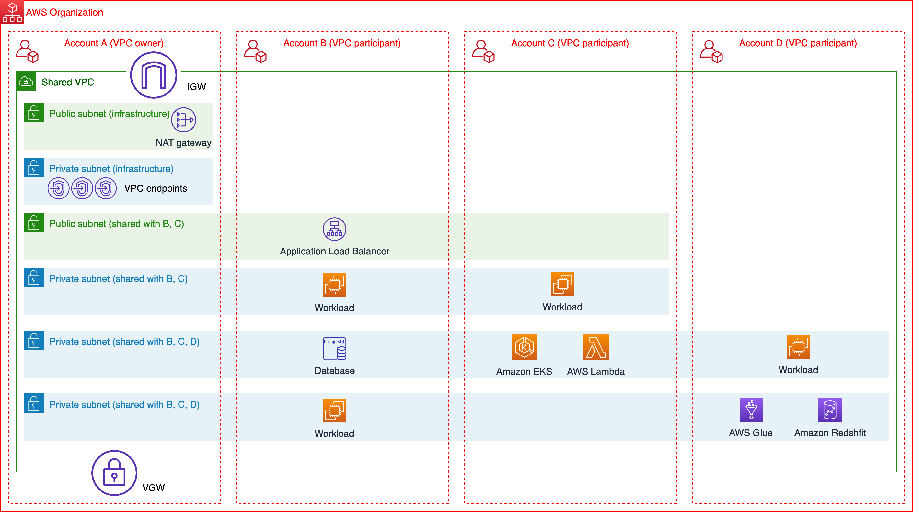
VPC Subnet Sharing

