Slide 1

AWS Trusted Advisor
Reduce costs, improve performance, improve security

Slide 2
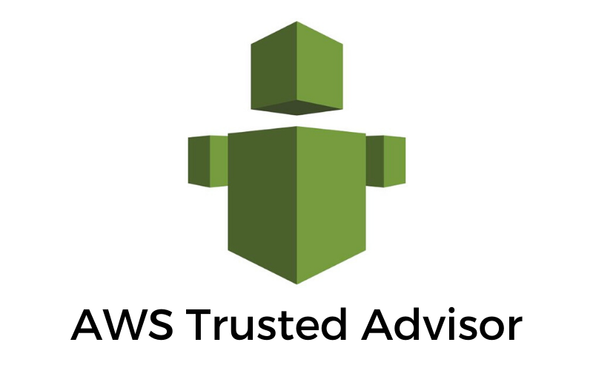
AWS Trusted Advisor
AWS Trusted Advisor provides recommendations that help you follow AWS best practices.
Trusted Advisor evaluates your account by using checks.
These checks identify ways to optimize your AWS infrastructure, improve security and performance, reduce costs, and monitor service quotas.
You can then follow the recommendations to optimize your services and resources.

Slide 3
AWS Trusted Advisor. Who can access what?
AWS Basic Support and AWS Developer Support customers can access core security checks and checks for service quotas.
AWS Business Support and AWS Enterprise Support customers can access all checks, including cost optimization, security, fault tolerance, performance, and service quotas.

Slide 4
AWS Trusted Advisor: Benefits
Cost optimization
Trusted Advisor can help you save cost with actionable recommendations by analyzing usage, configuration and spend.
Examples include identifying idle RDS DB instances, underutilized EBS volumes, unassociated Elastic IP addresses, and excessive timeouts in Lambda functions.
Performance
Trusted Advisor can help improve the performance of your services with actionable recommendations by analyzing usage and configuration.
Examples include analyzing EBS throughput and latency, compute usage of EC2 instances, and configurations on CloudFront.
Security
Trusted Advisor can help improve the security of your AWS environment by suggesting foundational security best practices curated by security experts.
Examples include identifying RDS security group access risk, exposed access keys, and unnecessary S3 bucket permissions.
Fault tolerance
Trusted Advisor can help improve the reliability of your services.
Examples include examining Auto scaling EC2 groups, deleted health checks on Route 53, disabled Availability Zones, and disabled RDS backups.

Slide 5
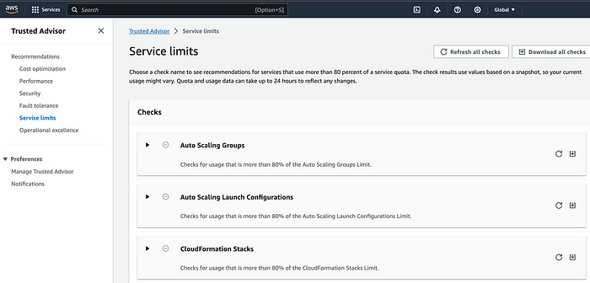
AWS Trusted Advisor: Service Quotas
Service quotas
Service quotas are the maximum number of resources that you can create in an AWS account. AWS implements quotas to provide highly available and reliable service to all customers and protects you from unintentional spend.
Trusted Advisor will notify you once you reach more than 80% of a service quota.
You can then follow recommendations to delete resources or request a quota increase.

Slide 6
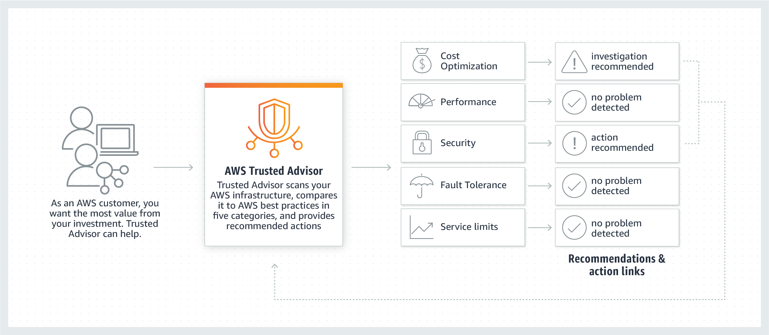
AWS Trusted Advisor: How it works

Slide 7
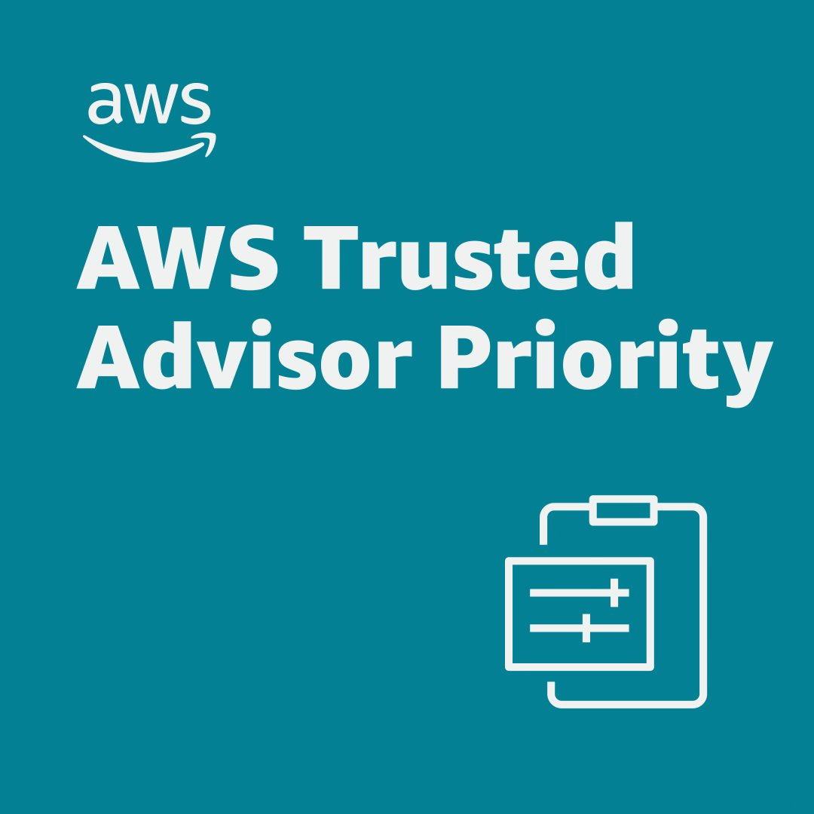
AWS Trusted Advisor Priority
AWS Trusted Advisor Priority helps you focus on the most important recommendations to optimize your cloud deployments, improve resilience, and address security gaps.
Available to AWS Enterprise Support customers, Trusted Advisor Priority provides prioritized and context-driven recommendations that come from your AWS account team as well as machine-generated checks from AWS services.
Customers and their Technical Account Managers (TAMs) can keep track of the recommendation lifecycle and history from the creation of a recommendation to its acceptance, resolution, or rejection.
You can use Trusted Advisor Priority to view and search recommendations for all member accounts in your organization.

Slide 8
AWS Trusted Advisor Priority: Benefits
Prioritized recommendations
Prioritize recommendations across your AWS accounts to help you focus on critical recommendations.
Closed-loop feedback tracking
Track, accept, reject, or resolve recommendations with your AWS account team using a closed-loop collaboration mechanism.
Multi-account views
Aggregate information from your AWS accounts to provide an overall risk posture across your business
Historical views of actions taken
Review at any point in time actions taken across your AWS accounts.

Slide 9
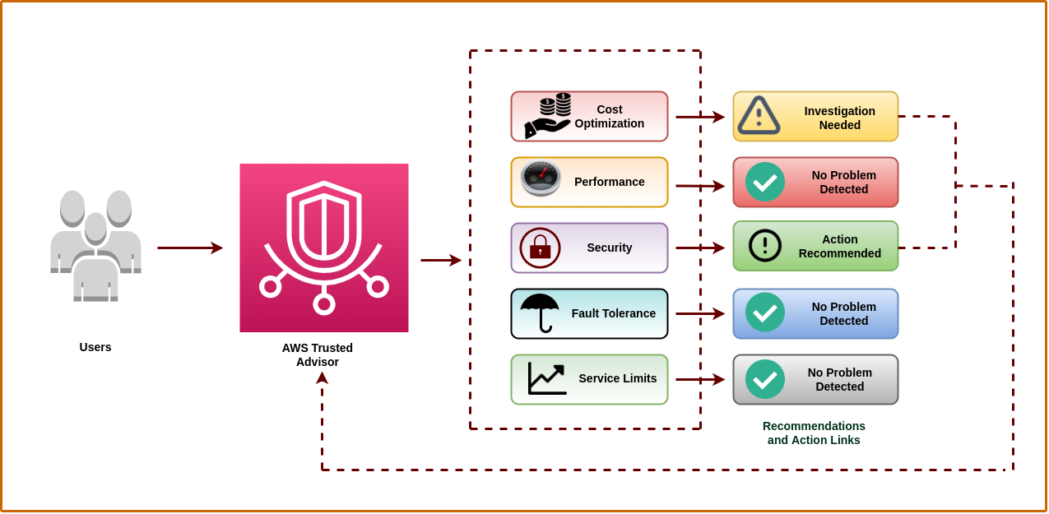
Diagram

Slide 10
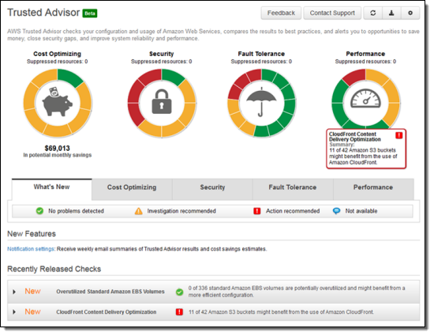
Diagram

