Slide 1
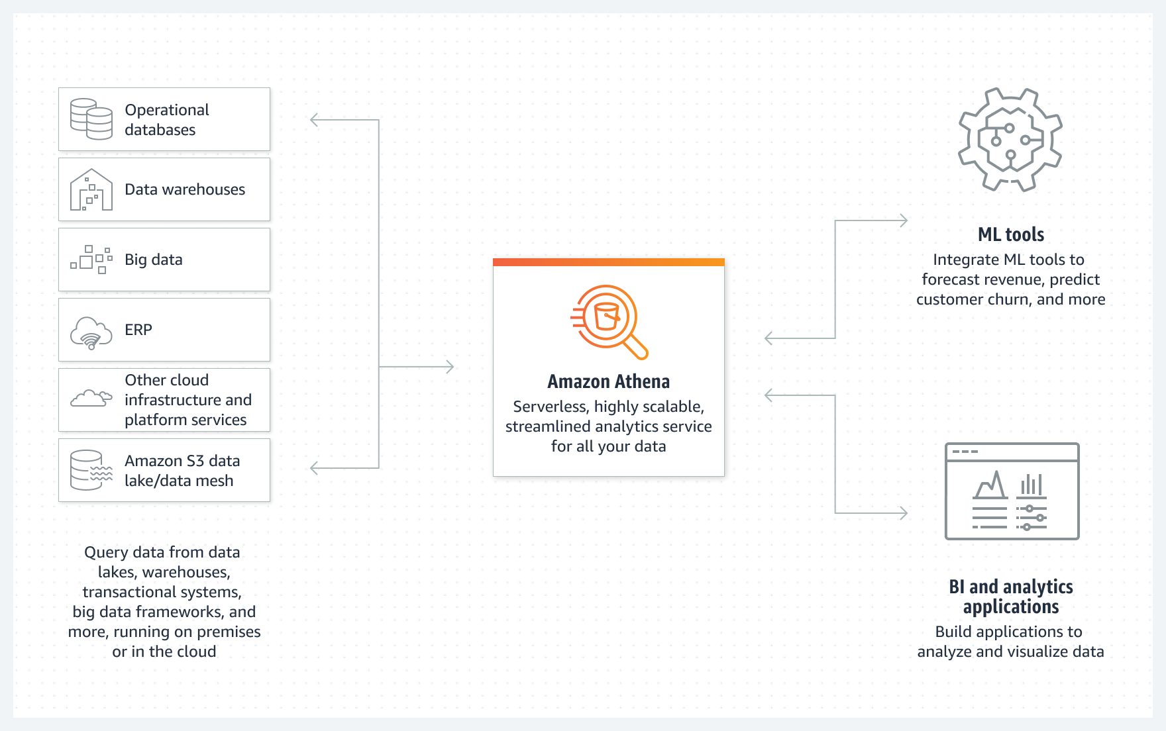
Amazon Athena

Slide 2

What is Athena?
Amazon Athena is a service that enables data analysts to perform interactive queries in the web-based cloud storage service, Amazon Simple Storage Service (S3).
Athena is used with large-scale data sets.

Slide 3
What features does Amazon Athena have?
No server to manage. Analysts do not have to manage the underlying infrastructure. The software automatically handles configuration and software updates.
Easy SQL querying. Athena uses the distributed SQL query engine, Presto, which is optimized for low-latency data analysis.
Integrations. Athena integrates with other Amazon services, including AWS Glue out of the box, which helps integration with other services.
Federated queries. Amazon Athena Federated Query enables Athena to run SQL queries across relational, nonrelational, object and custom data sources.
Security. Athena uses AWS Identity and Access Management (IAM) policies, Amazon S3 bucket policies and access control lists.
Machine learning. Developers can use Amazon SageMaker to create and deploy machine learning models in Amazon Athena.

Slide 4
What are the benefits of Amazon Athena?
Serverless. There is no need to manage any underlying compute infrastructure to use the tool.
SQL-based. Users can run SQL queries using Presto. The query engine is open source and optimized for data analysis.
Organizations only pay for data scanned. Pay only for queries that are run. Query costs are $5 per terabyte scanned.
Speed. Queries are executed in parallel for large data sets, making complex queries fast.
An open architecture. Users are not limited to AWS-specific software, avoiding vendor lock-in.
Flexibility. Users can run multiple queries simultaneously.

Slide 5
What are the limitations of Amazon Athena?
Optimization is limited to queries. For example, data already stored in S3 cannot be optimized.
No indexing options. Indexing options commonly appear in traditional databases. Without indexing, the operation load on Athena increases, potentially affecting performance.
Efficient queries require partitioning. In order to enable efficient queries, data must first be partitioned. Partitions must then be managed for what best fits performance needs.
Stored procedures, parameterized queries and Presto federated connectors are not supported. Amazon Athena Federated Query is needed to connect data sources.
When querying a table with thousands of partitions, Athena can time out.
Source files that start with an underscore or a dot are treated as hidden.
The row and column size cannot exceed 32 megabytes.
Athena does not support querying data in S3 Glacier and S3 Glacier Deep Archive storage classes.

Slide 6
Athena Data Formats
Most importants:
CSV (comma-separated value)
JSON
ORC (Optimized Row Columnar)
Apache Parquet and Apache Avro
Athena also supports compressed data in Snappy, Zlib, LZO (Lempel-Ziv-Oberhumer) and Gzip (GNU Zip) formats.
Other examples of supported data types:
Boolean
TinyIT
SMALLINT
Column
VARCHAR
CHAR
BigInt
WorkGroupConfigurationUpdates
UnprocessedNamedQueryId

Slide 7
Athena Pricing
Pricing is set at $5 for each TB of data scanned. This means you pay only for the queries you run without additional costs. This pricing is not unlike what Google BigQuery charges for compute time.
Queries are rounded up to the nearest MB, with a 10 MB minimum.
Users pay for stored data at regular S3 rates.
Amazon advises users to use compressed data files, have data in columnar formats, and routinely delete old results sets to keep charges low.
Formatting data in open-source file formats like Apache Parquet can speed up queries and reduce query bills.
Users pay only for the amount of data scanned by queries they run. Also, the results that get stored in S3 can incur storage charges.

Slide 8
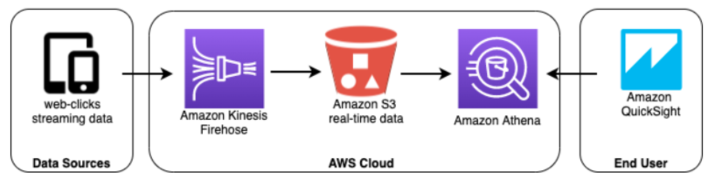
AWS-native architecture for small volumes of click-stream data

