Slide 1
Autoscaling in AWS

Slide 2
Auto Scaling - Supported resources
AWS Auto Scaling supports the use of scaling plans for the following services and resources:
Amazon Aurora – Increase or decrease the number of Aurora read replicas that are provisioned for an Aurora DB cluster.
Amazon EC2 Auto Scaling – Launch or terminate EC2 instances by increasing or decreasing the desired capacity of an Auto Scaling group.
Amazon Elastic Container Service – Increase or decrease the desired task count in Amazon ECS.
Amazon DynamoDB – Increase or decrease the provisioned read and write capacity of a DynamoDB table or a global secondary index.
Spot Fleet – Launch or terminate EC2 instances by increasing or decreasing the target capacity of a Spot Fleet.

Slide 3
Scaling Options
The scaling options define the triggers and when instances should be provisioned/de-provisioned.
There are four scaling options:
Maintain – keep a specific or minimum number of instances running.
Manual – use maximum, minimum, or a specific number of instances.
Scheduled – increase or decrease the number of instances based on a schedule.
Dynamic – scale based on real-time system metrics (e.g. CloudWatch metrics).
Predictive – machine learning to schedule the right number of EC2 instances in anticipation of approaching traffic changes.

Slide 4
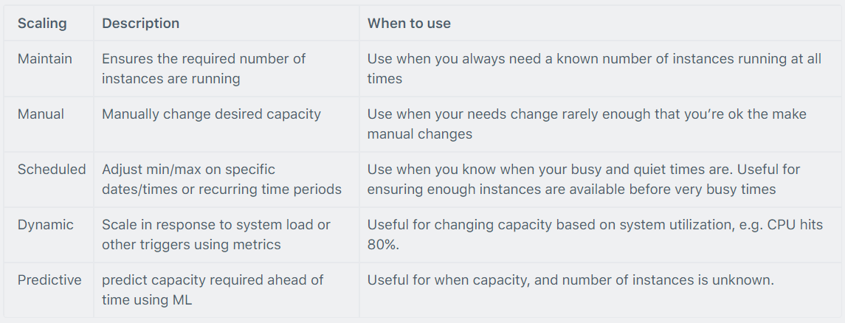
The following table describes the scaling options available and when to use them:

Slide 5
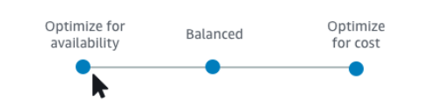
What is a scaling strategy?
The scaling strategy tells AWS Auto Scaling how to optimize the utilization of resources in your scaling plan. You can optimize for availability, for cost, or a balance of both.
Alternatively, you can also create your own custom strategy, per the metrics and thresholds you define. You can set separate strategies for each resource or resource type.

Slide 6
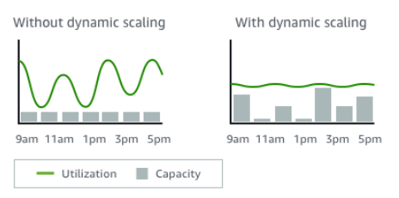
What is dynamic scaling?
Dynamic scaling creates target tracking scaling policies for the resources in your scaling plan. These scaling policies adjust resource capacity in response to live changes in resource utilization. The intention is to provide enough capacity to maintain utilization at the target value specified by the scaling strategy.
Example : This is similar to the way that your thermostat maintains the temperature of your home. You choose the temperature and the thermostat does the rest.
For example, you can configure your scaling plan to keep the number of tasks that your Amazon Elastic Container Service (Amazon ECS) service runs at 75 percent of CPU. When the CPU utilization of your service exceeds 75 percent (meaning that more than 75 percent of the CPU that is reserved for the service is being used), then your scaling policy adds another task to your service to help out with the increased load.

Slide 7
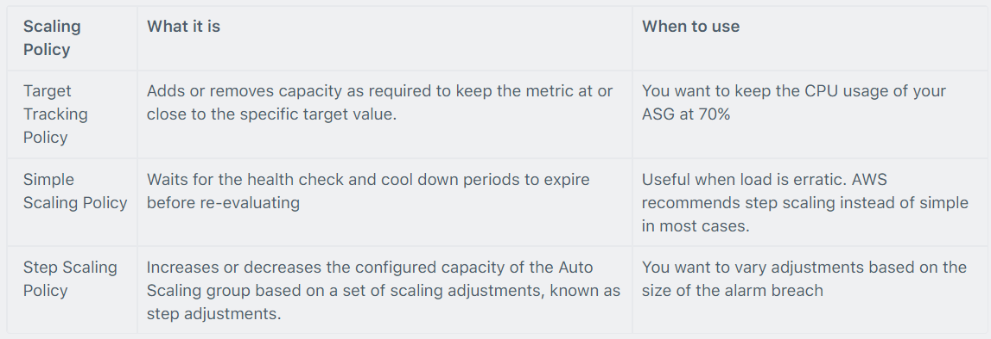
Dynamic scaling policy

Slide 8
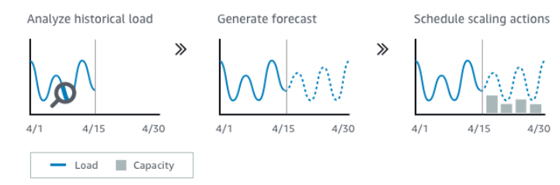
What is predictive scaling?
Predictive scaling uses machine learning to analyze each resource's historical workload and regularly forecasts the future load. This is similar to how weather forecasts work.
Using the forecast, predictive scaling generates scheduled scaling actions to make sure that the resource capacity is available before your application needs it. Like dynamic scaling, predictive scaling works to maintain utilization at the target value specified by the scaling strategy.
For example, you can enable predictive scaling and configure your scaling strategy to keep the average CPU utilization of your Auto Scaling group at 50 percent. Your forecast calls for traffic spikes to occur every day at 8:00. Your scaling plan creates the future scheduled scaling actions to make sure that your Auto Scaling group is ready to handle that traffic ahead of time. This helps keep the application performance constant, with the aim of always having the capacity required to maintain resource utilization as close to 50 percent as possible at all times.

Slide 9
The following are the key concepts for understanding predictive scaling
Load forecasting: AWS Auto Scaling analyzes up to 14 days of history for a specified load metric and forecasts the future demand for the next two days. This data is available in one-hour intervals and is updated daily.
Scheduled scaling actions: AWS Auto Scaling schedules the scaling actions that proactively increases and decreases capacity to match the load forecast. At the scheduled time, AWS Auto Scaling updates the minimum capacity with the value specified by the scheduled scaling action.
The intention is to maintain resource utilization at the target value specified by the scaling strategy. If your application requires more capacity than is forecast, dynamic scaling is available to add additional capacity.
Maximum capacity behavior: Minimum and maximum capacity limits for auto scaling apply to each resource. However, you can control whether your application can increase capacity beyond the maximum capacity when the forecast capacity is higher than the maximum capacity.

Slide 10
What is scheduled scaling?
Scheduled scaling helps you to set up your own scaling schedule according to predictable load changes.
For example, let's say that every week the traffic to your web application starts to increase on Wednesday, remains high on Thursday, and starts to decrease on Friday. You can configure a schedule for Amazon EC2 Auto Scaling to increase capacity on Wednesday and decrease capacity on Friday.
To use scheduled scaling, you create scheduled actions. Scheduled actions are performed automatically as a function of date and time. When you create a scheduled action, you specify when the scaling activity should occur and the new desired, minimum, and maximum sizes for the scaling action. You can create scheduled actions that scale one time only or that scale on a recurring schedule.

Slide 11
Monitoring and Reporting
When Auto Scaling group metrics are enabled the Auto Scaling group sends sampled data to CloudWatch every minute (no charge).
You can enable and disable Auto Scaling group metrics using the AWS Management Console, AWS CLI, or AWS SDKs.
The AWS/AutoScaling namespace includes the following metrics which are sent to CloudWatch every 1 minute:
GroupMinSize
GroupMaxSize
GroupDesiredCapacity
GroupInServiceInstances
GroupPendingInstances
GroupStandbyInstances
GroupTerminatingInstances
GroupTotalInstances
Metrics are also sent from the Amazon EC2 instances to Amazon CloudWatch:
Basic monitoring sends EC2 metrics to CloudWatch about ASG instances every 5 minutes.
Detailed monitoring can be enabled and sends metrics every 1 minute (chargeable).
If the launch configuration is created from the console basic monitoring of EC2 instances is enabled by default.
If the launch configuration is created from the CLI detailed monitoring of EC2 instances is enabled by default.
EC2 Auto Scaling uses health checks to check if instances are healthy and available.

Slide 12
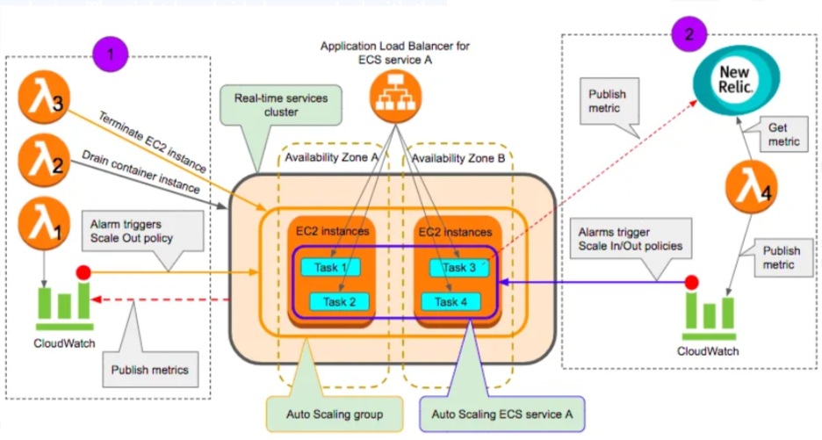
Architecture with services
In diagram below below, the left-hand side box marked with the number (1) shows components constituting an autoscaling workflow for EC2 instances backing a real-time services cluster. The right-hand side box marked with the number (2) shows components constituting an autoscaling workflow for an ECS service.

Slide 13
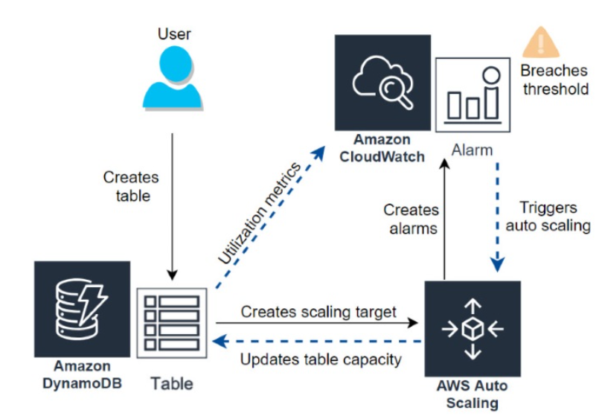
How DynamoDB auto scaling works

Slide 14
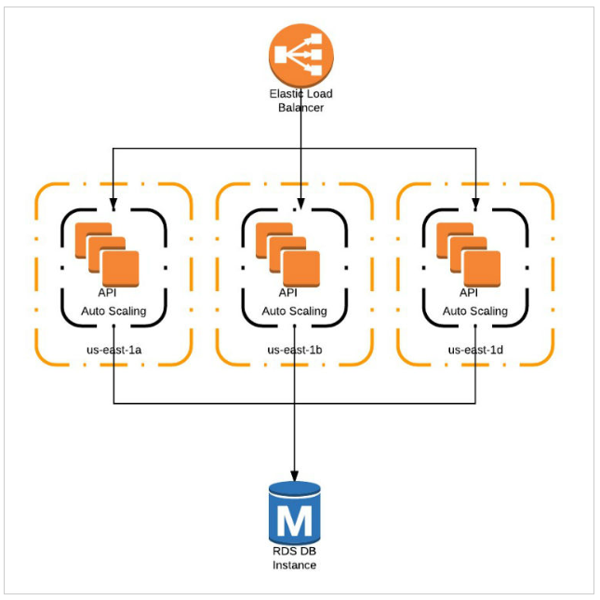
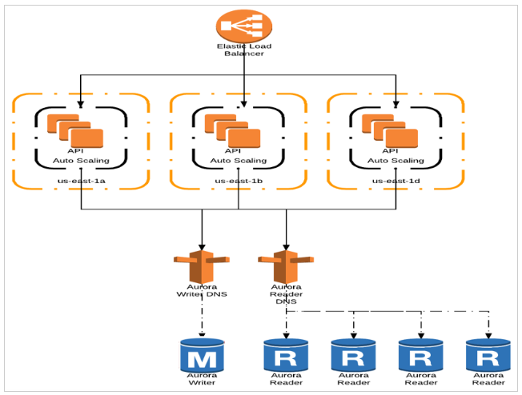
How Aurora auto scaling works
In Aurora, the autoscaling works by creating more number of reader instances in multiple availability zones and when it has to scale down, it deletes the reader instances. This indeed takes some time to spin up so you should configure your autoscaling policy accordingly.

Slide 15
AWS Startup Scaling Serverless vs microservices
Serverless
Lambda
Api Gateway
S3
SQS
SNS
Etc
With serverless you can rebuild instead of refactor
Microservices
Ec2
ECS
EKS
etc

Slide 16
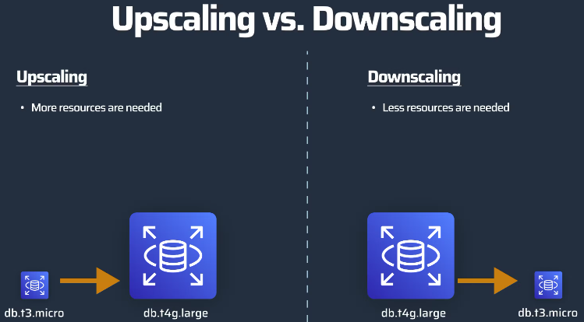
RDS Autoscaling
Upscaling & Downscaling
Upscaling means your database requires more resources like CPU or storage.
Downscaling means that your database needs fewer resources to save costs.

Slide 17
RDS Autoscaling horizontal vs vertical
Horizontal scaling means adding more instances. Instead of having one database instance, you would have two or three for example.
Adding read replicas is one of the most straightforward ways of horizontal scaling. If your application only needs to scale for reading reasons, which is often the case, add a read replica and point all read applications to this database.
Vertical Scaling enhances the current database instance
Vertical scaling refers to scaling the actual hardware. For example more memory, more CPU, or more storage.
Auto Scaling allows you to scale up and down automatically, based on a policy. A policy can be based on a metric like free storage.
A common example is: if there is only 10% free storage → Scale up
You can enable auto-scaling in the RDS properties.

Slide 18
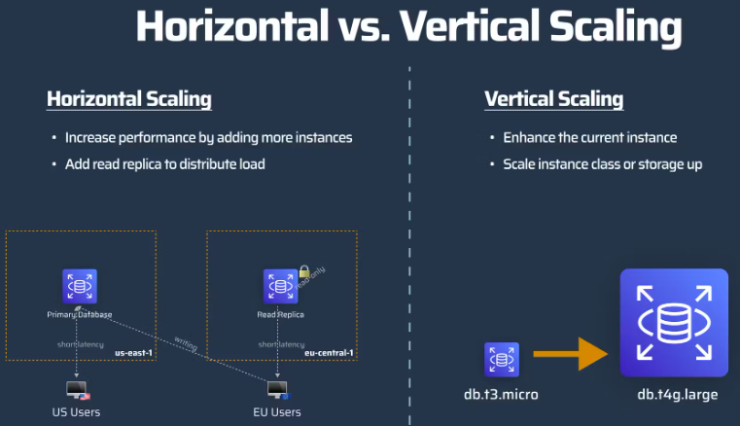
RDS Autoscaling horizontal vs vertical diagram

Slide 19
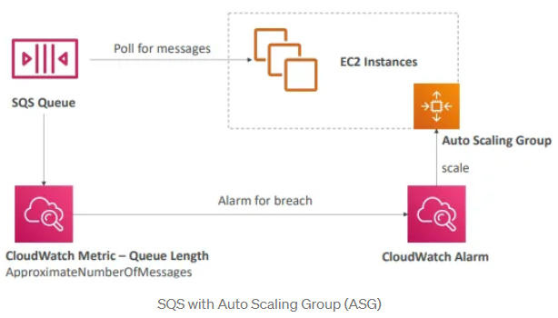
SQS Autoscaling
So we have an SQS queue, and an auto-scaling group and the EC2 instances within the ASG are going to poll for messages from the SQS queue. Now the idea is to scale the auto-scaling groups, automatically based on the queue size.
Therefore we can look at the CloudWatch metric called queue length or the approximate number of messages. which basically represents how many messages are left in the queue. And then you can set the alarm if this metric is over for example 1000, which means there are 1000 messages in the queue waiting to be processed, which means we are lagging on the processing.
Therefore, we are going to create an alarm saying, over 1000 is going to be an alarm, and this alarm is going to trigger a scaling action in your auto-scaling group. Because we don't have enough EC2 instances.
Therefore more EC2 instances are going to be added to your auto-scaling group, which will scale. Therefore, the message will be processed faster. The SQS size will decrease and you will have scaled for it. And this works in both ways.
You can scale up or scale down. So this is the main idea of using an auto-scaling group and SQS queue.

Slide 20
SQS Autoscaling - Use target tracking with the right metric
If you use a target tracking scaling policy based on a custom Amazon SQS queue metric, dynamic scaling can adjust to the demand curve of your application more effectively.
The issue with using a CloudWatch Amazon SQS metric like ApproximateNumberOfMessagesVisible for target tracking is that the number of messages in the queue might not change proportionally to the size of the Auto Scaling group that processes messages from the queue.
That's because the number of messages in your SQS queue does not solely define the number of instances needed. The number of instances in your Auto Scaling group can be driven by multiple factors, including how long it takes to process a message and the acceptable amount of latency (queue delay).

Slide 21
SQS Autoscaling - Use target tracking with the right metric - solution
The solution is to use a backlog per instance metric with the target value being the acceptable backlog per instance to maintain. You can calculate these numbers as follows:
Backlog per instance: To calculate your backlog per instance, start with the ApproximateNumberOfMessages queue attribute to determine the length of the SQS queue (number of messages available for retrieval from the queue). Divide that number by the fleet's running capacity, which for an Auto Scaling group is the number of instances in the InService state, to get the backlog per instance.
Acceptable backlog per instance: To calculate your target value, first determine what your application can accept in terms of latency. Then, take the acceptable latency value and divide it by the average time that an EC2 instance takes to process a message.

Slide 22
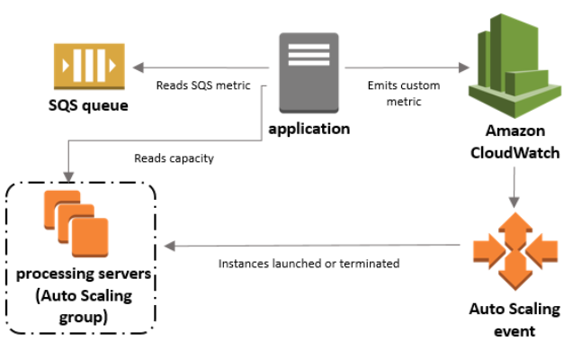
SQS Autoscaling - Use target tracking with the right metric
The following procedures demonstrate how to publish the custom metric and create the target tracking scaling policy that configures your Auto Scaling group to scale based on these calculations.
There are three main parts to this configuration:
An Auto Scaling group to manage EC2 instances for the purposes of processing messages from an SQS queue.
A custom metric to send to Amazon CloudWatch that measures the number of messages in the queue per EC2 instance in the Auto Scaling group.
A target tracking policy that configures your Auto Scaling group to scale based on the custom metric and a set target value. CloudWatch alarms invoke the scaling policy.

Slide 23
Lambda scaling
Concurrency is the number of in-flight requests your AWS Lambda function is handling at the same time. For each concurrent request, Lambda provisions a separate instance of your execution environment.
As your functions receive more requests, Lambda automatically handles scaling the number of execution environments until you reach your account's concurrency limit.
By default, Lambda provides your account with a total concurrency limit of 1,000 across all functions in a region. To support your specific account needs, you can request a quota increase and configure function-level concurrency controls so that your critical functions don't experience throttling.

Slide 24
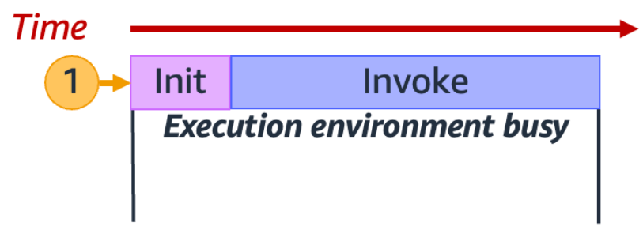
Lambda scaling - Understanding and visualizing concurrency
Lambda invokes your function in a secure and isolated execution environment. To handle a request, Lambda must first initialize an execution environment (the Init phase), before using it to invoke your function (the Invoke phase).
When your function receives its very first request (represented by the yellow circle with label 1), Lambda creates a new execution environment and runs the code outside your main handler during the Init phase.
Then, Lambda runs your function's main handler code during the Invoke phase. During this entire process, this execution environment is busy and cannot process other requests.

Slide 25
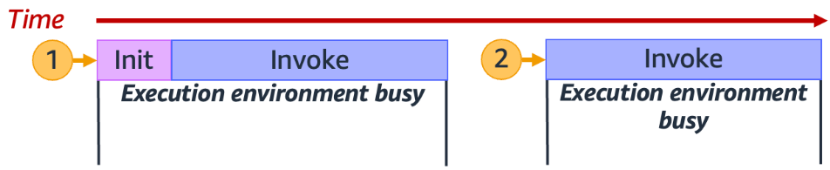
Lambda scaling - Understanding and visualizing concurrency
When Lambda finishes processing the first request, this execution environment can then process additional requests for the same function. For subsequent requests, Lambda doesn't need to re-initialize the environment.
In the diagram, Lambda reuses the execution environment to handle the second request (represented by the yellow circle with label 2).

Slide 26
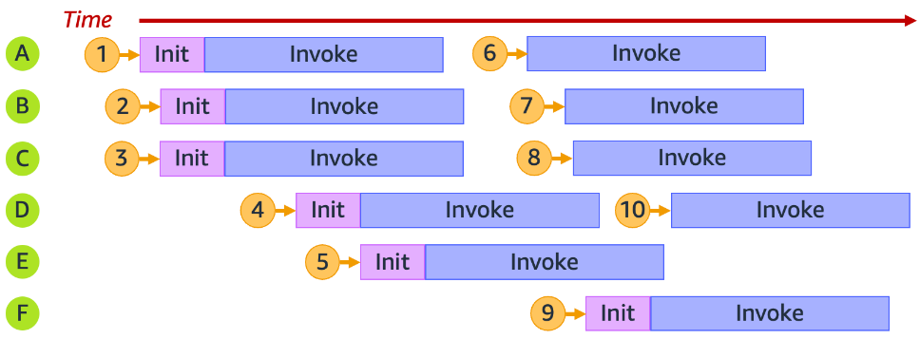
Lambda scaling
In practice, Lambda may need to provision multiple execution environment instances in parallel to handle all incoming requests. When your function receives a new request, one of two things can happen:
If a pre-initialized execution environment instance is available, Lambda uses it to process the request.
Otherwise, Lambda creates a new execution environment instance to process the request.
For example, let's explore what happens when your function receives 10 requests:

Slide 27
How to calculate concurrency
In general, concurrency of a system is the ability to process more than one task simultaneously. In Lambda, concurrency is the number of in-flight requests that your function is handling at the same time.
A quick and practical way of measuring concurrency of a Lambda function is to use the following formula:
Concurrency = (average requests per second) * (average request duration in seconds)

Slide 28
Architecture discuss
We have: ECS, Message Queues and RDS
How will we scale it?

Slide 29
Practise
Create a deployment schema first.
Design a highly available and scalable web application using AWS services.
Define the requirements and architecture of the web application.
Create a VPC with multiple availability zones (AZs) for high availability and fault tolerance.
Create public and private subnets within each AZ.
Create a NAT Gateway in the public subnet for outbound traffic from the private subnets.
Create an Elastic Container Registry (ECR) repository to store the application image.
Push the application image to the ECR repository.
Create an ECS cluster with Fargate launch type to host and run the application.
Create a task definition that references the application image from ECR and sets the minimum and maximum number of tasks to 2 for redundancy and high availability.
Create an Application Load Balancer (ALB) with listeners and target groups that route traffic to the ECS tasks.
Configure a custom 404 page as a default text for the ALB.
Create an ECS service that deploys and manages the application tasks across multiple AZs.
Test the web application and monitor its performance and availability using CloudWatch metrics and alarms.
Advanced:
Configure autoscaling policies for the ECS service to scale up or down based on the demand.
Add a VPC endpoint to allow the ECS instances to download the application image from ECR without using the public internet.

