Slide 1
SAM

Slide 2
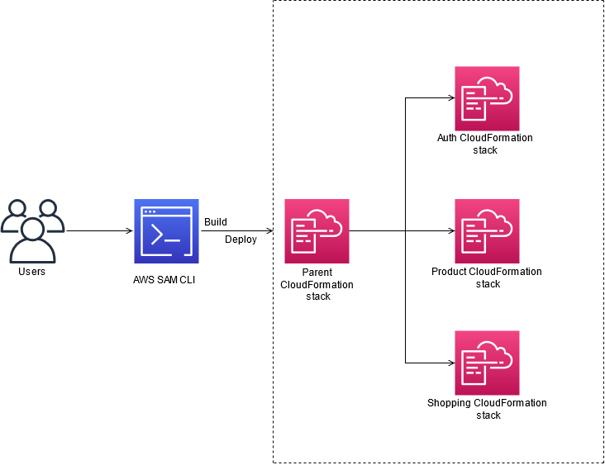
What is the AWS Serverless Application Model?
The AWS Serverless Application Model (AWS SAM) is an open-source framework that you can use to build serverless applications on AWS.
A serverless application is a combination of Lambda functions, event sources, and other resources that work together to perform tasks. Note that a serverless application is more than just a Lambda function—it can include additional resources such as:
APIs
Databases
Event source mappings
You can use AWS SAM to define your serverless applications. AWS SAM consists of the following components:
AWS SAM template specification. You use this specification to define your serverless application. It provides you with a simple and clean syntax to describe the functions, APIs, permissions, configurations, and events that make up a serverless application. You use an AWS SAM template file to operate on a single, deployable, versioned entity that's your serverless application.
AWS SAM command line interface (AWS SAM CLI). You use this tool to build serverless applications that are defined by AWS SAM templates. The CLI provides commands that enable you to verify that AWS SAM template files are written according to the specification, invoke Lambda functions locally, step-through debug Lambda functions, package and deploy serverless applications to the AWS Cloud, and so on.

Slide 3
Benefits of using AWS SAM
Because AWS SAM integrates with other AWS services, creating serverless applications with AWS SAM provides the following benefits:
Single-deployment configuration. AWS SAM makes it easy to organize related components and resources, and operate on a single stack. You can use AWS SAM to share configuration (such as memory and timeouts) between resources, and deploy all related resources together as a single, versioned entity.
Extension of AWS CloudFormation. Because AWS SAM is an extension of AWS CloudFormation, you get the reliable deployment capabilities of AWS CloudFormation. You can define resources by using AWS CloudFormation in your AWS SAM template. Also, you can use the full suite of resources, intrinsic functions, and other template features that are available in AWS CloudFormation.
Built-in best practices. You can use AWS SAM to define and deploy your infrastructure as config. This makes it possible for you to use and enforce best practices such as code reviews. Also, with a few lines of configuration, you can enable safe deployments through CodeDeploy, and can enable tracing by using AWS X-Ray.
Local debugging and testing. The AWS SAM CLI lets you locally build, test, and debug serverless applications that are defined by AWS SAM templates. The CLI provides a Lambda-like execution environment locally. It helps you catch issues upfront by providing parity with the actual Lambda execution environment. To step through and debug your code to understand what the code is doing, you can use AWS SAM with AWS toolkits like the AWS Toolkit for JetBrains, AWS Toolkit for PyCharm, AWS Toolkit for IntelliJ, and AWS Toolkit for Visual Studio Code. This tightens the feedback loop by making it possible for you to find and troubleshoot issues that you might run into in the cloud.
Deep integration with development tools. You can use AWS SAM with a suite of AWS tools for building serverless applications. You can discover new applications in the AWS Serverless Application Repository. For authoring, testing, and debugging AWS SAM–based serverless applications, you can use the AWS Cloud9 IDE. To build a deployment pipeline for your serverless applications, you can use CodeBuild, CodeDeploy, and CodePipeline. You can also use AWS CodeStar to get started with a project structure, code repository, and a CI/CD pipeline that's automatically configured for you. To deploy your serverless application, you can use the Jenkins plugin.

Slide 4
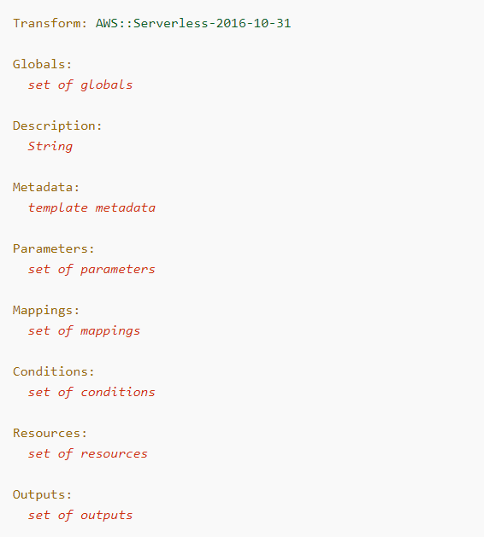
AWS SAM template anatomy
An AWS SAM template file closely follows the format of an AWS CloudFormation template file, which is described in Template anatomy in the AWS CloudFormation User Guide. The primary differences between AWS SAM template files and AWS CloudFormation template files are the following:
Transform declaration. The declaration Transform: AWS::Serverless-2016-10-31 is required for AWS SAM template files. This declaration identifies an AWS CloudFormation template file as an AWS SAM template file. For more information about transforms, see Transform in the AWS CloudFormation User Guide.
Globals section. The Globals section is unique to AWS SAM. It defines properties that are common to all your serverless functions and APIs. All the AWS::Serverless::Function, AWS::Serverless::Api, and AWS::Serverless::SimpleTable resources inherit the properties that are defined in the Globals section. For more information about this section, see Globals section of the AWS SAM template.
Resources section. In AWS SAM templates the Resources section can contain a combination of AWS CloudFormation resources and AWS SAM resources. For more information about AWS CloudFormation resources, see AWS resource and property types reference in the AWS CloudFormation User Guide. For more information about AWS SAM resources, see AWS SAM resource and property reference.
Parameters section. Objects that are declared in the Parameters section cause the sam deploy --guided command to present additional prompts to the user. For examples of declared objects and the corresponding prompts, see sam deploy in the AWS SAM CLI command reference.

Slide 5
Template sections
AWS SAM templates can include several major sections. Only the Transform and Resources sections are required.
You can include template sections in any order. However, as you build your template, it can be helpful to use the logical order that's shown in the following list. This is because the values in one section might refer to values from a previous section.
Transform (required)
For AWS SAM templates, you must include this section with a value of AWS::Serverless-2016-10-31.
Additional transforms are optional. For more information about transforms, see Transform in the AWS CloudFormation User Guide.
Globals (optional)
Properties that are common to all your serverless functions, APIs, and simple tables.
This section is unique to AWS SAM. There isn't a corresponding section in AWS CloudFormation templates.
Description (optional)
A text string that describes the template.
This section corresponds directly with the Description section of AWS CloudFormation templates.
Metadata (optional)
Objects that provide additional information about the template.
This section corresponds directly with the Metadata section of AWS CloudFormation templates.

Slide 6
Template sections
Parameters (optional)
Values to pass to your template at runtime (when you create or update a stack). You can refer to parameters from the Resources and Outputs sections of the template.
Values that are passed in using the --parameter-overrides parameter of the sam deploy command—and entries in the configuration file—take precendence over entries in the AWS SAM template file. For more information about the sam deploy command, see sam deploy in the AWS SAM CLI command reference. For more information about the configuration file, see AWS SAM CLI configuration file.
Mappings (optional)
A mapping of keys and associated values that you can use to specify conditional parameter values, similar to a lookup table. You can match a key to a corresponding value by using the Fn::FindInMap intrinsic function in the Resources and Outputs sections.
This section corresponds directly with the Mappings section of AWS CloudFormation templates.
Conditions (optional)
Conditions that control whether certain resources are created or whether certain resource properties are assigned a value during stack creation or update. For example, you could conditionally create a resource that depends on whether the stack is for a production or test environment.
This section corresponds directly with the Conditions section of AWS CloudFormation templates.
Resources (required)
The stack resources and their properties, such as an Amazon Elastic Compute Cloud (Amazon EC2) instance or an Amazon Simple Storage Service (Amazon S3) bucket. You can refer to resources in the Resources and Outputs sections of the template.
This section is similar to the Resources section of AWS CloudFormation templates. In AWS SAM templates, this section can contain AWS SAM resources in addition to AWS CloudFormation resources.
Outputs (optional)
The values that are returned whenever you view your stack's properties. For example, you can declare an output for an S3 bucket name, and then call the aws cloudformation describe-stacks AWS Command Line Interface (AWS CLI) command to view the name.
This section corresponds directly with the Outputs section of AWS CloudFormation templates.

Slide 7
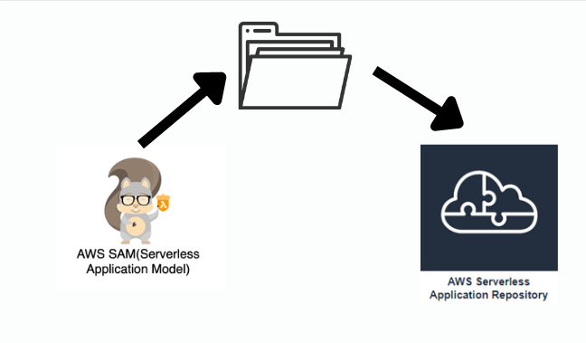
Publishing serverless applications using the AWS SAM CLI
To make your AWS SAM application available for others to find and deploy, you can use the AWS SAM CLI to publish it to the AWS Serverless Application Repository.
To publish your application using the AWS SAM CLI, you must define it using an AWS SAM template. You also must have tested it locally or in the AWS Cloud.
Follow the instructions in this topic to create a new application, create a new version of an existing application, or update the metadata of an existing application. (What you do depends on whether the application already exists in the AWS Serverless Application Repository, and whether any application metadata is changing.).

Slide 8
SAM Importants
An open-source framework for building serverless applications
During deployment, SAM transforms and expands the SAM syntax into AWS CloudFormation syntax. Any resource that you can declare in an AWS CloudFormation template you can also declare in an AWS SAM template.
Overview of Syntax
AWS::Serverless::Api
This resource type describes an API Gateway resource. It’s useful for advanced use cases where you want full control and flexibility when you configure your APIs.
AWS::Serverless::Application
This resource type embeds a serverless application from the AWS Serverless Application Repository or from an Amazon S3 bucket as a nested application. Nested applications are deployed as nested stacks, which can contain multiple other resources.
AWS::Serverless::Function
This resource type describes configuration information for creating a Lambda function. You can describe any event source that you want to attach to the Lambda function—such as Amazon S3, Amazon DynamoDB Streams, and Amazon Kinesis Data Streams.
AWS::Serverless::LayerVersion
This resource type creates a Lambda layer version that contains library or runtime code needed by a Lambda function. When a serverless layer version is transformed, AWS SAM also transforms the logical ID of the resource so that old layer versions are not automatically deleted by AWS CloudFormation when the resource is updated.
AWS::Serverless::SimpleTable
This resource type provides simple syntax for describing how to create DynamoDB tables.

Slide 9
SAM Importants CLI Commands
sam init
The command generates a preconfigured AWS SAM template and example application code in the language that you choose.
sam validate
Verifies whether a Cloud Formation template is valid.
sam build
sam build command to prepare your serverless application for local testing or deploying to the AWS Cloud. This command creates a .aws-sam directory that structures your application in a format and location that sam local and sam deploy require.
sam deploy
Use this command to deploy your serverless application to the AWS Cloud. It creates the AWS resources and sets permissions and other configurations that are defined in the AWS SAM template.
sam package
Use this command to bundle your application code and dependencies into a “deployment package” that’s needed in order to upload to the AWS Cloud.
sam publish
Publish an AWS SAM application to the AWS Serverless Application Repository to share them publicly with the community or privately within your team or across your organization.
sam local generate-event
Generates sample payloads from different event sources, such as Amazon S3, Amazon API Gateway, and Amazon SNS. This payload can be used to test the lambda function locally or on AWS cloud environment.
sam local invoke
Invokes a local Lambda function once and quits after invocation completes. Useful for quick development and testing.
sam local start-api
Run your serverless application locally, easy for quick development and testing. This command creates a local HTTP server that hosts all of your functions.
sam local start-lambda
This command starts a Lambda function locally as a local endpoint that serves AWS Lambda. start-api command starts all functions in the the directory, this command starts just specified function.
sam logs
Use this command to fetch logs generated by your Lambda function to help with testing and debugging your application after you’ve deployed it to the AWS Cloud.

