Slide 1
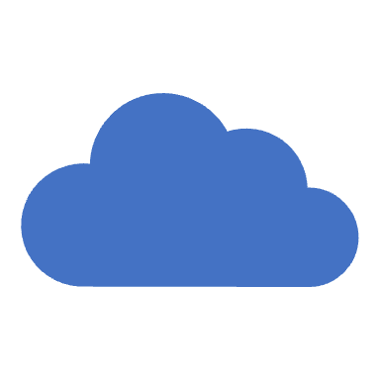
VMware Cloud on AWS
The Fastest, Safest Path for all your VMware Workloads

Slide 2
What is VMware?
VMware is a virtualization and cloud computing software provider.
Enterprise grade Virtualization
With VMware server virtualization, a hypervisor is installed on the physical server to allow for multiple virtual machines (VMs) to run on the same physical server.
Each VM can run its own operating system (OS), which means multiple OSes can run on one physical server.

Slide 3
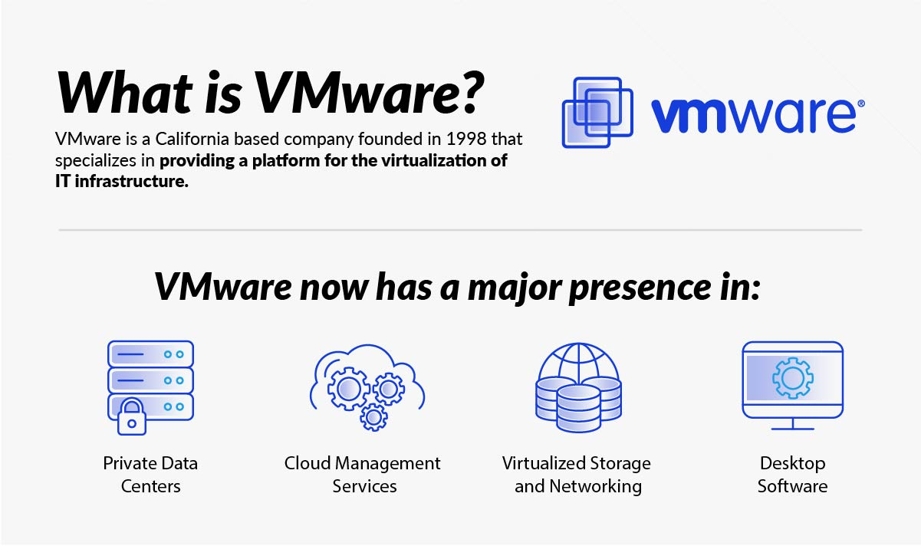
What is VMware?

Slide 4
Benefits of VMware
security based on a zero-trust model, along with better security than container systems like Kubernetes;
better provisioning of applications and resources;
simplified data center management
increased efficiency and agility of data center systems.

Slide 5
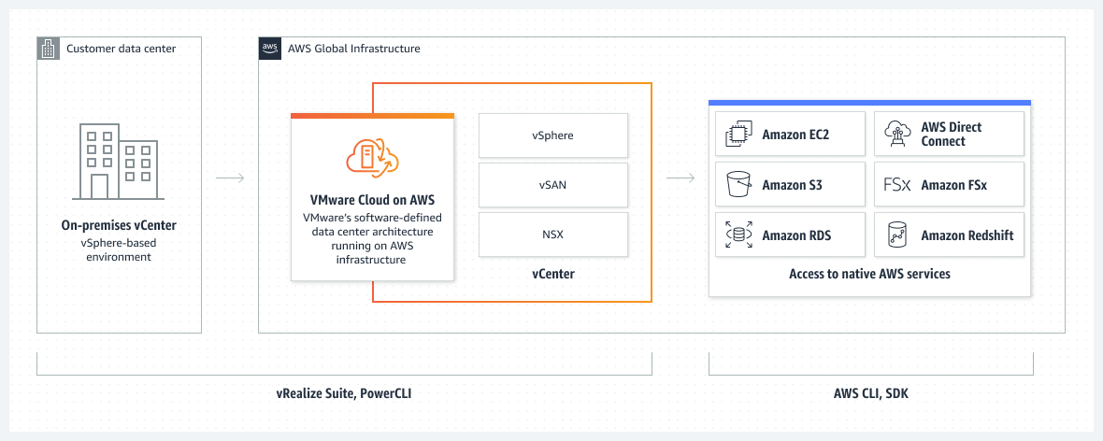
VMware Cloud on AWS

Slide 6
VMware Cloud on AWS: Use Cases
Application Migration and Modernization: Enterprises can use VMware on AWS to seamlessly migrate and modernize applications, taking advantage of AWS's scalable infrastructure while retaining the familiar VMware management framework, thus facilitating a smoother transition to the cloud with minimized downtime.
Hybrid Cloud Architecture: Organizations can build a resilient hybrid cloud architecture using VMware on AWS, creating an environment that allows for seamless workload mobility between on-premises VMware environments and the AWS cloud, therefore achieving a flexible and efficient infrastructure that meets evolving business needs.
Data Center Extension or Evacuation: Companies undergoing data center transformations can utilize VMware on AWS for data center extensions or evacuations, leveraging the solution to quickly add capacity to their existing data center or to evacuate data centers completely while maintaining operational continuity.
Disaster Recovery as a Service (DRaaS): Businesses can implement a robust disaster recovery solution using VMware Site Recovery on AWS, ensuring business continuity with a scalable, on-demand recovery solution that allows for consistent operations and swift recovery in the event of a disaster.
Next-Generation App Development: Developers can leverage VMware on AWS for next-generation application development, utilizing VMware Tanzu on AWS to build and deploy modern apps that can scale dynamically, thus encouraging innovation and speeding up the development process through a platform that supports both containerized and traditional workloads.

