Slide 1
AWS Backup
Centrally manage and automate data protection

Slide 2
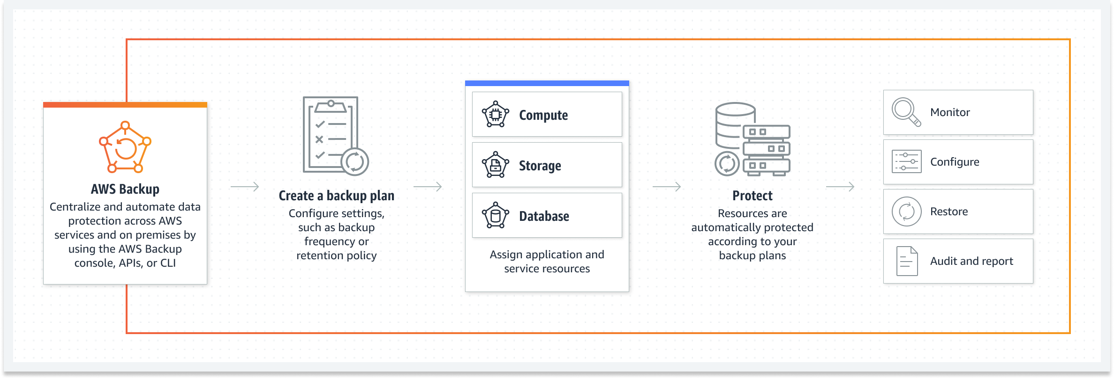
AWS Backup

Slide 3
AWS Backup Overview
AWS Backup is a fully managed backup service that makes it easy to centralize and automate the backing up of data across AWS services.
With AWS Backup, you can create backup policies called backup plans.
You can use these plans to define your backup requirements, such as how frequently to back up your data and how long to retain those backups.
AWS Backup lets you apply backup plans to your AWS resources by simply tagging them.
AWS Backup then automatically backs up your AWS resources according to the backup plan that you defined.

Slide 4
AWS Backup Supported AWS resources
Supported resource | Supported resource type
Amazon Elastic Compute Cloud (Amazon EC2) | Amazon EC2 instances (excluding store-backed AMIs)
Amazon Simple Storage Service (Amazon S3) | Amazon S3 data
Amazon Elastic Block Store (Amazon EBS) | Amazon EBS volumes
Amazon DynamoDB | Amazon DynamoDB tables
Amazon Relational Database Service (Amazon RDS) | Amazon RDS database instances (including all database engines); Multi-Availability Zone clusters
Amazon Aurora | Aurora clusters
Amazon Elastic File System (Amazon EFS) | Amazon EFS file systems
FSx for Lustre | FSx for Lustre file systems
FSx for Windows File Server | FSx for Windows File Server file systems
Amazon FSx for NetApp ONTAP | FSx for ONTAP file systems
Amazon FSx for OpenZFS | FSx for OpenZFS file systems
AWS Storage Gateway (Volume Gateway) | AWS Storage Gateway volumes
Amazon DocumentDB | Amazon DocumentDB clusters
Amazon Neptune | Amazon Neptune clusters
Amazon Redshift | Amazon Redshift clusters
Amazon Timestream | Amazon Timestream clusters
VMware Cloud™ on AWS | VMware Cloud™ virtual machines on AWS
VMware Cloud™ on AWS Outposts | VMware Cloud™ virtual machines on AWS Outposts
AWS CloudFormation | AWS CloudFormation stacks
SAP HANA databases | SAP HANA databases on Amazon EC2 instances

Slide 5
AWS Backup Vault Lock
Write-Once-Read-Many (WORM)
AWS Backup Vault Lock is a feature that helps you prevent changes to backup lifecycle as well as prevent manual deletion of backups, helping you meet your compliance requirements.
AWS Backup Vault Lock implements safeguards that verifies you are storing your backups using a Write-Once-Read-Many (WORM) model.
Why should I use AWS Backup Vault Lock?
AWS Backup Vault Lock verifies that no user, including administrators or perpetrators of malicious actions, can delete your backups or change their lifecycle settings such as retention periods and transition to cold storage.
AWS Backup keeps these backups according to your scheduled retention periods, helping you meet your business continuity goals.
AWS Backup Vault Lock also works with backup policies such as retention periods, cold storage transitioning, and cross-account/Region copy.
This provides an additional layer of protection and helps meet your compliance requirements.
AWS Backup Vault Lock protects you from keeping backups that don’t meet your acceptable minimum and maximum retention periods.

Slide 6
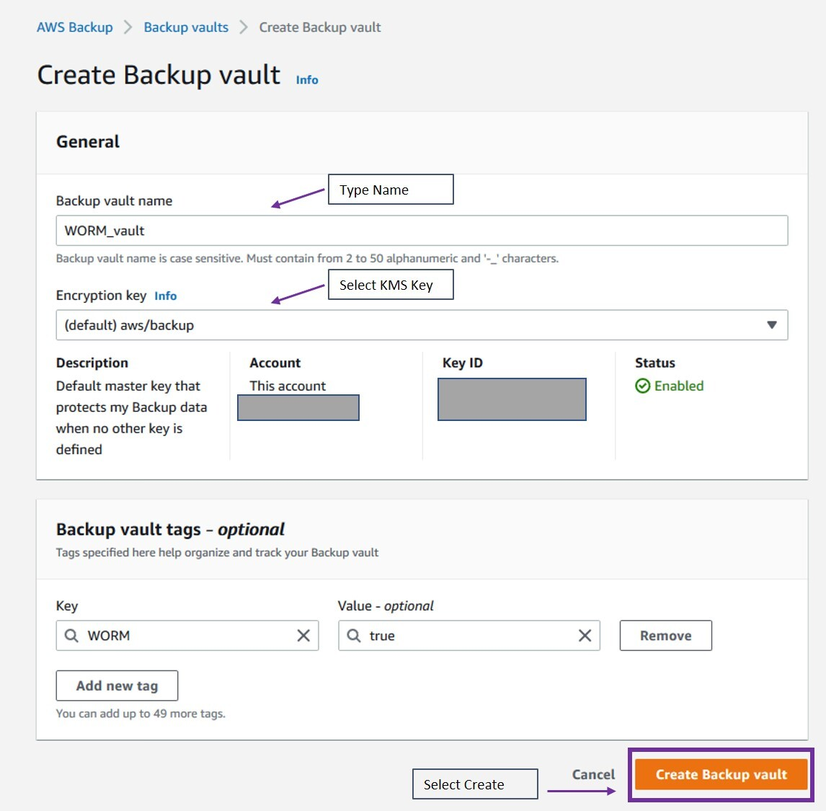
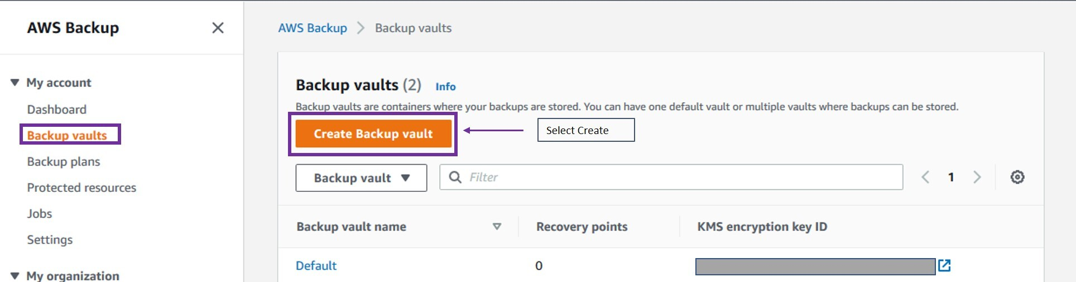
AWS Backup Vault Lock

Slide 7
AWS Backup Valut lock modes
Governance mode
Governance mode is intended to allow a vault to be managed only by users with sufficient IAM privileges.
Governance mode helps an organization meet governance requirements, ensuring only designated personnel can make changes to a backup vault.
Compliance mode
Compliance mode is intended for backup vaults in which the vault (and by extension, its contents) is expected to never be deleted or altered until the data retention period is complete.
Once a vault in compliance mode is locked, it is immutable, meaning the lock cannot be removed.
A vault locked in Governance mode can be managed or deleted by users who have the appropriate IAM permissions.
A vault lock in Compliance mode cannot be altered or deleted by any user or by AWS. A vault lock in compliance mode has a grace time period you set before it locks and becomes immutable.

Slide 8
AWS Backup Vault Lock a backup vault programmatically
Compiance mode:
aws backup put-backup-vault-lock-configuration \ --backup-vault-name my_vault_to_lock \ --changeable-for-days 3 \ --min-retention-days 7 \ --max-retention-days 30
Governance mode
aws backup put-backup-vault-lock-configuration \ --backup-vault-name my_vault_to_lock \ --min-retention-days 7 \ --max-retention-days 30

Slide 9
AWS Backup Use Cases
Healthcare Data Compliance: Healthcare institutions can use AWS Backup to create automated backup routines that adhere to regulatory requirements, ensuring the integrity and availability of sensitive healthcare data while facilitating compliance with laws like HIPAA.
Enterprise Database Backup: Large enterprises can utilize AWS Backup to automate the backup of their extensive databases, ensuring data consistency and reducing the operational burden of database backups, while adding a layer of security through encryption and monitoring features.
Educational Institutions Resource Backup: Educational institutions can leverage AWS Backup to safeguard their digital resources, including learning materials and student records, thus ensuring the accessibility and safety of educational data, while benefiting from cost-effective and centralized backup solutions.
Financial Services Data Retention: Financial service companies can deploy AWS Backup to meet stringent data retention requirements, creating a reliable and secure backup solution that helps in safeguarding critical financial data and facilitating rapid recovery in the event of data loss.
E-commerce Transaction Records Backup: E-commerce platforms can use AWS Backup to routinely back up transaction records and customer data, enhancing data security through encryption and providing a scalable solution to manage increasing volumes of transaction data as the business grows.

Slide 10
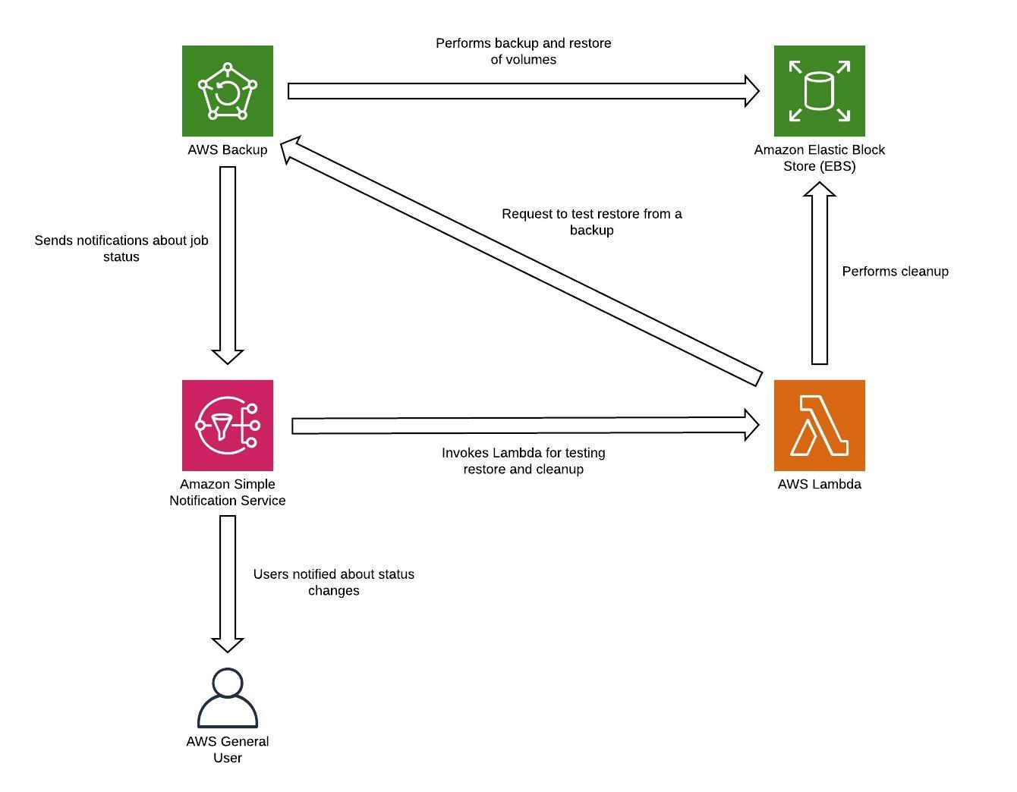
AWS Backup Architecture

