Slide 1

Disaster recovery options in the cloud
Disaster recovery is the process of preparing for and recovering from a disaster

Slide 2
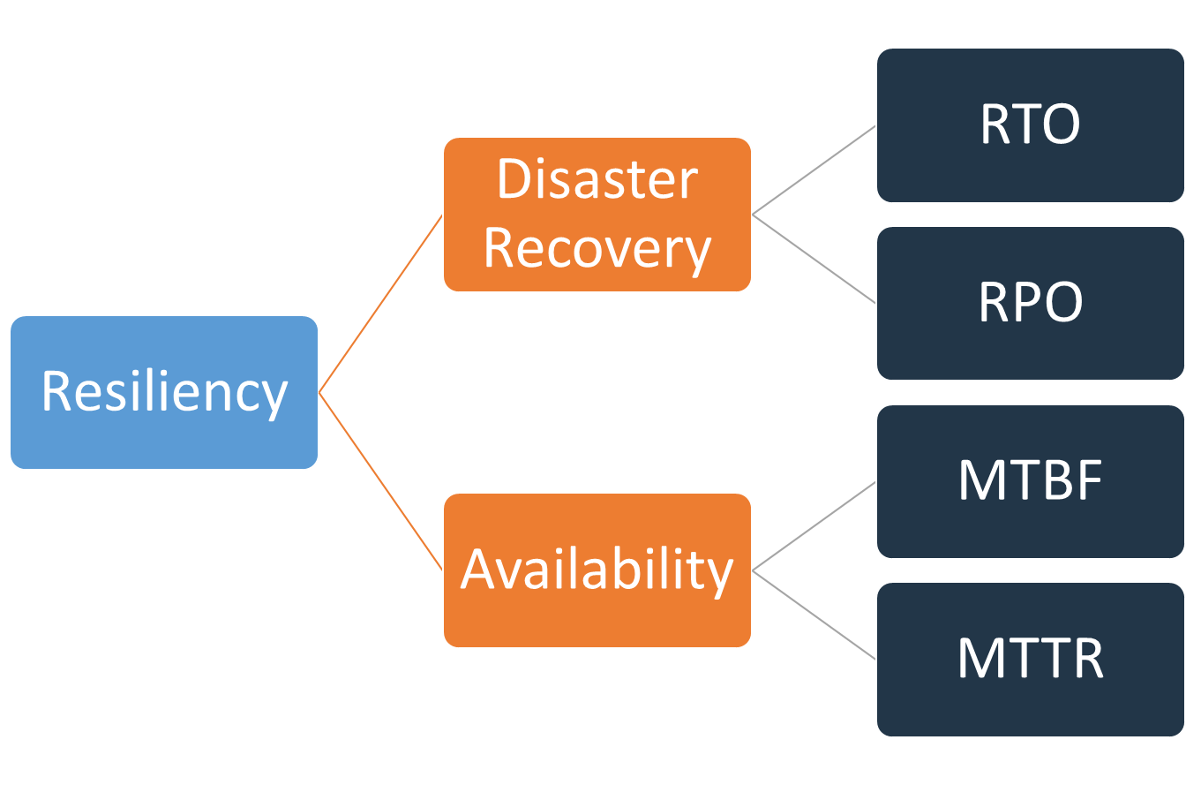
Introduction
You must architect for resiliency.
Resiliency is the ability of a workload to recover from infrastructure, service, or application disruptions, dynamically acquire computing resources to meet demand, and mitigate disruptions, such as misconfigurations or transient network issues.
Disaster recovery can be compared to availability, which is another important component of your resiliency strategy.
Whereas disaster recovery measures objectives for one-time events, availability objectives measure mean values over a period of time.

Slide 3

Availability
Availability is calculated using Mean Time Between Failures (MTBF) and Mean Time to Recover (MTTR)

Slide 4
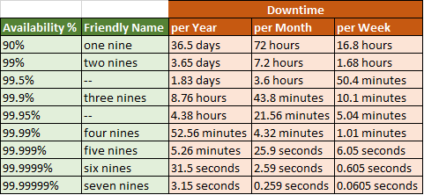
Availability in “Nines”

Slide 5
Business Continuity Plan (BCP)
Your disaster recovery plan should be a subset of your organization’s business continuity plan (BCP), it should not be a standalone document.
Your DR strategy should be based on business requirements, priorities, and context.
The analysis should help to determine how quickly the workload needs to be made available and how much data loss can be tolerated.
For highly critical workloads, you might consider deploying infrastructure across multiple Regions with data replication and continuous backups in place to minimize business impact.
For less critical workloads, a valid strategy may be not to have any disaster recovery in place at all.
And for some disaster scenarios, it is also valid not to have any disaster recovery strategy in place as an informed decision based on a low probability of the disaster occurring.
Remember that Availability Zones within an AWS Region are already designed with meaningful distance between them, and careful planning of location, such that most common disasters should only impact one zone and not the others.
Therefore, a multi-AZ architecture within an AWS Region may already meet much of your risk mitigation needs.

Slide 6
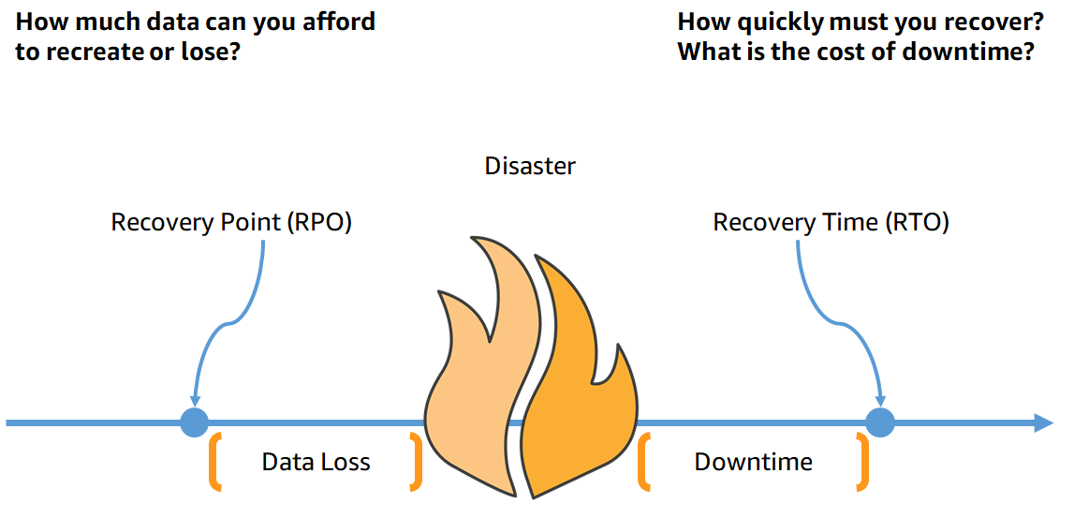
Recovery Objectives: RTO and PRO
Recovery Time Objective (RTO)
Recovery Point Objective (RPO).

Slide 7

RTO & RPO
Recovery Time Objective (RTO) is the maximum acceptable delay between the interruption of service and restoration of service.
This objective determines what is considered an acceptable time window when service is unavailable and is defined by the organization.
Recovery Point Objective (RPO) is the maximum acceptable amount of time since the last data recovery point.
This objective determines what is considered an acceptable loss of data between the last recovery point and the interruption of service and is defined by the organization.

Slide 8
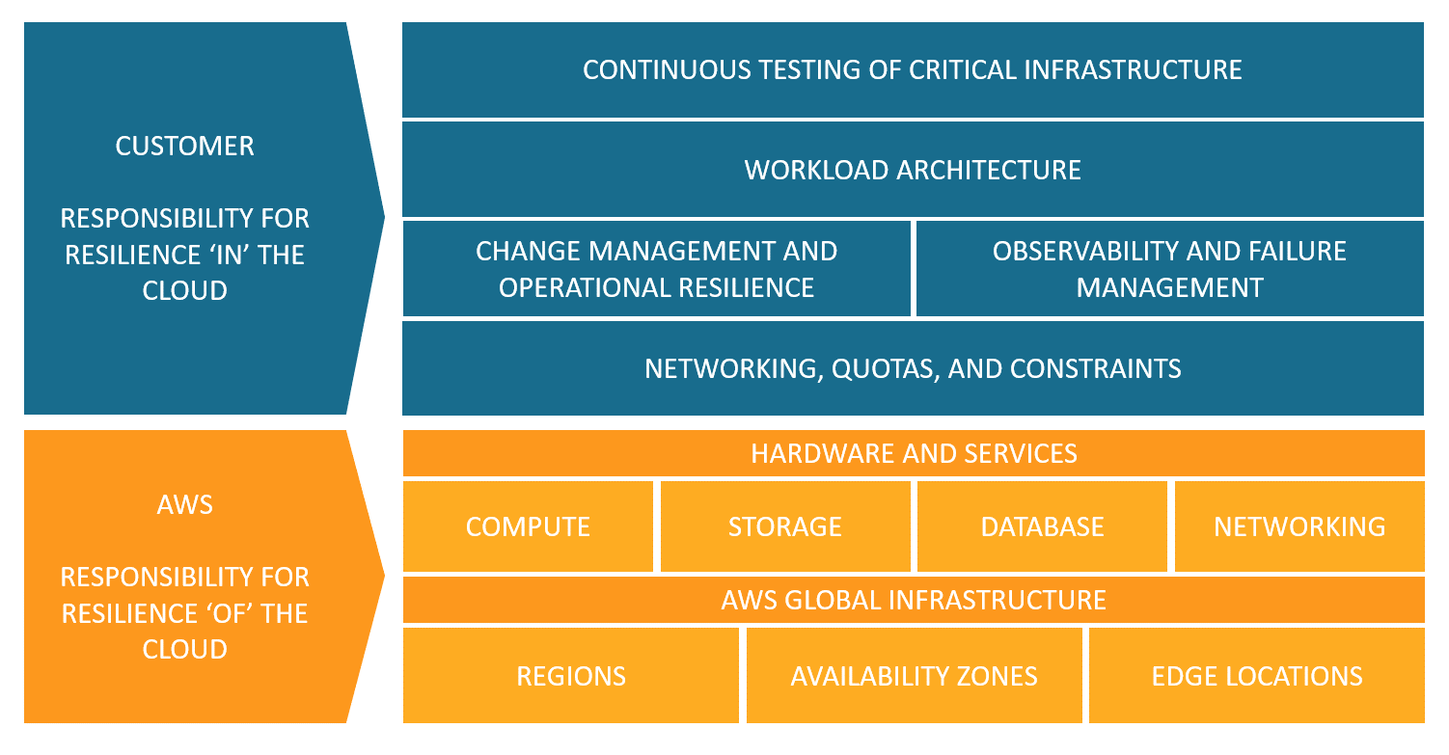
Shared Responsibility Model for Resiliency

Slide 9
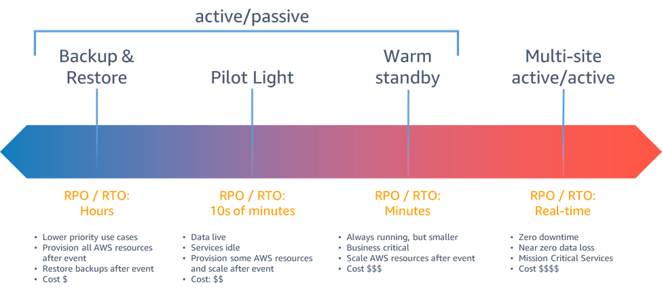
Disaster recovery options in the cloud

Slide 10
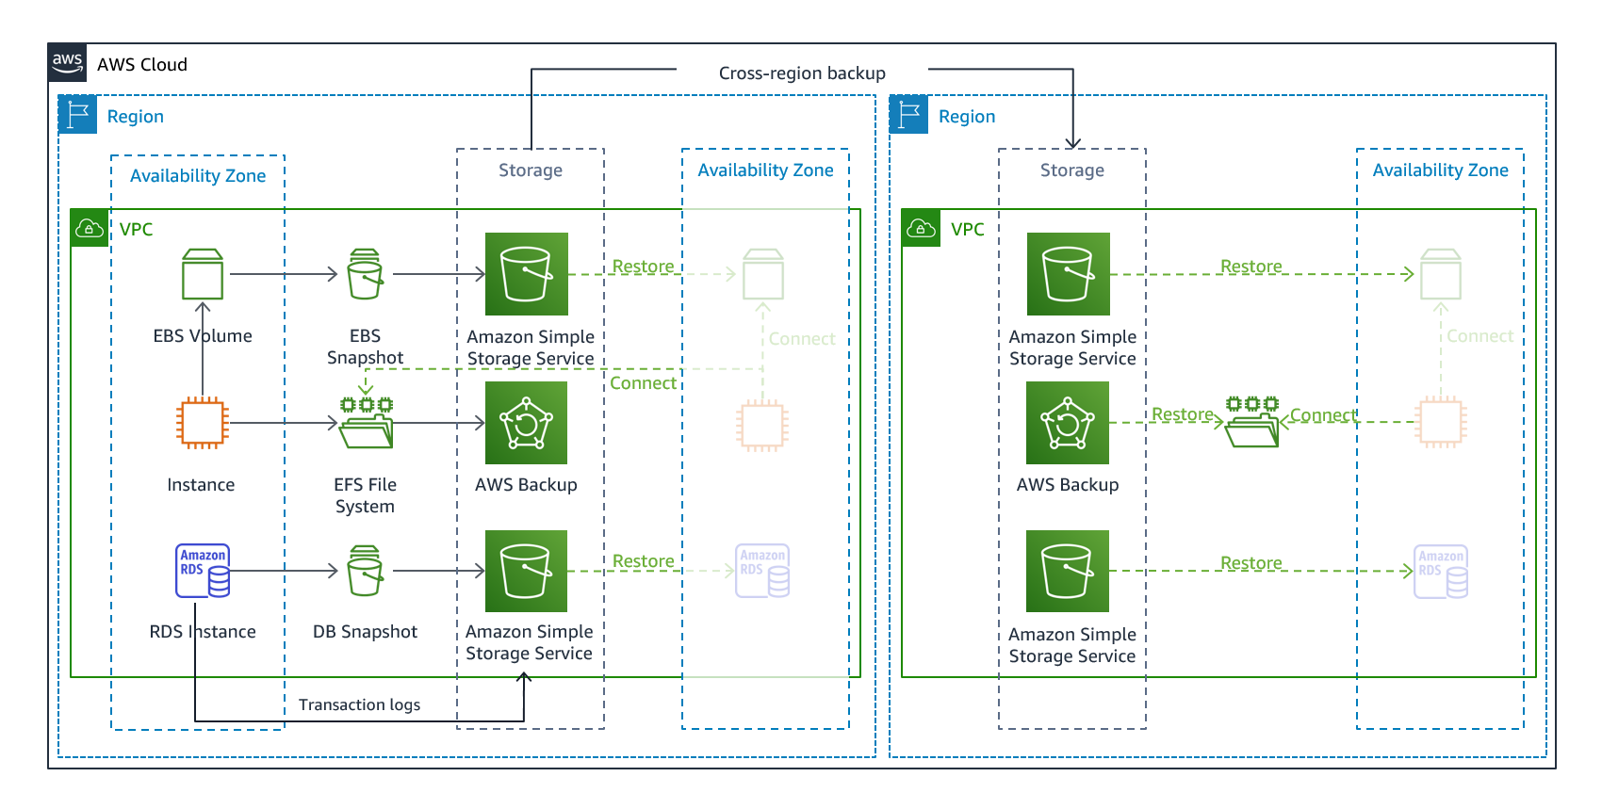
Backup and restore
Backup and restore is a suitable approach for mitigating against data loss or corruption
For quick redeployment use IaC: CloudFormation, CDK, Terraform

Slide 11
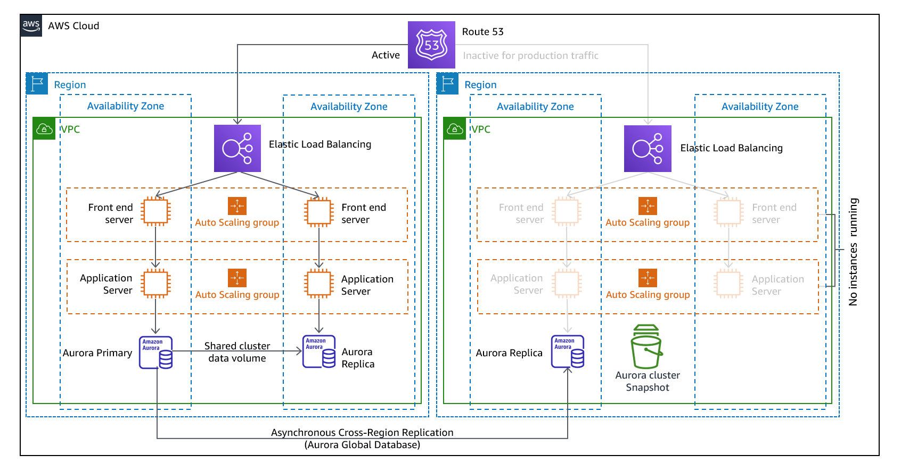
Pilot light
With the pilot light approach, you replicate your data from one Region to another and provision a copy of your core workload infrastructure.

Slide 12
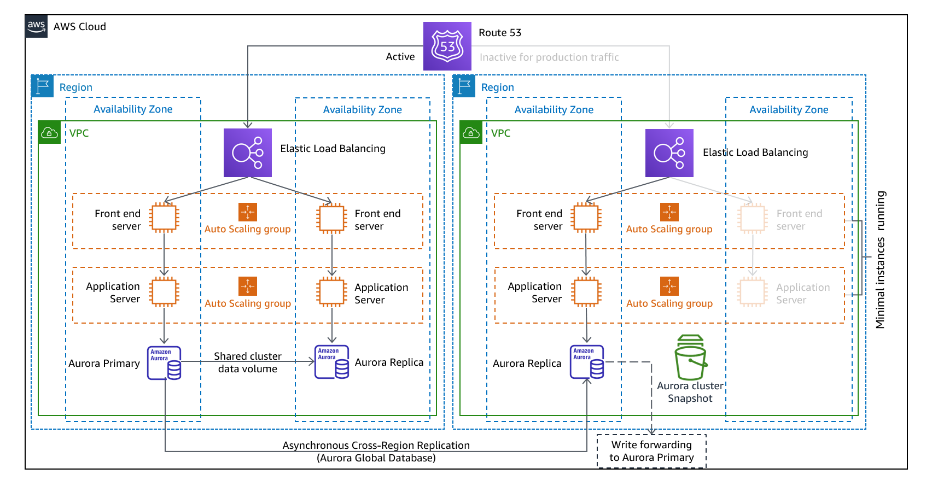
Warm standby
The warm standby approach involves ensuring that there is a scaled down, but fully functional, copy of your production environment in another Region.
This approach extends the pilot light concept and decreases the time to recovery because your workload is always-on in another Region.

Slide 13
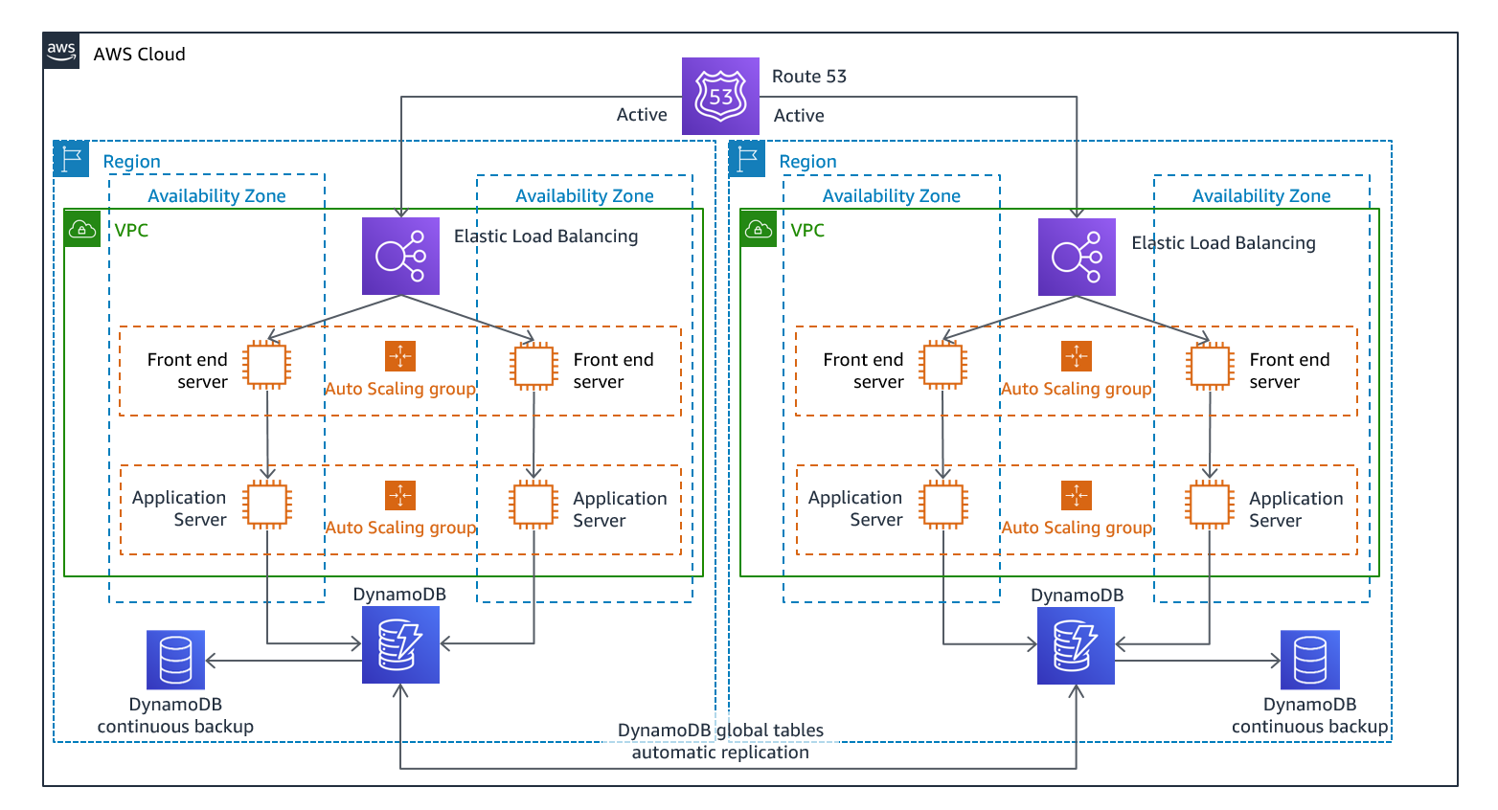
Multi-site active/active
Run your workload simultaneously in multiple Regions as part of a multi-site active/active or hot standby active/passive strategy.
Multi-site active/active serves traffic from all regions to which it is deployed, whereas hot standby serves traffic only from a single region, and the other Region(s) are only used for disaster recovery

Slide 14
Disaster recovery plan checklist
Determine recovery objectives (RTO and RPO)
Identify stakeholders
Establish communication channels
Collect all infrastructure documentation
Choose the right technology
Define incident response procedure
Define action response procedure and verification process
Perform regular disaster recovery drills
Stay up to date
Prepare for failback to primary environment
https://pages.awscloud.com/rs/112-TZM-766/images/GEN_disaster-recovery-plan-checklist_May-2020.pdf

