Slide 1
Kinesis
Easily collect, process, and analyze video and data streams in real time

Slide 2
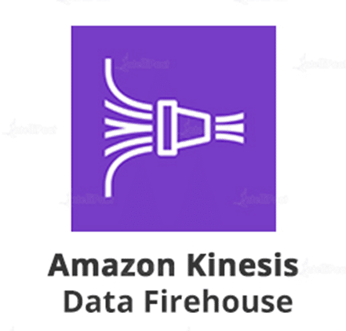
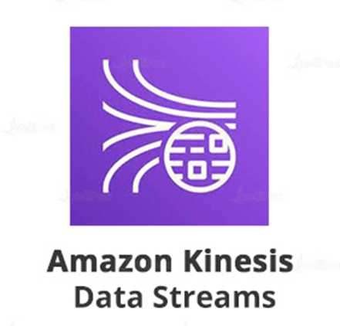
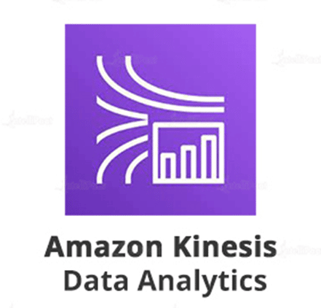
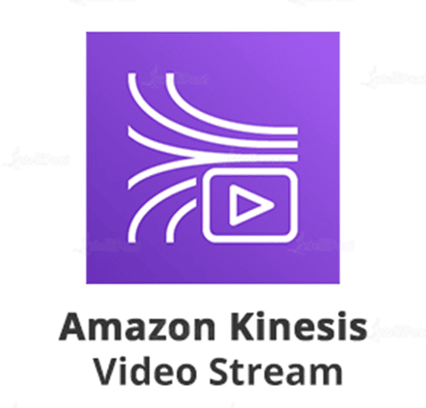
Kinesis overview
Amazon Kinesis is an Amazon Web Service designed to makes it easy to collect, process, and analyze video and data streams in real time.

Slide 3
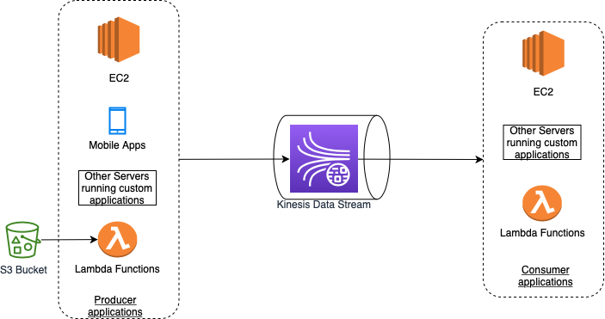
Kinesis Data Stream
You can use Amazon Kinesis Data Streams to collect and process large streams of data records in real time.
A typical Kinesis Data Streams application reads data from a data stream as data records.
These applications can use the Kinesis Client Library, and they can run on Amazon EC2 instances.
You can send the processed records to dashboards, use them to generate alerts, dynamically change pricing and advertising strategies, or send data to a variety of other AWS services.
The following are typical scenarios for using Kinesis Data Streams:
Accelerated log and data feed intake and processing
Real-time metrics and reporting
Real-time data analytics
Complex stream processing

Slide 4
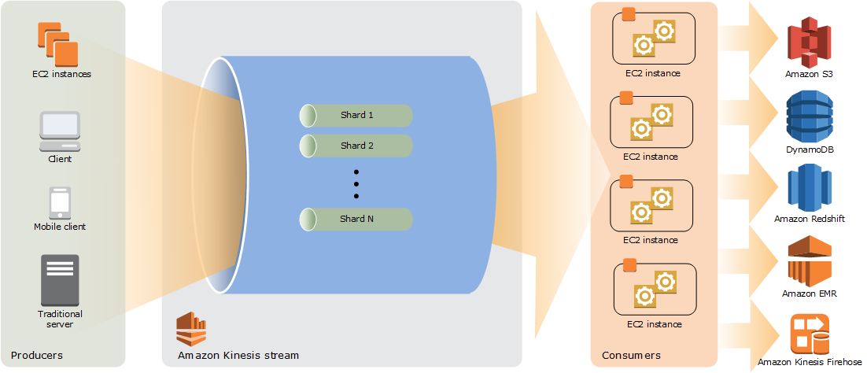
Kinesis Data Stream How shards work
A Kinesis data stream is a set of shards. Each shard has a sequence of data records .Each data record has a sequence number that is assigned by Kinesis Data Streams.
A shard is a uniquely identified sequence of data records in a stream. A stream is composed of one or more shards, each of which provides a fixed unit of capacity.
Each shard can support up to 5 transactions per second for reads, up to a maximum total data read rate of 2 MB per second and up to 1,000 records per second for writes, up to a maximum total data write rate of 1 MB per second (including partition keys).
The data capacity of your stream is a function of the number of shards that you specify for the stream.
The total capacity of the stream is the sum of the capacities of its shards.

Slide 5
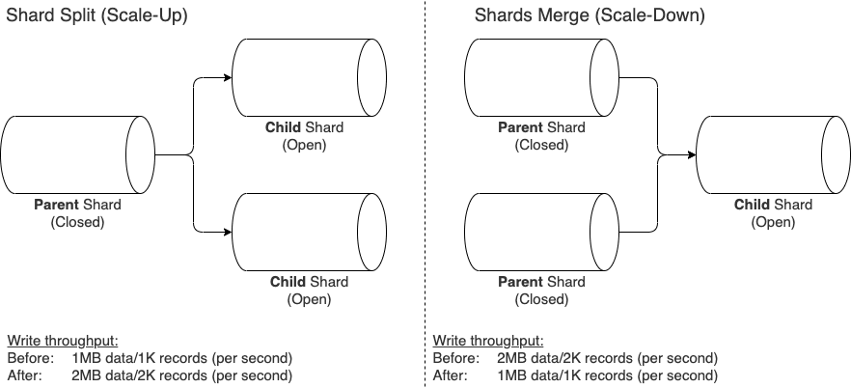
Kinesis Data Stream Resharding a Stream
Amazon Kinesis Data Streams supports resharding, which lets you adjust the number of shards in your stream to adapt to changes in the rate of data flow through the stream.
There are two types of resharding operations:
shard split and shard merge.
Resharding is always pairwise in the sense that you cannot split into more than two shards in a single operation, and you cannot merge more than two shards in a single operation.
Splitting increases the number of shards in your stream and therefore increases the data capacity of the stream and the cost of your stream. Similarly, merging reduces the number of shards in your stream and therefore decreases the data capacity—and cost—of the stream.
The maximum number of instances you can launch is n, to match the number of open shards in a ratio of 1:1.

Slide 6
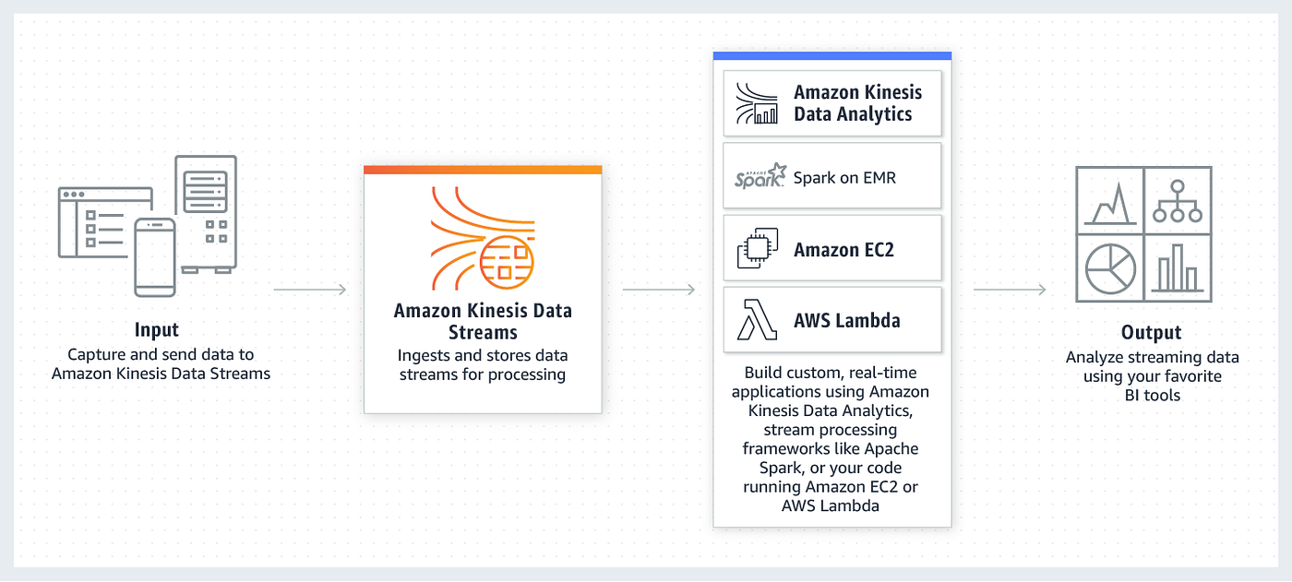
Kinesis Data Stream Destinations

Slide 7
Kinesis Data Steam Use Cases
Real-time Analytics for E-Commerce: E-commerce platforms can use Kinesis Data Streams to analyze customer data in real-time, allowing them to provide personalized recommendations, optimize website layouts, and identify buying patterns to enhance the customer shopping experience dynamically.
Fraud Detection in Financial Institutions: Banks and other financial institutions can deploy Kinesis Data Streams to monitor transactions in real-time, utilizing machine learning algorithms to detect unusual patterns and potentially fraudulent activities instantly, thereby enhancing the security of financial transactions.
Smart City Traffic Management: Municipalities can use Kinesis Data Streams to process data from various traffic sensors and CCTV cameras in real-time, enabling them to manage traffic flows more efficiently, reduce congestion, and respond quickly to incidents, thus fostering smarter and safer urban environments.
Healthcare Remote Patient Monitoring: Healthcare providers can utilize Kinesis Data Streams to enable remote patient monitoring, gathering data from wearable devices and medical sensors in real-time to provide timely interventions and personalized healthcare services, enhancing patient outcomes.
Supply Chain Optimization in Manufacturing: Manufacturing companies can leverage Kinesis Data Streams to monitor and analyze data from various points in the supply chain in real-time, helping them to optimize logistics, reduce operational costs, and respond swiftly to any disruptions in the supply chain.

Slide 8
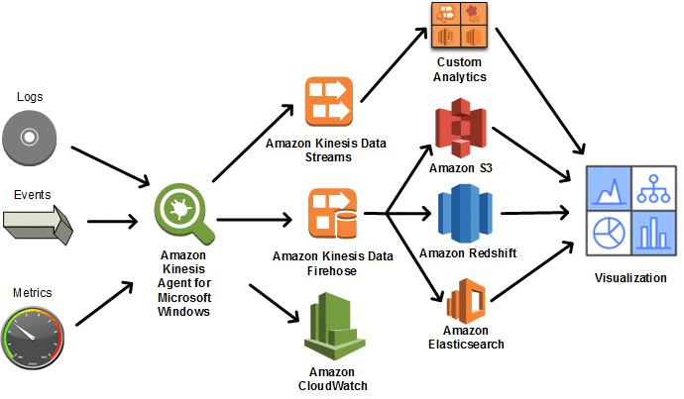
Kinesis Agent
Kinesis Agent is a stand-alone Java software application that offers an easy way to collect and send data to Kinesis Data Streams or Kinesis Data Firehose.
The agent continuously monitors a set of files and sends new data to your stream.
The agent handles file rotation, checkpointing, and retry upon failures.
It delivers all of your data in a reliable, timely, and simple manner.
It also emits Amazon CloudWatch metrics to help you better monitor and troubleshoot the streaming process.

Slide 9
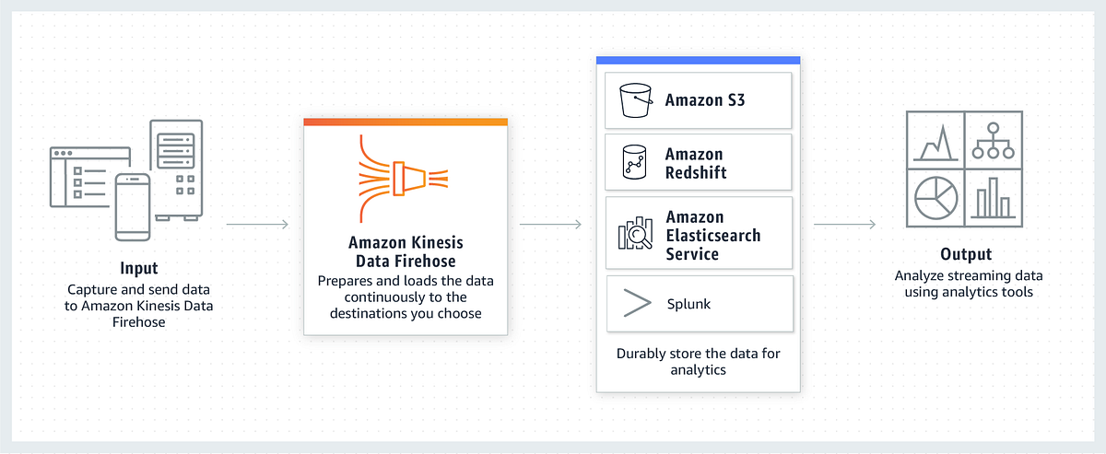
Kinesis Firehose
Amazon Kinesis Data Firehose is a fully managed service for delivering real-time streaming data to destinations such as Amazon Simple Storage Service (Amazon S3), Amazon Redshift, Amazon OpenSearch Service, Amazon OpenSearch Serverless, Splunk, and any custom HTTP endpoint or HTTP endpoints owned by supported third-party service providers.
With Kinesis Data Firehose, you don't need to write applications or manage resources.
You configure your data producers to send data to Kinesis Data Firehose, and it automatically delivers the data to the destination that you specified.
You can also configure Kinesis Data Firehose to transform your data before delivering it.

Slide 10
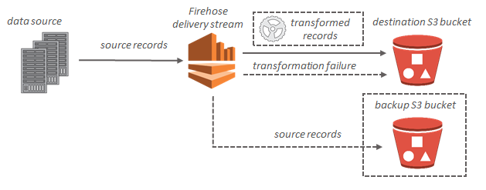
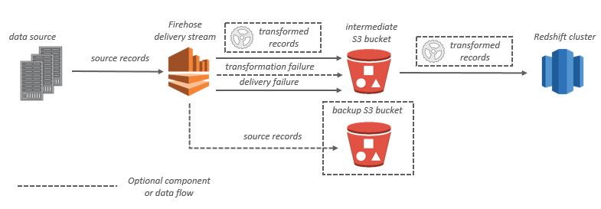
Kinesis Firehose Data flow

Slide 11
Kinesis Firehose Use Cases
Real-time Log and Event Data Analysis: Companies can leverage Kinesis Data Firehose to ingest large volumes of log and event data in real-time, enabling them to analyze operational data swiftly and maintain high system performance while identifying and responding to issues proactively.
Streaming Data Lakes: Organizations can use Kinesis Data Firehose to build data lakes with streaming data, facilitating near-real-time analytics and machine learning to gain insights from data as it is generated, thus creating a more responsive and agile business environment.
Social Media Sentiment Analysis: Businesses can use Kinesis Data Firehose to conduct real-time sentiment analysis on social media feeds, helping them to gauge public sentiment about their brand and products, and allowing for prompt responses to customer feedback and market trends.
IoT Device Data Aggregation: Companies can employ Kinesis Data Firehose to aggregate data from numerous IoT devices, facilitating the analysis of data streams to monitor device health, optimize performance, and glean actionable insights from the vast amount of data generated by these devices.
Mobile App Usage Analytics: App developers can utilize Kinesis Data Firehose to analyze mobile app usage data in real time, helping them to understand user behavior, identify popular features, and tailor app development strategies based on current usage patterns, thus improving app functionality and user satisfaction.

Slide 12
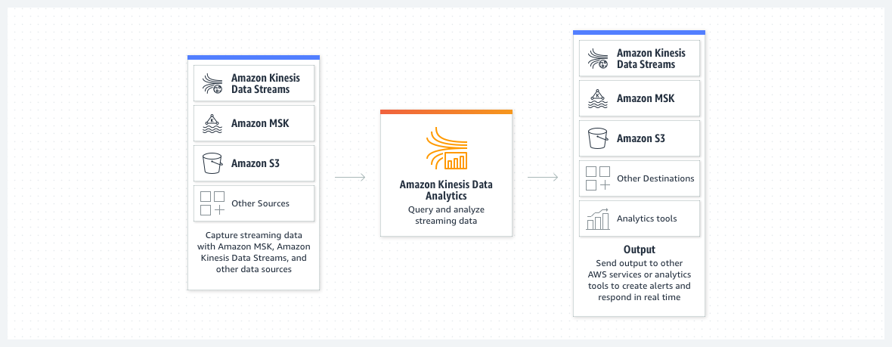
Kinesis Data Analytics
Amazon Kinesis Data Analytics is the easiest way to manipulate and analyze streaming data in real time with Apache Flink.
You can also use an interactive SQL editor to easily query streaming data and build streaming applications.

Slide 13
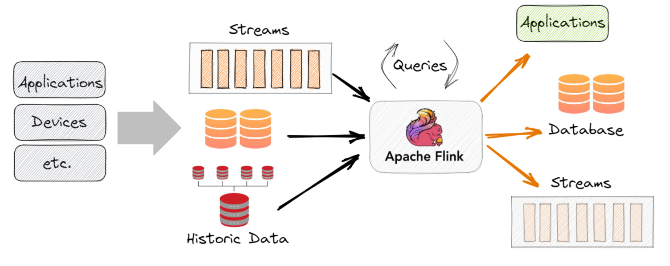
Apache Flink
Apache Flink is an open-source, unified stream-processing and batch-processing framework developed by the Apache Software Foundation

Slide 14
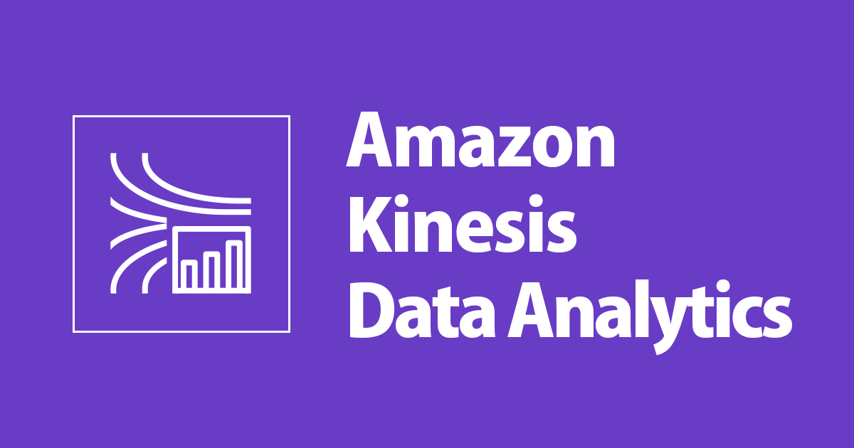
Kinesis Data Analytics
Amazon Kinesis Data Analytics is ideal for solving a wide range of streaming data use cases, including:
Streaming ETL for Internet-of-Things (IoT) with Apache Flink Applications
You can develop applications with Apache Flink libraries and use Amazon Kinesis Data Analytics to transform, aggregate, and filter streaming data from IoT devices such as consumer appliances, embedded sensors, and TV set-top boxes. You can then use the data to send real-time alerts when a sensor exceeds certain operating thresholds.
Real-time log analytics with SQL
You can stream billions of small messages to Amazon Kinesis Data Analytics and calculate key metrics, which you can then use to refresh content performance dashboards in real time and improve content performance.

Slide 15
Kinesis Analytics Benefits
Powerful real-time processing
Amazon Kinesis Data Analytics provides built-in functions to filter, aggregate, and transform streaming data for advanced analytics.
It processes streaming data with sub-second latencies, enabling you to analyze and respond to incoming data and streaming events in real time.
No servers to manage
Amazon Kinesis Data Analytics is serverless;
there are no servers to manage.
It runs your streaming applications without requiring you to provision or manage any infrastructure.
Amazon Kinesis Data Analytics automatically scales the infrastructure up and down as required to run your applications with low latency.
Pay only for what you use
With Amazon Kinesis Data Analytics, you pay only for the processing resources that your streaming applications use.
There are no minimum fees or upfront commitments.

Slide 16
Kinesis Data Analytics Use Cases
Real-time Inventory Management: Retail businesses can use Kinesis Data Analytics to monitor and analyze inventory levels in real-time, enabling immediate responses to low stock levels and helping to optimize inventory turnover, reducing carrying costs and avoiding stockouts.
Dynamic Pricing in Travel and Hospitality: Airlines and hotels can leverage Kinesis Data Analytics to implement dynamic pricing strategies, analyzing real-time market data to adjust prices dynamically based on current demand and competitor pricing, maximizing revenue and improving competitiveness.
Live Sports Analytics: Sports broadcasters can utilize Kinesis Data Analytics to offer real-time analytics and insights during live sports events, enhancing viewer engagement by providing dynamic statistics and interactive experiences based on live data streams.
Emergency Response Coordination: Government agencies can deploy Kinesis Data Analytics during emergency situations to analyze data from various sources in real time, coordinating responses more effectively and disseminating critical information to the public promptly, thereby enhancing safety and responsiveness.
Predictive Maintenance in Manufacturing: Manufacturing firms can use Kinesis Data Analytics to develop predictive maintenance models, analyzing sensor data in real time to predict when machinery is likely to fail, scheduling maintenance proactively to prevent costly downtimes and prolong equipment life.

Slide 17
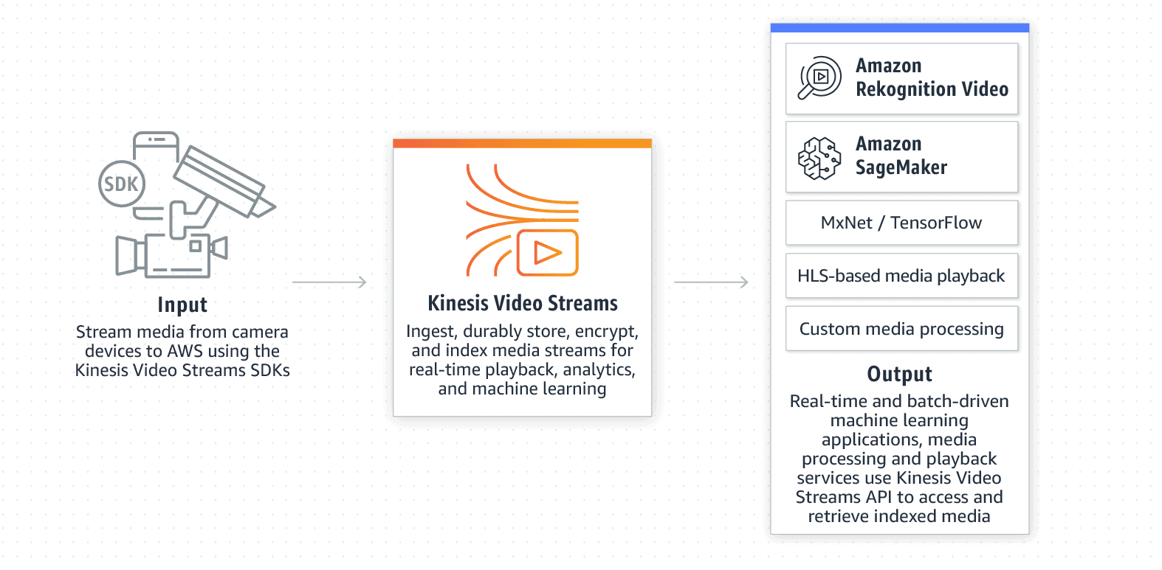
Kinesis video streams
You can use Amazon Kinesis Video Streams, a fully managed AWS service, to stream live video from devices to the AWS Cloud, or build applications for real-time video processing or batch-oriented video analytics.
Kinesis Video Streams isn't only storage for video data. You can use it to watch your video streams in real time as they are received in the cloud.
You can use Kinesis Video Streams to capture massive amounts of live video data from millions of sources. You can also send non-video, time-serialized data such as audio data, thermal imagery, depth data, and RADAR data.
You can also configure your Kinesis video stream to durably store media data for the specified retention period. Kinesis Video Streams automatically stores this data and encrypts it at rest.

Slide 18
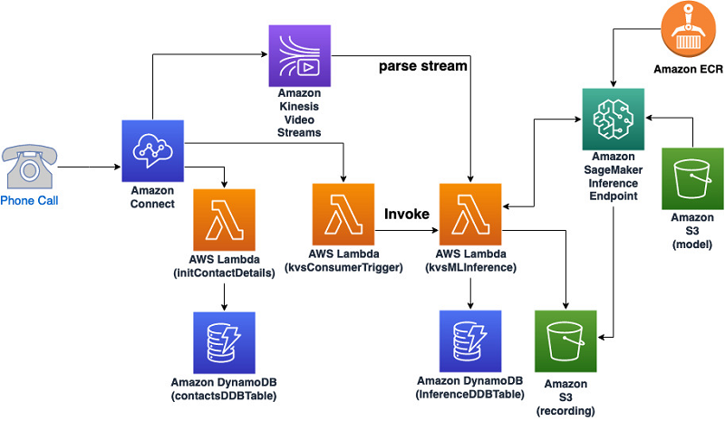
Kinesis video streams
Benefits of using Kinesis Video Streams include the following:
Connect and stream from millions of devices.
Durably store, encrypt, and index.
Focus on managing applications instead of infrastructure.
Build real-time and batch applications on data streams.
Stream data more securely.
Pay as you go.
Can be viewed:
HTTP Live Streaming (HLS) – You can use HLS for live playback.
GetMedia API – You use the GetMedia API to build your own applications to process Kinesis video streams. GetMedia is a real-time API with low latency.

Slide 19
Exam takeaway
Data Stream –
A logical grouping of shards. There are no bounds on the number of shards within a data stream. A data stream will retain data for 24 hours, or up to 7 days when extended retention is enabled.
One shard can ingest up to 1000 data records per second, or 1MB/sec. Add more shards to increase your ingestion capability.
When consumers use enhanced fan-out, one shard provides 1MB/sec data input and 2MB/sec data output for each data consumer registered to use enhanced fan-out.
Data Firehose
Record – The data of interest that your data producer sends to a Kinesis Data Firehose delivery stream. A record can be as large as 1,000 KB.
Kinesis Data Firehose buffers incoming data up to 3 MB by default.

