Slide 1
Amazon QuickSight
Unified business intelligence at hyperscale

Slide 2
Amazon QuickSight
Serverless Amazon QuickSight is a cloud-scale business intelligence (BI) service that you can use to deliver easy-to-understand insights to the people who you work with, wherever they are.
Amazon QuickSight connects to your data in the cloud and combines data from many different sources.
In a single data dashboard, QuickSight can include AWS data, third-party data, big data, spreadsheet data, SaaS data, B2B data, and more.

Slide 3
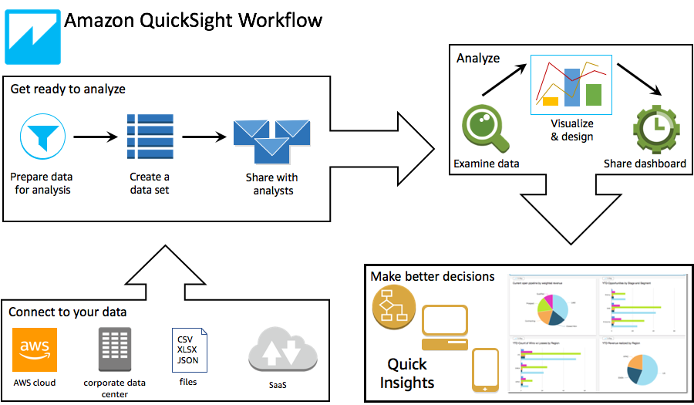
Amazon QuickSight Workflow

Slide 4
Amazon QuickSight Concepts
Users & Groups (enterprise)
QuickSight Author
QuickSight Reader
QuickSight Admin
QuickSight Reader session
Dashboards are a collection of visualizations, tables, and other visual displays arranged and visible together
Stories are guided tours through specific views of analysis. They are used to convey key points, a thought process, or the evolution of an analysis for collaboration.
Data ManagementData preparation is the process of transforming raw data for use in an analysis.
You can upload XLSX, CSV, TSV, CLF, XLF
Amazon QuickSight has a feature called AutoGraph that allows it to select the most appropriate visualizations based on the properties of the data, such as cardinality and data type.

Slide 5
Amazon QuickSight SPICE
When you import data into a dataset rather than using a direct SQL query, it becomes SPICE data because of how it's stored. SPICE (Super-fast, Parallel, In-memory Calculation Engine) is the robust in-memory engine that Amazon QuickSight uses.
It's engineered to rapidly perform advanced calculations and serve data. In Enterprise edition, data stored in SPICE is encrypted at rest.
Uses a combination of columnar storage, in-memory technologies.
Data in SPICE is persisted until it is explicitly deleted by the user.
SPICE also automatically replicates data for high availability and enables QuickSight to scale easily.
The SPICE engine supports data sets up to 250M rows and 500GB.

Slide 6
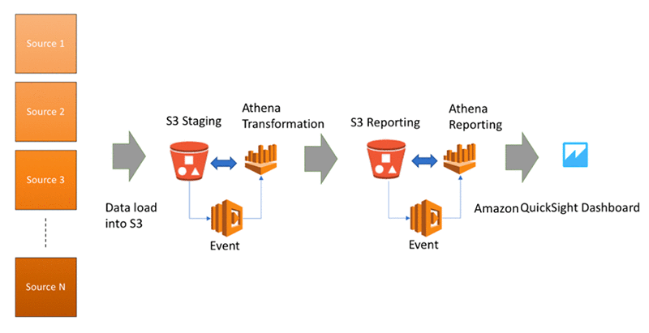
AWS QuickSight Architecture

Slide 7
Amazon QuickSight Use Cases
Sales Performance Dashboards: Sales teams in various industries can leverage AWS QuickSight to create interactive and real-time dashboards, which provide insights into sales performance, helping to track goals and identify opportunities for improvement dynamically.
Supply Chain Analytics: Manufacturing companies can use AWS QuickSight to analyze supply chain data comprehensively, helping to identify bottlenecks, optimize logistics, and enhance the efficiency and responsiveness of their supply chains through data-driven insights.
Educational Institutions Reporting: Educational institutions can employ AWS QuickSight to develop reporting systems that track and analyze student performance and educational outcomes, facilitating data-driven decision-making to enhance the quality of education and student success.
Healthcare Patient Outcomes Analysis: Healthcare providers can utilize AWS QuickSight to analyze patient data, developing insights into patient outcomes and helping to identify patterns and trends that can inform treatment plans and improve healthcare delivery.
Retail Customer Insights: Retail businesses can leverage AWS QuickSight to analyze customer data, deriving insights into buying patterns and preferences, which can inform marketing strategies and help in personalizing the customer experience, fostering increased customer loyalty and satisfaction.

Slide 8
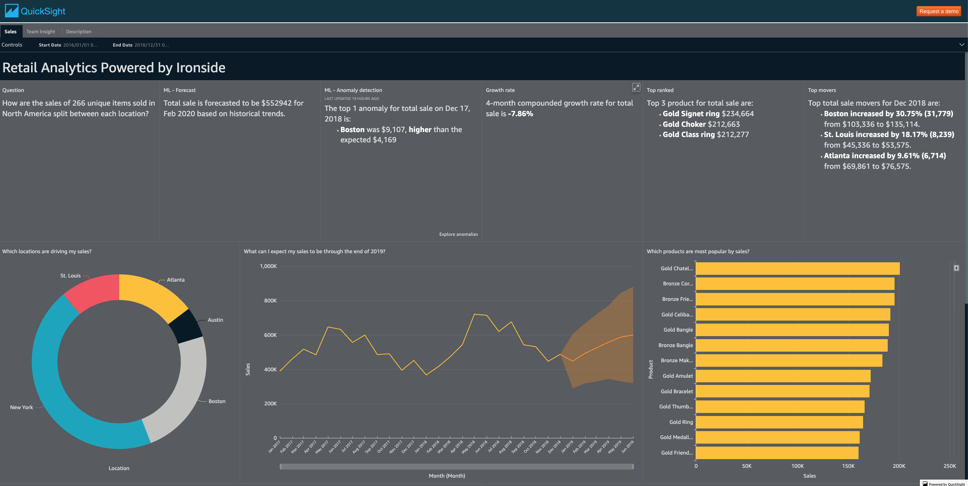
AWS QuickSight Dashboard example
https://aws.amazon.com/quicksight/gallery/
https://d2lzvqq4w5ulk4.cloudfront.net/?dashboardName=retailSales

