Slide 1
AWS Graviton Processors

Slide 2
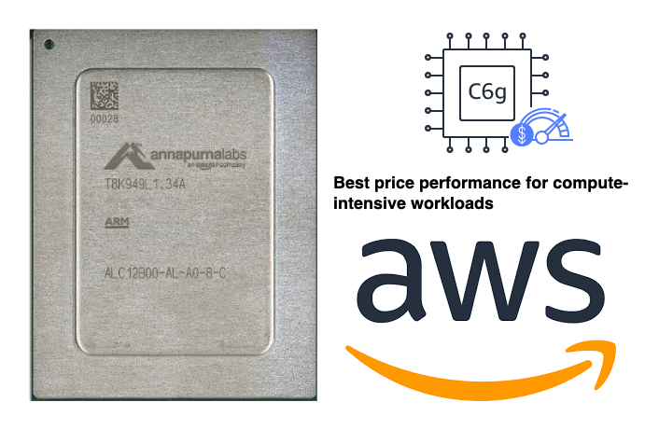
Introduction to AWS Graviton Processors
Introduce AWS Graviton Processors as cutting-edge, ARM-based CPUs developed by AWS.
Historical perspective: Graviton processor to the advanced Graviton3.
Key attributes: Exceptional performance per watt, reduced costs, and custom-built for cloud-native application

Slide 3
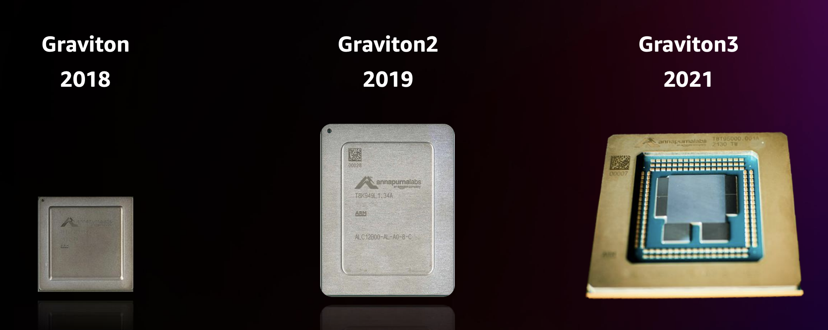
Graviton vs Graviton2 vs Graviton3

Slide 4
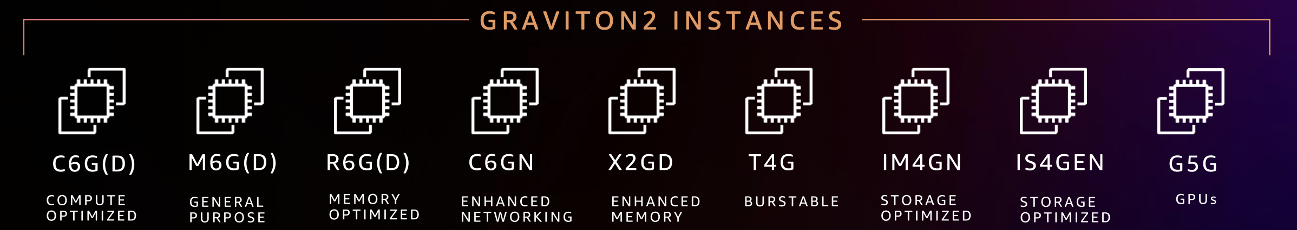
AWS Graviton2 instances

Slide 5
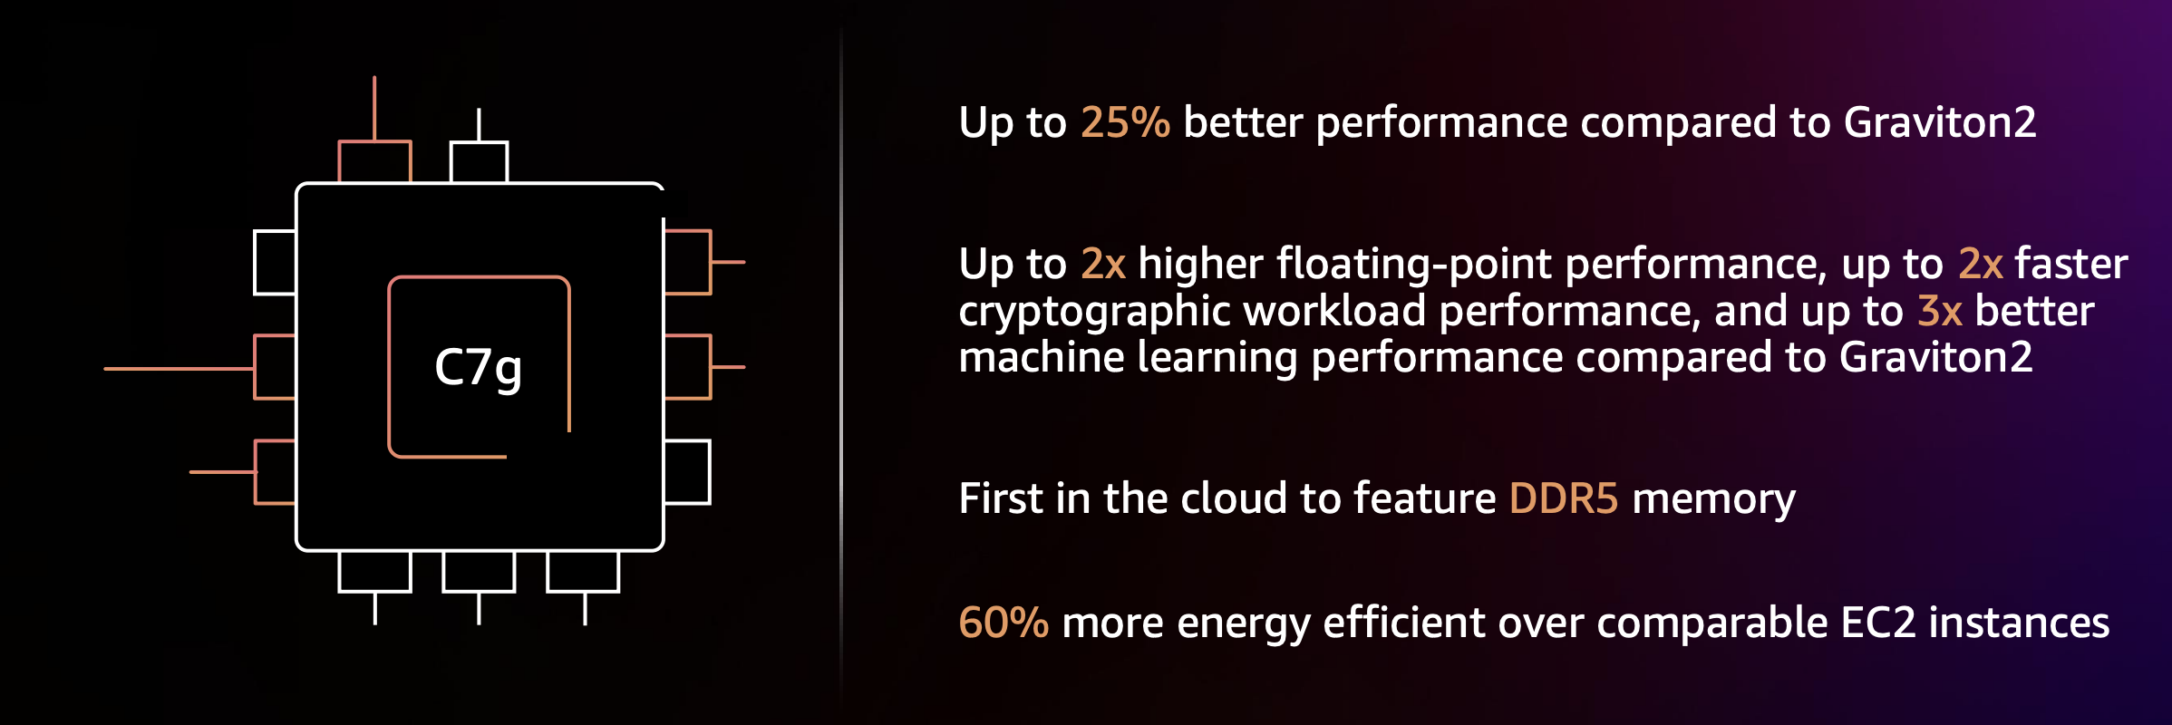
AWS Graviton3 based instance

Slide 6
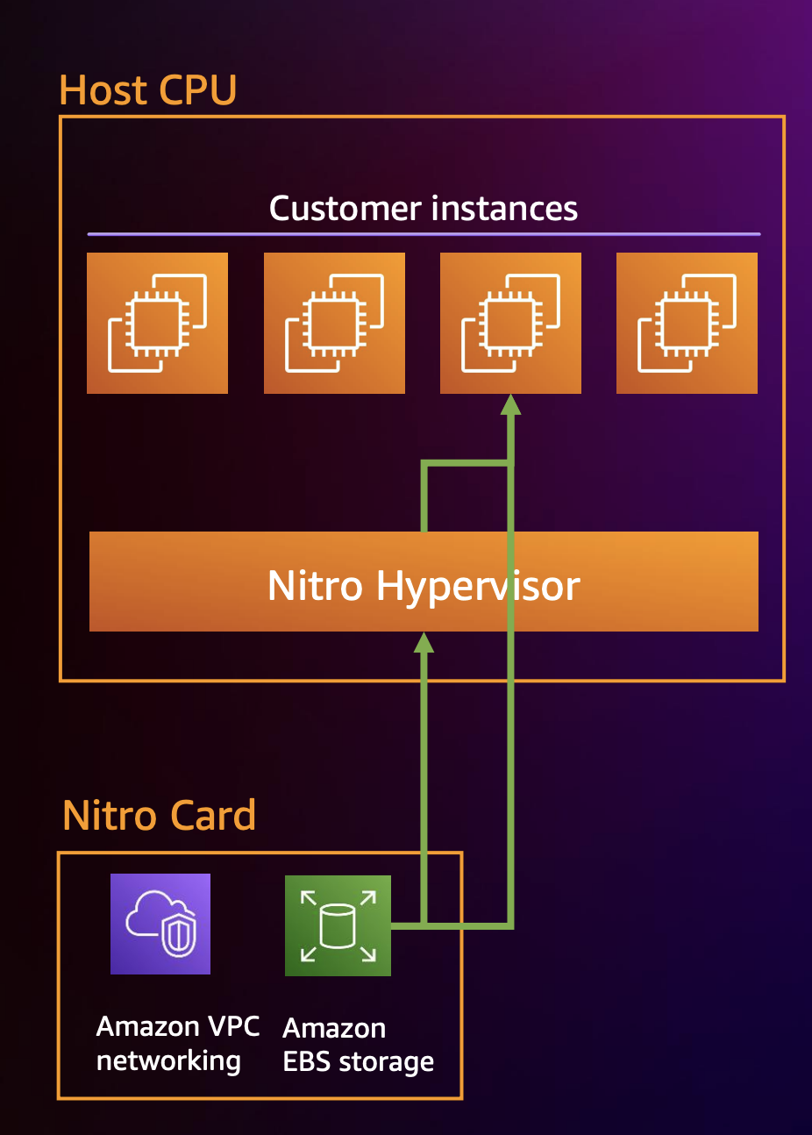
AWS Graviton 2 & 3 Direct interrupt Injection

Slide 7
Performance Benefits of AWS Graviton
Benchmarks showing significant improvement in compute-intensive operations compared to traditional x86 processors.
Focus on energy efficiency: Emphasize the environmental benefits of Graviton's lower power requirements.
Enhanced performance for web servers, containerized applications, data analytics, and gaming servers.

Slide 8
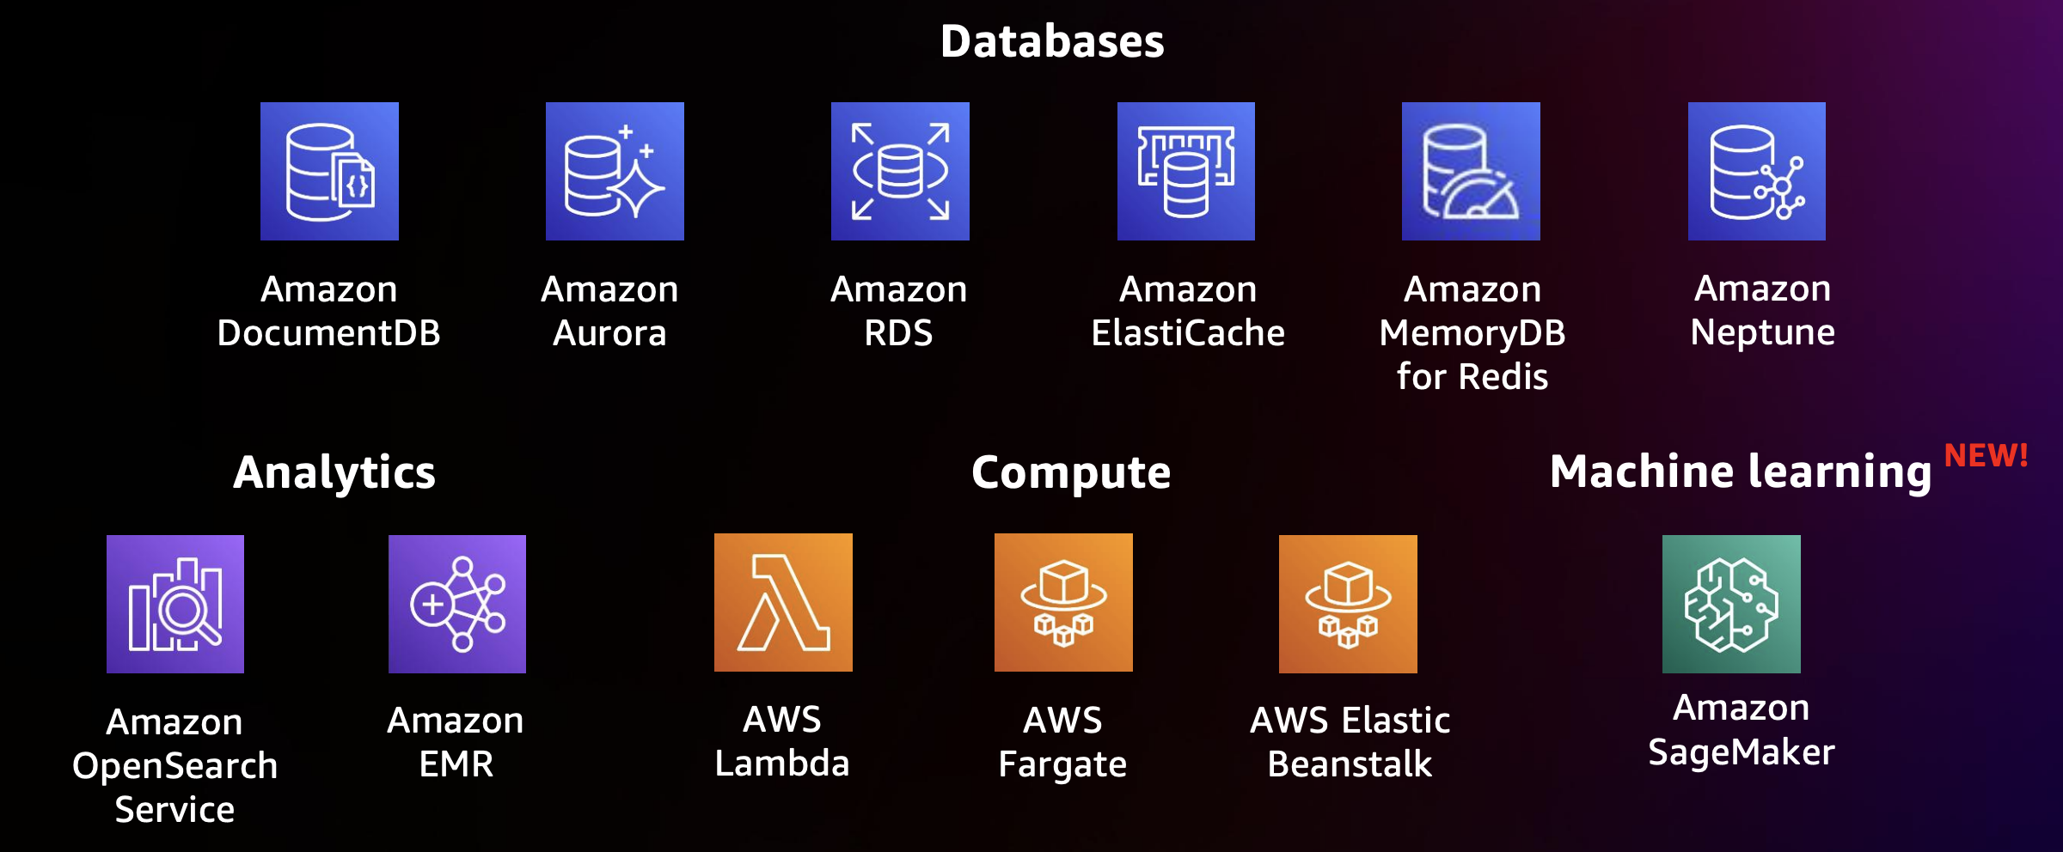
AWS Managed services supporting Graviton

Slide 9
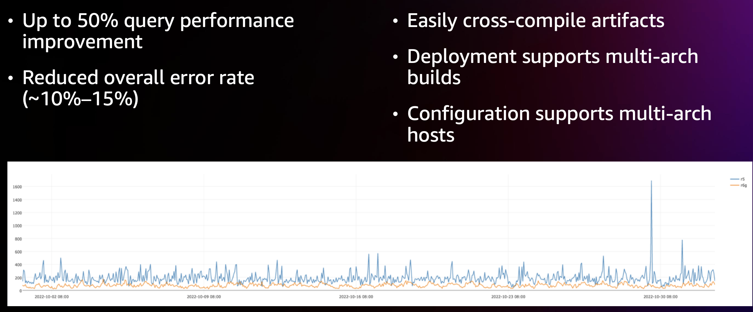
Stripe migration results

Slide 10

AWS Graviton
Best practices:
https://github.com/aws/aws-graviton-getting-started
Fast Start:
https://aws.amazon.com/ec2/graviton/fast-start/

