Slide 1
Amazon MQ
Fully managed service for open-source message brokers

Slide 2
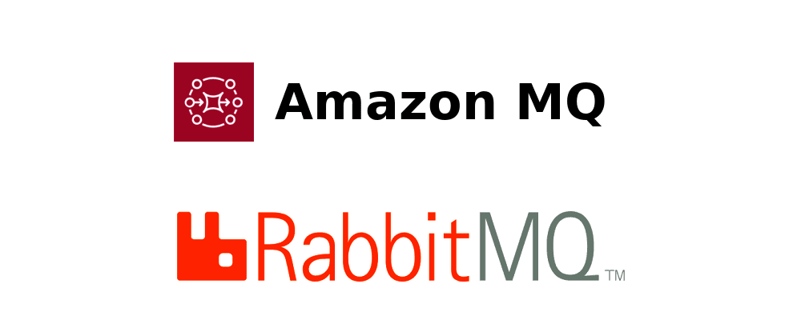
What is Amazon MQ ?
Amazon MQ is a managed message broker service for Apache ActiveMQ and RabbitMQ that makes it easy to set up, migrate and operate message brokers on AWS Cloud.

Slide 3
Amazon MQ Features
Managed Service — Amazon MQ manages administrative tasks such as hardware provisioning, broker setup, software upgrades, and failure detection and recovery.
Security — Amazon MQ provides encryption of messages at rest and in transit.
Monitoring — Amazon MQ is integrated with Amazon CloudWatch and AWS CloudTrail.
Broker Instance Types — Amazon MQ supports both single-instance brokers, suitable for evaluation and testing, and active/standby brokers for high availability in production.
Protocols — Amazon MQ uses industry-standard APIs and protocols for messaging, including Java Message Service (JMS), .NET Message Service (NMS), AMQP, AMQP 0–9–1, STOMP, MQTT, OpenWire, and WebSocket.

Slide 4
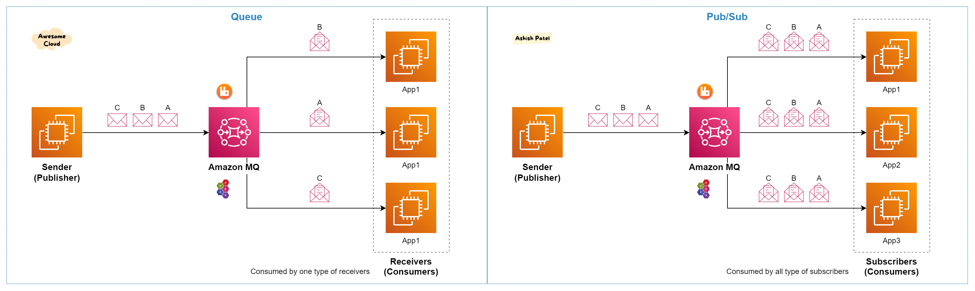
Amazon MQ

Slide 5
Amazon MQ Take Away
Amazon MQ is integrated with IAM, and provides ability to control the actions that IAM users and groups can take on specific MQ brokers.
Amazon MQ supports AWS KMS to create and manage keys for at-rest encryption of data in MQ.
Pricing — You are charged for broker instance, storage usage, and standard data transfer fees.
Amazon MQ is HIPAA eligible, and meets standards for PCI, SOC, and ISO compliance.
Amazon MQ works with your existing applications and services without the need to manage, operate, or maintain your own messaging system.
Amazon MQ stores your messages redundantly across multiple Availability Zones (AZs).

