Slide 1
AWS AppSync
Connect apps to data and events with secure, serverless, and performant GraphQL and Pub/Sub APIs

Slide 2
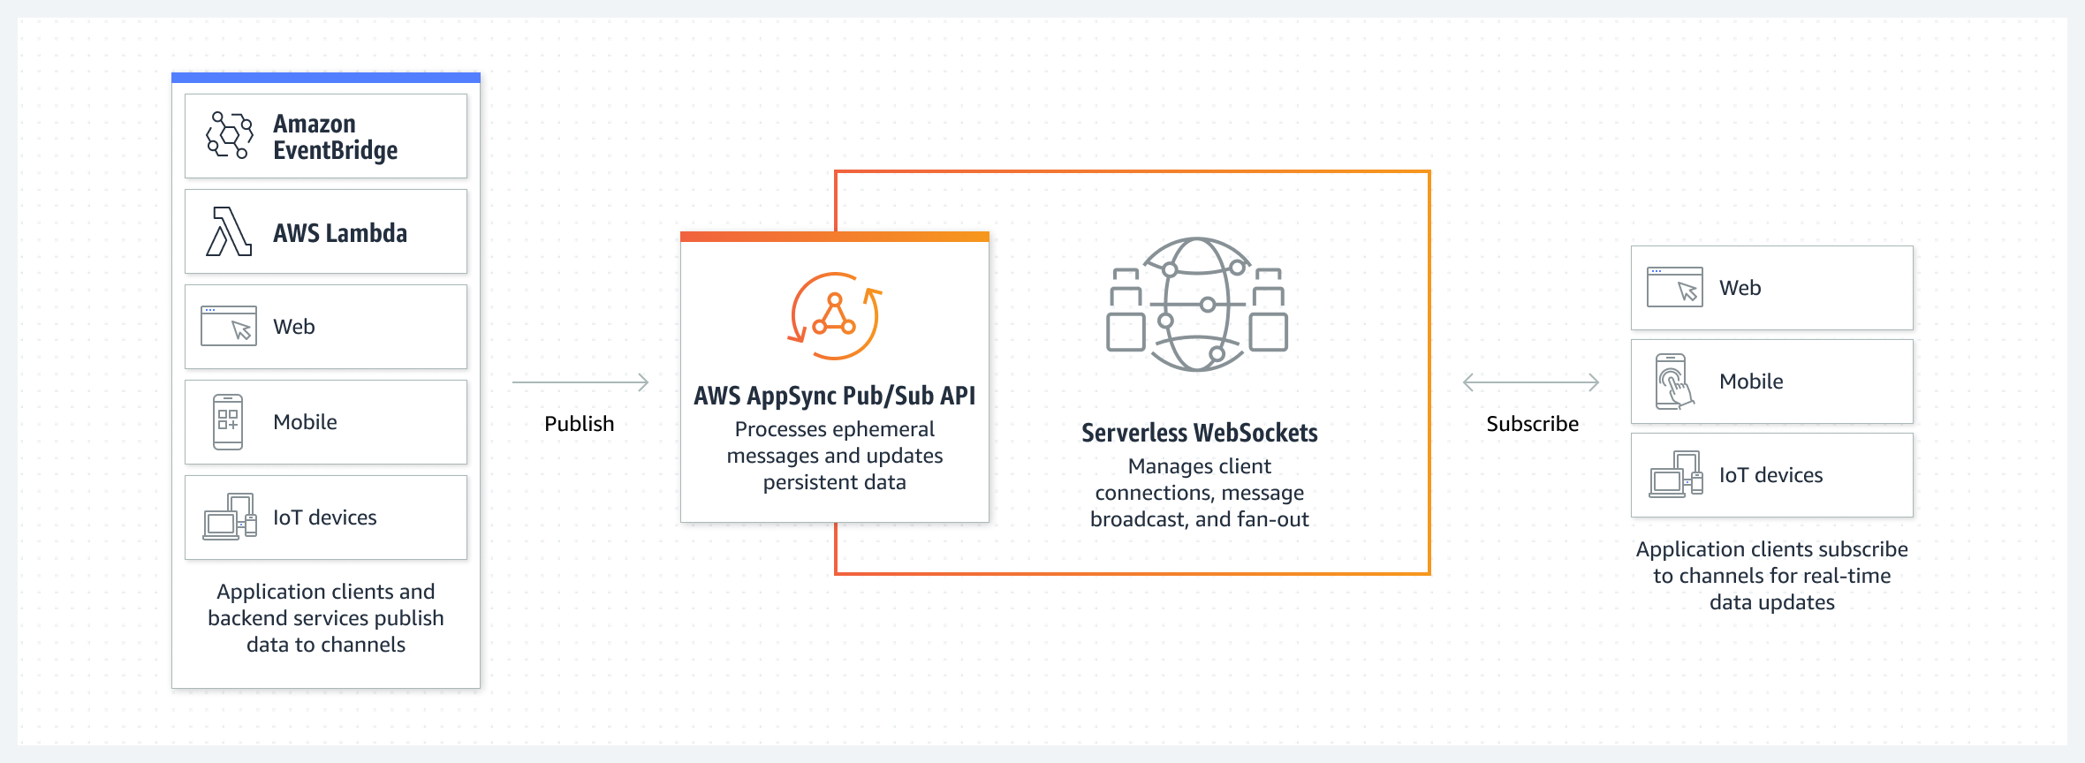
AWS AppSyc Pub/Sub APIs
Pub/Sub APIs built with AWS AppSync give frontend developers the ability to publish real-time data updates to subscribed API clients through serverless WebSocket connections.

Slide 3
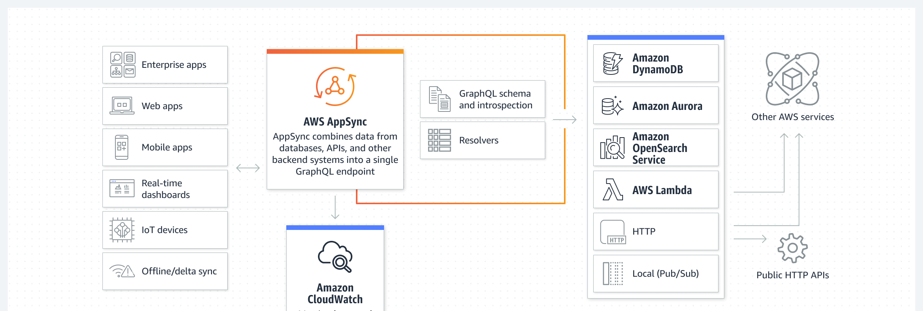
AWS AppSync GraphQL APIs
GraphQL APIs built with AWS AppSync give frontend developers the ability to query multiple databases, microservices, and APIs from a single GraphQL endpoint

Slide 4
What is GraphQL?
GraphQL is a query and manipulation language for APIs.
GraphQL provides a flexible and intuitive syntax to describe data requirements and interactions.
It enables developers to ask for exactly what is needed and get back predictable results.
Making updates to data is made simple with mutations, allowing developers to describe how the data should change. GraphQL also facilitates the quick setup of real-time solutions via subscriptions. All of these features combined, coupled with powerful developer tools, make GraphQL essential to managing application data.
GraphQL is an alternative to REST.
RESTful architecture is currently one of the more popular solutions for client-server communication.
It's centered on the concept of your resources (data) being exposed by a URL.
These URLs can be used to access and manipulate the data through CRUD operations in the form of HTTP methods like GET, POST, and DELETE. REST's advantage is that it's relatively simple to learn and implement.

Slide 5
GraphQL concepts
AppSync GraphQL APIs – provides a unified endpoint for securely querying and updating data from multiple databases, microservices, and APIs
AppSync Pub/Sub APIs – data updates are automatically published to subscribed API clients via serverless WebSockets connections.
Three level operations:
Query – read-only fetch
Mutation – write followed by a fetch
Subscription – long-lived connection for receiving data
To build a GraphQL API, you need to have the following:
GraphQL Schema – each GraphQL API is defined by a single GraphQL schema.
Data Source – AWS resources that GraphQL APIs can interact with.
Resolvers – uses mapping templates to convert a GraphQL expression into a format that the data source can use.
Unit resolver – performs a single operation against a predefined data source.
Pipeline resolver – executes multiple operations against multiple data sources.
Data filtering
Basic – subscription query filtering based on client-defined arguments.
Enhanced – filtering based on logic defined centrally in the backend of the AWS AppSync.

Slide 6
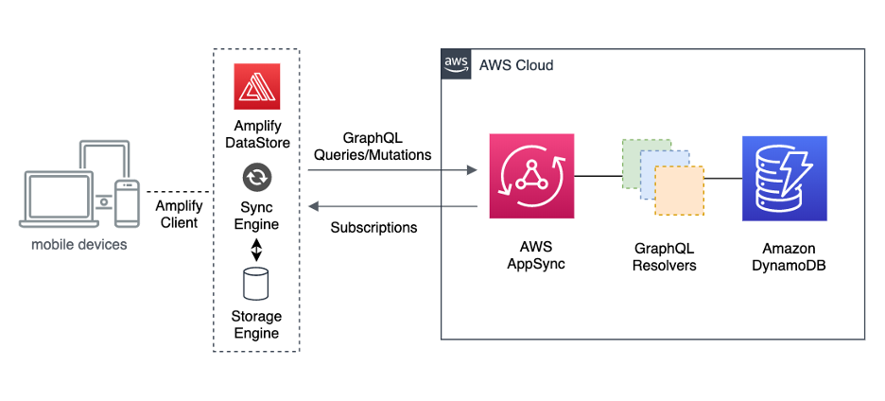
AWS AppSync offline reference architecture
https://aws.amazon.com/blogs/mobile/aws-appsync-offline-reference-architecture/

