Slide 1
KMS

Slide 2

AWS Key Management Service
AWS Key Management Store (KMS) is a managed service that enables you to easily encrypt your data.
AWS KMS provides a highly available key storage, management, and auditing solution for you to encrypt data within your own applications and control the encryption of stored data across AWS services.
AWS KMS allows you to centrally manage and securely store your keys. These are known as AWS KMS keys (formerly known as customer master keys (CMKs).
Anytime you hear “encryption” for an AWS service, it’s most likely KMS

Slide 3

AWS KMS Keys
A KMS key consists of:
Alias.
Creation date.
Description.
Key state.
Key material (either customer provided or AWS provided).
KMS keys are the primary resources in AWS KMS.
The KMS key includes metadata, such as the key ID, creation date, description, and key state.
The KMS key also contains the key material used to encrypt and decrypt data.
AWS KMS supports symmetric and asymmetric KMS keys.
KMS keys are created in AWS KMS. Symmetric KMS keys and the private keys of asymmetric KMS keys never leave AWS KMS unencrypted.
By default, AWS KMS creates the key material for a KMS key.
A KMS key can encrypt data up to 4KB in size.
A KMS key can generate, encrypt, and decrypt Data Encryption Keys (DEKs).
A KMS key can never be exported from KMS (CloudHSM allows this).

Slide 4
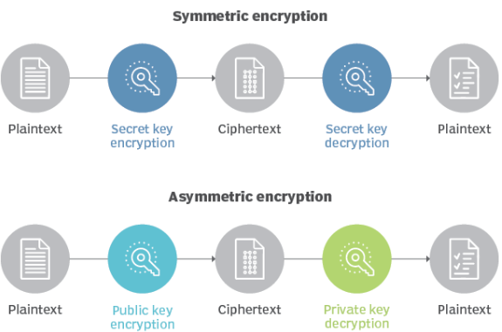
KMS Key Types
Symmetric (AES-256 keys)
First offering of KMS, single encryption key that is used to Encrypt and Decrypt
AWS services that are integrated with KMS use Symmetric KMS keys
Necessary for envelope encryption
You never get access to the KMS key unencrypted (must call KMS API to use)
Asymmetric (RSA & ECC key pairs)
Public (Encrypt) and Private Key (Decrypt) pair
Used for Encrypt/Decrypt, or Sign/Verify operations
The public key is downloadable, but you can’t access the Private Key unencrypted
Use case: encryption outside of AWS by users who can’t call the KMS API

Slide 5
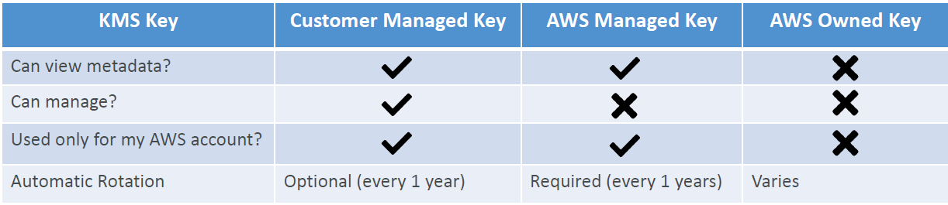
Types of KMS Keys
Customer Managed Keys
Create, manage and use, can enable or disable
Possibility of rotation policy (new key generated every year, old key preserved)
Can add a Key Policy (resource policy) & audit in CloudTrail
Leverage for envelope encryption
AWS Managed Keys
Used by AWS service (aws/s3, aws/ebs, aws/redshift)
Managed by AWS (automatically rotated every 1 years)
View Key Policy & audit in CloudTrail
AWS Owned Keys
Created and managed by AWS, use by some AWS services to protect your resources
Used in multiple AWS accounts, but they are not in your AWS account
You can’t view, use, track, or audit

Slide 6
KMS Key Material Origin
Identifies the source of the key material in the KMS key
Can’t be changed after creation
KMS (AWS_KMS) – default
AWS KMS creates and manages the key material in its own key store
External (EXTERNAL)
You import the key material into the KMS key
You’re responsible for securing and managing this key material outside of AWS
Custom Key Store (AWS_CLOUDHSM)
AWS KMS creates the key material in a custom key store (CloudHSM Cluster)

Slide 7
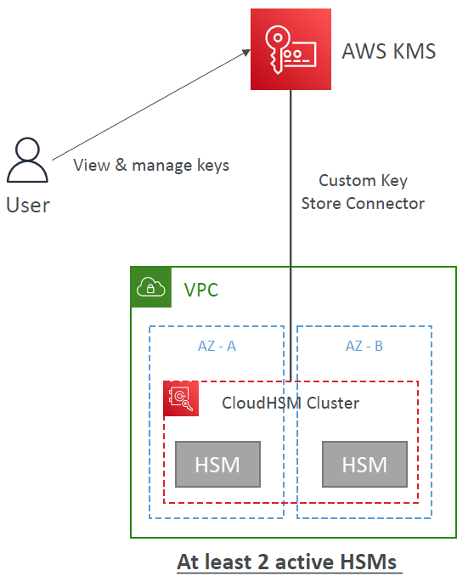
KMS Key Source – Custom Key Store (CloudHSM)
Integrate KMS with CloudHSM cluster as a Custom Key Store
Key materials are stored in a CloudHSM cluster that you own and manage
The cryptographic operations are performed in the HSMs
Use cases:
You need direct control over the HSMs
KMS keys needs to be stored in a dedicated HSMs
HSMs must be validated at FIPS 140-2 Level 3 (KMS validated at FIPS 140-2 Level 2)

Slide 8
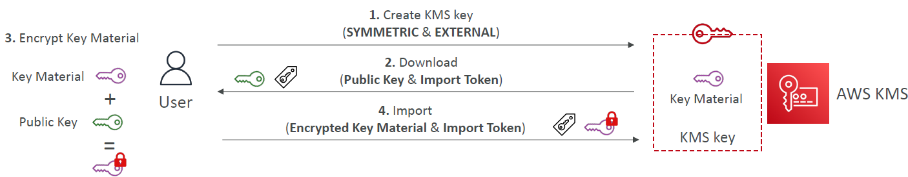
KMS Key Source - External
Import your own key material into KMS key, Bring Your Own Key (BYOK)
You’re responsible for key material’s security, availability, and durability outside of AWS
Must be 256-bit Symmetric key (Asymmetric is NOT supported)
Can’t be used with Custom Key Store (CloudHSM)
Manually rotate your KMS key (Automatic Key Rotation is NOT supported)

Slide 9
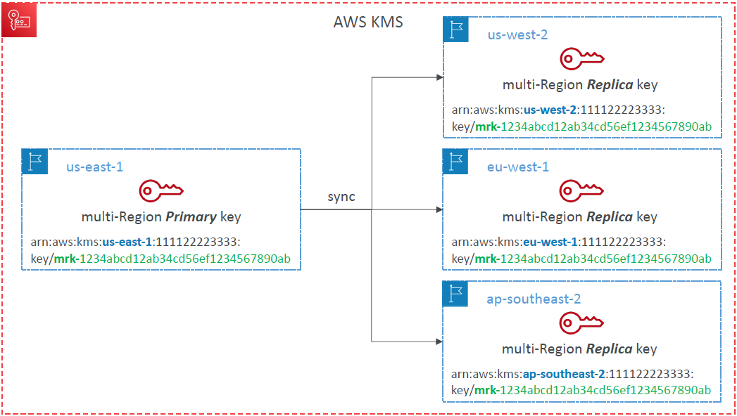
KMS Multi-Region Keys
Identical KMS keys in different AWS Regions that can be used interchangeably
Multi-Region keys have the same key ID, key material, automatic rotation…
Encrypt in one Region and decrypt in other Regions
No need to re-encrypt or making cross-Region API calls
KMS Multi-Region are NOT global (Primary + Replicas)
Each Multi-Region key is managed independently
Use cases: global client-side encryption, encryption on Global DynamoDB, Global Aurora

Slide 10
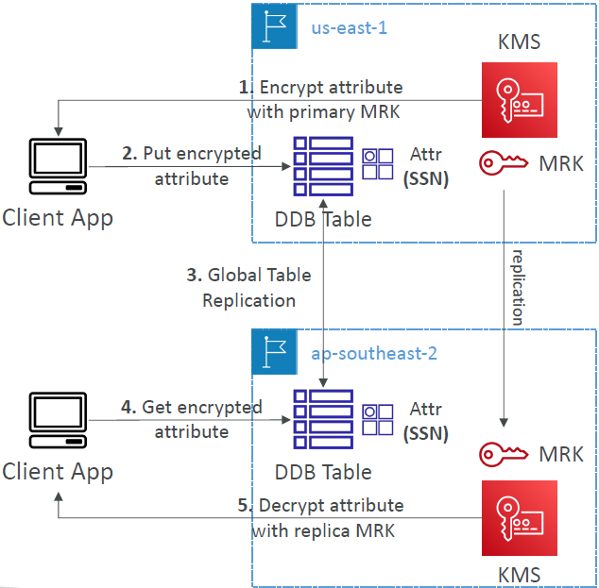
DynamoDB Global Tables and KMS Multi-Region Keys Client-Side encryption
We can encrypt specific attributes client-side in our DynamoDB table using the Amazon DynamoDB Encryption Client
Combined with Global Tables, the client-side encrypted data is replicated to other regions
If we use a multi-region key, replicated in the same region as the DynamoDB Global table, then clients in these regions can use low latency API calls to KMS in their region to decrypt the data client-side
Using client-side encryption we can protect specific fields and guarantee only decryption if the client has access to an API key

Slide 11
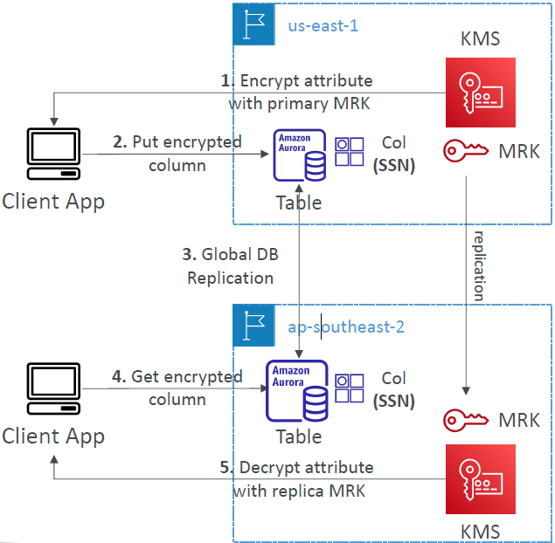
Global Aurora and KMS Multi-Region Keys Client-Side encryption
We can encrypt specific attributes client-side in our Aurora table using the AWS Encryption SDK
Combined with Aurora Global Tables, the client-side encrypted data is replicated to other regions
If we use a multi-region key, replicated in the same region as the Global Aurora DB, then clients in these regions can use low-latency API calls to KMS in their region to decrypt the data client-side
Using client-side encryption we can protect specific fields and guarantee only decryption if the client has access to an API key, we can protect specific fields even from database admins

Slide 12
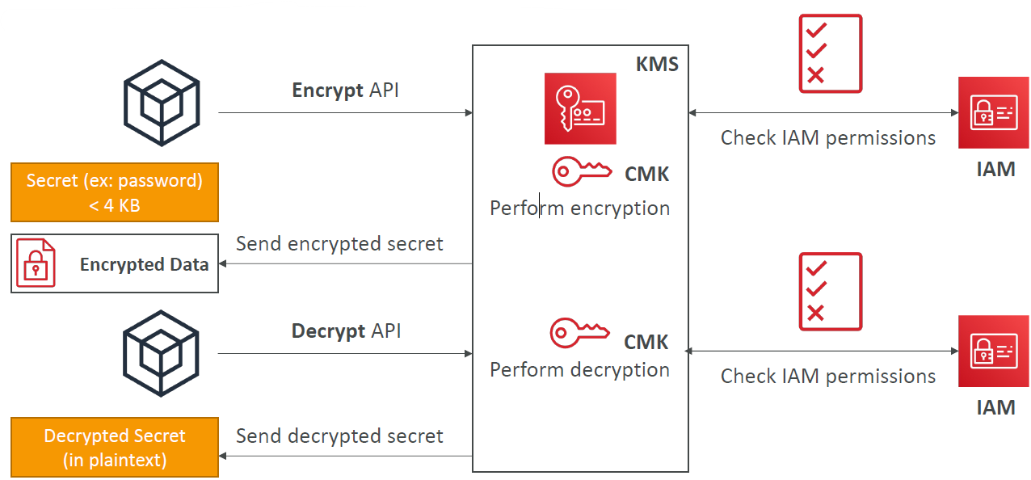
How does KMS work? API – Encrypt and Decrypt

Slide 13
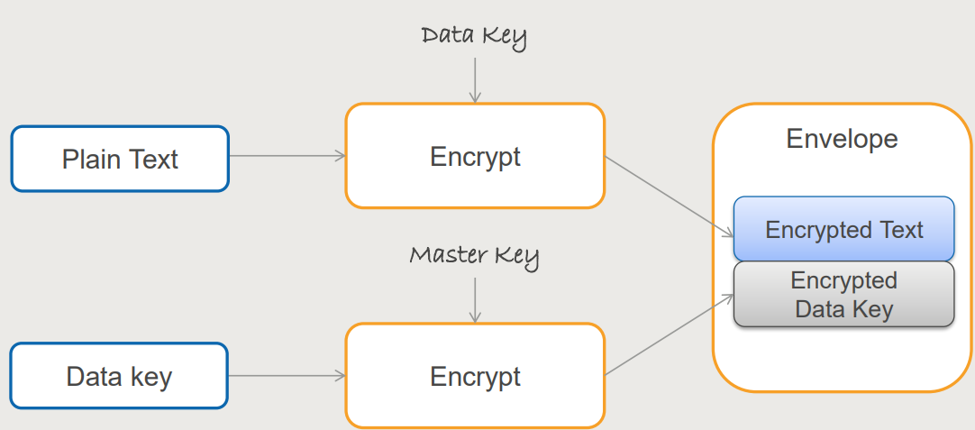
Envelope Encryption
AWS KMS is integrated with AWS services and client-side toolkits that use a method known as envelope encryption to encrypt your data.
Under this method, KMS generates data keys which are used to encrypt data and are themselves encrypted using your master keys in KMS:
A KMS key is used to encrypt the data key (envelope key).
The envelope key is used to decrypt the data.
KMS Encrypt API call has a limit of 4 KB
If you want to encrypt >4 KB, we need to use
Envelope Encryption
The main API that will help us is the
GenerateDataKey API

Slide 14
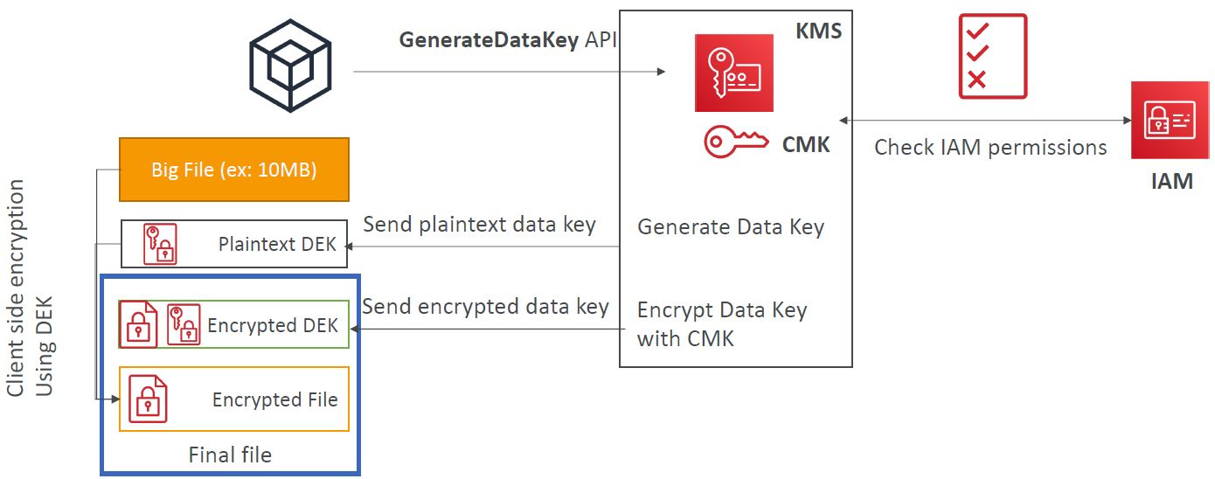
Envelope Encryption GenerateDataKey API

Slide 15
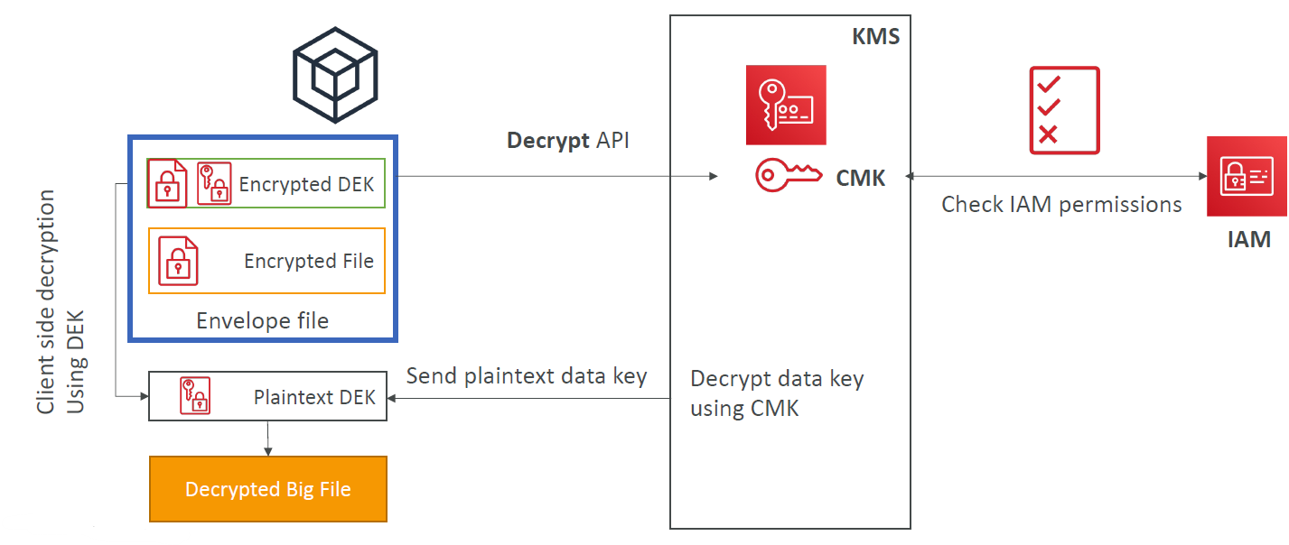
Envelope Encryption Decrypt envelope data

Slide 16
Encryption SDK
The AWS Encryption SDK implemented Envelope Encryption for us
The Encryption SDK also exists as a CLI tool we can install
Implementations for Java, Python, C, JavaScript
Feature - Data Key Caching:
re-use data keys instead of creating new ones for each encryption
Helps with reducing the number of calls to KMS with a security trade-off
Use LocalCryptoMaterialsCache (max age, max bytes, max number of messages)

Slide 17
KMS API Summary
Encrypt: encrypt up to 4 KB of data through KMS
GenerateDataKey: generates a unique symmetric data key (DEK)
returns a plaintext copy of the data key
AND a copy that is encrypted under the CMK that you specify
Enables automatic rotation of the key material for the specified symmetric customer master key (KMS key).
You cannot perform this operation on a KMS key in a different AWS account.
GenerateDataKeyWithoutPlaintext:
Generates a unique symmetric data key.
Generate a DEK to use at some point (not immediately)
DEK that is encrypted under the CMK that you specify (must use Decrypt later)
Decrypt: decrypt up to 4 KB of data (including Data Encryption Keys)
GenerateRandom: Returns a random byte string

Slide 18
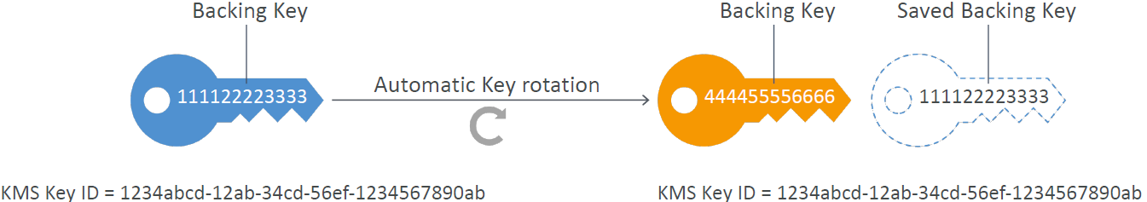
KMS Automatic Key Rotation
AWS-managed KMS Keys: automatically rotated every 1 year
For Customer-Managed KMS Key
Automatic key rotation is optionally enabled, will happen every 1 year
Previous key is kept active so you can decrypt old data
New Key has the same KMS Key ID (only the backing key is changed)

Slide 19
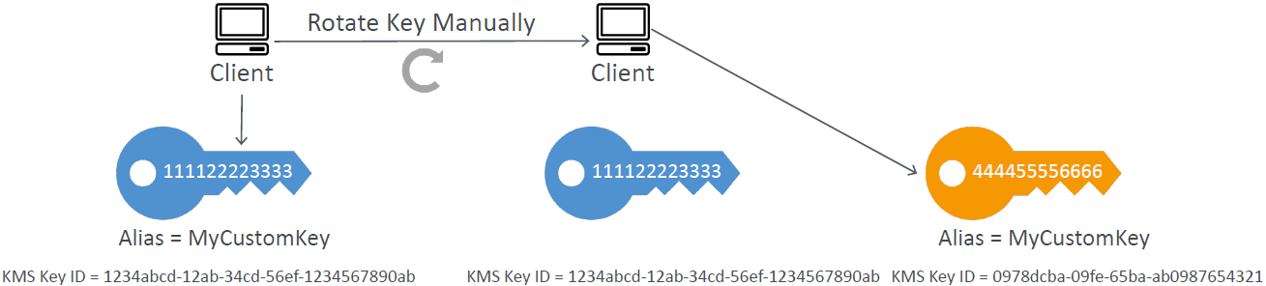
KMS Manual Key Rotation (for Customer-Managed KMS Key and Imports)
When you want to rotate key every 90 days, 180 days, etc…
New Key has a different KMS Key ID
Keep the previous key active so you can decrypt old data
Better to use aliases in this case (to hide the change of key for the application)
Good solution to rotate KMS Key that are not eligible for automatic rotation (like asymmetric CMK)

Slide 20
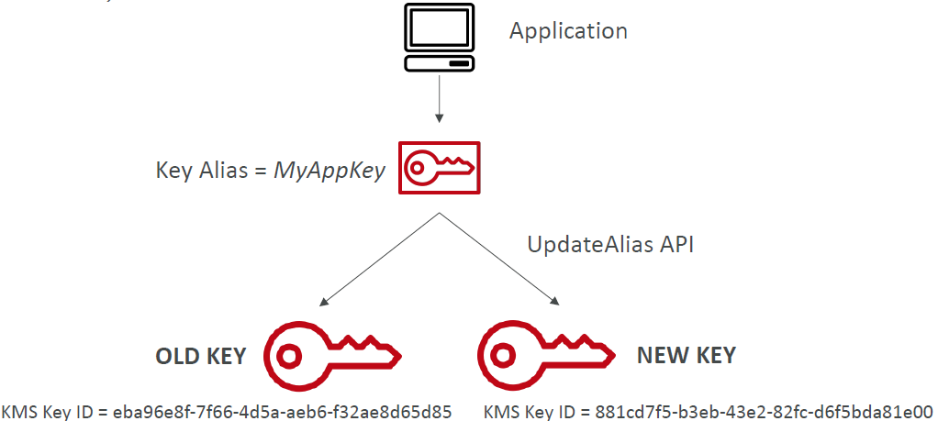
KMS Alias Updating
Better to use aliases in this case (to hide the change of key for the application)

Slide 21
KMS Key Deletion
Generated Keys (from within KMS)
No expiration date
You may manually disable it immediately instead (to re-enable it later)
Cannot be deleted immediately, mandatory 7 to 30 days waiting period
You can cancel key deletion during the waiting period
During the waiting period, the KMS Key cannot be used for Encrypt / Decrypt
Everything will be deleted at the end of the waiting period
Imported Keys:
You may manually disable it and schedule for deletion (everything is deleted)
You may set an expiration period on the Key
KMS will delete the key material
You can also delete the key material on demand
The metadata is kept so you can re-import in the future
AWS managed keys or AWS owned keys cannot be deleted

Slide 22
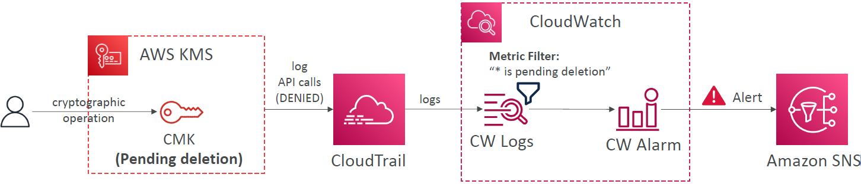
KMS Key Deletion – CloudWatch Alarm
Use CloudTrail, CloudWatch Logs, CloudWatch Alarms and SNS to be notified when someone tries to use a CMK that’s ”Pending deletion” in a cryptographic operation (Encrypt, Decrypt, …)

Slide 23
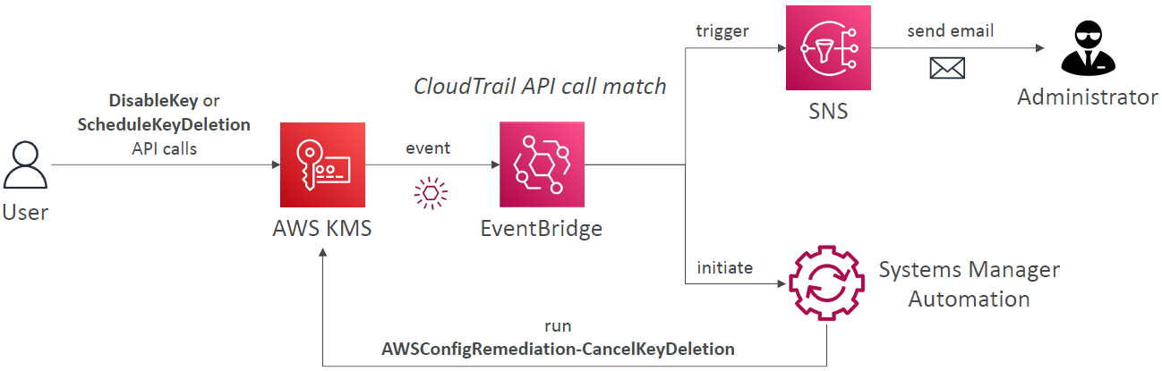
KMS Key Deletion – Notifications
To be notified of Keys being deleted or disabled
Using CloudTrail + EventBridge

Slide 24
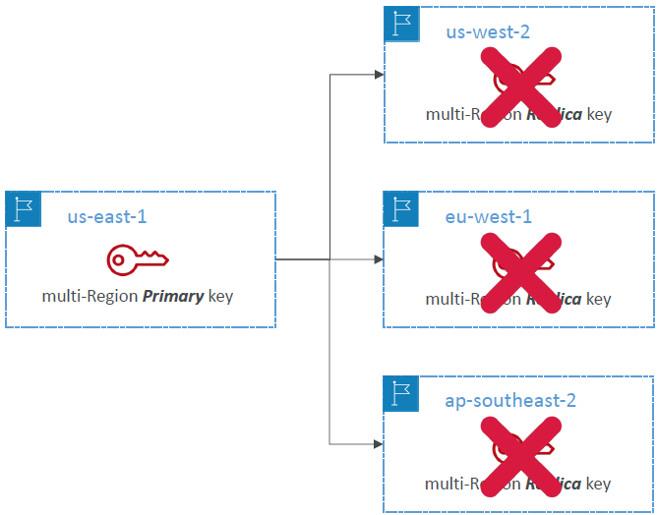
KMS Multi Region Key Deletion
Deleting Replica Key
Less risky, can always be re-created from the Primary Key (if it exists)
Must be scheduled (7 to 30 days)
Deleting Primary Key
Cannot happen until all Replicas have been deleted
If you want to delete a Primary Key but keep Replicas, promote another one as Primary and then delete the “old Primary Key”
Must be scheduled (7 to 30 days after the replicas are deleted)

Slide 25
KMS Key Policies
Control access to KMS keys, “similar” to S3 bucket policies
Difference: you cannot control access without them
Default KMS Key Policy:
Created if you don’t provide a specific KMS Key Policy
Complete access to the key to the root user = entire AWS account
Custom KMS Key Policy:
Define users, roles that can access the KMS key
Define who can administer the key
Useful for cross-account access of your KMS key

Slide 26
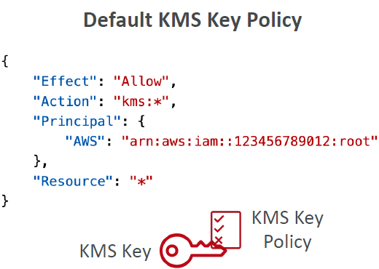
Default KMS Key Policy
It gives the AWS account that owns the KMS key, full access to the KMS key
KMS Key Policy does NOT automatically give permission to the account or any of its users
Allows the account to use IAM policies to allow access to the KMS key, in addition to the key policy

Slide 27
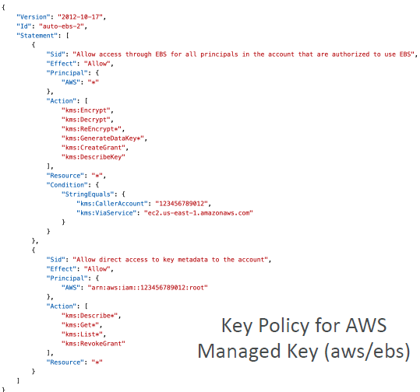
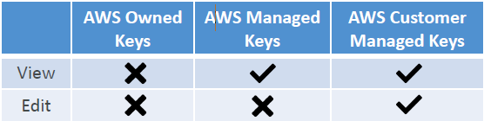
KMS Key Policies
AWS Owned Keys
You cannot view or change the Key Policy
AWS Managed Keys (e.g., aws/ebs)
You can view the Key Policy
You cannot change the Key Policy
AWS Customer Managed Keys
You can view the Key Policy
You can edit the Key Policy

Slide 28
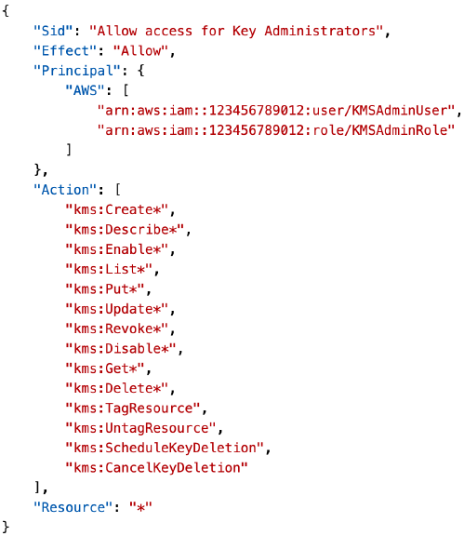
Custom KMS Key Policy – Allow Admins
KMS Key administrators have permissions to manage the KMS key
KMS Key administrators cannot use the KMS Key Cryptographic Operations (Encrypt / Decrypt…)
You can add IAM Users / Roles as KMS Key administrators

Slide 29
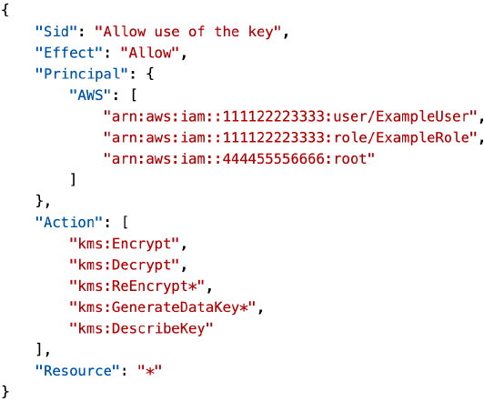
Custom KMS Key Policy – Allow Users to Directly Use the KMS Key
Allows IAM Users / Roles to use the KMS Key directly
IAM Users / Roles don’t need IAM Policies if the KMS Key is in the same account
The KMS Key explicitly authorizes the IAM Principal
Alternative is Default KMS Key + IAM Policy

Slide 30
KMS Grants
Allows you to grant access to specific AWS KMS keys to other AWS accounts and IAM Users / Roles within your AWS account
Often used for temporary permissions
Can be created for a variety of operations, including encrypt, decrypt, sign, and verify, as well as creating more grants
Grant are for one KMS Key only, and one or more IAM Principal
Once granted, a principal can perform any operation as specified in the Grant
Grants do NOT expire automatically, you must delete them manually
You don’t need to change KMS Key Policy or IAM Policy

Slide 31
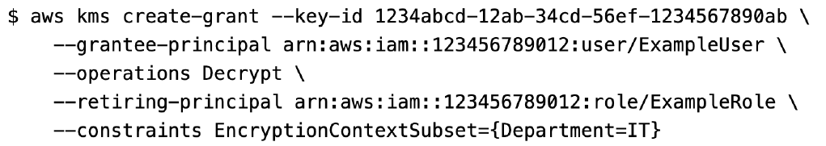
Creating a KMS Key Grant
Using AWS CLI
Make sure to delete a KMS Key Grant when you’re done using it
For now, there’s no support in the AWS Console

Slide 32
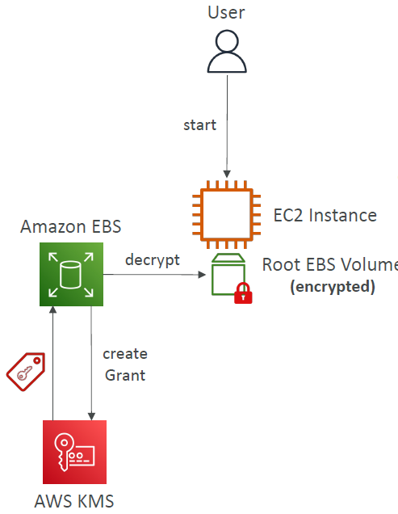
KMS Grants – AWS Service Usage
Grants are commonly used by AWS services that integrate with AWS KMS to encrypt your data at rest
The AWS service creates a Grant on behalf of a user in the account, uses its permissions, and retires the grant as soon as its task is complete
Users must have the CreateGrant IAM permission

Slide 33
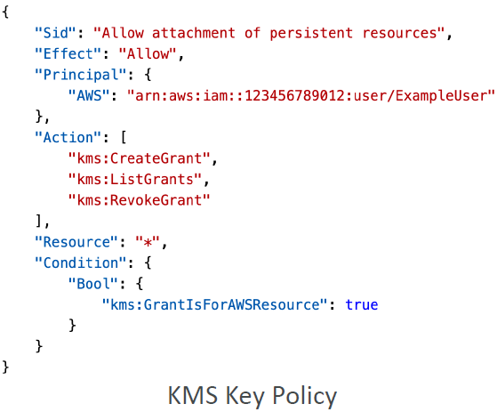
Custom KMS Key Policy –Grants for AWS Services Use Cases
Use this KMS Key Policy with:
Amazon EBS and Amazon EC2 to attach an encrypted EBS volume to an EC2 instance
Amazon Redshift to launch an encrypted cluster
AWS services integrated with AWS KMS that use grants to create, manage, or use encrypted resources with those services

Slide 34
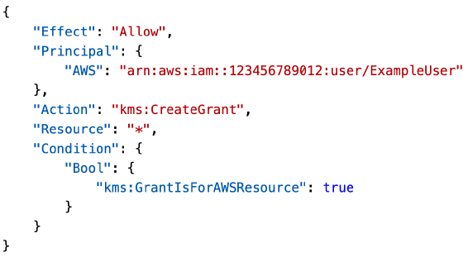
Troubleshooting: Can’t Start an EC2 Instance with Encrypted EBS Volume
Reasons:
KMS key might be disabled or deleted
EBS service might not have the required permissions to use KMS key
Resolution:
Make sure the KMS key is exists and enabled
Make sure that EBS service has the require permissions to create KMS Grants in behalf of the specified principal
kms:GrantIsForAWSResource – allows AWS services to create Grants (e.g., EBS)

Slide 35
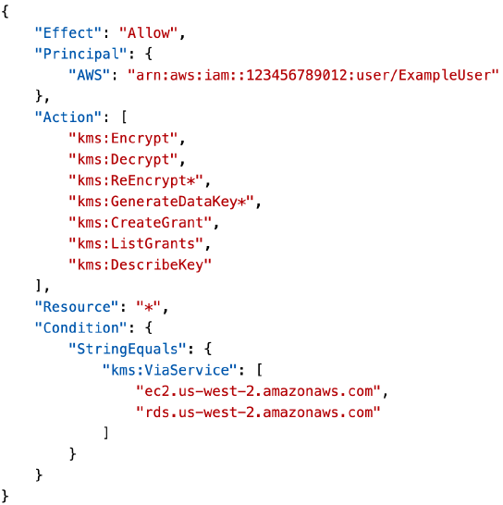
Condition Keys – kms:ViaService
kms:ViaService – limits the use of a KMS key to requests from specified AWS services
Example: the following key policy allow usage of the KMS Key through EC2 or RDS in us-west-2 on behalf of the ExampleUser
IAM user must be authorized to use the KMS Key and Grant it to the AWS service
Can be used with AWS Managed Keys (e.g., aws/ebs)

Slide 36
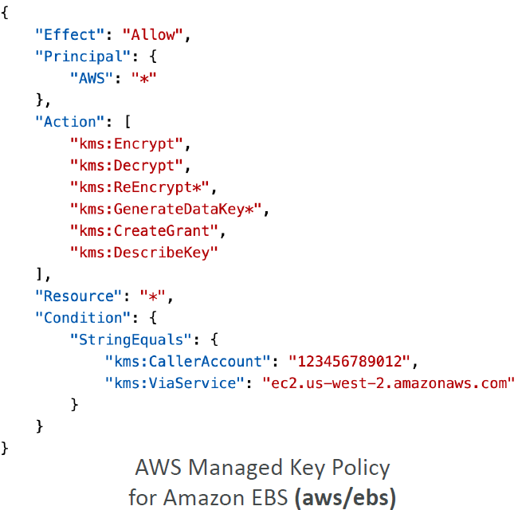
Condition Keys – kms:CallerAccount
kms:CallerAccount – Allow or deny access to all identities (IAM users and roles) in an AWS account
Example: the following KMS Key policy is the Key policy for AWS Managed Key for Amazon EBS (aws/ebs)

Slide 37
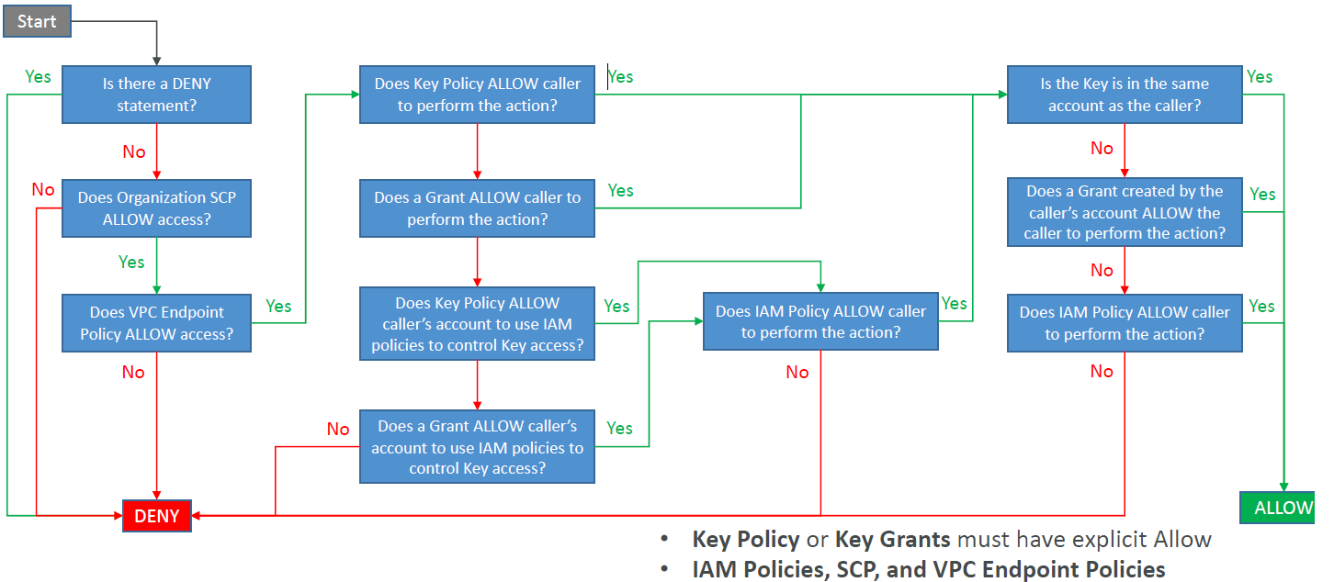
KMS Key Authorization Process

Slide 38
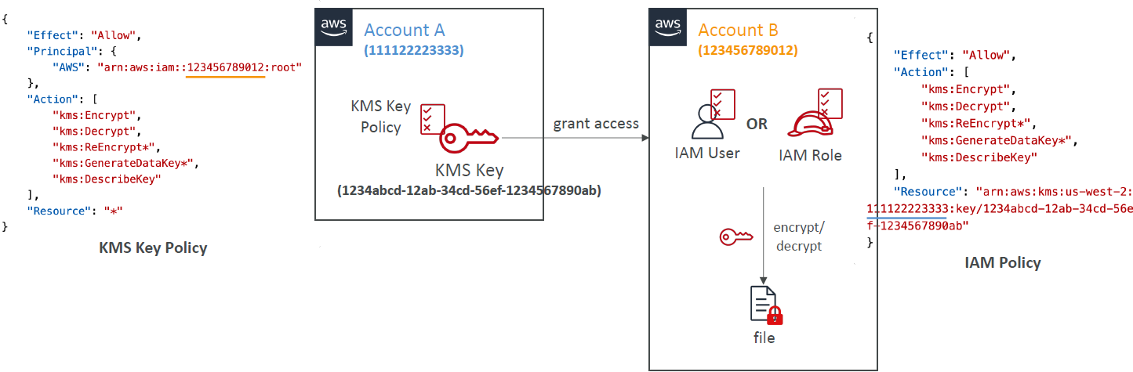
KMS Key – Cross-Account Access

Slide 39
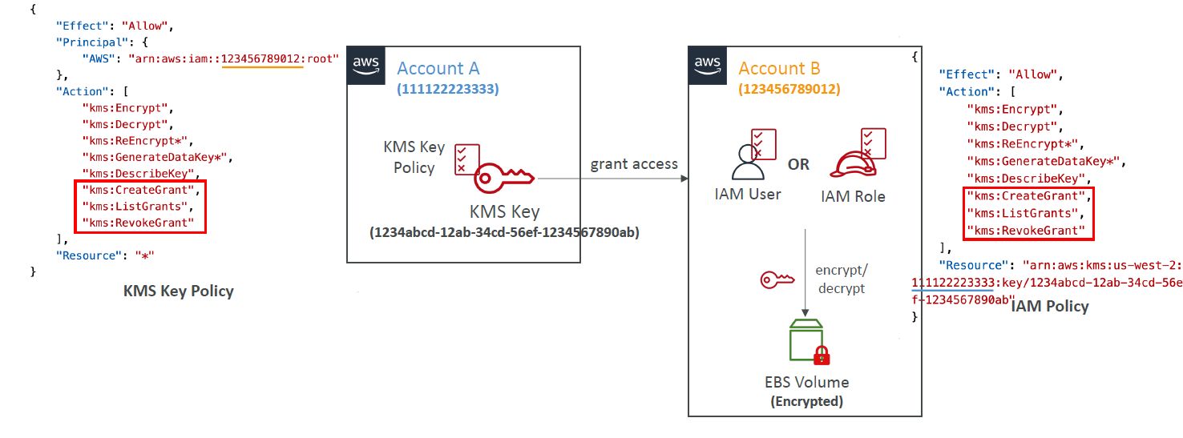
KMS Key – Cross-Account Access Usage of External KMS Keys with AWS Services

Slide 40
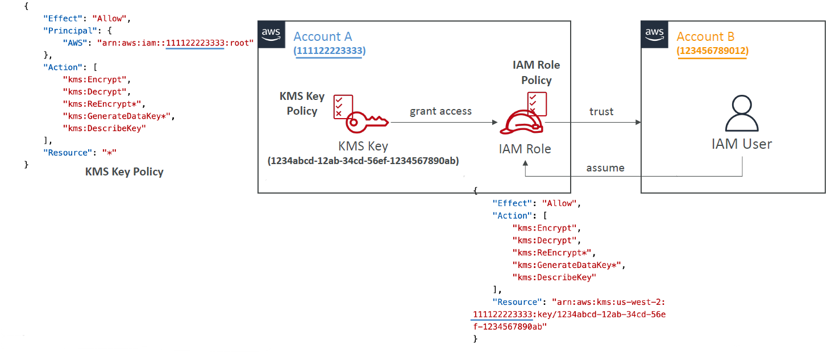
KMS Key – Cross-Account Access Through assuming an IAM Role

Slide 41
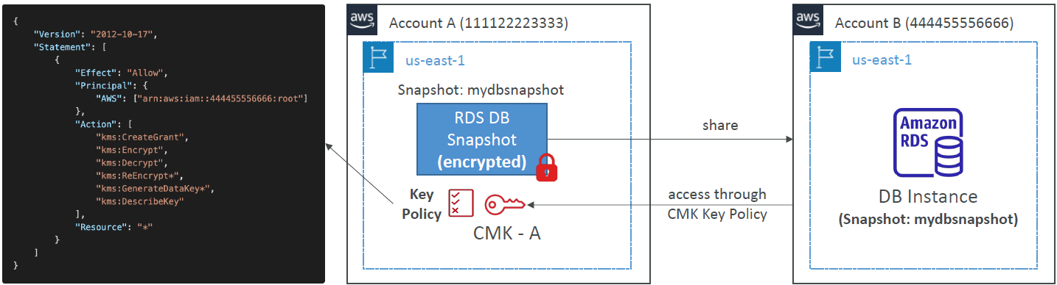
Sharing KMS Encrypted RDS DB Snapshots
You can share RDS DB snapshots encrypted with KMS CMK with other accounts, but must first share the KMS CMK with the target account using Key Policy

Slide 42
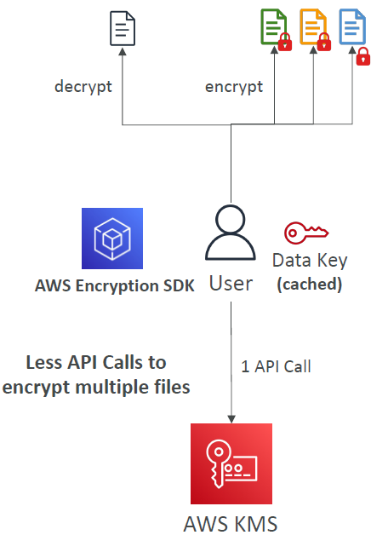
KMS API Calls Limits & Data Key Caching
When your application makes multiple API calls to KMS and you hit service limits (requests per second limit)…
Data Key Caching allows you to reuse data keys that protect your data
Instead of generating a new data key for each encryption operation
Reduce latency, improve throughput, reduce cost, stay within service limits, …
Implemented using AWS Encryption SDK
Note: encryption best practices discourages reuse of data keys (trade-off cost / security)

Slide 43
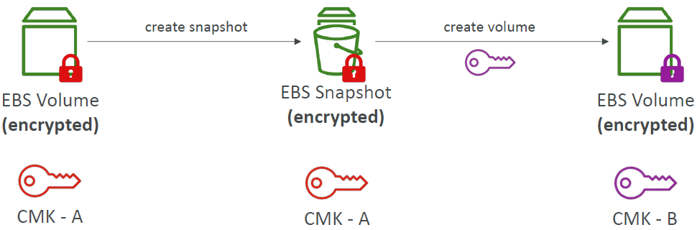
Changing The KMS Key For An Encrypted EBS Volume
You can’t change the encryption keys used by an EBS volume
Create an EBS snapshot and create a new EBS volume and specify the new KMS key

Slide 44
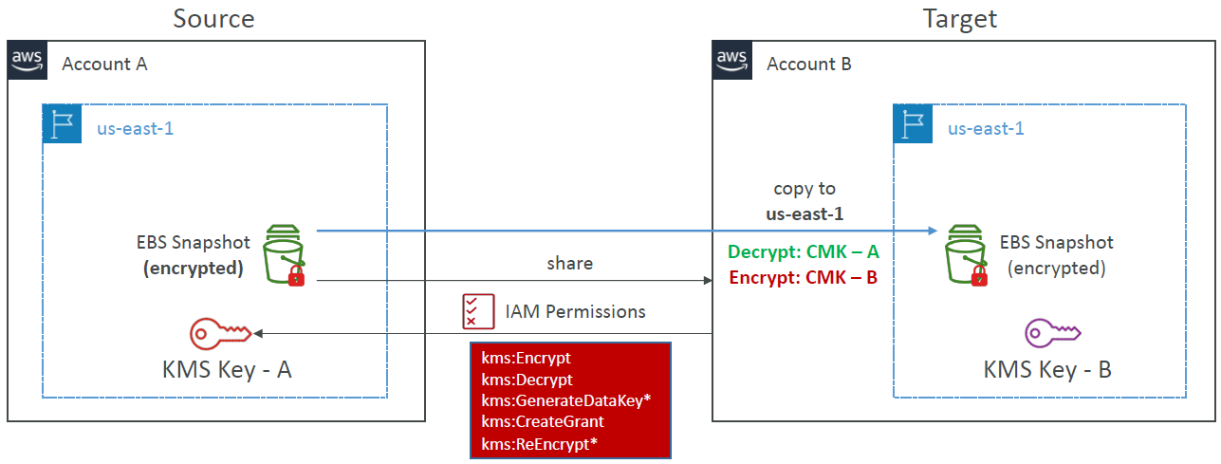
Automate Cross-Account EBS KMS-Encrypted Snapshot Copies

Slide 45
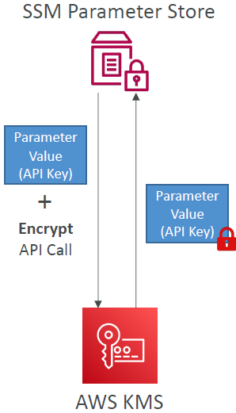
KMS with SSM Parameter Store
SSM Parameter Store uses KMS to encrypt/decrypt parameter values of type Secure String
Two types of Secure String Parameters:
Standard – all parameters encrypted using the same KMS key
Advanced – each parameter encrypted with a unique data key (Envelope Encryption)
Specify the KMS key or use AWS Managed Key (aws/ssm)
Works only with Symmetric KMS Keys
Encryption process takes place in AWS KMS
Note: you must have access to both the KMS key and the parameter in SSM Parameter Store

