Slide 1
AWS DataSync
Simplify and accelerate secure data migrations

Slide 2
AWS DataSync
Securely discover and migrate your data to AWS with end-to-end security, including data encryption and data integrity validation.
Simplify migration planning and reduce expensive on-premises data movement costs with a fully managed service that seamlessly scales as data loads increase.
Easily manage data movement workloads with bandwidth throttling, migration scheduling, task filtering, and task reporting
Rapidly migrate file and object data to the cloud for data replication or archival

Slide 3
AWS DataSync Use cases
Migrate your data
Quickly move file and object data to AWS. Your data is secure with in-flight encryption and end-to-end data validation.
Protect your data
Securely replicate your data into cost-efficient AWS storage services, including any Amazon S3 storage class.
Archive your cold data
Reduce on-premises storage costs by moving data directly to Amazon S3 Glacier archive storage classes
Manage your hybrid data workflows
Seamlessly move data between on-premises systems and AWS to accelerate your critical hybrid workflows

Slide 4
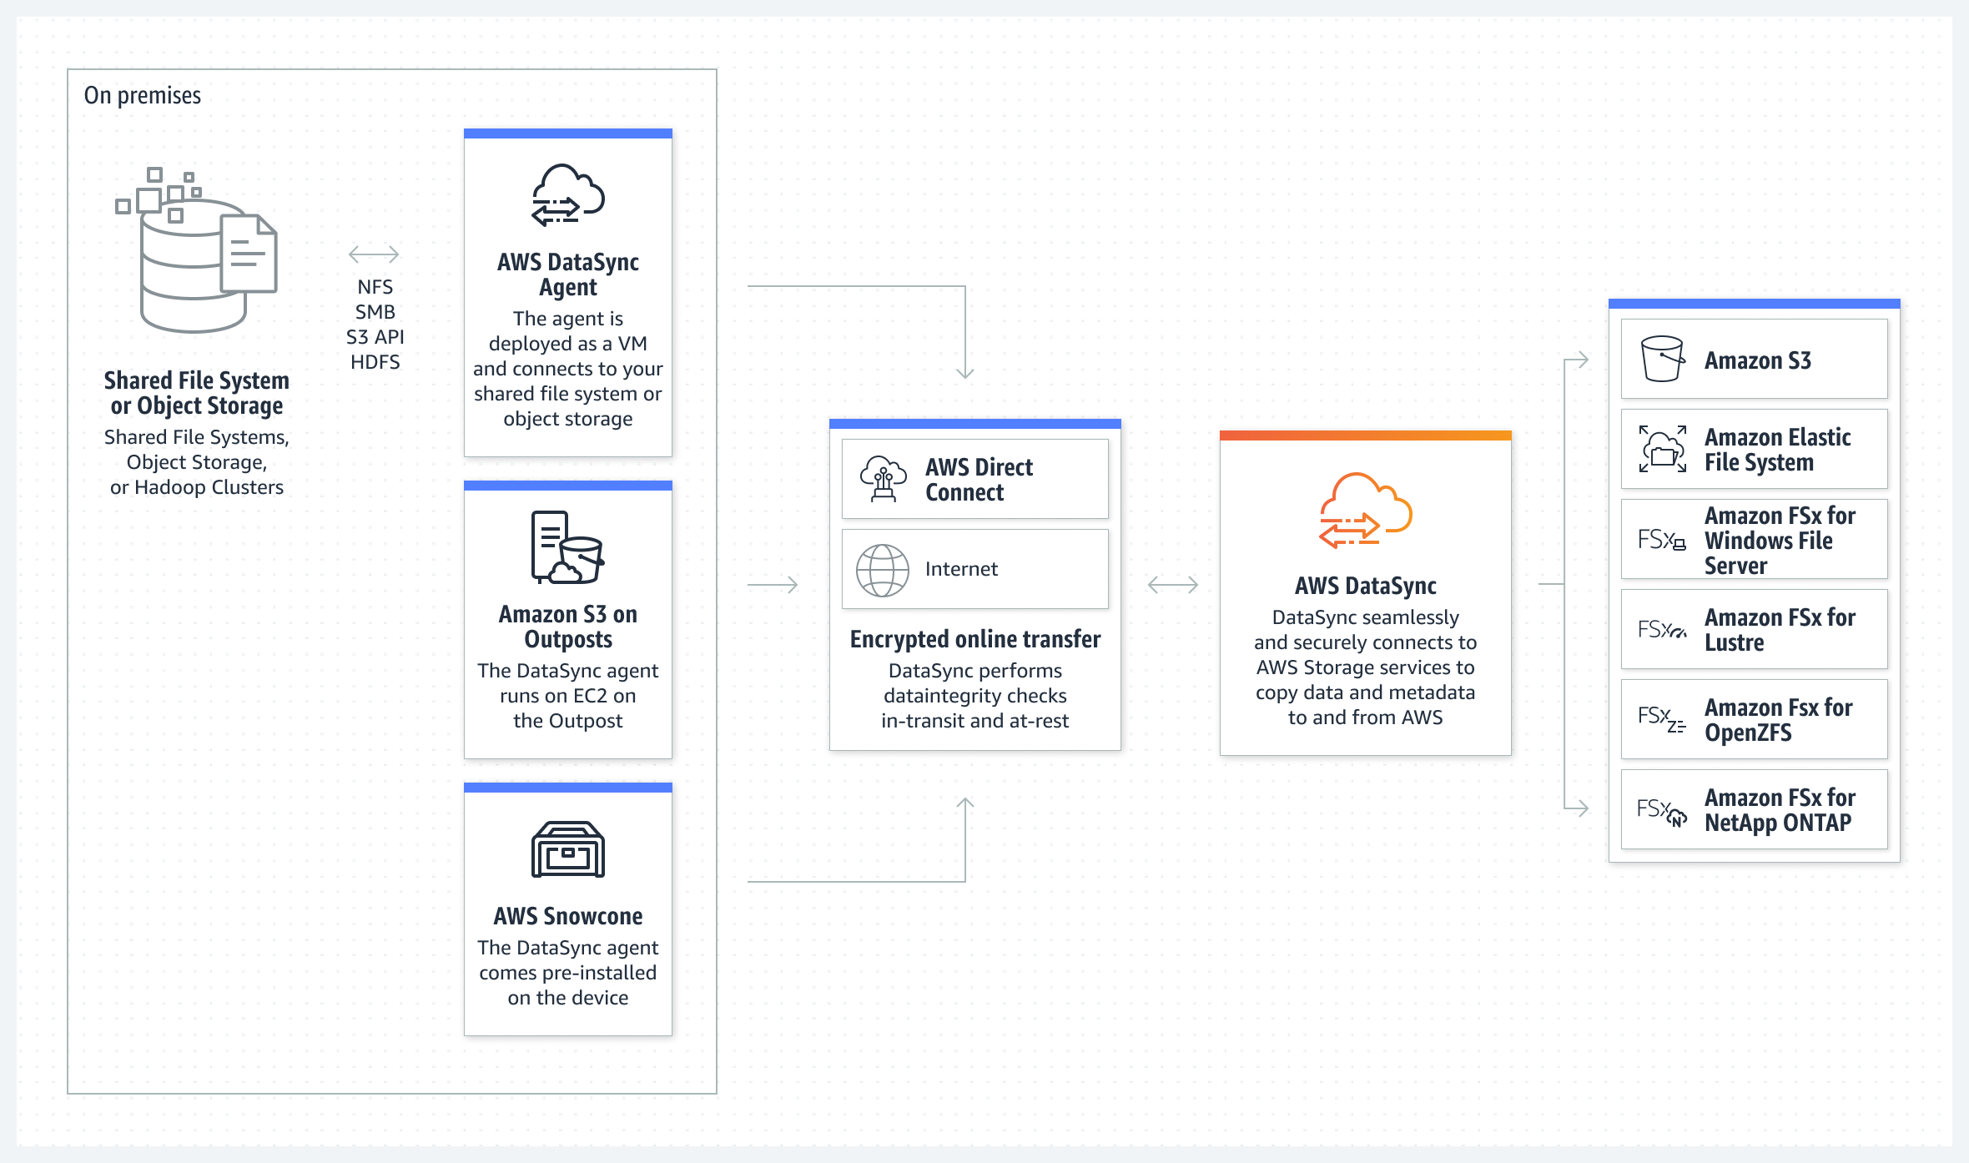
Transfer data between on premises and AWS

Slide 5
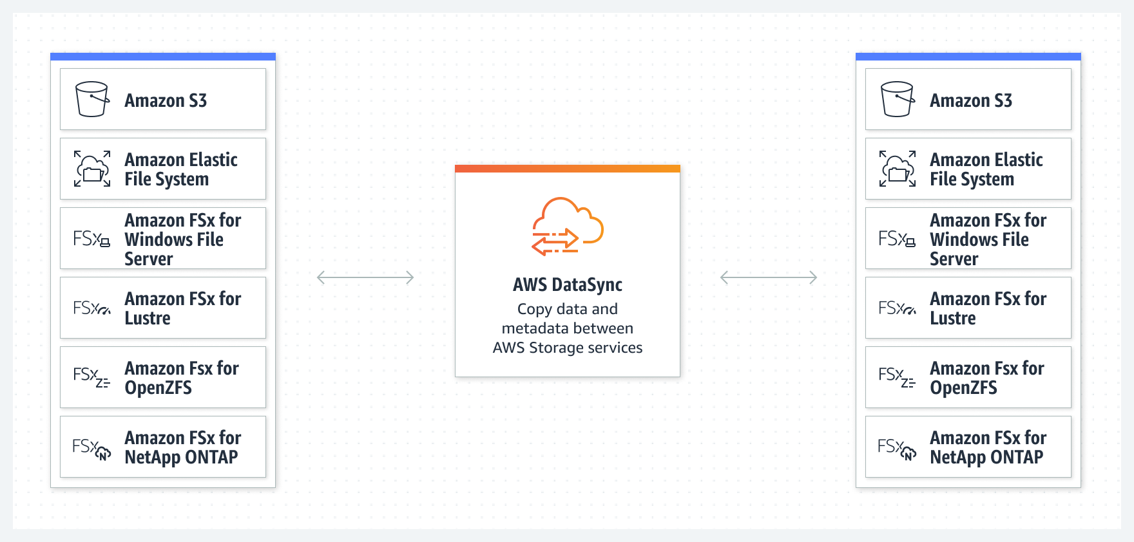
Transfer data between AWS storage services

Slide 6
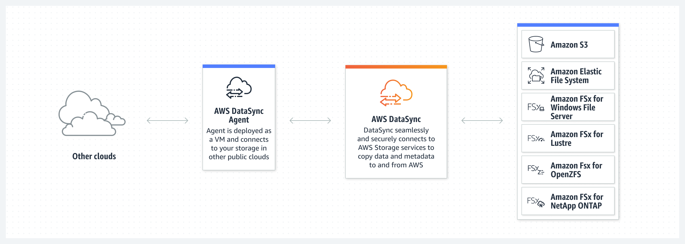
Transfer data between AWS and other locations

Slide 7
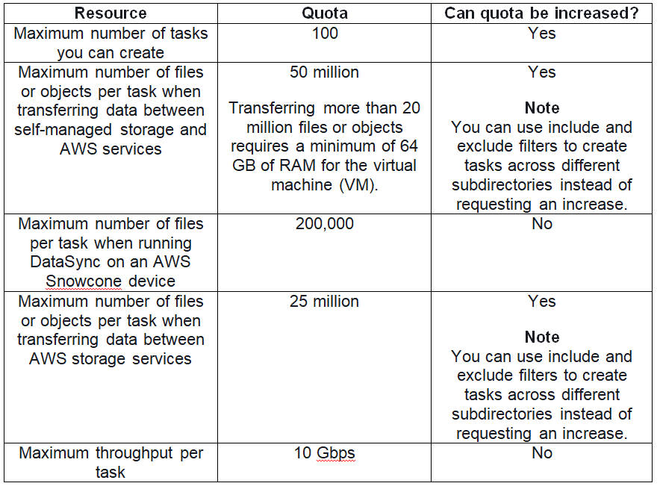
AWS DataSync Limits

Slide 8
AWS Datasync Pricing
DataSync charges a flat fee per gigabyte for network acceleration technology, managed cloud infrastructure, data validation, and automation capabilities.
AWS services, such as Amazon S3, Amazon EFS, Amazon FSx for Windows File Server, and AWS Key Management Service (KMS) charge standard request, storage, and data transfer rates.
You pay AWS Data Transfer at your standard rate when copying data from AWS to an on-premises storage system. In addition, Amazon CloudWatch Logs, Amazon CloudWatch Events, and Amazon CloudWatch Metrics are charged at standard rates.
The AWS PrivateLink service will charge you for interface VPC endpoints that you create to manage and control traffic between your agent(s) and the DataSync service.
https://aws.amazon.com/datasync/pricing/

