Slide 1

AWS Migration Hub
Discover the tools that you need to simplify your migration and modernization

Slide 2
AWS Migration Hub
Access essential discovery, analysis, and planning tools from a single location to build your migration plan.
Accelerate your migration to AWS by building an automated migration factory.
Access AWS expertise to plan your migration and meet your business objectives.
Use proven workflow templates to save time migrating enterprise applications like SAP and Microsoft SQL Server.

Slide 3
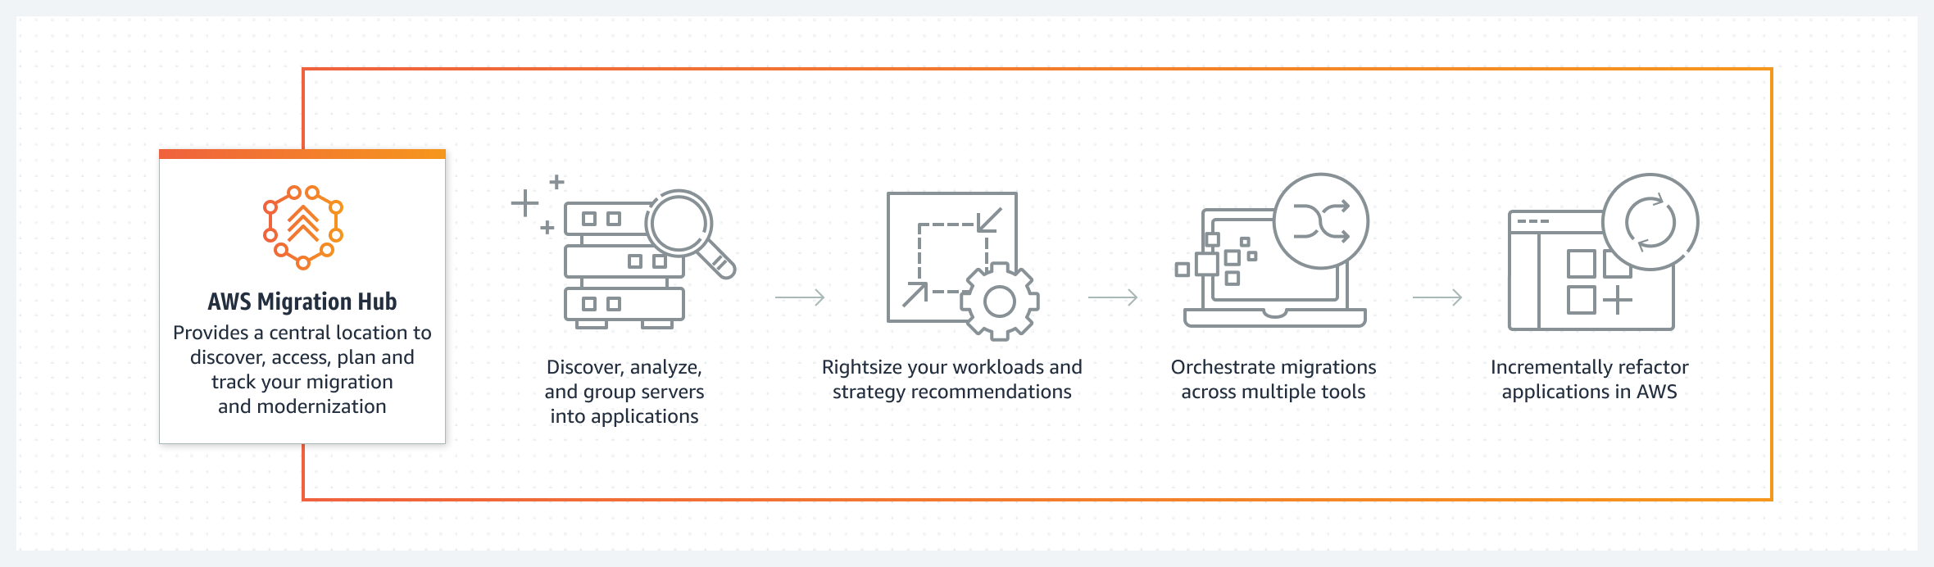
AWS Migration Hub

Slide 4
AWS Migration Hub Use Cases
Assess and plan your migration
Discover applications to determine whether they can be migrated and review modernization strategy recommendations.
Automate lift-and-shift migrations to AWS
End many of the manual tasks involved in migrating large-scale enterprise applications and managing dependencies between different tools.
Refactor legacy applications
Fast-track application refactoring, simplify development, and manage existing applications and microservices as one application.

Slide 5
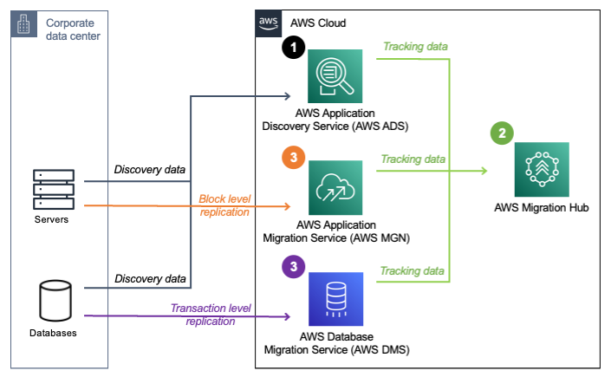
Migration Solution Architecture

