Slide 1

AWS Cloud WAN & Network Manager

Slide 2
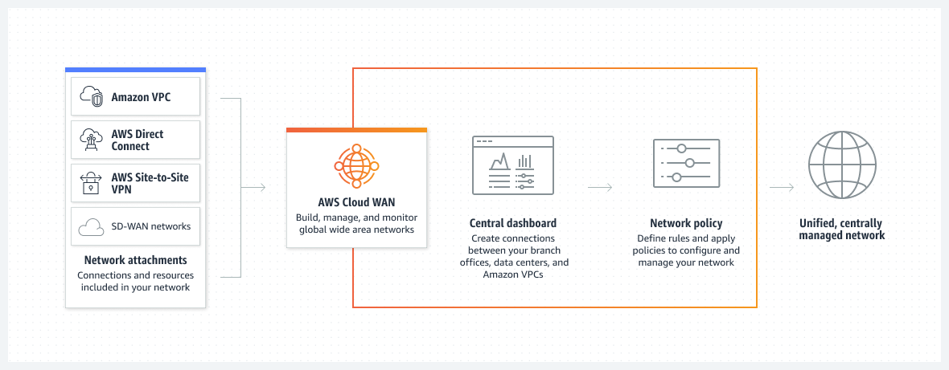
AWS Cloud WAN
AWS Cloud WAN provides a central dashboard for making connections between your branch offices, data centers, and Amazon Virtual Private Clouds (Amazon VPCs)—building a global network with only a few clicks.
You use network policies to automate network management and security tasks in one location.
Cloud WAN generates a complete view of your on-premises and AWS networks to help you monitor network health, security, and performance.

Slide 3
AWS Cloud WAN & Network Manager
Cloud WAN is managed within AWS Network Manager, which enables you to centrally manage and visualize your Cloud WAN core network and Transit Gateway networks across AWS accounts, Regions, and on-premises locations.
Network Manager provides you several dashboard visualizations to help you view and monitor all aspects of your global network. Some of the dashboards include:
World maps that pinpoint where your network resources, such as edge locations, devices, and attachments, are located.
Monitoring that uses CloudWatch Events to track 15 months' worth of statistics, giving you a better perspective on how your networks are performing.
Event tracking that streams real-time events to an events dashboard.
Topological and logical diagrams of your transit gateway networks and transit gateways.
Both Transit Gateway and Cloud WAN allow centralized connectivity between VPCs and on-premises locations.
Transit Gateway is a regional network connectivity hub and is optimal for customers that operate in a few AWS Regions, want to manage their own peering and routing configuration, or prefer to use their own automation.
Cloud WAN is optimal for customers who want to define their global network through policy and have the service implement the underlying components automatically.

Slide 4
Cloud WAN key Concepts
Global network
A single, private network that acts as the high-level container for your network objects. A global network can contain both AWS Transit Gateways and other AWS Cloud WAN core networks. These can be seen in the Network Manager console.
Core network
The part of your global network managed by AWS. This includes Regional connection points and attachments, such as VPNs, VPCs, and Transit Gateway Connects. Your core network operates in the Regions that are defined in your core network policy document.
Core network policy
A core network policy document is a single document applied to your core network that captures your intent and deploys it for you. The core network policy is a declarative language that defines segments, AWS Region routing, and how attachments should map to segments. With a core network policy, you can describe your intent for access control and traffic routing, and AWS Cloud WAN handles the configuration details. Some examples of advanced architectures that you can create with policy include creating a segment for shared services (for example, service directories or authentication services), providing internet access through a firewall for a segment, automatically assigning VPCs to segments based on tags, and defining which AWS Regions a segment is available in.
Attachments
Attachments are any connections or resources that you want to add to your core network. Supported attachments include VPCs, VPNs, Transit Gateway route table attachments, and Connect attachments.
Core Network Edge
The Regional connection point managed by AWS in each Region, as defined in the core network policy. Every attachment connects to a Core Network Edge. Under the hood, this is an AWS Transit Gateway, and it inherits many of the same properties.
In your core network policy document, you define the AWS Region where you want connectivity. At any time, you can add or remove AWS Regions using the policy document. For each AWS Region that you define in the policy document, AWS Cloud WAN then creates a Core Network Edge router in the specified Region. All Core Network Edges in your core network create full-mesh peering with each other to form a highly resilient network. Traffic across the AWS global network uses redundant connections and multiple paths.

Slide 5
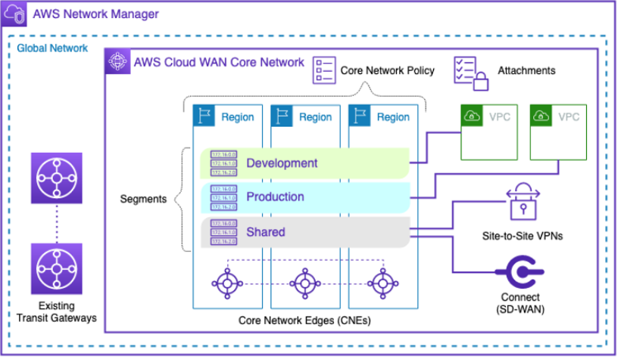
AWS Network Manager

Slide 6
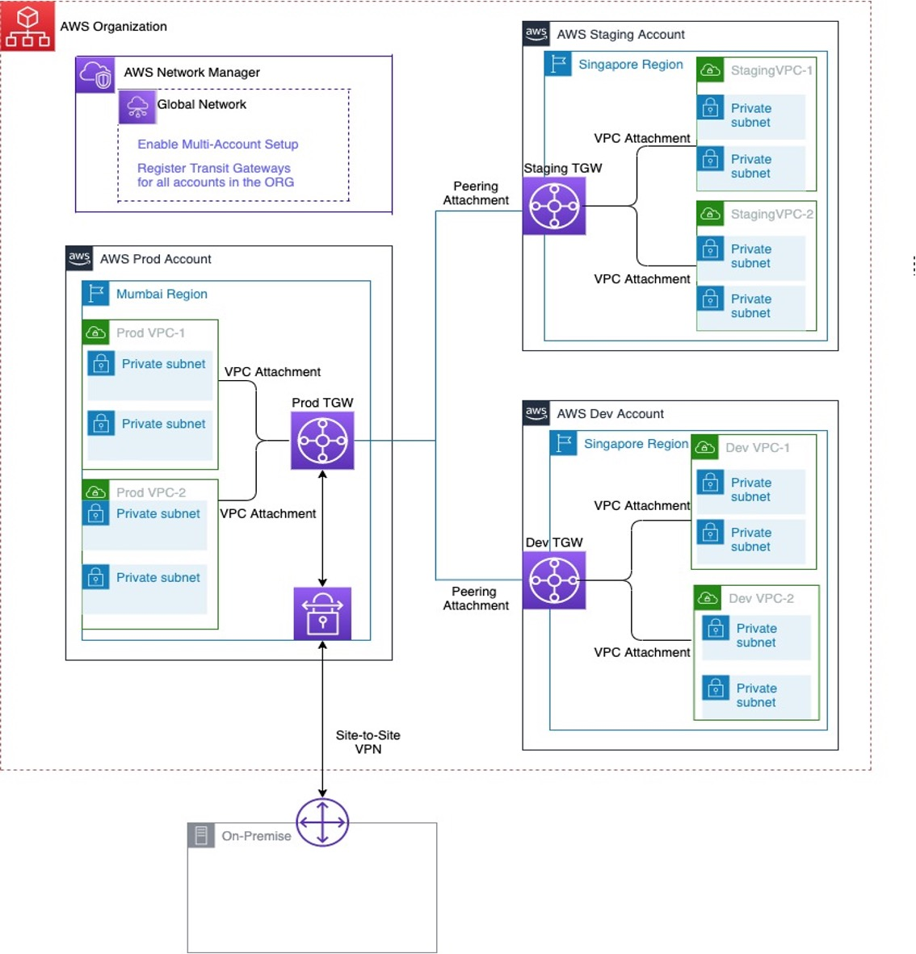
AWS Network Manager to visualize Transit Gateways across multiple accounts in the AWS Organization
https://aws.amazon.com/blogs/networking-and-content-delivery/how-to-use-aws-network-manager-to-visualize-transit-gateways-across-all-accounts-in-the-aws-organization/

