Slide 1
AWS Direct Connect

Slide 2
AWS Direct Connect Public and Private VIF
A Virtual Interface (VIF) is a logical partition of an AWS Direct Connect connection that allows access to AWS services.
When you create a Direct Connect connection, you must create a VIF to start using the service.
There are 3 types of the VIFs
Public VIF - Enables the connectivity to all AWS public IP addresses
Public VIF enables your network to connect to all AWS Public IPs globally
From customer router to AWS maximum 1000 route prefixes can be advertised per Border Gateway Protocol (BGP) session
You can access services outside VPC e.g S3, SQS, DynamoDB and other public endpoints like AWS managed VPN (VGW) Public IPs
Private VIF - Enables the connectivity to VPC via Virtual Private Gateway or Direct Connect Gateway
Enables your network to connect to resources inside VPC using Private IPs for resources like EC2, RDS, Redshift over Private Ips
You must attach your VPC to VGW and associate VGW with Private VIF
Private VIF and VGW must be in the same AWS Region
Supports MTU of 1500 (default) and 9001 for propagated routes
Does not provide access to VPC DNS resolver at cidr + 2
Does not provide access to VPC Gateway endpoints
You can announce a maximum of 100 prefixes to AWS
Transit VIF – Enables the connectivity to Transit Gateways via Direct Connect gateway
Enables the connection between Direct Connect and Transit Gateway
Transit VIF is connected to Direct Connect Gateway and Direct Connect Gateway connects to Transit Gateway
Support MTU of 1500 and 8500 (Jumbo Frames)
You can attach multiple Transit Gateways to a single DX Gateway

Slide 3
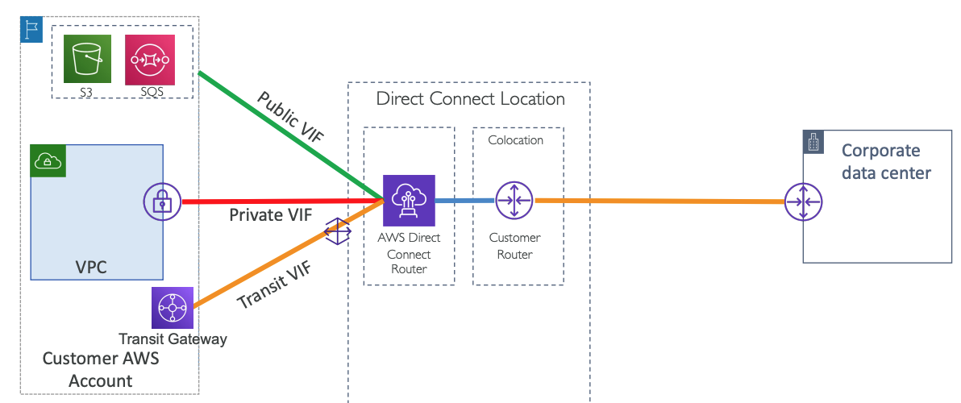
AWS Direct Connect

Slide 4
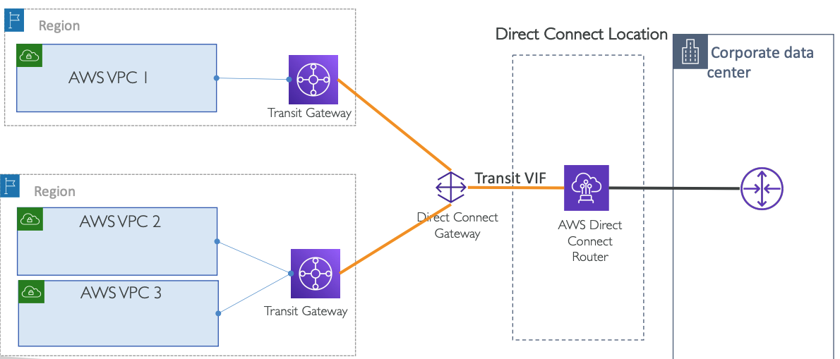
Transit VIF

Slide 5
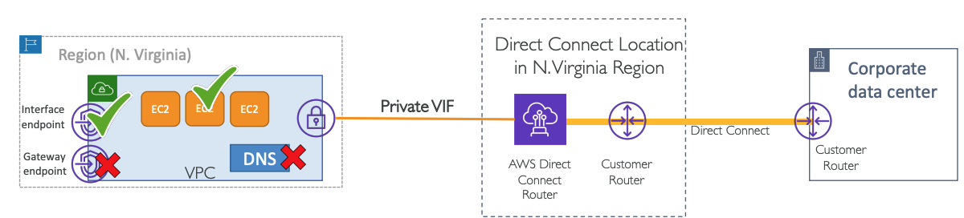
Private VIF Limitations

Slide 6
Direct Connect – Connection Types
Dedicated Connections: 1Gbps, 10 Gbps and 100 Gbps capacity
Physical ethernet port dedicated to a customer
Request made to AWS first, then completed by AWS Direct Connect Partners
Can be either setup by your Network Provider or AWS Direct Connect Partner
Hosted Connections:
50, 100, 200, 300, 400, 500 Mbps and 1 Gbps, 2 Gbps, 5 Gbps, 10 Gbps
Connection requests are made via AWS Direct Connect Partners
1, 2, 5, 10 Gbps available at select AWS Direct Connect Partners
AWS uses traffic policing on hosted connections – excess traffic is dropped

Slide 7
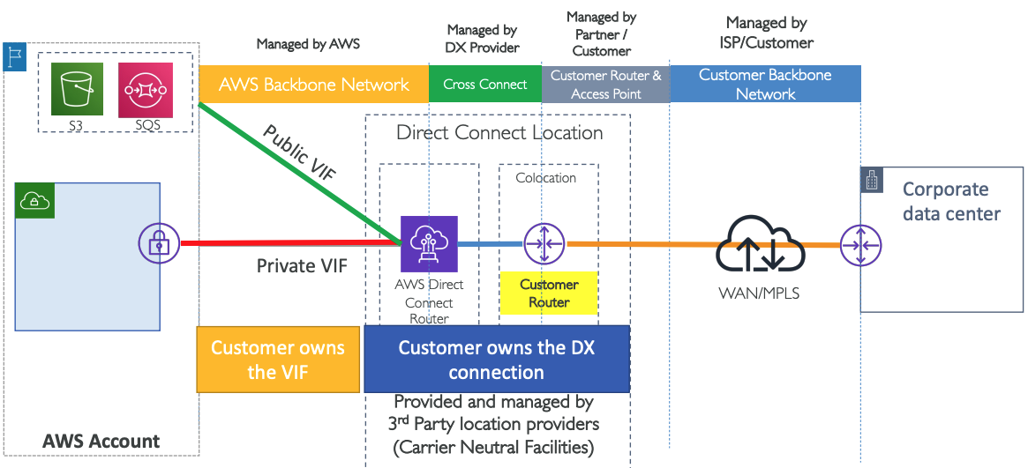
AWS Direct Connect: Dedicated Connection

Slide 8
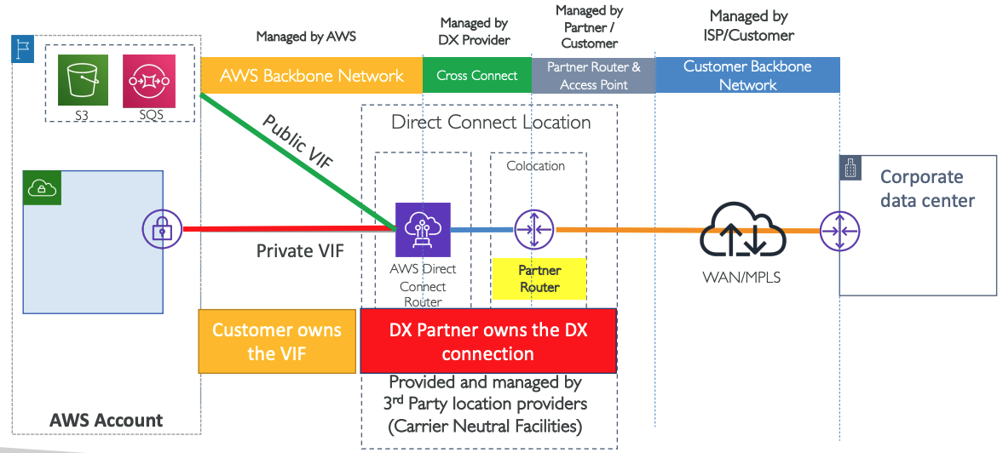
AWS Direct Connect: Hosted Connection

Slide 9
What is AWS Direct Connect SiteLink?
Connects on-premises networks through the AWS global network backbone
https://aws.amazon.com/blogs/networking-and-content-delivery/advanced-routing-scenarios-with-aws-direct-connect-sitelink/
https://docs.aws.amazon.com/architecture-diagrams/latest/routing-scenarios-with-aws-direct-connect-sitelink/routing-scenarios-with-aws-direct-connect-sitelink.html

Slide 10
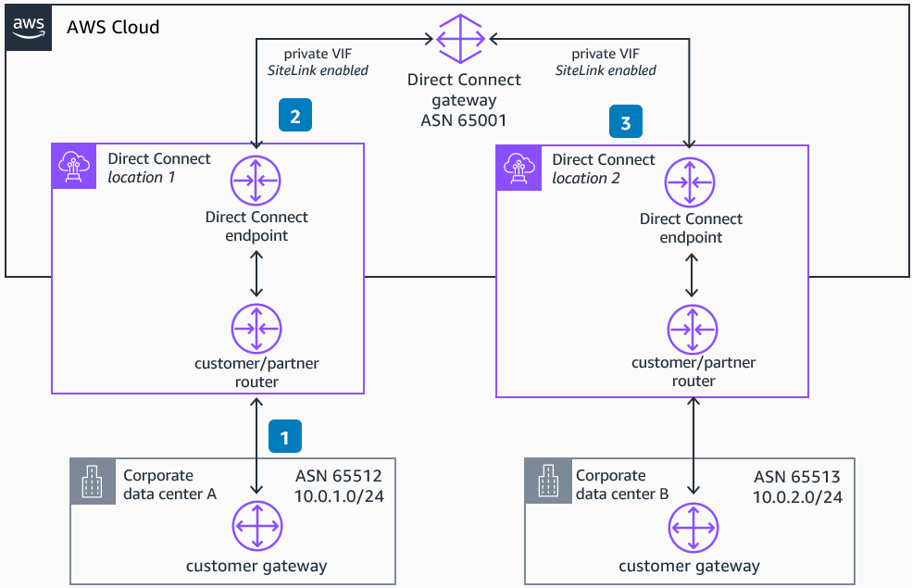
SiteLink

Slide 11
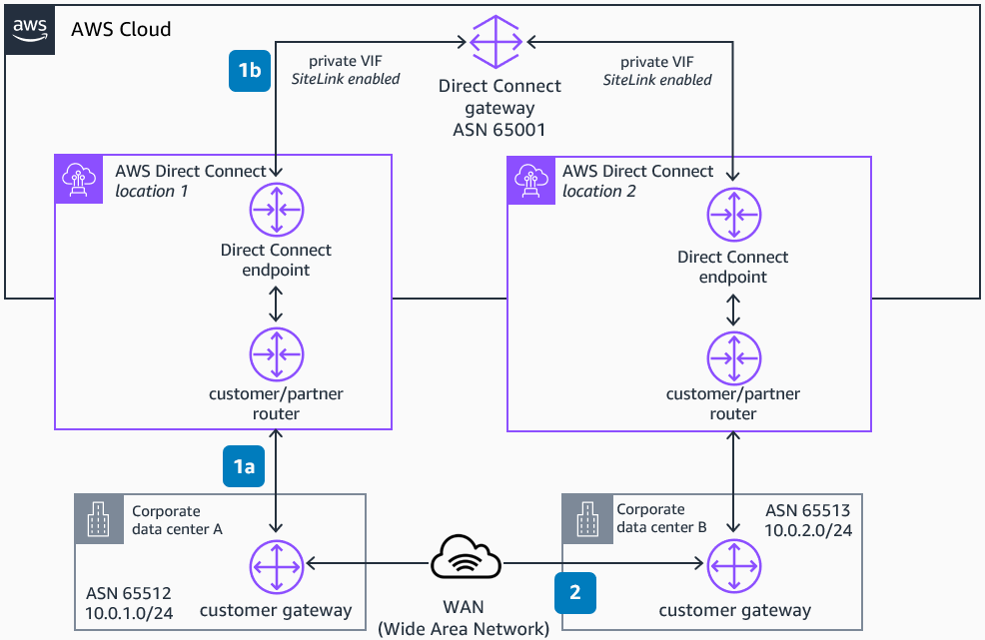
SiteLink Backup

Slide 12
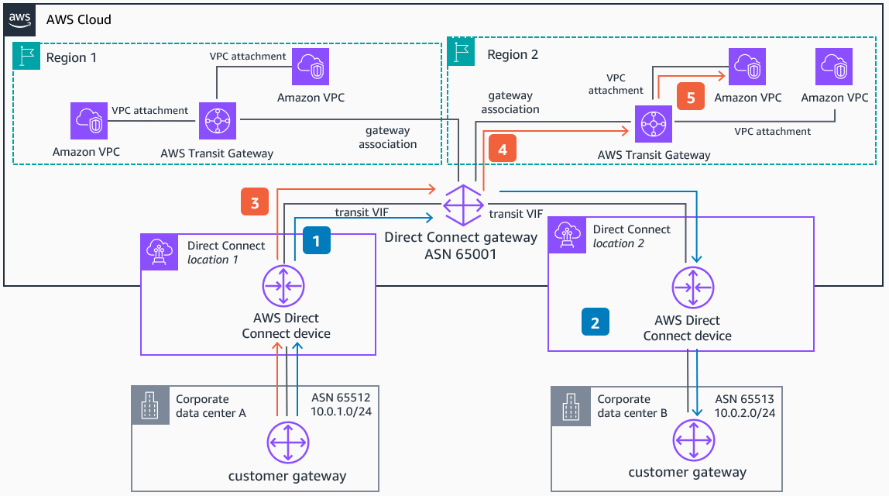
Full Mesh Connectivity Between On-Premises Locations and AWS

