Slide 1
AWS Network Limits & Performance

Slide 2
Network Performance - Basics
Bandwidth
The maximum data transfer rate of a network.
Key Point: Determines how much data can be sent over the network at any given time.
Latency
The time delay experienced between two points in a network.
Components:
Propagation Delay: Time taken for signals to travel across the medium.
Processing Delay: Time taken by network devices to process data.
Jitter
The variation in time between packets arriving, caused by network congestion, timing drift, or route changes.
Impact: Can affect the quality of streaming applications and real-time communications.
Throughput
The rate of successful data transfer over a network, typically measured in bits per second (bps).
Influencing Factors: Directly affected by Bandwidth, Latency, and Packet Loss.
Packets Per Second (PPS)
The number of packets processed by the network in one second.
Relevance: Indicates the processing capacity of network devices.
Maximum Transmission Unit (MTU)
The largest size of a packet or frame that can be sent in a packet- or frame-based network.
Importance: Larger MTU can reduce overhead but may increase the risk of packet loss and delays.

Slide 3
MTU – Maximum transmission unit, Jumbo Frames
Standard MTU Size
Most networks support a Maximum Transmission Unit (MTU) of 1500 bytes.
Jumbo Frames
Packets larger than the standard MTU, ranging up to 9001 bytes.
Purpose: Designed to accommodate larger packets for improved efficiency.
Benefits of Using Jumbo Frames
Reduced Packet Count: Fewer packets are needed for the same amount of data, leading to less overhead.
Enhanced Throughput: Larger packet size results in more data being transferred, increasing the throughput.
MTU and Throughput
Increasing the MTU is beneficial for throughput, especially when the rate of Packets Per Second (PPS) cannot be increased.
Larger MTU means larger data payloads in each packet, enhancing overall data transmission efficiency.
https://docs.aws.amazon.com/AWSEC2/latest/UserGuide/network_mtu.html

Slide 4
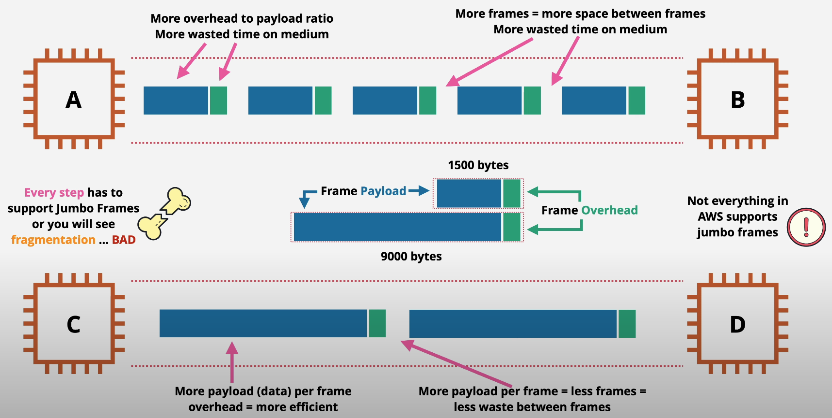
MTU

Slide 5
MTU
Within AWS:
Within VPC : Supports Jumbo frames (9001 bytes)
Over the VPC Endpoint : MTU 8500 bytes
Over the Internet Gateway : MTU 1500 bytes
Intra region VPC Peering: MTU 9001 bytes
Inter region VPC Peering : MTU 1500 bytes
On-premise network:
Over the VPN using VGW : MTU 1500 bytes
Over the VPN via Transit Gateway : MTU 1500 for traffic for Site to Site VPN
Over the DirectConnect (DX) : Supports Jumbo frames (9001 bytes)
Over the DX via Transit Gateway : MTU 8500 for VPC attachments connected over the Direct Connect

Slide 6
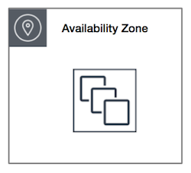
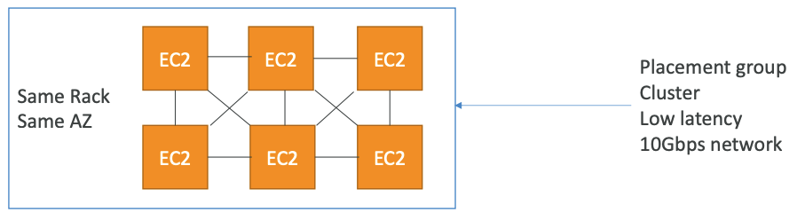
Ec2 Network Optimizations: Cluster Placement Group
An EC2 Cluster Placement Group is a construct provided by AWS that enables you to group EC2 instances within a single Availability Zone to benefit from low-latency, high-throughput network connections.
This grouping is ideal for high-performance computing (HPC) applications and other demanding network-bound workloads that require high levels of inter-node communication efficiency.

Slide 7
Ec2 Network Optimizations: EBS Optimized Instances
EBS Optimized Instances: Enhanced Performance and Reduced Latency
Network-Based Storage: Amazon EBS (Elastic Block Store) functions as a network drive, not a physical one, and communicates with EC2 instances over the network, which may introduce a small amount of latency.
Dedicated Throughput: EBS-optimized instances are designed to provide dedicated bandwidth between EC2 instances and EBS, ensuring minimal interference between EBS I/O operations and other network traffic from the EC2 instance. This results in improved performance and reduced contention.

Slide 8
AWS EC2 UltraClusters
High-performance networking
EC2 instances deployed in EC2 UltraClusters are interconnected with EFA networking to improve performance for distributed training workloads and tightly coupled HPC workloads.
P5 instances deliver up to 3,200 Gbps;
Trn1 instances deliver up to 1,600 Gbps;
and P4d instances deliver up to 400 Gbps of EFA networking.
EFA is also coupled with NVIDIA GPUDirect RDMA (P5, P4d) and NeuronLink (Trn1) to enable low-latency accelerator-to-accelerator communication between servers with operating system bypass.
https://aws.amazon.com/ec2/ultraclusters/

Slide 9
VPC Bandwidth limits
No VPC specific limits
No limit for any Internet Gateway
No limit for VPC peering
Each NAT gateway can provide up to 45 Gbps. Use multiple NAT gateways to scale beyond 45 Gbps.

