Slide 1
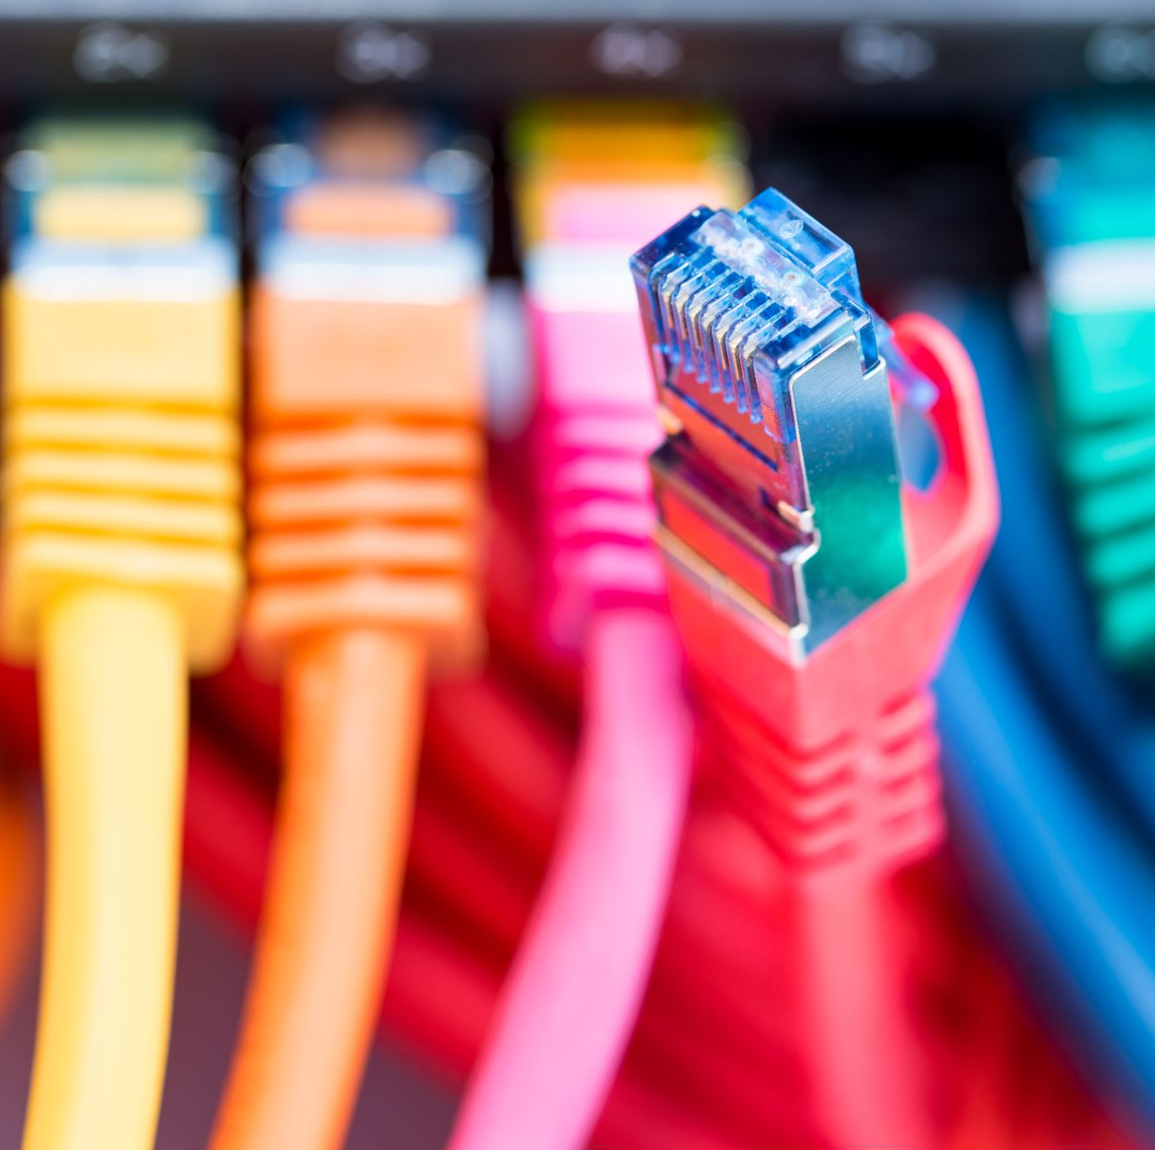
Network Protocols

Slide 2
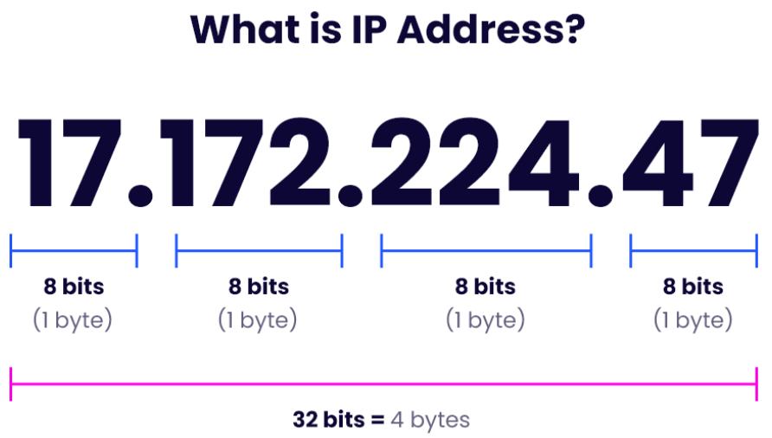
What is IP address?
An IP address represents a unique address that distinguishes any device on the internet or any network from another.
IP or Internet Protocol defines the set of commands directing the setup of data transferred through the internet or any other local network.

Slide 3
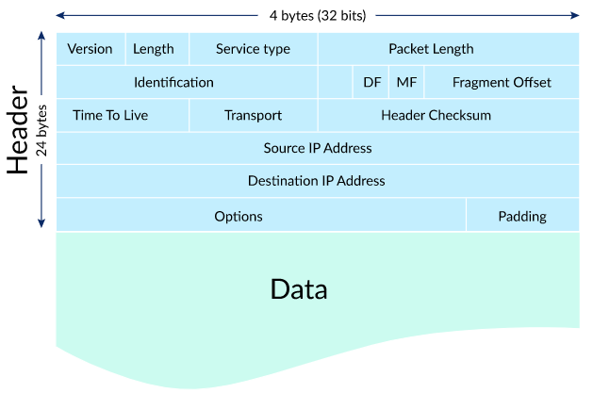
What is an IP packet
IP packets are created by adding an IP header to each packet of data before it is sent on its way.
An IP header is just a series of bits, and it records several pieces of information about the packet, including the sending and receiving IP address.
Each IP packet contains both a header (20 or 24 bytes long) and data (variable length).
The header includes the IP addresses of the source and destination, plus other fields that help to route the packet.
The data is the actual content, such as a string of letters or part of a webpage.

Slide 4
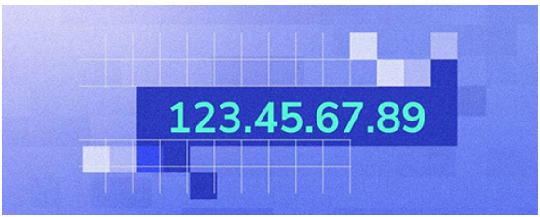
IP address types
Types of IP addresses you’ll hear referred to include:
Static
Dynamic
Public
Private
Dedicated
Shared
IPv4
IPv6

Slide 5
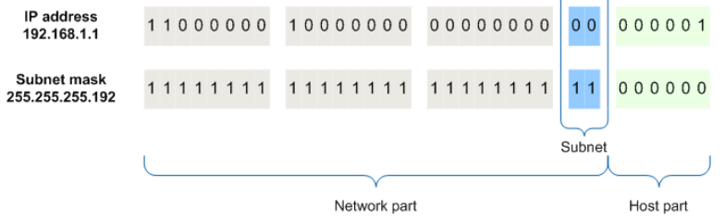
What is Subnet Mask?
Subnet masks are used when subnetting, which is when you break a network up into smaller networks.
By adjusting the subnet mask, you can set the number of available IP addresses within a network.
Subnet masks break an IP address up into network bits and host bits.
When a device sees the network and host bits of another device's IP address, it can figure out if the other device is part of the same network (home, business, etc.), or is somewhere else online

Slide 6
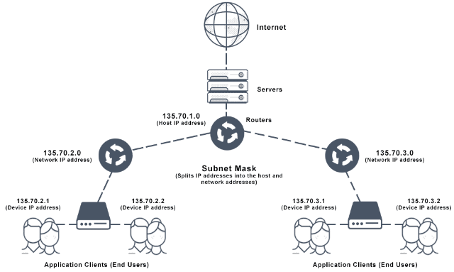
How do IP classes and subnet masks relate?
Networks come in different sizes.
Some require access for just a few hosts.
Others need to offer access to many thousands of hosts. Because of this, there are different classes of IP addresses.
They make space for class A networks, class B networks, and class C networks.
There are also class D and class E networks.
Class D facilitates multicasting and class E – research, so they’re not relevant here.
The IP address class dictates the possible size of the network as well as how many of the octets are dedicated to the subnet mask.
Different IP address classes are suitable for different needs.

Slide 7
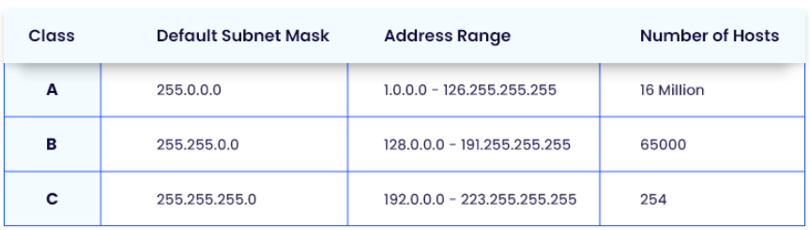
Network classes
Class A network supports over 65,536 hosts.
It makes all that access by only having the subnet mask reflect the network address in the first octet, with the second, third, and fourth left free for the administrator to assign as required to hosts and subnets.
Class B network has an IP address where the subnet mask reflects the network address in the first and second octets.
Leaving only the third and fourth for assignment with the network.
Class B network, therefore, has availability for connections to only between 256 to 65,534 hosts.
Class C network supports the fewest hosts.
In a class C network, the first, second, and third octets are all used to reflect the network number.
Leaving only the final octet to facilitate up to 254 host addresses.
Both class B address and class C address look the same. Therefore, they require a subnet mask to identify the network address and host address.

Slide 8
TCP/IP vs OSI Model
TCP/IP Model
Origin: Developed in the 1970s, the TCP/IP model was created by the Defense Advanced Research Projects Agency (DARPA) for the internet. It is practical and based on standard protocols used on the internet.
Layers:
Application Layer: This is where application protocols like HTTP, FTP, SMTP, etc., operate.
Transport Layer: Manages end-to-end communication, ensuring data integrity and delivery. Protocols like TCP and UDP operate here.
Internet Layer: Responsible for routing of data packets. Protocols like IP work at this layer.
Network Interface Layer: Concerned with the physical transmission of data, including hardware addresses (MAC).
Practical framework with Focus on Standard Protocols:
The TCP/IP model is not only a theoretical framework but also a practical implementation guide.
It focuses on standard protocols used in the internet, making it highly relevant for real-world applications.
Simplified Model: It has fewer layers than the OSI model and is generally considered easier to understand and implement in real-world networking.
OSI Model
Origin: Developed in the late 1970s and 1980s by the International Organization for Standardization (ISO). It was designed to be a universal model for network protocol design, not bound to any specific set of protocols.
Layers:
Application Layer: Closest to the end user, providing network services to applications.
Presentation Layer: Translates data between the application layer and the network format.
Session Layer: Manages sessions and controls dialogues between computers.
Transport Layer: Responsible for data transfer, error checking, and reliability.
Network Layer: Manages packet routing through logical addressing and routing.
Data Link Layer: Responsible for node-to-node data transfer and error correction.
Physical Layer: Deals with the physical medium of data transmission (cables, radio frequencies).
Theoretical and Comprehensive: The OSI model is more theoretical and provides a comprehensive view of networking with its seven layers. It's used as a reference tool to understand how different networking protocols interact.
Layer Abstraction: Each layer serves a specific function and is more distinct compared to the layers in the TCP/IP model. This abstraction makes it easier to understand the role of each layer but can be more complex in practical implementation.

Slide 9
TCP/IP Layers & protocols
Application Layer
HTTP (Hypertext Transfer Protocol): Used for web browsing.
HTTPS (HTTP Secure): Secure version of HTTP.
FTP (File Transfer Protocol): Used for transferring files.
SMTP (Simple Mail Transfer Protocol): Used for sending emails.
POP3 (Post Office Protocol version 3): Used for receiving emails.
IMAP (Internet Message Access Protocol): Used for retrieving emails.
DNS (Domain Name System): Resolves domain names to IP addresses.
SSH (Secure Shell): Provides secure access to remote computers.
TELNET: Allows remote command-line interface access.
SNMP (Simple Network Management Protocol): Used for network management.
Transport Layer
TCP (Transmission Control Protocol): Provides reliable, ordered, and error-checked delivery of a stream of packets.
UDP (User Datagram Protocol): Provides simpler, connectionless communication for tasks requiring less reliability and sequencing.
Internet Layer
IP (Internet Protocol): Responsible for routing and addressing packets. Versions include IPv4 and IPv6.
ICMP (Internet Control Message Protocol): Used for diagnostic and error messages.
ARP (Address Resolution Protocol): Resolves IP addresses to MAC (hardware) addresses.
RARP (Reverse Address Resolution Protocol): Resolves MAC addresses to IP addresses.
IGMP (Internet Group Management Protocol): Used for multicast group management.
Network Interface Layer
Ethernet: A predominant link layer protocol used in LANs.
PPP (Point-to-Point Protocol): Used for direct connections between two network nodes.
SLIP (Serial Line Internet Protocol): An older version of PPP.
MAC (Media Access Control): Responsible for hardware addressing.

Slide 10
OSI Layers Protocols
1. Physical Layer
Ethernet: The most common wired network technology.
DSL (Digital Subscriber Line): A family of technologies providing internet access over telephone lines.
ISDN (Integrated Services Digital Network): An international standard for end-to-end digital transmission of voice, data, and signaling.
USB (Universal Serial Bus): Standard for connecting devices like computers and peripherals.
Bluetooth: A wireless technology standard for exchanging data over short distances.
2. Data Link Layer
MAC (Media Access Control): Part of the Ethernet protocol for data transmission.
PPP (Point-to-Point Protocol): Used for creating direct connections between two network nodes.
ARP (Address Resolution Protocol): Translates IP addresses into physical MAC addresses.
RARP (Reverse Address Resolution Protocol): Maps a physical MAC address to an IP address.
VLAN (Virtual LAN): Allows for network segmentation in a virtual environment.
3. Network Layer
IP (Internet Protocol), including IPv4 and IPv6: The principal communications protocol for relaying datagrams across network boundaries.
ICMP (Internet Control Message Protocol): Used for error reporting and query messages.
IGMP (Internet Group Management Protocol): Used by hosts and adjacent routers to establish multicast group memberships.
RIP (Routing Information Protocol): A routing protocol that uses hop count as a routing metric.
4. Transport Layer
TCP (Transmission Control Protocol): Provides reliable, ordered, and error-checked delivery of data.
UDP (User Datagram Protocol): Offers a simpler, connectionless communication model for tasks requiring less reliability and sequencing.
SCTP (Stream Control Transmission Protocol): Designed to transport PSTN (Public Switched Telephone Network) signaling messages over IP networks.
5. Session Layer
NetBIOS (Network Basic Input/Output System): Provides services related to the session layer allowing applications on separate computers to communicate over a local area network.
NFS (Network File System): Allows a user on a client computer to access files over a network.
RPC (Remote Procedure Call): Enables a program to request a service from a program located on another computer in a network.
6. Presentation Layer
SSL (Secure Sockets Layer) and TLS (Transport Layer Security): Protocols for encrypting internet communication.
JPEG, GIF, TIFF (and other image formats): Standard image formats.
ASCII, EBCDIC, UNICODE (and other character encoding schemes): Standard character encoding systems.
MPEG, QuickTime, MIDI (and other multimedia formats): Standard formats for video and audio.
7. Application Layer
HTTP (Hypertext Transfer Protocol): Used for web browsing.
FTP (File Transfer Protocol): Transfers files between a client and server on a network.
SMTP (Simple Mail Transfer Protocol): Used for sending emails.
POP3 (Post Office Protocol version 3) and IMAP (Internet Message Access Protocol): Used for retrieving emails.
DNS (Domain Name System): Translates domain names to IP addresses.

Slide 11
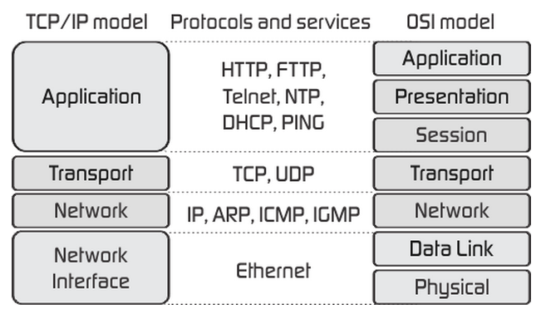
Network basics: OSI & TCP/IP

Slide 12
IP Protocol vs Ethernet
IP Protocol (Internet Protocol)
Layer: IP operates at the Network Layer (Layer 3) in the OSI model.
Purpose: IP is designed for routing data packets across both local networks and the internet. It enables internetworking and essentially establishes the Internet.
Functionality:
Addressing: IP uses IP addresses (like IPv4 or IPv6) to identify devices on a network. These addresses are used to route data across networks.
Path Selection: IP is responsible for choosing the path over which data will travel from its source to its destination across multiple networks.
Data Packet Routing: IP routes data packets based on the destination IP address contained in the packet header.
Protocols: IP is a key part of the TCP/IP protocol suite and works closely with higher-level protocols like TCP and UDP.
Differences
Layer of Operation: IP operates at the network layer, focusing on routing data across networks, while Ethernet operates at the data link and physical layers, handling data transmission within the same network.
Scope of Application: IP is used for data routing across different networks (internet or between LANs), whereas Ethernet is used for connecting devices within the same local network.
Addressing Mechanism: IP uses IP addresses for identifying devices, while Ethernet uses MAC addresses for the local delivery of frames.
Function: IP is concerned with the logical routing of packets across networks. Ethernet deals with the actual physical and data link connections between devices.
Protocol Suite: They belong to different protocol suites; IP is part of the TCP/IP suite, whereas Ethernet is a set of standards for LANs.
Ethernet
Layer: Ethernet primarily operates at the Data Link Layer (Layer 2) and partially at the Physical Layer (Layer 1) in the OSI model.
Purpose: Ethernet is a technology for connecting devices in a local area network (LAN). It's used to facilitate data communication over short distances, like within a building.
Functionality:
Local Area Networking: Ethernet connects devices like computers, printers, and routers in a LAN.
Frame Transmission: Ethernet transmits data in units called frames. Each frame contains source and destination MAC (Media Access Control) addresses, which are used for communication on the same network.
Physical Media: Ethernet defines the standards for wiring and signals for the physical layer of the network (cabling, connectors, signal transmission).
Protocols: Ethernet is foundational for LAN communication and is often used in conjunction with IP for internet and intranet communication.

Slide 13
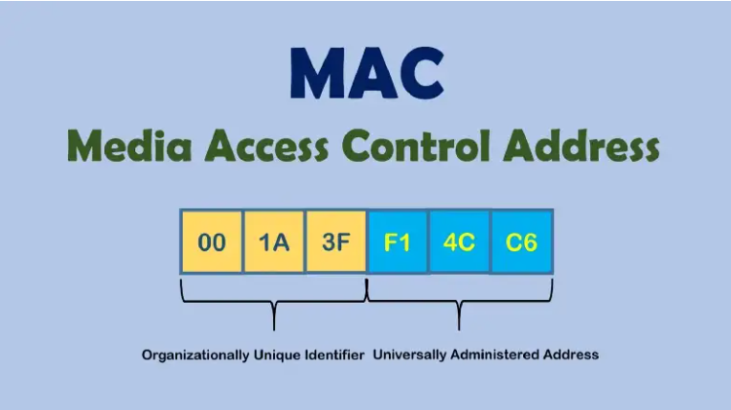
What is MAC Address?
The MAC address is a device's physical address, which uniquely identifies it on a specific network.
MAC is short for Media Access Control and is also referred to as a hardware address, physical address, or burned-in address (BIA).
The MAC address works on the OSI model's data link layer.
The Address Resolution Protocol (ARP), a layer 2 communication protocol, maps the MAC addresses to the IP (Internet Protocol) address.

Slide 14
Types of MAC Addresses
Unicast MAC Address:
Purpose: Used to direct packets to a specific device on a network.
Characteristics: The unicast MAC address is unique to each network interface card (NIC) and is used for one-to-one communication.
Example Usage: When a computer sends data to another computer on the same network, it uses the unicast MAC address of the destination computer.
Broadcast MAC Address:
Purpose: Used to send data to all devices on a local network segment.
Characteristics: The broadcast MAC address is a special address that all network adapters recognize. It typically consists of all binary 1s (FF:FF:FF:FF:FF:FF in hexadecimal).
Example Usage: When a device needs to communicate with all devices on the local network, such as during ARP (Address Resolution Protocol) requests. (ARP's primary function is to map a network address (IP address) to a physical address (MAC address). It is used in local area networks (LANs) where IP traffic needs to be sent to a specific physical machine.)
Multicast MAC Address:
Purpose: Used to send data to a group of devices on a local network.
Characteristics: Multicast MAC addresses allow a source device to send packets to a group of destinations with a single transmission. The first octet of a multicast MAC address includes binary '1' in the least significant bit.
Example Usage: Streaming a video or audio to multiple devices simultaneously within a network.
Multicast MAC Addresses for IPv6:
Purpose: Specifically used for IPv6 multicast traffic.
Characteristics: These MAC addresses start with a specific range (33:33:xx:xx:xx:xx), where the last 32 bits are derived from the IPv6 multicast address.
Locally Administered MAC Address:
Purpose: Assigned manually by a network administrator, overriding the manufacturer’s default address.
Characteristics: The second least significant bit of the first octet is set to 1. These are not guaranteed to be globally unique.
Example Usage: Used in scenarios where customized addressing is needed, such as in virtual networks or when administratively overriding a hardware address.

Slide 15
TCP
TCP, or Transmission Control Protocol, is one of the main protocols of the Internet Protocol Suite, which is used to provide reliable, ordered, and error-checked delivery of a stream of data between applications running on hosts communicating via an IP network. It is a cornerstone of modern Internet communication and ensures that data is delivered correctly from one network destination to another. Here are some key aspects of TCP:
Connection-Oriented Protocol: TCP is a connection-oriented protocol, meaning it requires a connection to be established between the sending and receiving parties before data transfer begins. This is done through a process known as the TCP three-way handshake.
Reliability: TCP provides reliable data transfer, ensuring that data packets are delivered in order and without errors. If any packet is lost during transmission, TCP is responsible for retransmitting that packet.
Flow Control: TCP uses flow control mechanisms to prevent a sender from overwhelming a receiver with data. It ensures that the rate of data transmission is manageable for both parties involved in the communication.
Congestion Control: TCP implements congestion control algorithms to prevent network congestion. It dynamically adjusts the volume of data being sent based on the current state of the network.
Segmentation and Reassembly: TCP divides large data files into smaller segments for transmission. At the receiving end, these segments are reassembled to construct the original data.
Error Detection: Through the use of checksums, TCP is able to detect errors in data transmission. If an error is detected in a segment, that segment is retransmitted.
Three-Way Handshake: The process of establishing a TCP connection involves a three-step process known as the three-way handshake. This involves the exchange of SYN (synchronize) and ACK (acknowledgment) packets.
Port Numbers: TCP uses port numbers to identify sending and receiving application endpoints (or services) on a host, which enables multiple networked applications to coexist on the same server.
Full Duplex Communication: TCP supports full duplex communication, meaning that data can be transmitted in both directions (send and receive) simultaneously during a session.
Session Management: TCP manages sessions between clients and servers, ensuring that a session remains open until the client or server decides to close it, allowing for continuous and bidirectional flow of data.

Slide 16
UDP
UDP, or User Datagram Protocol, is a communication protocol used across the Internet. It is one of the core members of the Internet protocol suite, often contrasted with TCP (Transmission Control Protocol). Here are the key characteristics and uses of UDP:
Connectionless Protocol: Unlike TCP, UDP is a connectionless protocol. This means it does not establish a connection before sending data, and there's no formal session between the sender and receiver. Data is sent as "datagrams," with each datagram handled independently of others.
Speed and Efficiency: Because UDP doesn't perform the kind of error checking and handshaking that TCP does, it is faster and more efficient, especially in situations where speed is more critical than reliability.
No Error Recovery: UDP does not offer error recovery services like retransmission, acknowledgment, or sequencing of data packets. If a packet is lost or arrives with errors, UDP does not resend it. It's up to the application to handle these situations.
No Congestion Control: UDP does not have mechanisms for managing network congestion. It continues to send data at the same rate regardless of the network condition, which could lead to packet loss.
Use Cases: Due to its characteristics, UDP is suitable for applications where speed and efficiency are more important than error correction. Common use cases include:
Live Broadcasting and Streaming: For media streams (like video and voice), where delay is more critical than minor data loss.
Online Games: Where real-time performance is more important than perfect data transmission.
DNS Lookups: UDP is used for DNS queries due to its lower overhead.
SNMP (Simple Network Management Protocol): For network management.
Header Format: UDP has a simpler header format compared to TCP. It includes fields for the source port, destination port, length of the datagram, and a checksum.
Port Numbers: Like TCP, UDP uses port numbers to differentiate between multiple applications running on the same device.
Multicast and Broadcast Support: UDP supports multicast (sending data to multiple destinations simultaneously) and broadcast (sending data to all devices in a network), making it suitable for certain types of network communications

Slide 17
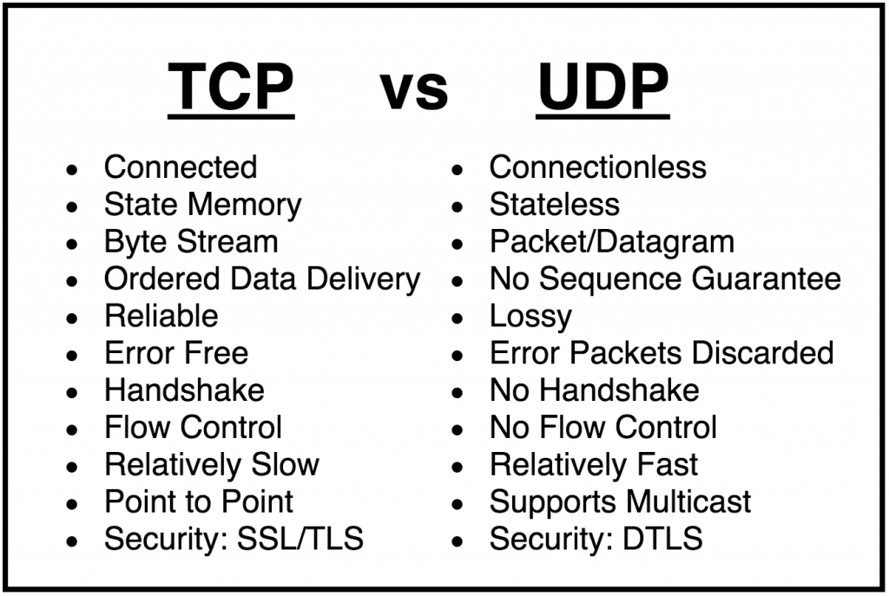
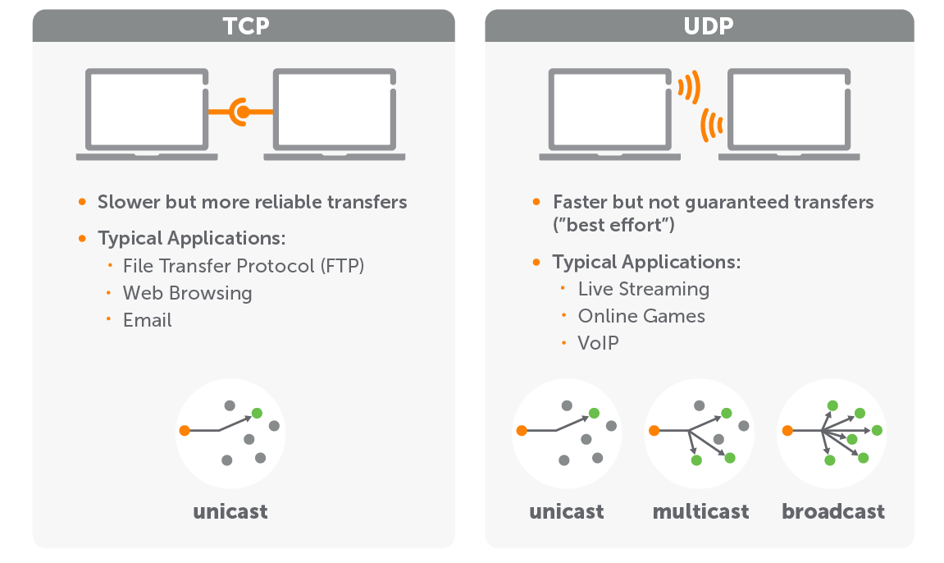
Network basics: TCP vs UDP

Slide 18
HTTP1.x
HTTP/1.x (HTTP/1.0 and HTTP/1.1)
Text-Based Protocol: HTTP/1.x is text-based, making it easy to read and debug, but less efficient in terms of performance.
Connection Management: HTTP/1.0 opens a new TCP connection for each request/response cycle, while HTTP/1.1 introduced persistent connections to reuse connections for multiple requests.
Stateless and Synchronous: HTTP/1.x is stateless and handles requests synchronously, often leading to head-of-line blocking.
No Header Compression: Headers are sent in plain text, which increases overhead, especially when headers are repetitive.
Limited Parallelism: HTTP/1.1 supports pipelining, but it's not widely used due to head-of-line blocking issues.
A typical HTTP request contains:
HTTP version type
a URL
an HTTP method
HTTP request headers
https://www.w3.org/Protocols/HTTP/1.0/spec.html
https://www.rfc-editor.org/rfc/rfc9112.html

Slide 19
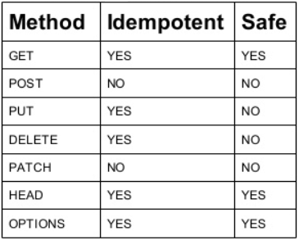
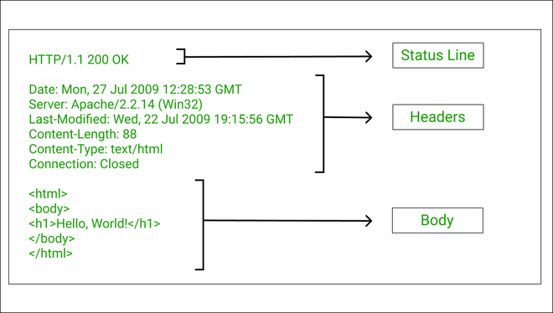
Network basics: HTTP

Slide 20
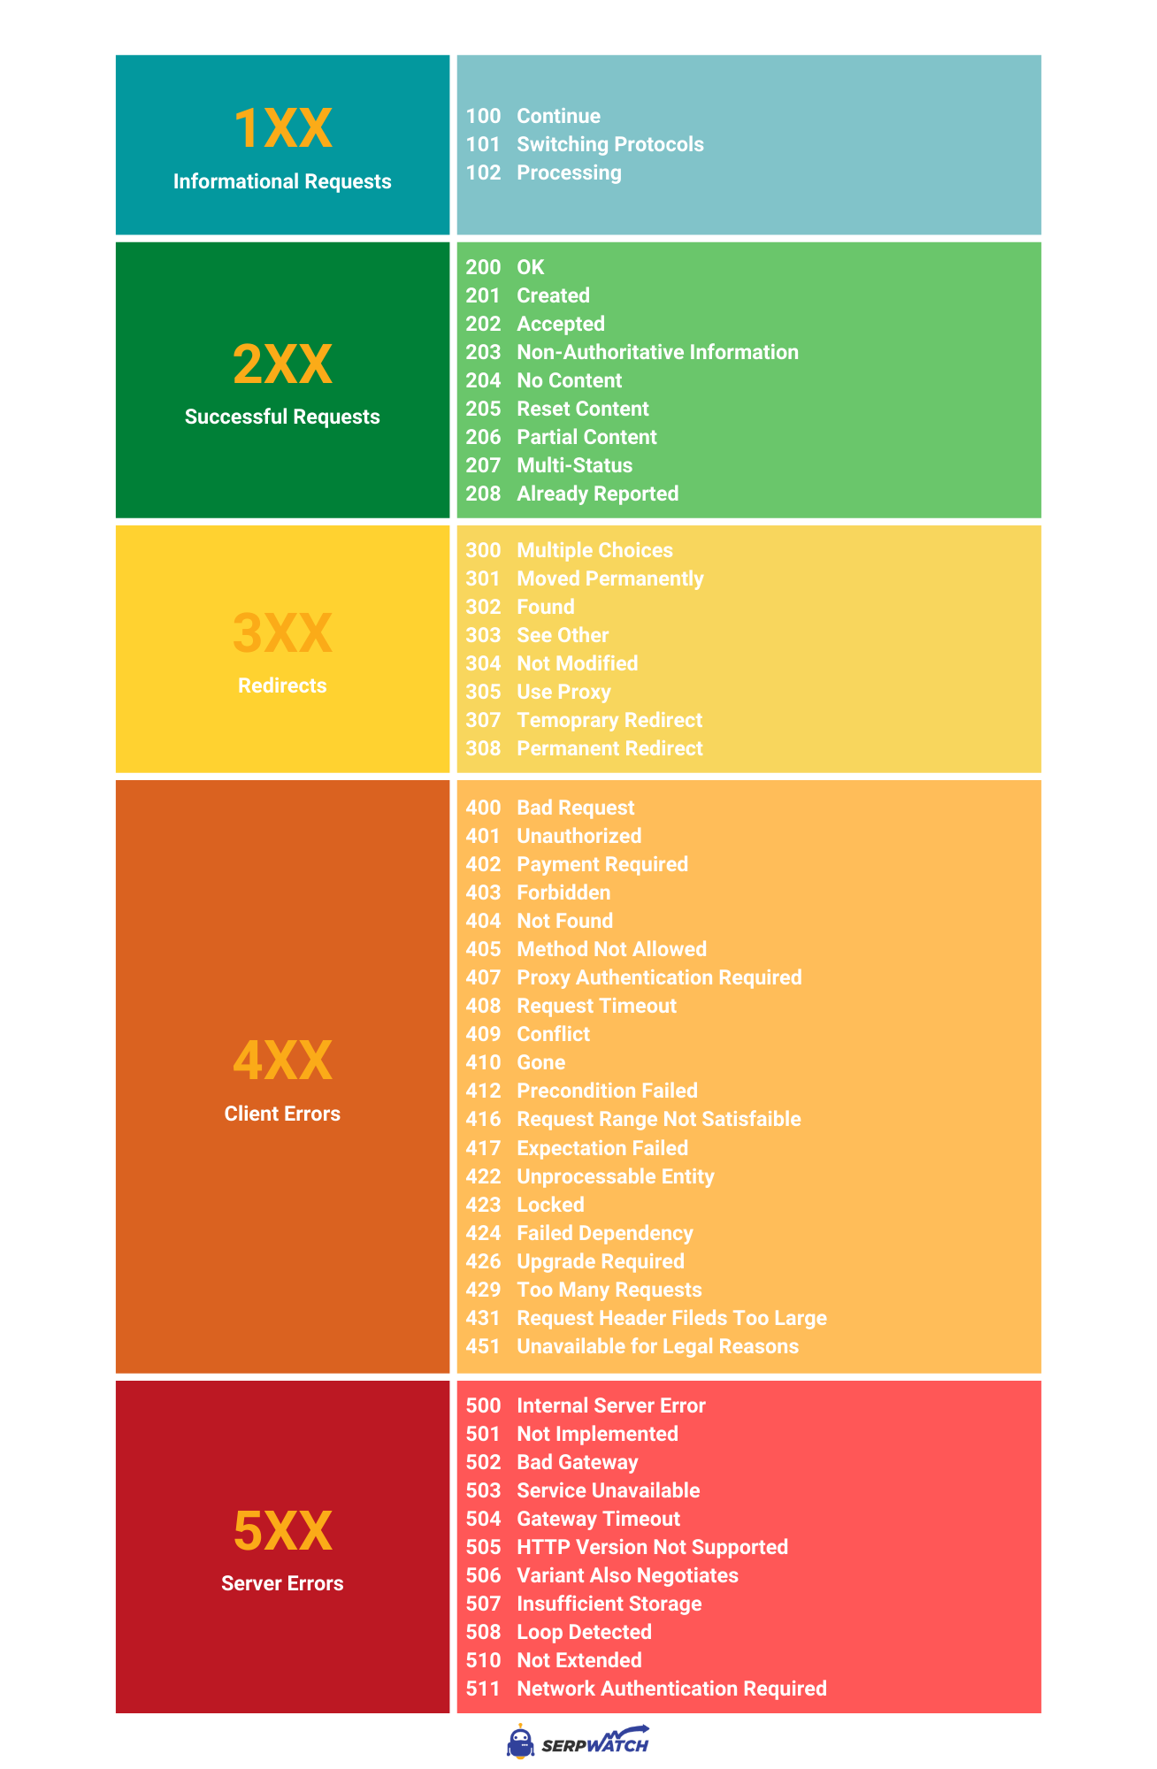
HTTP Response Codes

Slide 21
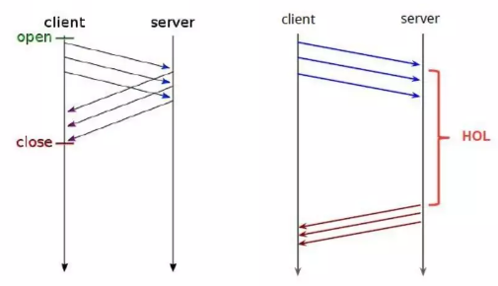
Head-of-line
Head-of-line (HOL) blocking is a performance issue that occurs in networking and computer systems.
It happens when a line of tasks (such as network packets, requests, or processes) cannot proceed because the first task in the line is blocked, thereby delaying all subsequent tasks behind it.
This concept is present in various contexts, but it's particularly relevant in network protocols like HTTP and TCP.

Slide 22
Head of line Contexts
1. In TCP (Transmission Control Protocol):
TCP ensures reliable data transmission over the internet.
Data sent over TCP is broken down into packets, which must be received and acknowledged in order.
If a packet is lost or arrives out of order, TCP waits for that packet to be retransmitted and received before it can process any subsequent packets.
This waiting causes HOL blocking.
For example, in a web page loading scenario, if one TCP packet containing a portion of a website's HTML is delayed, the browser must wait for that packet before it can proceed to render parts of the website contained in subsequent packets, even if those subsequent packets have arrived.
2. In HTTP/2 Multiplexing:
HTTP/2 introduced multiplexing, allowing multiple requests and responses to be intermixed on the same TCP connection.
While this greatly improved efficiency compared to HTTP/1.x, it introduced a new form of HOL blocking.
In HTTP/2, different streams (individual requests/responses) share the same TCP connection.
If one stream's packet is lost, it can delay all other streams on that connection, because TCP, underlying HTTP/2, still requires in-order packet delivery.
This means a lost packet in one stream can block the progress of packets in another stream, even though they are unrelated.
Resolution in HTTP/3:
HTTP/3 addresses HOL blocking by using QUIC, which operates over UDP (User Datagram Protocol) instead of TCP.
QUIC allows individual streams to be independent, so if a packet is lost in one stream, it doesn't affect the others.
This significantly reduces the impact of HOL blocking, improving the efficiency and responsiveness of web applications, especially in lossy network environments like mobile networks.
In summary, head-of-line blocking is a limitation in sequential processing systems, notably in TCP and HTTP/2, where the delay of a single task or packet blocks all subsequent ones. This issue is significantly mitigated in HTTP/3 with the adoption of QUIC.

Slide 23
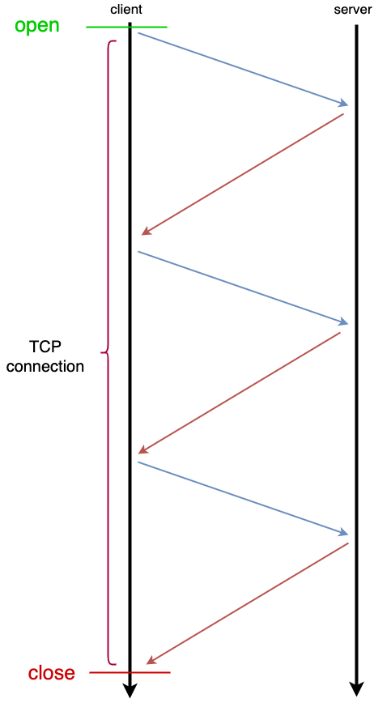
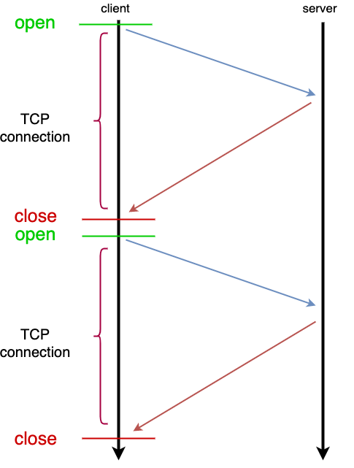
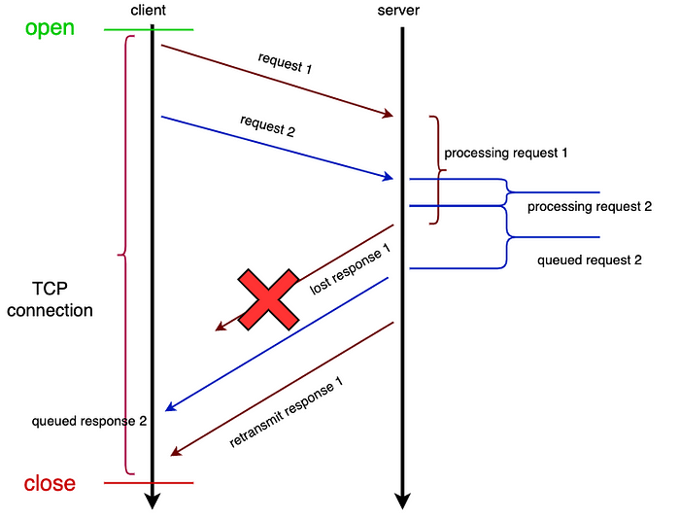
Head of Line: One per connection, Keep-alive header, HTTP Pipelining

Slide 24
HTTP2
Binary Protocol: HTTP/2 is a binary protocol, making it more efficient and less error-prone than text-based protocols.
Multiplexing: Allows multiple requests and responses to be interleaved on the same connection, reducing the number of connections and eliminating head-of-line blocking within a single connection.
Header Compression (HPACK): Compresses headers, reducing overhead.
Server Push: HTTP/2 introduces a server push feature, where a server can send resources to the client proactively. The server can push resources it knows the client will need (like stylesheets or JavaScript files) before the client requests them, which can improve page load times.
Stream Prioritization: Clients can prioritize requests, letting the server know the order in which it should respond to requests.
Improved Security (with HTTPS): Although HTTP/2 itself does not require encryption, most major browsers only support HTTP/2 over a TLS (Transport Layer Security) connection, making HTTPS the de facto standard for HTTP/2.
Flow Control: HTTP/2 includes flow control at the application layer, allowing both the client and server to control the rate of data transmission to prevent overwhelming the other side.
Error Handling: HTTP/2 has better error handling mechanisms than HTTP/1.x. It defines specific error codes and allows the client and server to signal errors and gracefully close connections if necessary.
https://httpwg.org/specs/rfc9113.html

Slide 25
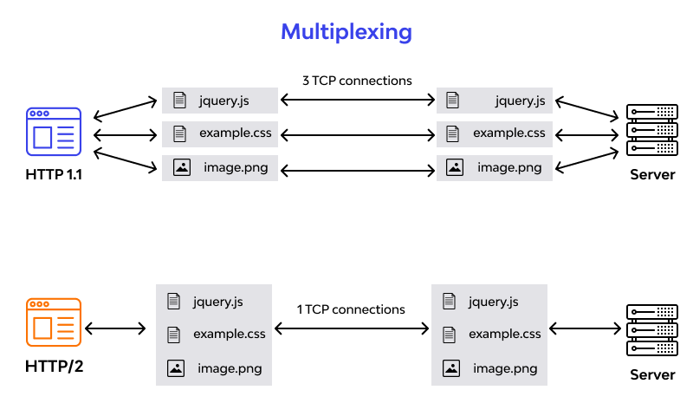
HTTP/2 Multiplexing

Slide 26
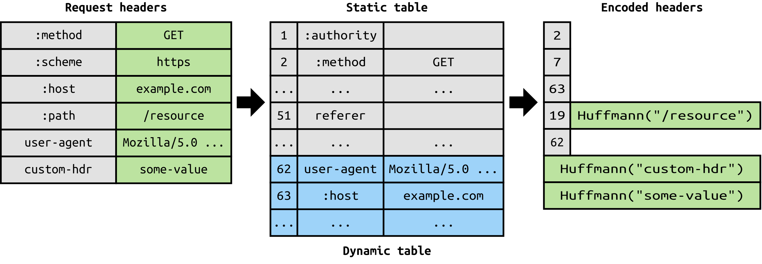
HPACK
HPACK is a compression format used in HTTP/2 for encoding HTTP headers. It was specifically designed to address several issues associated with HTTP/1.x and to improve overall web performance.
Efficient Header Compression:
In HTTP/1.x, headers are sent as plain text, which can be quite verbose and repetitive, especially in a scenario with multiple requests.
HPACK compresses these headers, reducing the amount of data that needs to be sent over the network.
Reduction of Redundancy:
HPACK reduces redundancy by encoding frequently used headers in a more efficient way.
It does this using two key components: a static table and a dynamic table.
Static Table: Contains a list of commonly used HTTP headers (61 predefined headers). These headers are assigned predefined index values, so instead of sending the full header text, only the index values are sent, greatly reducing the size of the headers.
Dynamic Table: Maintains a list of headers used in the current connection. As headers are sent and received, they are added to this table, and subsequent transmissions can refer to these headers by their index in the dynamic table, further reducing redundancy.
Security Considerations: HPACK was designed with security in mind, especially to mitigate vulnerabilities like CRIME and BREACH which exploited compression to leak sensitive data like session cookies. It does this by avoiding the compression of parts of headers that are potentially vulnerable to such attacks.
Context-Aware Compression: Both the client and the server maintain and update their own dynamic tables throughout the session, ensuring that the compression is context-aware and adapts to the specific use case of the connection.
Compatibility with HTTP/2: HPACK is specifically tailored for HTTP/2's binary framing and multiplexing model, making it an integral part of the protocol's efficiency improvements over HTTP/1.x.
https://httpwg.org/specs/rfc7541.html

Slide 27
CRIME (Compression Ratio Info-leak Made Easy)
Discovery and Impact: Discovered in 2012 by security researchers Juliano Rizzo and Thai Duong, CRIME exploits a vulnerability in the TLS/SSL compression feature.
Attack Mechanism: The vulnerability arises when a client’s HTTPS request includes both secret (like a cookie) and attacker-controlled data. The attacker can make repeated requests, altering the attacker-controlled data each time. If the secret data is compressed effectively (due to similarities with the attacker-controlled input), the size of the compressed request decreases. By observing the changes in the size of the response, the attacker can deduce the secret data.
Affected Protocols: CRIME affects TLS/SSL protocols that support data compression.
Mitigation: The most effective mitigation against CRIME is to disable TLS/SSL compression, which most browsers and servers did following the discovery of the vulnerability.

Slide 28
BREACH (Browser Reconnaissance and Exfiltration via Adaptive Compression of Hypertext)
Discovery and Impact: Discovered in 2013 by Angelo Prado, Neal Harris, and Yoel Gluck, BREACH exploits a vulnerability in HTTP compression.
Attack Mechanism: Similar to CRIME, BREACH also exploits the compression feature but targets HTTP compression rather than TLS/SSL compression. The attacker manipulates plaintext in an HTTP request (like a search query) and observes the size of the compressed HTTP response. This allows the attacker to deduce secrets from the response (like CSRF tokens or session cookies) through a similar process of trial and error.
Affected Scenarios: BREACH can affect any web application that uses HTTP compression, even when served over HTTPS.
Mitigation: Mitigation strategies include disabling HTTP compression, separating secrets from user input, randomizing secrets per request, and masking secrets (e.g., applying per-request random tokens).

Slide 29
HTTP3
QUIC Protocol: The most significant change in HTTP/3 is its shift from TCP to QUIC, an UDP-based transport layer protocol.
Improved Connection Establishment: QUIC significantly reduces the time required to establish a connection. TCP requires a number of round-trips between the client and server to establish a connection, while QUIC combines these into a single round-trip, speeding up the process, especially for secure, TLS-encrypted connections.
Better Congestion Control: QUIC has improved congestion control mechanisms to reduce latency.
Multiplexing Without Head-of-Line Blocking: QUIC solves the head-of-line blocking problem at the transport level, not just per TCP connection, enhancing the multiplexing benefits introduced in HTTP/2.
Integrated Security: QUIC incorporates TLS 1.3, ensuring that connections are encrypted and secure by default.
Improved Handling of Network Changes: QUIC handles changes in IP addresses (like when switching from Wi-Fi to mobile data) more gracefully, reducing connection interruptions.

Slide 30
QUICK Protocol
QUIC (Quick UDP Internet Connections) is a modern transport layer network protocol designed by Google. It was developed to overcome limitations of the traditional TCP (Transmission Control Protocol) and to improve the performance of web applications. QUIC is used primarily for handling traffic over the internet and is the foundation for HTTP/3.
Based on UDP: Unlike traditional web traffic which mostly uses TCP, QUIC is built on top of UDP (User Datagram Protocol). UDP is simpler and has lower latency than TCP, which makes QUIC faster in establishing connections and transmitting data.
Reduced Connection Establishment Time: QUIC reduces the time it takes to establish a connection. Traditional TCP connections require a handshake process that can take time, especially if also establishing a TLS (Transport Layer Security) session. QUIC combines the transport and encryption handshakes, reducing the time to establish secure connections.
Multiplexed Streams without Head-of-Line Blocking: QUIC allows multiple streams of data to be multiplexed (combined) over a single connection without suffering from head-of-line blocking—a performance issue where the delay of a single packet affects all subsequent packets. In QUIC, packet loss in one stream does not impact the other streams.
Improved Congestion Control: QUIC includes advanced features for congestion control, which help to efficiently manage how much data is sent over the network, especially in cases of packet loss or high latency.
Seamless Connection Migration: QUIC supports connection migration, which allows a connection to stay alive even when the underlying network changes (like switching from Wi-Fi to a mobile network). This is particularly beneficial for mobile devices.
Built-in Encryption: QUIC integrates TLS 1.3, the latest version of the TLS protocol, by default. This means all QUIC connections are encrypted, enhancing security and privacy.
Forward Error Correction (FEC) and Error Recovery: QUIC has mechanisms for quick recovery from packet loss, which is common in mobile and wireless networks. Although not all implementations use FEC, the protocol allows for such mechanisms.
Error Handling
Selective Acknowledgment (SACK): QUIC uses a selective acknowledgment mechanism similar to TCP's SACK. This allows the receiver to inform the sender about all the packets that have arrived successfully, enabling the sender to retransmit only the missing segments of data.
Flow Control: Like TCP, QUIC implements flow control mechanisms, but it does so at both the connection and stream levels. This double-layered approach provides more granular control over data flow and helps in efficiently managing network resources.
Checksums: Although UDP itself does not have strong error-checking capabilities, QUIC includes its own checksums to ensure data integrity. This means that QUIC can detect and react to corrupted packets, which is something UDP on its own cannot do.
Google's Involvement and Standardization: Initially developed by Google for use in their services (like YouTube and Google Search), QUIC has gained widespread attention. It's being standardized by the Internet Engineering Task Force (IETF) and is the basis for HTTP/3.

Slide 31
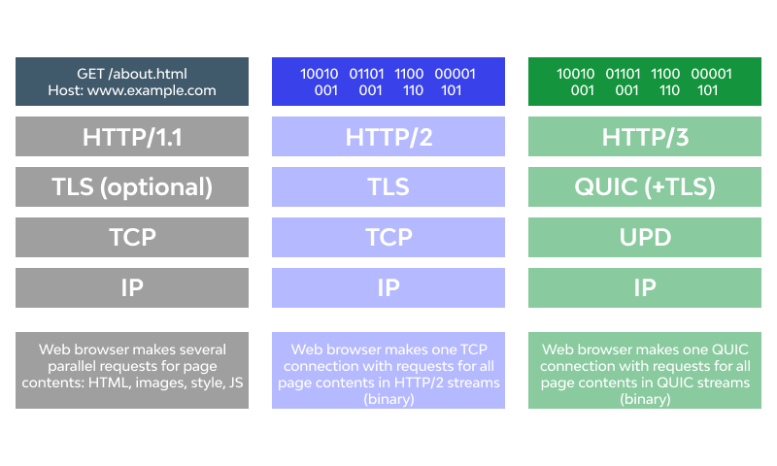
HTTP1 vs HTTP2 vs HTTP3
HTTP/1.x is simple and reliable but lacks efficiency and speed, especially for complex, resource-heavy websites.
HTTP/2 improves speed and efficiency by introducing multiplexing, header compression, and server push, but it still relies on TCP.
HTTP/3 builds on the strengths of HTTP/2 but replaces TCP with QUIC to further improve speed, reliability, and efficiency, particularly in environments with unreliable connections or high latency.

Slide 32
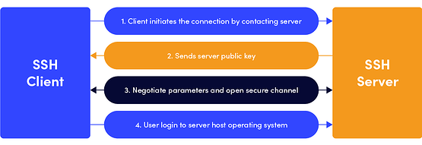
SSH – The Secure Shell Protocol
The SSH protocol (also referred to as Secure Shell) is a method for secure remote login from one computer to another.
It provides several alternative options for strong authentication, and it protects the communications security and integrity with strong encryption.
SFTP - (SSH File Transfer Protocol) is a secure file transfer protocol. It runs over the SSH protocol.
Tools to use:
Git bash
Putty
WinSCP

