Slide 1
Enhanced Networking

Slide 2
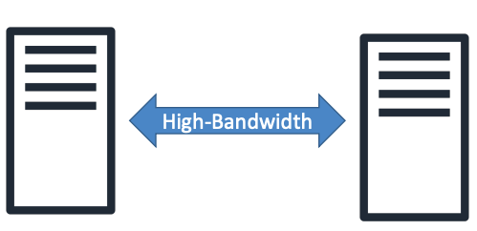
What is Enhanced networking?
Reduces instance-to-instance latencies
Passthrough hypervisor
Enabled using Elastic Network Adapter (ENA), Elastic Fabric Adapter (EFA) or ixbevf driver
SR-IOV (Single-root input/output virtualization) and PCI (I/O bus) passthrough are methods of device virtualization that provide higher I/O performance and lower CPU utilization
SR-IOV allows a single physical NIC (Network Interface Card) to present itself as multiple vNICs
PCI passthrough enables PCI devices such as ENI to appear as if they are physically attached to the guest operating system bypassing hypervisor
Ultimately in combination this allows low latency, high rate data transfer (>1 M PPS)
With enhanced networking it “owns” it own network interface, which means it can send traffic without using Hen hypervisor
Benefits:
Higher bandwidth
Higher PSS performance (packet per second)
Lower inter-instance latency
Around 8% gain in throughput

Slide 3
Enhanced Networking pre-requisites
Depending on Instance Type, Enhanced Networking can be enabled using one of the following Network drivers
Option 1: Intel 82599 VF up to 10 Gbps (VF uses ixgbevf driver)
Option 2: Elastic Network Adapter (ENA) up to 100 Gbps
The eligible EC2 instance families support one of the above two drivers
Remember: For Enhanced Networking, it requires support from both EC2 operating system (AMI) and Instance Type that is flagged for Enhanced Networking
• Instances supporting Elastic Network Adapter (ENA) for speed upto 100 Gbps
A1, C5, C5a, C5d, C5n, C6g, F1, G3, G4, H1, I3, I3en etc
Instances supporting Intel 82599 Virtual Function (VF) interface for speed upto 10 Gbps
C3, C4, D2, I2, M4 (excluding m4.16xlarge), and R3 etc

Slide 4
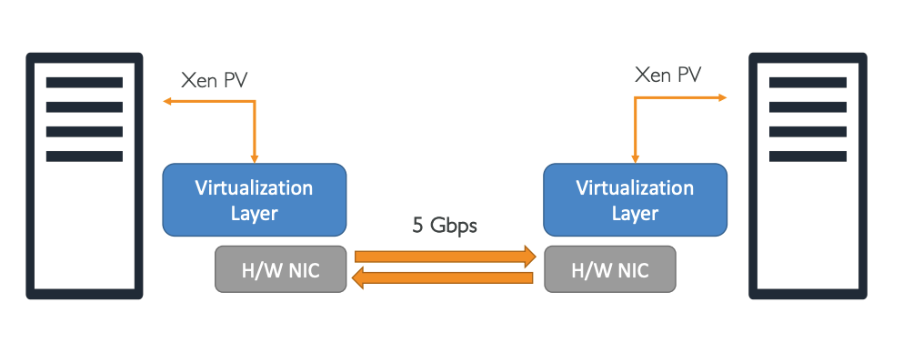
Ec2 Networking Default
Hypervisor -> virtualization layer -> hardware NIC (Network Interface Card) -> Communication between two phyzical controllers
Default bandwidth – 5 Gbps

Slide 5
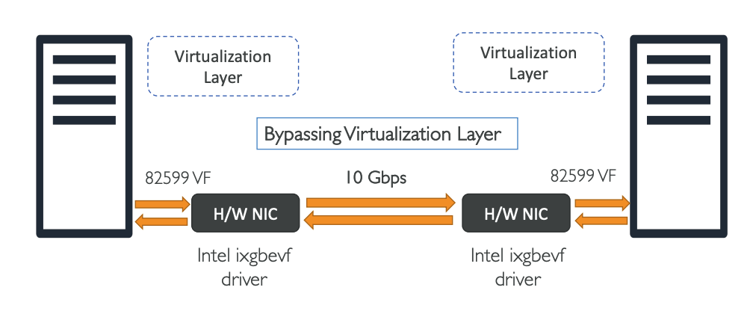
Ec2 Networking With Intel VF (Virtual Fuction)
By using Enhanced networking virtualization layer removed from the flow – Bypass Vrtuazalition Layer
By using this driver you directly talking to Hardware Network Interface Card
Maximum of 10 Gbps bandwidth

Slide 6
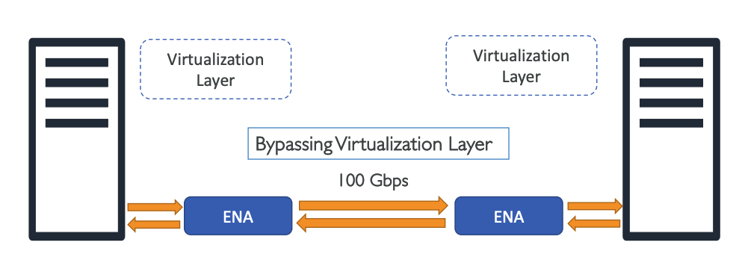
Ec2 Networking With ENA (Elastic Network Adapter)
Same Enhanced networking -> bypass virtualization layer
Maximum of 100 Gbps But..
It is not bandwidth per flow ( flow == connection between two machines (source ip, destination ip, source port, destination port, protocol)
To archive it, you need to use multiple parallel connections between machines
Single flow = 10 Gbps maximum only if machines are part of Cluster Placement Group
If not than maximum is 5 Gpbs
If you want to have 100 Gbps -> use Multiple Flow -> means multiple parallel connections.

Slide 7
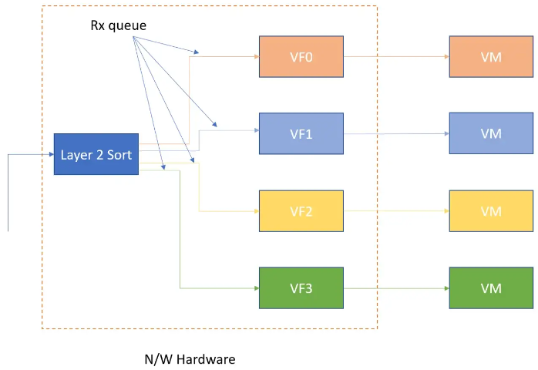
ENA
The Elastic Network Adapter (ENA) is designed to provide Enhanced Networking to your EC2 instances.
With ENA, you can expect high throughput and packet per second (PPS) performance, as well as consistently low latencies on Amazon EC2 instances.
Using ENA, you can utilize up to 100 Gbps of network bandwidth on certain EC2 instance types – massively improving your networking throughput compared to other EC2 instances, or on premises machines.
In the above diagram we see that sorting and queue assignment happens at networking device and VM directly get the message.
There is no hypervisor switch involved in this. Also all VMs process packets from their own dedicated queue in parallel.
Jumbo Frames: ENAs support jumbo frames (MTU of 9001 bytes), which are larger than the standard Ethernet frame size, to improve network efficiency for large data packet

Slide 8
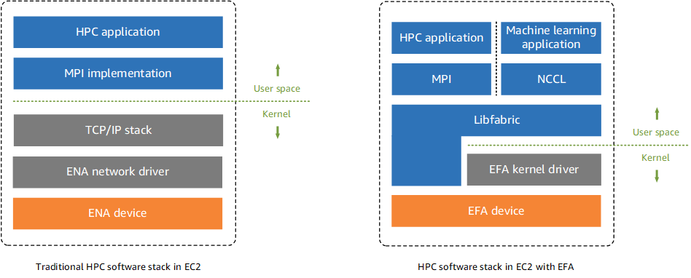
EFA
EFAs are Elastic Network Adapters (ENAs) with additional OS-bypass capabilities.
AWS Elastic Fabric Adapter (EFA) is a specialized network interface for Amazon EC2 instances that allows customers to run high levels of inter-instance communication, such as HPC applications on AWS at scale on.
AWS EFA is often used in conjunction with Cluster placement groups – which allow physical hosts to be placed much closer together within an AZ to decrease latency even more.
Due to EFA’s support for libfabric APIs, applications using a supported MPI library can be easily migrated to AWS without having to make any changes to their existing code.
Provides OS bypass functionality for Linux
For windows instance it acts just as ENA
c5n.18xlarge, p3dn.24xlarge

Slide 9
EFA Limitations
Elastic Fabric Adapter Limitations
You can attach only one EFA per instance.
EFA OS-bypass traffic is limited to a single subnet. EFA traffic cannot be sent from one subnet to another. Normal IP traffic from the EFA can be sent from one subnet to another.
EFA OS-bypass traffic is not routable. Normal IP traffic from the EFA remains routable.
The EFA must be a member of a security group that allows all inbound and outbound traffic to and from the security group itself.

Slide 10
ENI vs ENA vs EFA
ENI (Elastic Network Interface):
An ENI is a virtual network interface that you can attach to an instance in a VPC.
ENIs are the standard network adapter that provides the basic networking capabilities for EC2 instances.
Each instance comes with a default ENI (the primary network interface), and you can attach additional ENIs to an instance.
ENIs can be used to create dual-homed instances with multiple private IP addresses, Elastic IPs, internal IPv4/IPv6 addresses, security groups, and MAC addresses.
ENIs can be detached from an instance and attached to another, allowing for network configurations to be easily moved.
up to 10 Gbps
ENA (Elastic Network Adapter):
ENA is a newer network interface model that provides enhanced networking capabilities for EC2 instances.
It supports higher bandwidth, higher packet per second (PPS) performance, and lower latency than ENIs.
ENA is designed to be scalable and supports networking speeds of up to 100 Gbps on supported instance types.
It is ideal for demanding applications, such as high-performance computing, machine learning, data analytics, and many more.
ENA also supports stateless offloads, which help to reduce CPU utilization for network packet processing.
EFA (Elastic Fabric Adapter):
EFA is a network device that you can attach to your EC2 instance to accelerate High Performance Computing (HPC) and machine learning applications.
It provides the capabilities of ENA and adds the ability to support reliable, scalable, low-latency inter-node communication that is commonly needed for HPC applications.
EFA is designed to bypass the OS network stack to provide lower and more consistent latency and higher throughput than traditional TCP channels.
It supports OS-bypass capabilities (userspace networking) which is particularly beneficial for applications that use Message Passing Interface (MPI).
EFA is used for tightly-coupled workloads where nodes need to communicate frequently, such as computational fluid dynamics, weather modeling, reservoir simulation, etc.
On supported instances, EFA can provide bandwidth of up to 100 Gbps.

Slide 11
When to use ENA and when EFA?
Both AWS Elastic Network Adapters (ENA) and Elastic Fabric Adapters (EFA) support high network speeds of up to 100 Gbps, but there are key differences that make EFA a more suitable choice for certain specific use cases:
Purpose-Built for High-Performance Computing (HPC) and Machine Learning:
EFAs are designed specifically to accelerate HPC and machine learning applications on Amazon EC2 instances.
They are ideal for applications that require high levels of inter-instance communication, enabling customers to achieve on-premises HPC cluster performance with the scalability of AWS Cloud​​.
OS-Bypass Capabilities:
One of the key features of EFA is its OS-bypass capability.
This allows HPC and machine learning applications to communicate directly with the network interface hardware, bypassing the operating system kernel.
This results in lower latency and more reliable transport, crucial for scaling HPC and machine learning applications​​​​.
Support for libfabric API and MPI:
EFA supports libfabric APIs, which means applications using a supported MPI (Message Passing Interface) library can be easily migrated to AWS without any changes to their existing code.
This feature is particularly beneficial in facilitating the transition of traditional HPC applications to the cloud​​.
Use with AWS Cluster Placement Groups:
EFAs are often used in conjunction with AWS Cluster Placement Groups.
This setup allows physical hosts to be placed closer together within an Availability Zone, further decreasing latency and enhancing application performance for workloads like weather modeling, oil and gas simulations, and financial modeling​​.
While ENA provides high network performance suitable for a wide range of applications, EFA is specifically tailored for HPC and machine learning workloads that demand lower latency, higher throughput, and efficient inter-instance communication.
The decision to use EFA over ENA would depend on the specific requirements of your applications, especially if they are in the realm of high-performance computing or require efficient parallel processing across multiple instances.

