Slide 1
VPC Endpoints

Slide 2
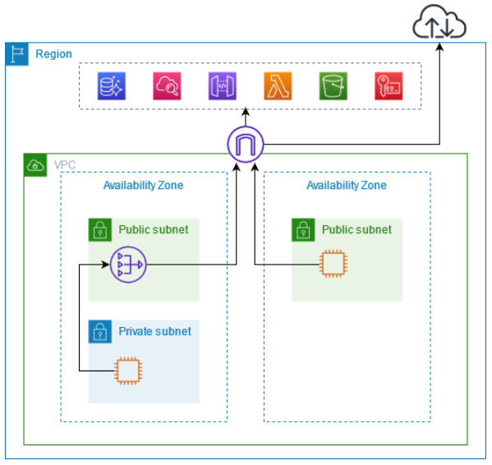
VPC endpoints
Access through public service endpoints
The following diagram shows how instances access AWS services through the public service endpoints.
Traffic to an AWS service from an instance in a public subnet is routed to the internet gateway for the VPC and then to the AWS service.
Traffic to an AWS service from an instance in a private subnet is routed to a NAT gateway, then to the internet gateway for the VPC, and then to the AWS service.
While this traffic traverses the internet gateway, it does not leave the AWS network.
They remove the need of IGW, NAT GW to access AWS Services

Slide 3
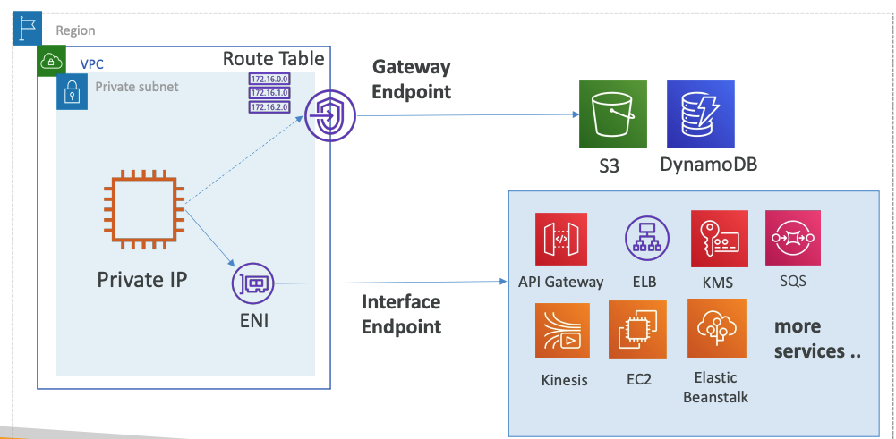
VPC Endpoint Types
There are two types of VPC endpoints –
Interface endpoints
Gateway endpoints
Gateway Endpoint: provisions a target and must be used in a route table – S3 and DynamoDB
Interface Endpoint: provisions an ENI (private IP) as an entry point – most other AWS services

Slide 4
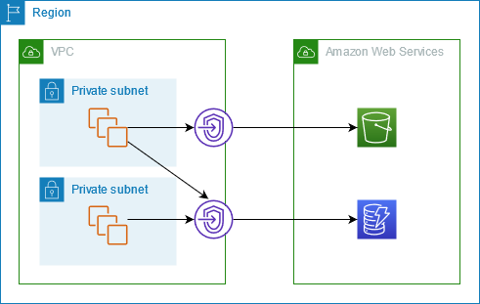
VPC Gateway Endpoint
Enables private connection between VPC and S3/DynamoDB
Need to modify the route tables and add an entry to route the traffic to S3 or DynamoDB through the gateway VPC endpoint
When we create an Amazon S3 endpoint, a prefix list is created in VPC
The prefix list is the collection of IP addresses that Amazon S3 uses. (same for DynamoDB)
The Prefix list is formatted as pl-xxxxxxxx and becomes an available option in both subnet routing tables and security groups
Prefix list could help your Security by modifying Outbound rule to destination of prefix list of endpoint

Slide 5
VPC Endpoint Security
Endpoints allows more granular access to VPC resources as compared to broad access through VPC peering connection
Access to S3 through VPC endpoint can be secured using:
bucket policies (resource based policy)
endpoint policies
VPC Endpoint policy
An IAM policy which is attached to VPC endpoint
Default policy allows full control to the AWS service

Slide 6
VPC Endpoint Policy Example for S3
You can use VPC Endpoint Policy to restrict access to a specific S3 bucket or a DynamoDB table
{
"Statement": [
{
"Sid": "Access-to-specific-bucket-only",
"Principal": "*",
"Action": [
"s3:GetObject",
"s3:PutObject"
],
"Effect": "Allow",
"Resource": [
"arn:aws:s3:::my_secure_bucket",
"arn:aws:s3:::my_secure_bucket/*"
]
}
]
}

Slide 7
Resource based policy: S3 bucket policy
{
"Version": "2012-10-17",
"Id": "Policy1415115909152",
"Statement": [
{
"Sid": "Access-to-specific-VPCE-only",
"Principal": "*",
"Action": "s3:*",
"Effect": "Deny",
"Resource": [
"arn:aws:s3:::my_secure_bucket",
"arn:aws:s3:::my_secure_bucket/*"
],
"Condition": {
"StringNotEquals": {
"aws:sourceVpce": "vpce-1a2b3c4d"
}
}
}
]
}
You can use S3 Bucket policy to restrict access to specific VPC endpoint

Slide 8
Combination of VPC Endpoint Policy and S3 bucket policy
S3 bucket policy can have:
Condition: "aws:sourceVpce": "vpce-1a2b3c4d"
to Deny any traffic that doesn't come from a specific VPC endpoint (more secure)
Condition: "aws:sourceVpc": "vpc-111bbb22"
for a specific VPC
The aws:sourceVpc condition only works for VPC Endpoints, in case you have multiple endpoints and want to manage access to your S3 buckets for all your endpoints
The S3 bucket policies can restrict access only from a specific public IP address or an elastic IP address. You can’t restrict based on private IP
Therefore aws:SourceIp condition doesn’t apply for VPC endpoints

Slide 9
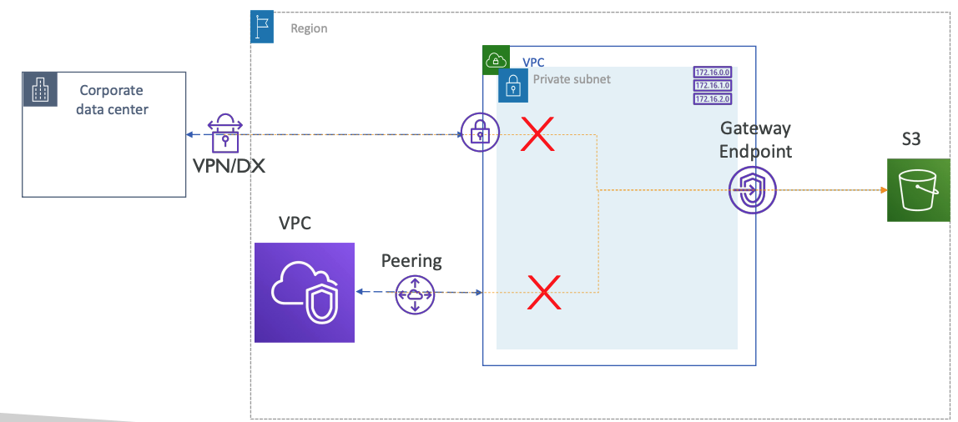
VPC Gateway Endpoint from Remote Network
No ENI Route table for Subnet not for VPN

Slide 10
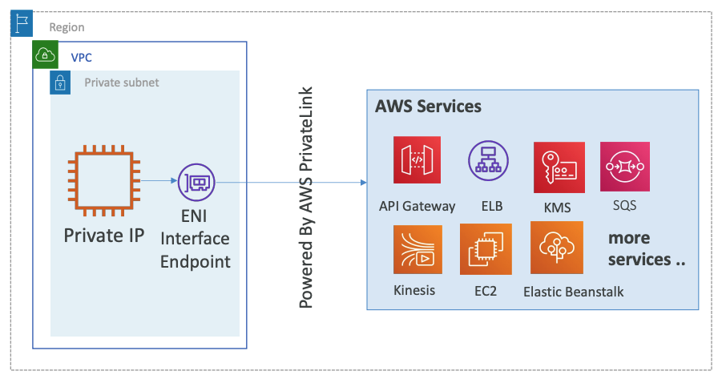
VPC Interface Endpoint
Interface endpoints create local IP addresses (using ENI) in your VPC
You create one interface endpoint per Availability zone for high availability
There is per hour cost (~$0.01/hr per AZ) and data processing cost (~$0.01/GB)
Uses Security Groups – inbound rules
For interface endpoints, AWS creates Regional and zonal DNS entries that resolves to private IP address of interface endpoint.
Interface endpoint supports only IPv4 traffic.
Interface VPC endpoints support traffic only over TCP

Slide 11
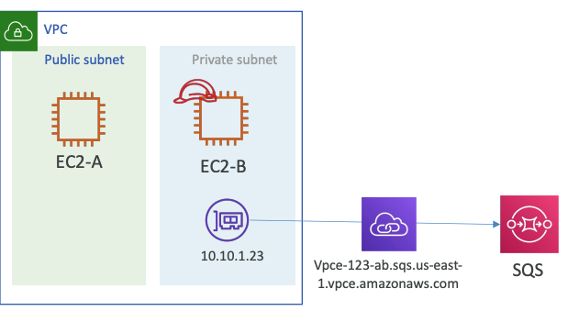
VPC Interface SQS Endpoint

Slide 12
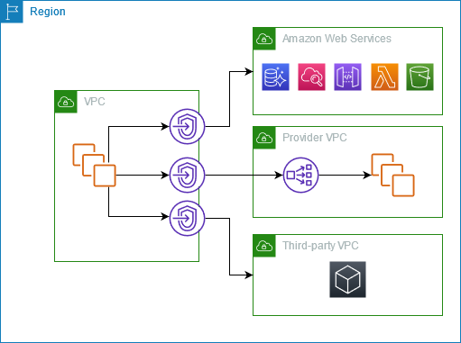
AWS PrivateLink
Connect through AWS PrivateLink
The following diagram shows how instances access AWS services through AWS PrivateLink.
First, you create an interface VPC endpoint, which establishes connections between the subnets in your VPC and an AWS service using network interfaces.
Traffic destined for the AWS service is resolved to the private IP addresses of the endpoint network interfaces using DNS, and then sent to the AWS service using the connection between the VPC endpoint and the AWS service.

Slide 13
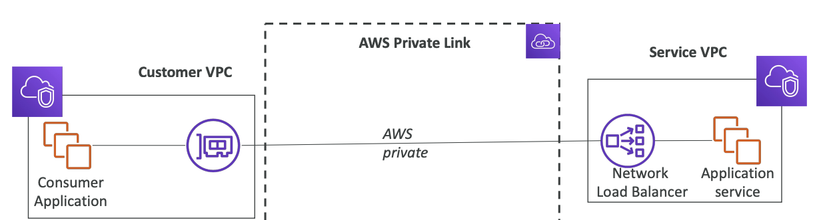
AWS PrivateLink (VPC Endpoint Services)
Most secure & scalable way to expose a service to many VPC (own or other accounts)
Does not require VPC peering, internet gateway, NAT, route tables
Requires a network load balancer (Service VPC) and ENI (Customer VPC)
If the NLB is in multiple AZ, and the ENI in multiple AZ, the solution is fault tolerant

Slide 14
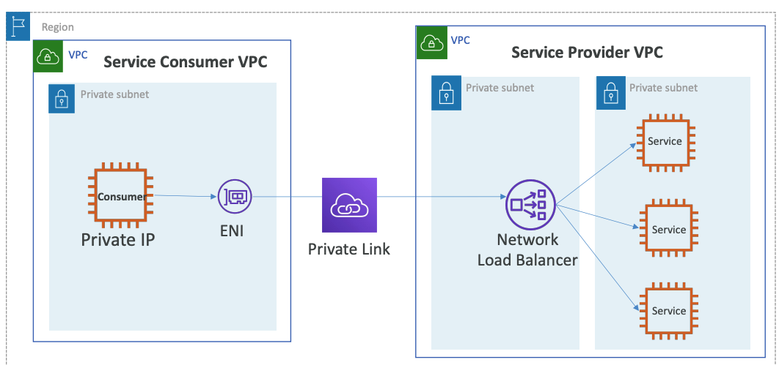
Interface VPC Endpoint – Accessing Customer VPC services

Slide 15
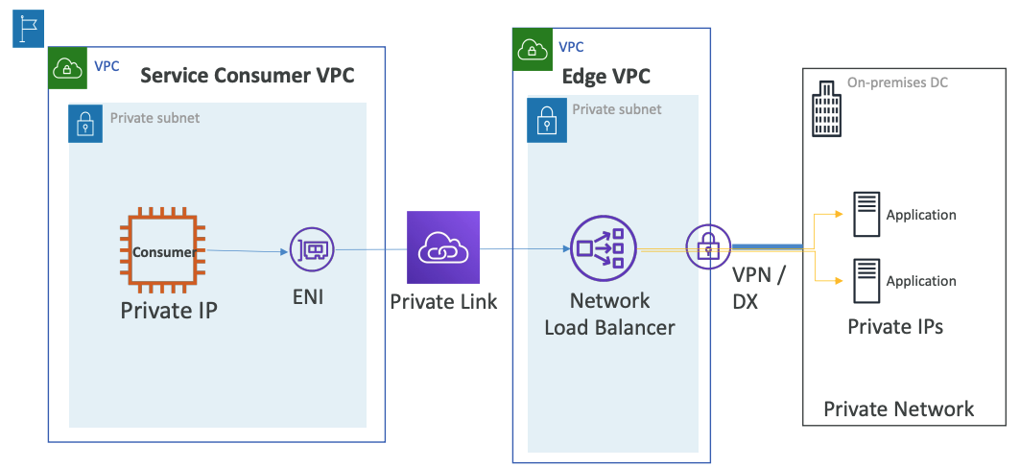
Interface VPC Endpoint – Accessing Customer On-premises services

Slide 16
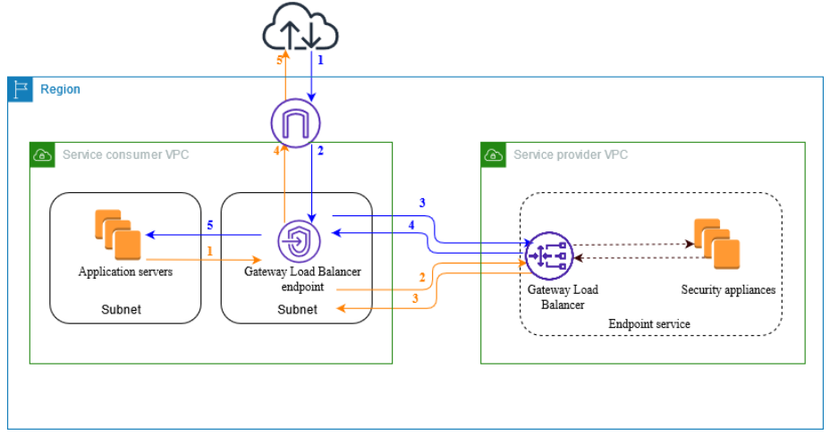
VPC endpoint services Gateway ELB
The following diagram shows how application servers access security appliances through AWS PrivateLink.
The application servers run in a subnet of the service consumer VPC.
You create a Gateway Load Balancer endpoint in another subnet of the same VPC.
All traffic entering the service consumer VPC through the internet gateway is first routed to the Gateway Load Balancer endpoint for inspection and then routed to the destination subnet.
Similarly, all traffic leaving the application servers is routed to the Gateway Load Balancer endpoint for inspection before it is routed back through the internet gateway.

Slide 17
VPC Interface Endpoint: Hostnames Introduction
Provisions an ENI that will have a private endpoint interface hostname
Private DNS settings for Interface endpoint (resolves to private IP inside VPC)
The public hostname of a service will resolve to the private Endpoint Interface hostname
VPC Setting: “Enable DNS hostnames” and “Enable DNS Support” must be 'true’
Example for SQS:
Regional: vpce-0b7d2995e9dfe5418-mwrths3x.sqs.us-east-1.vpce.amazonaws.com
Zonal: vpce-0b7d2995e9dfe5418-mwrths3x-us-east-1a.sqs.us-east-1.vpce.amazonaws.com
Zonal: vpce-0b7d2995e9dfe5418-mwrths3x-us-east-1b.sqs.us-east-1.vpce.amazonaws.com
Service DNS: sqs.us-east-1.amazonaws.com (private DNS name) (which will be resolved to YOUR ENI)
With Private DNS enabled, the consumer VPC can access the endpoint services using Service’s default DNS e.g ec2.us-east-1.amazonaws.com instead of using endpoint specific DNS e.g vpce-12345-ab.ec2.us-east-1.vpce.amazonaws.com

Slide 18
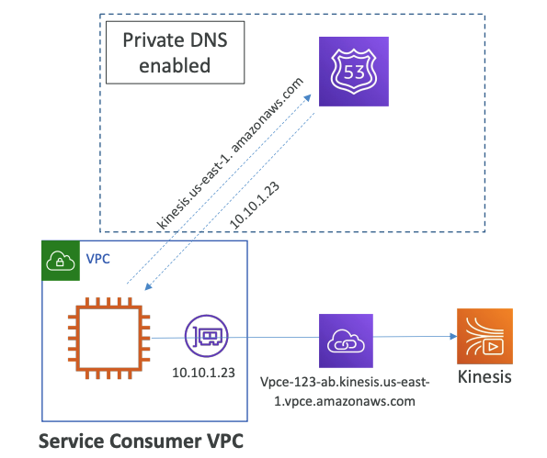
VPC Interface Endpoint DNS Resolution
For your VPC Endpoint, Private Hosted Zone will be created
This hosted zone will resolve private IP of your ENI for your VPC Endpoint
If you have not enabled Private DNS
-> public domain name of service would not be resolved to your ENI IP
-> you need to use DNS name of your VPC Endpoint

Slide 19
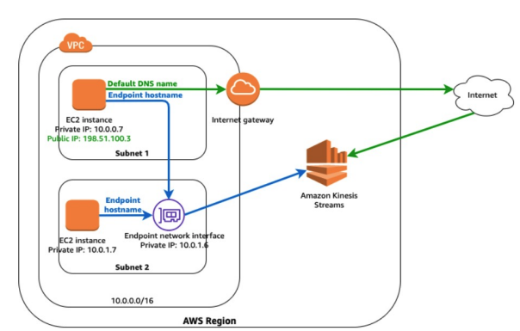
VPC Interface Endpoint – Private DNS disabled
Subnet 1 -> kinesis.us-east-1.amazon.com -> Via internet
Subnet 1 -> vpce-123-ab.kinesis.us-east-1.vpce.amazonaws.com -> Via Interface endpoint
Subnet 2 (No IGW) -> Only option is via interface endpoint using interface-endpoint DNS

Slide 20
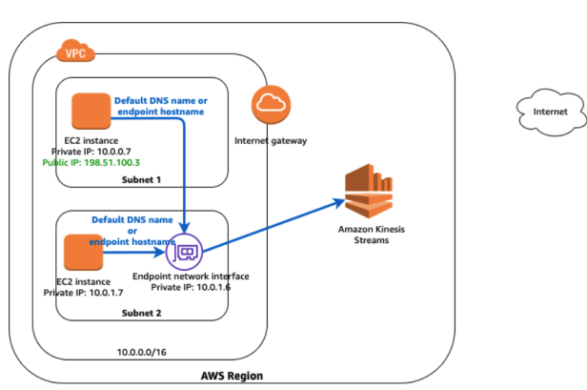
VPC Interface Endpoint – Private DNS enabled
Subnet 1/2 -> kinesis.us-east-1.amazon.com -> Via Interface endpoint
Subnet 1/2 -> vpce-123-ab.kinesis.us-east-1.vpce.amazonaws.com -> Via Interface endpoint

Slide 21
VPC endpoints DNS Resolution Summary
When Private DNS is enabled :
The public hostname of a AWS service will resolve to the private Endpoint Interface hostname (your ENI -> private IP)
For AWS services AWS creates Private Hosted Zone and associate it with your VPC (to help you resolve your private ENI)
Example: With Private DNS enabled, the consumer VPC can access the endpoint services using Service’s default DNS e.g ec2.us-east-1.amazonaws.com instead of using endpoint specific DNS e.g vpce-12345-ab.ec2.us-east-1.vpce.amazonaws.com
VPC Setting: “Enable DNS hostnames” and “Enable DNS Support” must be 'true

Slide 22
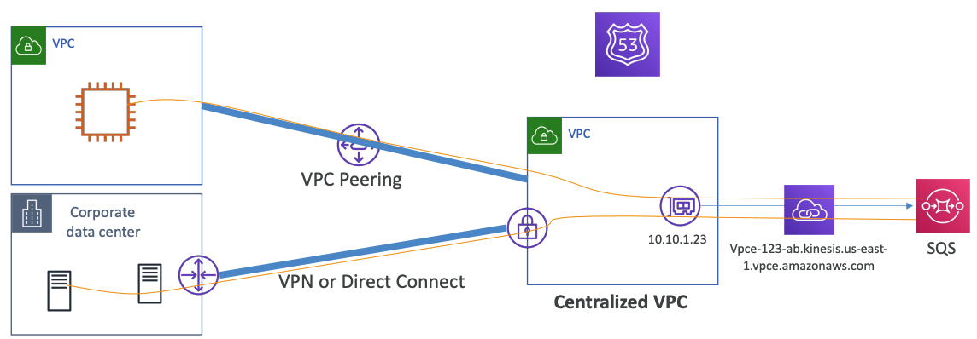
VPC Interface Endpoint Access From OnPrem == Remote Network
An Interface endpoint can be accessed through
Direct Connect
AWS Managed VPN
VPC peering connection
Peered VPCs can resolve the private DNS of Interface endpoint if attached to custom Route53 Private Hosted Zone
You need to move Private Hosted Zone on target VPC
And create an alias record on public dns name to vpc endpoint dns name
For On-premise DNS resolution the DNS queries should be forwarded to custom Route53 Resolver
Route53 Resolver will resolve your private ENI private IP Address

Slide 23
AWS PrivateLink vs VPC Peering
VPC peering is useful when there are many resources that should communicate between peered VPCs
PrivateLink should be used when you want to allow access to only single application hosted in your VPC to other VPCs without peering the VPCs
When there is overlapping CIDRs, VPC peering connection cannot be created. However private link does support overlapping CIDR
We can create a maximum of 125 peering connections. There is no limit on private link connections.
VPC peering enables bidirectional traffic origin. PrivateLink allows only consumer to originate the traffic.

Slide 24
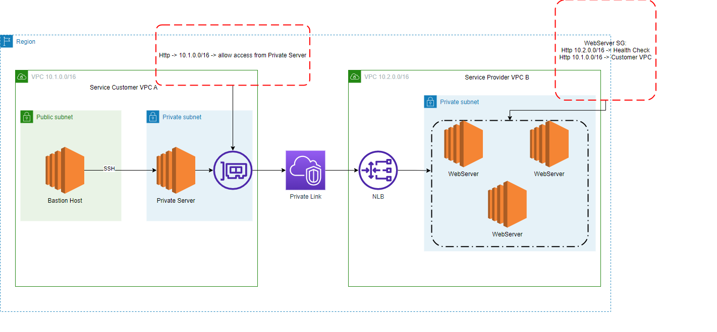
Vpc Endpoints Service Hands On

