Slide 1
Amazon EMR
Easily run and scale Apache Spark, Hive, Presto, and other big data workloads

Slide 2

Apache Hadoop
Apache Hadoop is an open-source framework that allows for the distributed processing of large datasets across clusters of computers using simple programming models.
It is designed to scale up from a single server to thousands of machines, with each offering local computation and storage, which facilitates rapid data transfer rates and protects against system failures.
Essentially, it enables organizations to analyze large quantities of data effectively and at a fraction of the time it would take using conventional methods.
Its core components include Hadoop Distributed File System (HDFS) for storage and MapReduce for processing data, working together to enable robust and scalable data analytics.

Slide 3

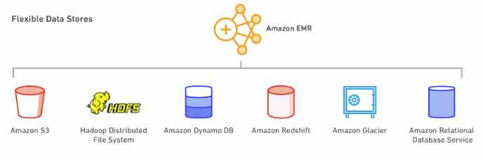
Amazon EMR Overview
Amazon EMR (previously known as Amazon Elastic MapReduce) is an Amazon Web Services (AWS) tool for big data processing and analysis
Amazon EMR is based on Apache Hadoop, a Java-based programming framework that supports the processing of large data sets in a distributed computing environment.
Using MapReduce, a core component of the Hadoop software framework, developers can write programs that process massive amounts of unstructured data across a distributed cluster of processors or standalone computers.
EMR comes bundled with Apache Spark, HBase, Presto, Flink

Slide 4
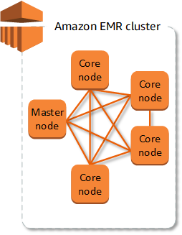
Amazon EMR Cluster and Node
The central component of Amazon EMR is the cluster.
A cluster is a collection of Amazon Elastic Compute Cloud (Amazon EC2) instances.
Each instance in the cluster is called a node. Each node has a role within the cluster, referred to as the node type.
Amazon EMR also installs different software components on each node type, giving each node a role in a distributed application like Apache Hadoop.
The node types in Amazon EMR are as follows:
Master/Primary node: A node that manages the cluster by running software components to coordinate the distribution of data and tasks among other nodes for processing. The primary node tracks the status of tasks and monitors the health of the cluster. Every cluster has a primary node, and it's possible to create a single-node cluster with only the primary node.
Core node: A node with software components that run tasks and store data in the Hadoop Distributed File System (HDFS) on your cluster. Multi-node clusters have at least one core node.
Task node: A node with software components that only runs tasks and does not store data in HDFS. Task nodes are optional.

Slide 5
Amazon EMR Deployment Options
Amazon EMR on Amazon EC2.
Amazon EMR can quickly process large amounts of data using Amazon EC2.
Users can configure Amazon EMR to take advantage of On-Demand, Reserved and Spot Instances.
Amazon EMR on Amazon Elastic Kubernetes Service (EKS).
The Amazon EMR console enables users to run Apache Spark applications with other applications on the same EKS cluster.
Organizations can share compute and memory resources across all applications and use a Kubernetes tool to monitor and manage the infrastructure.
Amazon EMR on AWS Outposts.
AWS Outposts enables organizations to run EMR in their own data centers.
This makes it easier to set up, deploy, manage and scale EMR in on-premises environments.

Slide 6
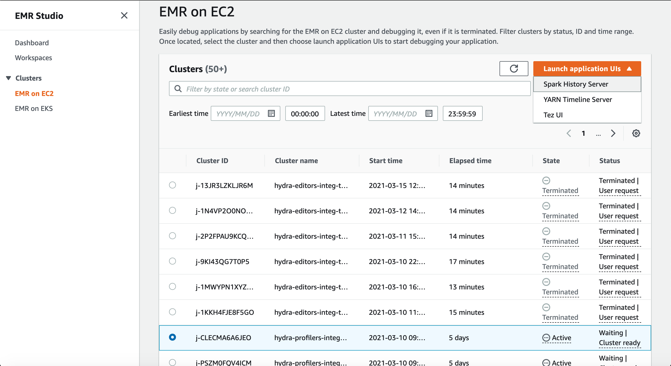
Amazon EMR Studio
Amazon EMR Studio is a web-based integrated development environment (IDE) for fully managed Jupyter notebooks that run on Amazon EMR clusters.
You can set up an EMR Studio for your team to develop, visualize, and debug applications written in R, Python, Scala, and PySpark.
EMR Studio is integrated with AWS Identity and Access Management (IAM) and IAM Identity Center so users can log in using their corporate credentials.

Slide 7
Amazon EMR Use Cases
Real-time Fraud Detection: Financial institutions can use AWS EMR to analyze large datasets in real time, identifying potential fraudulent transactions swiftly to enhance security measures and protect customer assets.
Genomic Data Analysis: Research institutions in the field of genomics can leverage AWS EMR to process and analyze massive genomic datasets, speeding up the research process and aiding in the development of personalized medicine approaches.
Predictive Maintenance: Manufacturing companies can utilize AWS EMR to perform predictive maintenance analytics by processing and analyzing sensor data from machinery, helping to foresee potential issues and reduce downtime through timely maintenance.
Consumer Behavior Analysis for Retail: Retail businesses can employ AWS EMR to analyze consumer buying patterns and preferences from large datasets, facilitating personalized marketing strategies and improving customer service through targeted offerings.
Energy Grid Optimization: Utility companies can leverage AWS EMR to analyze data from smart grids, optimizing energy distribution through real-time analysis of demand and supply patterns, fostering more efficient and sustainable energy systems.

Slide 8
EMR Exam Take Away
EMR Notebooks provide a managed environment, based on Jupyter Notebooks, to help users prepare and visualize data, collaborate with peers, build applications, and perform interactive analysis using EMR clusters.
EMR enables you to quickly and easily provision as much capacity as you need, and automatically or manually add and remove capacity.
You can leverage multiple data stores, including S3, the Hadoop Distributed File System (HDFS), and DynamoDB.
Components: Cluster Nodes, Node Type
Paying a per-second rate for every second for each node you use, with a one-minute minimum.

