Slide 1
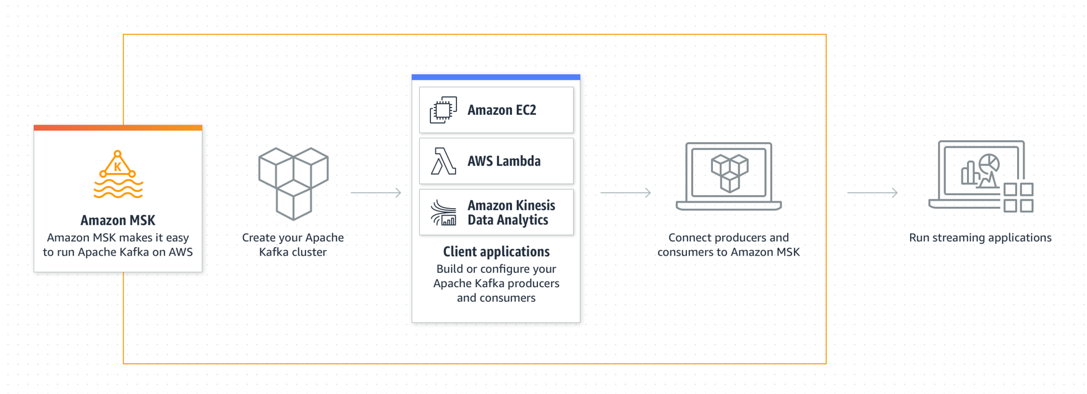
Amazon MSK
Amazon MSK makes it easy to ingest and process streaming data in real time with fully managed Apache Kafka.

Slide 2

Why you would want to use Amazon MSK
Managed service: you don’t have to bring together an entire engineering team together to setup Apache Kafka.
You can start building your applications in less than 15 minutes
Network security: Apache Kafka on Amazon MSK is deployed within your VPC, meaning that Apache Kafka network packets never goes out on the internet.
This is a big difference from public managed solutions such as Confluent Cloud.
Kafka security: MSK supports SSL based security and SASL/SCRAM.
I’ve setup Kafka security before, and I can tell you it’s error prone and hard.
You can directly use a secure Kafka cluster on MSK.

Slide 3
Why you would want to use Amazon MSK
Cost savings: one HUGE advantage of using Amazon MSK is that you do not pay for Kafka replication traffic going across your AZ.
If you are going to run Apache Kafka on EC2 machines yourself, and set a replication factor of 3, the network bill can become pretty significant if you have huge data volumes.
Managed upgrades: one simple API to upgrade your Kafka cluster with no downtime.

Slide 4
