Slide 1

AWS Lake Formation
Build, manage, and secure data lakes in days

Slide 2
AWS Lake Formation Overview
AWS Lake Formation is a fully managed service that makes it easy to build, secure, and manage data lakes.
Lake Formation simplifies and automates many of the complex manual steps that are usually required to create data lakes.
These steps include collecting, cleansing, moving, and cataloging data, and securely making that data available for analytics and machine learning.
Layer on top of AWS Glue

Slide 3
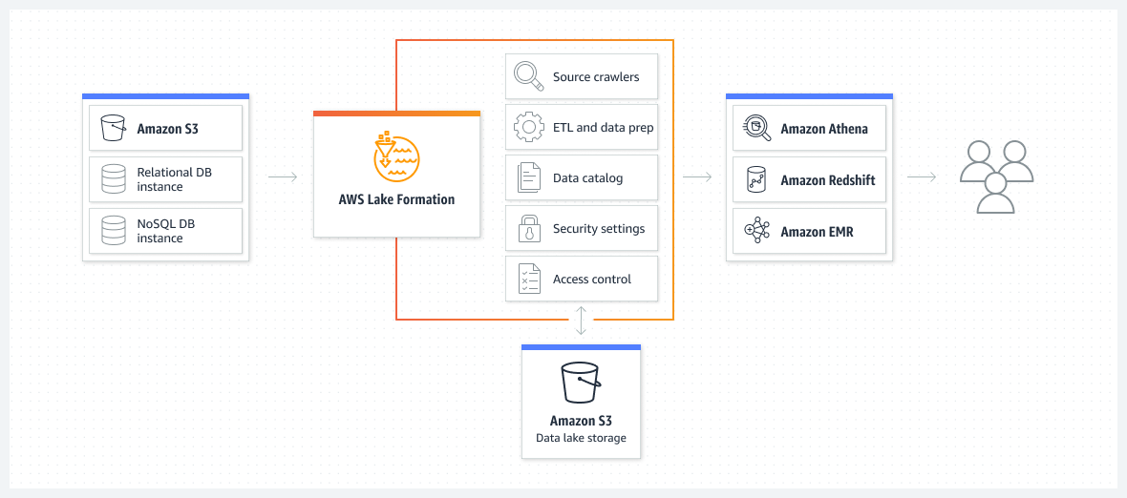
AWS Lake Formation Architecture

Slide 4
AWS Lake Formation Use Cases
Centralized Patient Records in Healthcare: Healthcare organizations can leverage AWS Lake Formation to centralize patient records and other healthcare data, streamlining access for healthcare providers and facilitating more informed decision-making through comprehensive data analysis.
Retail Customer Insights and Personalization: Retail companies can use AWS Lake Formation to consolidate customer data into a secure and searchable data lake, employing analytics to gain deeper insights into customer behavior and preferences, and enabling personalized marketing strategies and recommendations.
Financial Services Regulatory Compliance: Financial institutions can employ AWS Lake Formation to establish data lakes that aid in meeting regulatory compliance requirements, providing a secure and governed environment to store sensitive financial data, and facilitating auditing and reporting processes.
Smart City Urban Planning: Municipal governments can utilize AWS Lake Formation to create data lakes that centralize various data streams from city infrastructures, helping in urban planning initiatives through the analysis of real-time and historical data, fostering more sustainable and efficient cities.
Research and Development in Pharmaceuticals: Pharmaceutical companies can leverage AWS Lake Formation to foster collaborative research and development, providing a platform to integrate and analyze vast datasets, including clinical trial data, to speed up the drug development process and foster innovations.

Slide 6
AWS Lake Formation terminology
Data lake
The data lake is your persistent data that is stored in Amazon S3 and managed by Lake Formation using a Data Catalog. A data lake typically stores the following:
Structured and unstructured data
Raw data and transformed data
For an Amazon S3 path to be within a data lake, it must be registered with Lake Formation.
Data access
Lake Formation provides secure and granular access to data through a new grant/revoke permissions model that augments AWS Identity and Access Management (IAM) policies.
Analysts and data scientists can use the full portfolio of AWS analytic and machine learning services, such as Amazon Athena, to access the data. The configured Lake Formation security policies help ensure that users can access only the data that they are authorized to access.

Slide 7
AWS Lake Formation terminology
Blueprint
A blueprint is a data management template that enables you to easily ingest data into a data lake. Lake Formation provides several blueprints, each for a predefined source type, such as a relational database or AWS CloudTrail logs. From a blueprint, you can create a workflow. Workflows consist of AWS Glue crawlers, jobs, and triggers that are generated to orchestrate the loading and update of data. Blueprints take the data source, data target, and schedule as input to configure the workflow.
Workflow
A workflow is a container for a set of related AWS Glue jobs, crawlers, and triggers. You create the workflow in Lake Formation, and it executes in the AWS Glue service. Lake Formation can track the status of a workflow as a single entity.
When you define a workflow, you select the blueprint upon which it is based. You can then run workflows on demand or on a schedule.
Workflows that you create in Lake Formation are visible in the AWS Glue console as a directed acyclic graph (DAG). Using the DAG, you can track the progress of the workflow and perform troubleshooting.

Slide 8
AWS Lake Formation terminology
Data Catalog
The Data Catalog is your persistent metadata store.
It is a managed service that lets you store, annotate, and share metadata in the AWS Cloud in the same way you would in an Apache Hive metastore.
It provides a uniform repository where disparate systems can store and find metadata to track data in data silos, and then use that metadata to query and transform the data.
Lake Formation uses the AWS Glue Data Catalog to store metadata about data lakes, data sources, transforms, and targets.
Metadata about data sources and targets is in the form of databases and tables.
Tables store schema information, location information, and more.
Databases are collections of tables.
Lake Formation provides a hierarchy of permissions to control access to databases and tables in the Data Catalog.
Each AWS account has one Data Catalog per AWS Region.
Underlying data
Underlying data refers to the source data or data within the data lakes that Data Catalog tables point to.
Principal
A principal is an AWS Identity and Access Management (IAM) user or role or an Active Directory user.
Data lake administrator
A data lake administrator is a principal who can grant any principal (including self) any permission on any Data Catalog resource or data location. Designate a data lake administrator as the first user of the Data Catalog. This user can then grant more granular permissions of resources to other principals.

Slide 9
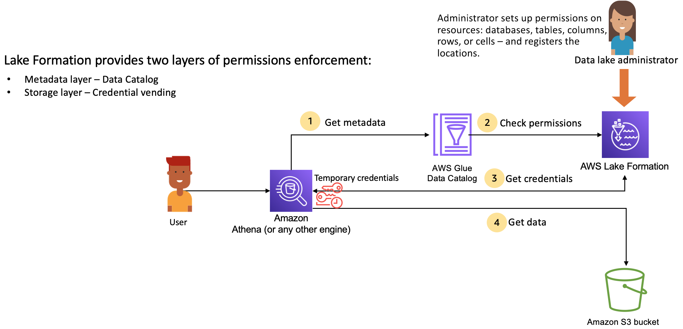
Lake Formation permissions management workflow

