Slide 1
Amazon OpenSearch Service
Securely unlock real-time search, monitoring, and analysis of business and operational data

Slide 2

The ELK Stack
ELK is an acronym that describes a popular combination of projects: Elasticsearch, Logstash, and Kibana.
The ELK stack gives you the ability to aggregate logs from all your systems and applications, analyze these logs, and create visualizations.
ELK is useful for visualizing application and infrastructure monitoring data, troubleshooting, security analytics and more.

Slide 3
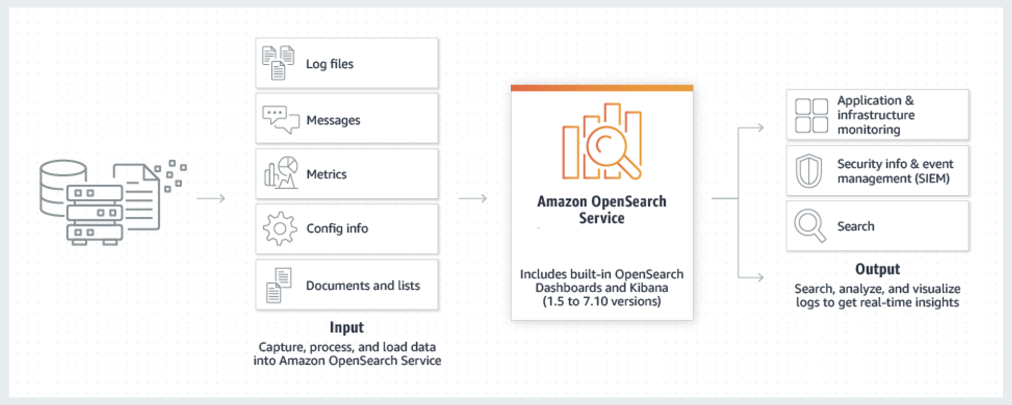
What is Amazon OpenSearch Service?
Amazon OpenSearch Service is a managed service that makes it easy to deploy, operate, and scale OpenSearch clusters in the AWS Cloud.
Amazon OpenSearch Service supports OpenSearch and legacy Elasticsearch OSS (up to 7.10, the final open source version of the software).
When you create a cluster, you have the option of which search engine to use.
OpenSearch is a fully open-source search and analytics engine for use cases such as log analytics, real-time application monitoring, and clickstream analysis

Slide 4
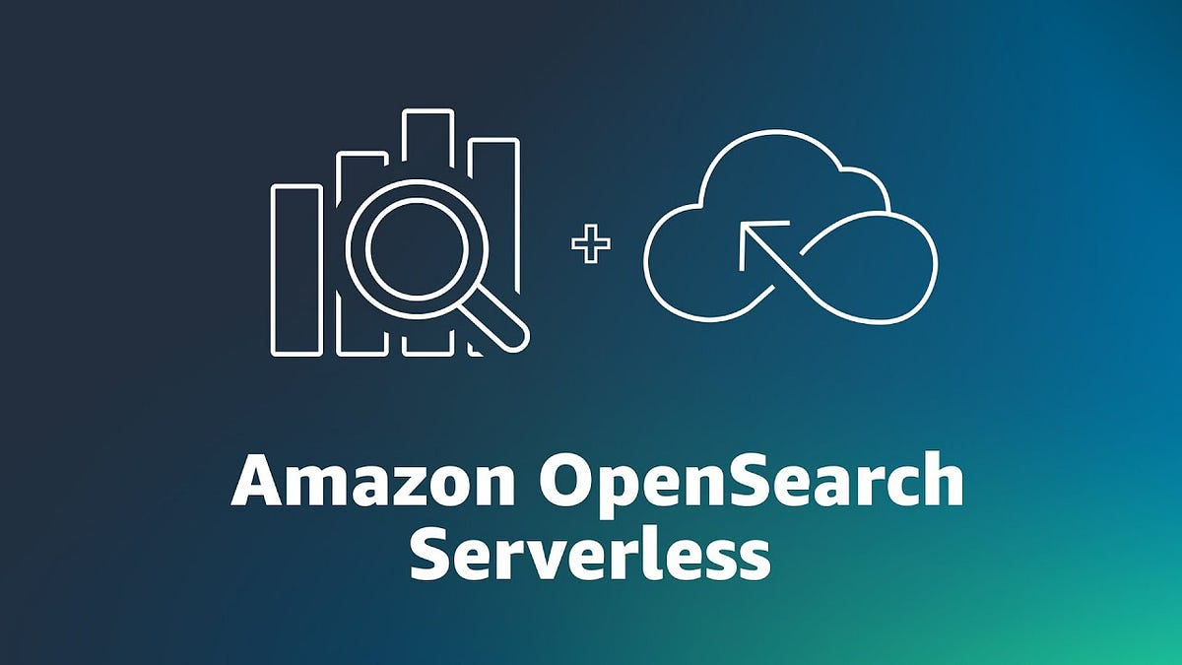
Amazon OpenSearch Serverless cluster
Amazon OpenSearch Serverless is an on-demand serverless configuration for Amazon OpenSearch Service.
Serverless removes the operational complexities of provisioning, configuring, and tuning your OpenSearch clusters.
It's a good option for organizations that don't want to self-manage their OpenSearch clusters, or organizations that don't have the dedicated resources or expertise to operate large clusters.
With OpenSearch Serverless, you can easily search and analyze a large volume of data without having to worry about the underlying infrastructure and data management.
An OpenSearch Serverless collection is a group of OpenSearch indexes that work together to support a specific workload or use case.
Collections are easier to use than self-managed OpenSearch clusters, which require manual provisioning.

Slide 5
Amazon OpenSearch Managed cluster
Amazon OpenSearch Managed Cluster:
This is a fully managed service where you can deploy, manage, and scale OpenSearch clusters with predefined resources.
You get a dedicated environment for your OpenSearch operations, but you need to manage aspects like sizing, sharding, and indexing yourself, albeit with tools and assistance from AWS.
It can potentially offer more control over the environment, making it suitable for enterprises with specific configurations and performance requirements.
Amazon OpenSearch Serverless:
This option abstracts away much of the operational complexity, offering a hands-off experience with automatic scaling of resources based on the workload, meaning you don't have to manage individual clusters or worry about resource provisioning.
Serverless deployments can be more cost-effective as you only pay for the resources your queries use, which can be a significant advantage for sporadic or unpredictable workloads.
It's ideal for businesses looking for easy setup, low maintenance, and cost-effective solutions.
In summary, the managed cluster offers more control but comes with increased management responsibilities, while the serverless option reduces operational burden and is generally more cost-effective for fluctuating workloads.

Slide 6
Amazon OpenSearch Serverless use cases
OpenSearch Serverless supports two primary use cases:
Log analytics - The log analytics segment focuses on analyzing large volumes of semi-structured, machine-generated time series data for operational and user behavior insights.
Full-text search - The full-text search segment powers applications in your internal networks (content management systems, legal documents) and internet-facing applications, such as ecommerce website content search.

Slide 7
Aws OpenSearch Use Cases
Real-time Analytics Dashboards: Companies can use AWS OpenSearch to create real-time analytics dashboards that provide insights into business operations, helping to monitor key performance indicators and make data-driven decisions.
Enhanced E-commerce Search Features: E-commerce platforms can employ AWS OpenSearch to enhance their search functionalities, providing customers with fast and relevant search results, including auto-complete suggestions and personalized recommendations, thereby improving the user experience and potentially increasing sales.
Log Analytics for IT Operations: IT teams can leverage AWS OpenSearch for log analytics, utilizing it to centralize, monitor, and analyze log data from various sources, helping in troubleshooting, system monitoring, and enhancing security through anomaly detection.
Content Recommendation Engines for Media Companies: Media companies can use AWS OpenSearch to build content recommendation systems, analyzing user behavior and preferences to provide personalized content recommendations, enhancing user engagement and satisfaction.
Fraud Detection in Financial Services: Financial institutions can implement AWS OpenSearch to develop fraud detection systems, utilizing real-time analytics and machine learning functionalities to identify potentially fraudulent activities and protect their customers from fraud.

