Slide 1
RDS

Slide 2
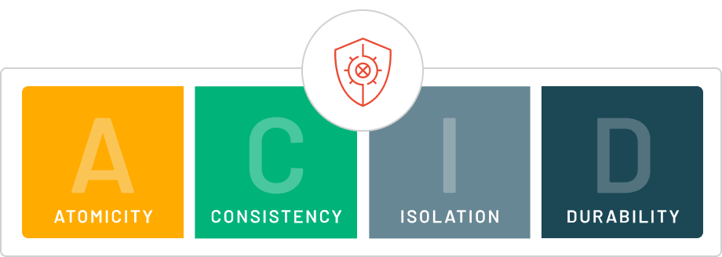
ACID
Atomicity - all operations succeed or fail together, i.e. the transaction is an "atomic" unit
Consistency - a successful transaction places the database in a valid state, that is, no schema violations
Isolation - transactions can be executed concurrently
Durability - a "committed" transaction is persisted to memory

Slide 3
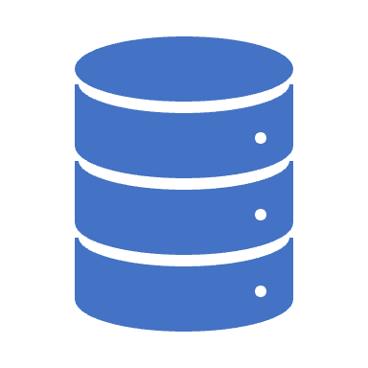
RDS
Amazon Relational Database Service (Amazon RDS) is a managed service that you can use to launch and manage relational databases on AWS.
Amazon RDS is an Online Transaction Processing (OLTP) type of database.
It is best suited to structured, relational data store requirements.
Amazon RDS supports the following database engines:
Amazon Aurora.
MySQL.
MariaDB.
Oracle.
SQL Server.
PostgreSQL.

Slide 4
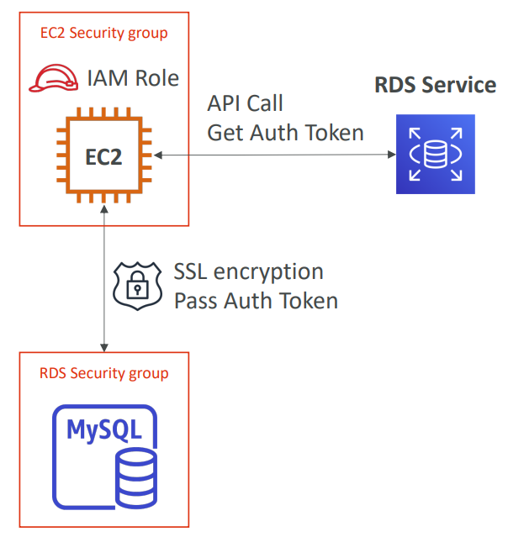
RDS IAM Authentication
IAM database authentication works with MySQL and PostgreSQL
You don’t need a password, just an authentication token obtained through IAM & RDS API calls
Auth token has a lifetime of 15 minutes
Benefits:
Network in/out must be encrypted using SSL
IAM to centrally manage users instead of DB
Can leverage IAM Roles and EC2 Instance profiles for easy integration

Slide 5
Performance
Amazon RDS uses EBS volumes (never uses instance store) for DB and log storage.
There are three storage types available: General Purpose (SSD), Provisioned IOPS (SSD), and Magnetic.
https://docs.aws.amazon.com/AmazonRDS/latest/UserGuide/CHAP_Storage.html
General Purpose (SSD):
Use for Database workloads with moderate I/O requirement.
Cost effective.
Also called gp2.
Burst up to 3000 IOPS.
Provisioned IOPS (SSD):
Use for I/O intensive workloads.
Low latency and consistent I/O.
Magnetic:
Not recommended anymore, available for backwards compatibility.
Doesn’t allow you to scale storage when using the SQL Server database engine.
Doesn’t support elastic volumes.
Limited to a maximum size of 4 TiB.
Limited to a maximum of 1,000 IOPS.

Slide 6
Monitoring of Storage Performance
IOPS – The number of I/O operations completed each second.
This metric is reported as the average IOPS for a given time interval.
Amazon RDS reports read and write IOPS separately on 1-minute intervals.
Total IOPS is the sum of the read and write IOPS.
Latency – The elapsed time between the submission of an I/O request and its completion.
This metric is reported as the average latency for a given time interval.
Amazon RDS reports read and write latency separately at 1-minute intervals.
Typical values for latency are in milliseconds (ms).
Throughput – The number of bytes each second that are transferred to or from disk.
This metric is reported as the average throughput for a given time interval.
Amazon RDS reports read and write throughput separately on 1-minute intervals using units of megabytes per second (MB/s).
Typical values for throughput range from zero to the I/O channel's maximum bandwidth.
Queue Depth – The number of I/O requests in the queue waiting to be serviced.
These are I/O requests that have been submitted by the application but have not been sent to the device because the device is busy servicing other I/O requests.
Time spent waiting in the queue is a component of latency and service time (not available as a metric).
This metric is reported as the average queue depth for a given time interval.
Amazon RDS reports queue depth in 1-minute intervals.
Typical values for queue depth range from zero to several hundred.

Slide 7
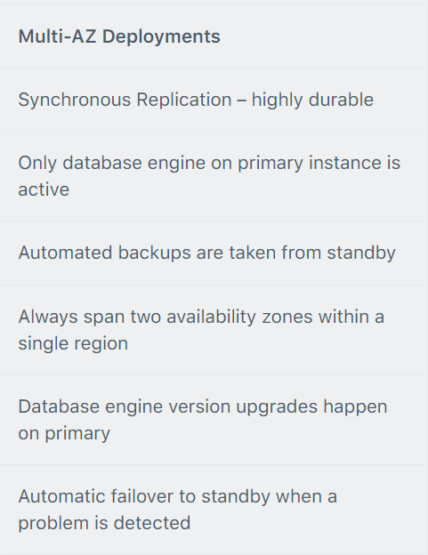
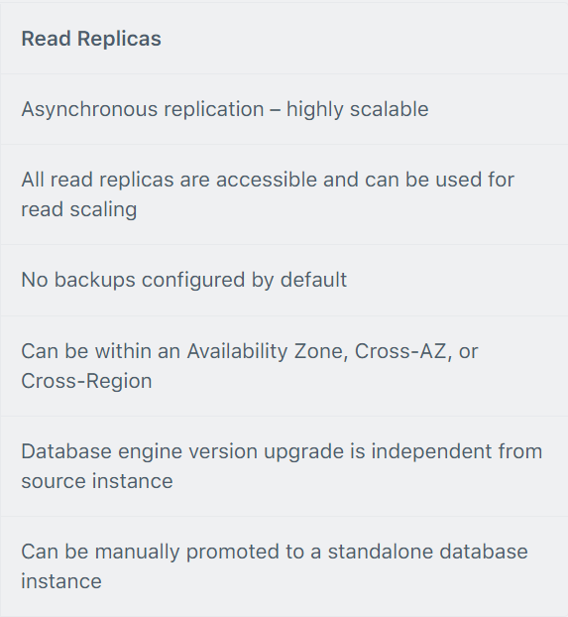
Multi-AZ and Read Replicas
Multi-AZ and Read Replicas are used for high availability, fault tolerance and performance scaling.
The table below compares multi-AZ deployments to Read Replicas:

Slide 8
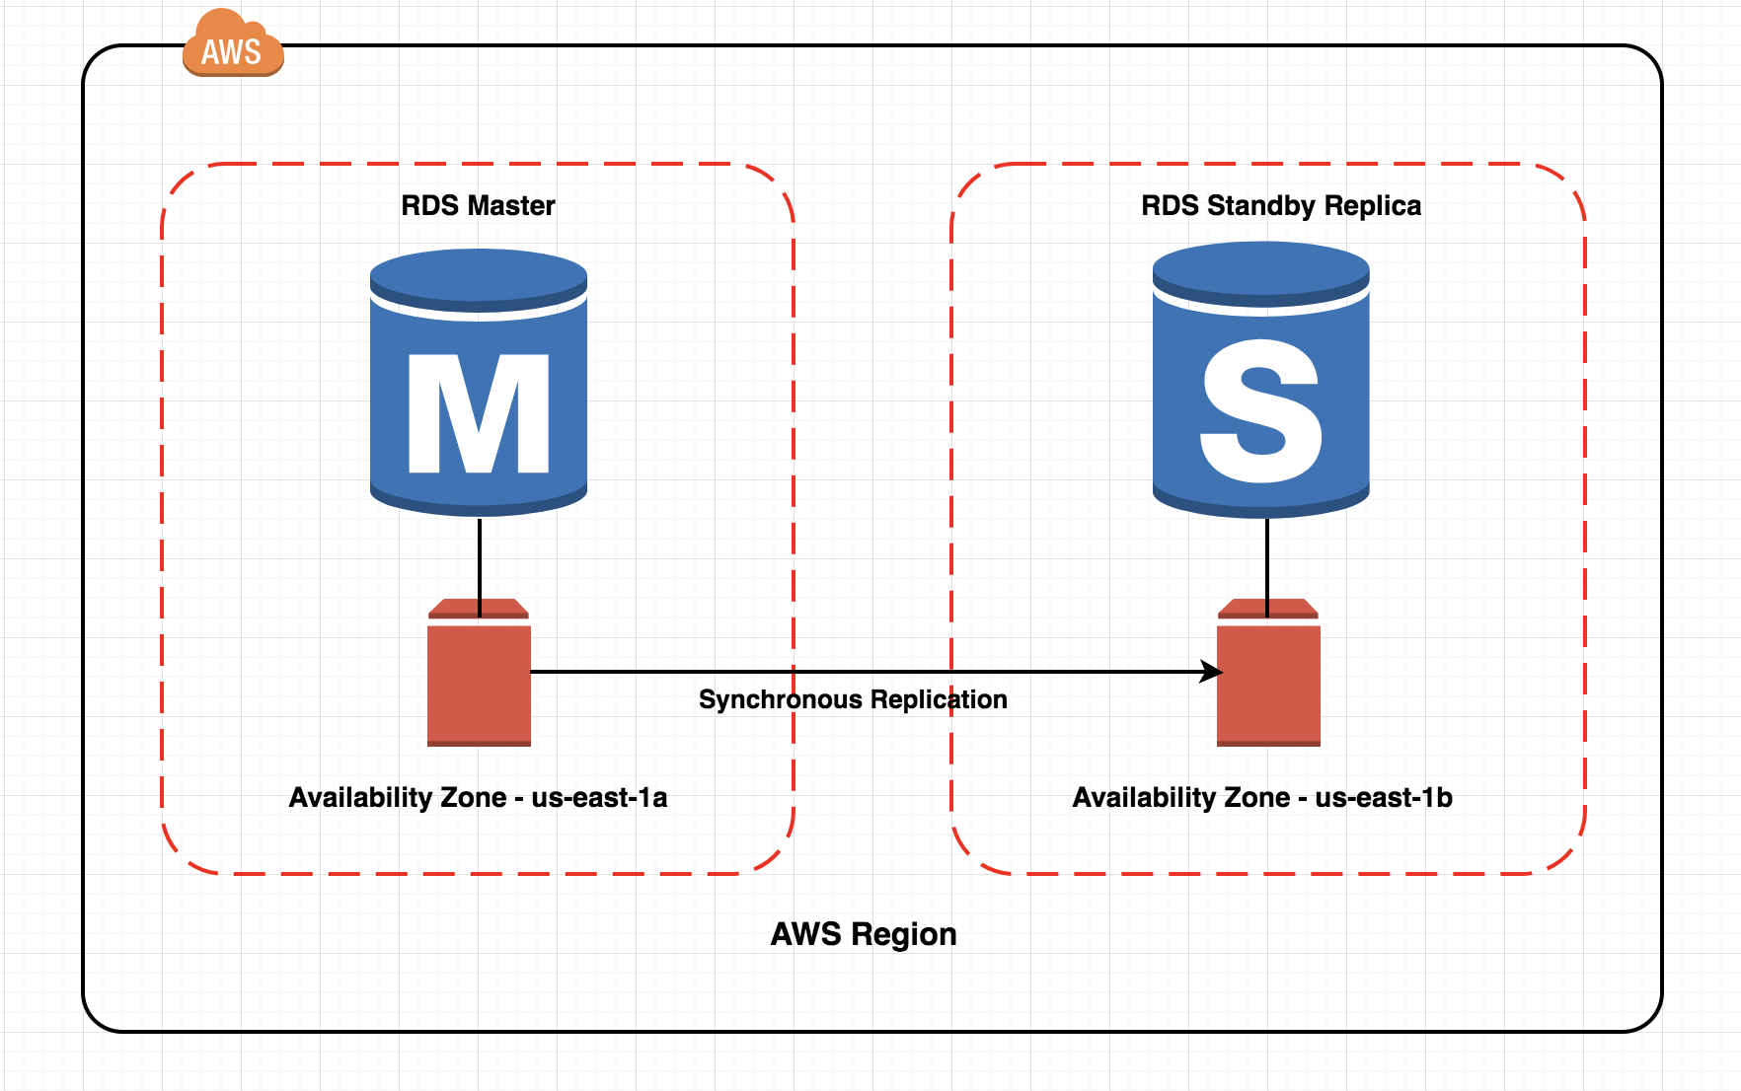
RDS Multi AZ
Multi-AZ RDS creates a replica in another AZ and synchronously replicates to it.
There is an option to choose multi-AZ during the launch wizard.
AWS recommends the use of provisioned IOPS storage for multi-AZ RDS DB instances.
Each AZ runs on its own physically distinct, independent infrastructure, and is engineered to be highly reliable.
You cannot choose which AZ in the region will be chosen to create the standby DB instance.

Slide 9
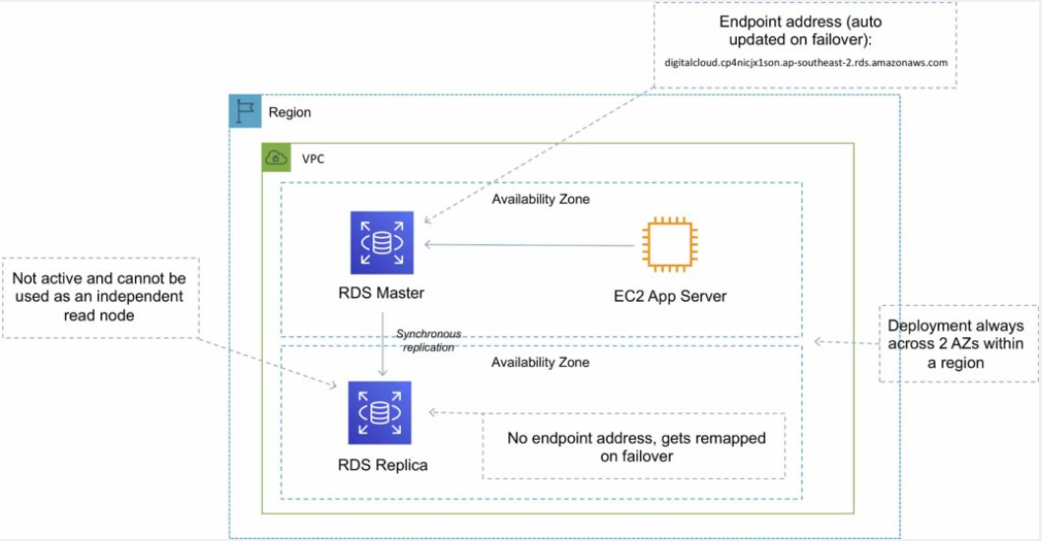
RDS Multi AZ

Slide 10
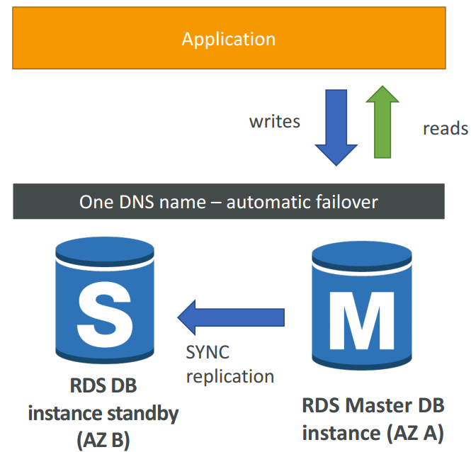
RDS Multi AZ (Disaster Recovery)
SYNC replication
One DNS name – automatic app failover to standby
Increase availability
Failover in case of loss of AZ, loss of network, instance or storage failure
No manual intervention in apps
Not used for scaling
Multi-AZ replication is free
Note : The Read Replicas be setup as Multi AZ for Disaster Recovery (DR)

Slide 11
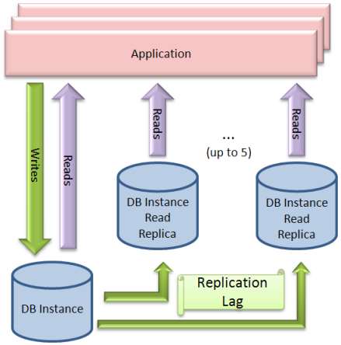
RDS Read Replicas
Read replicas are used for read-heavy DBs and replication is asynchronous.
Read replicas are for workload sharing and offloading.
Read replicas provide read-only DR.
Read replicas are created from a snapshot of the master instance.
You can have 5 read replicas of a production DB.

Slide 12
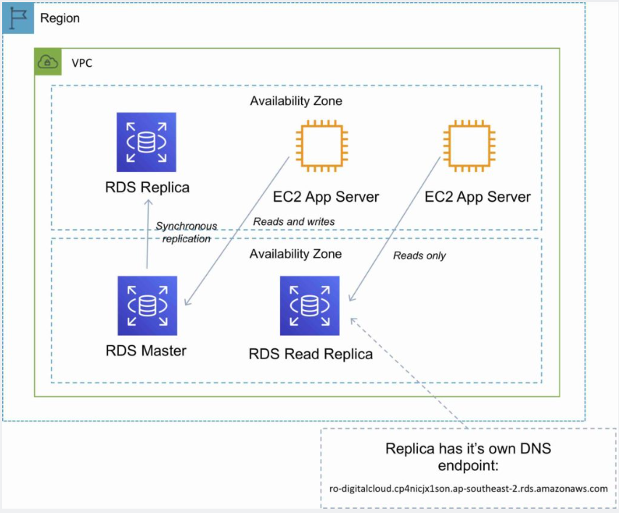
RDS Read Replicas

Slide 13
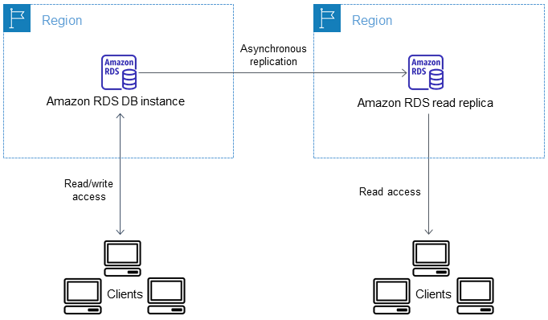
RDS Read Replicas in different Region

Slide 14
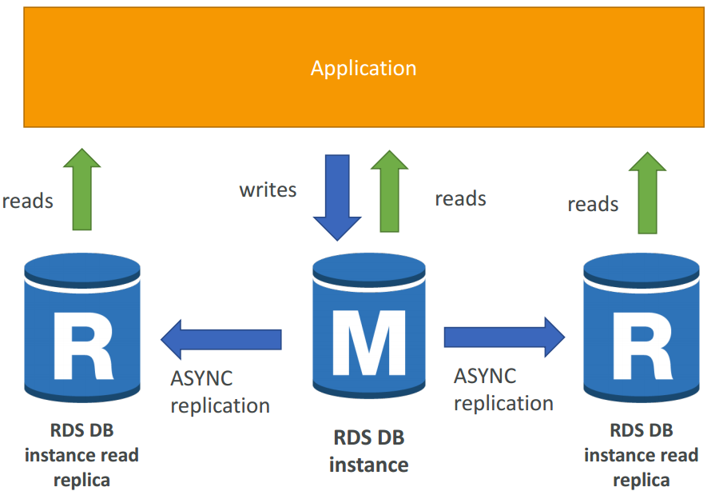
RDS Read Replicas for read scalability
Up to 5 Read Replicas
Within AZ, Cross AZ or Cross Region
Replication is ASYNC, so reads are eventually consistent
Replicas can be promoted to their own DB
Applications must update the connection string to leverage read replicas

Slide 15
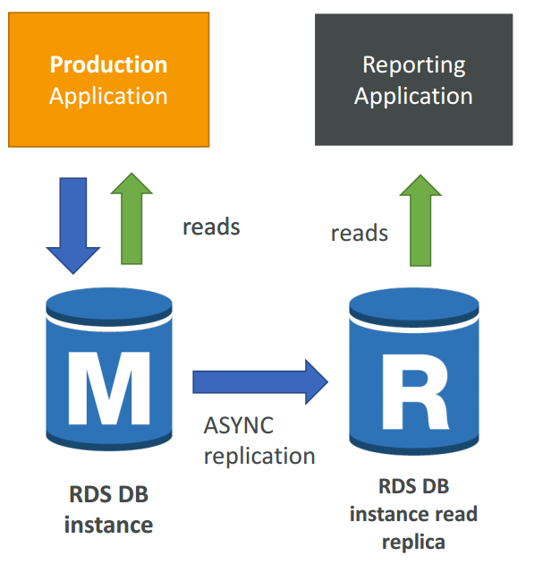
RDS Read Replicas – Use Cases
You have a production database that is taking on normal load
You want to run a reporting application to run some analytics
You create a Read Replica to run the new workload there
The production application is unaffected
Read replicas are used for SELECT (=read) only kind of statements (not INSERT, UPDATE, DELETE)

Slide 16
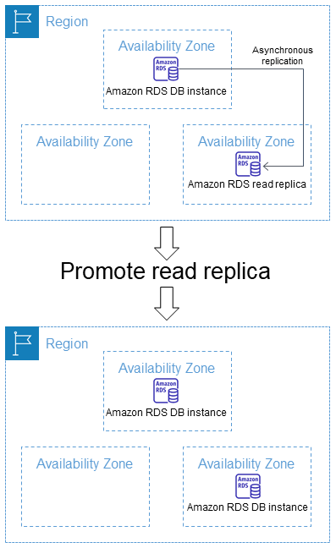
RDS Read Replica Promoting in standalone db

Slide 17
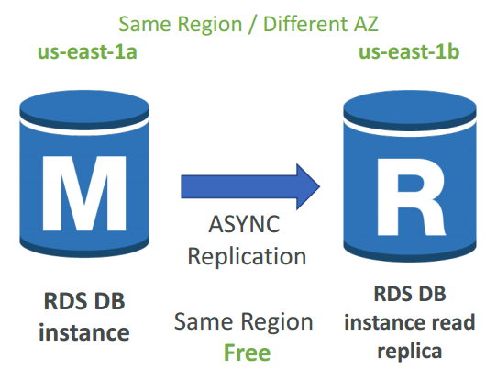
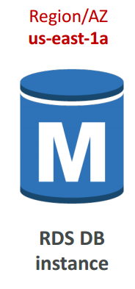
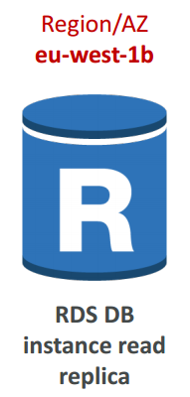
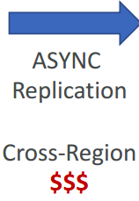
RDS Read Replicas – Network Cost
In AWS there’s a network cost when data goes from one AZ to another
For RDS Read Replicas within the same region, you don’t pay that fee

Slide 18
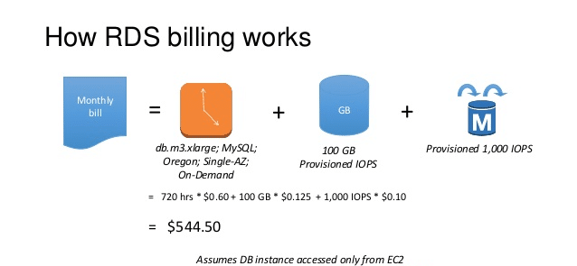
RDS - Billing and Provisioning
AWS Charge for:
DB instance hours (partial hours are charged as full hours).
Storage GB/month.
I/O requests/month – for magnetic storage.
Provisioned IOPS/month – for RDS provisioned IOPS SSD.
Egress data transfer.
Backup storage (DB backups and manual snapshots).
For multi-AZ you are charged for:
Multi-AZ DB hours.
Provisioned storage.
Double write I/Os.

Slide 19
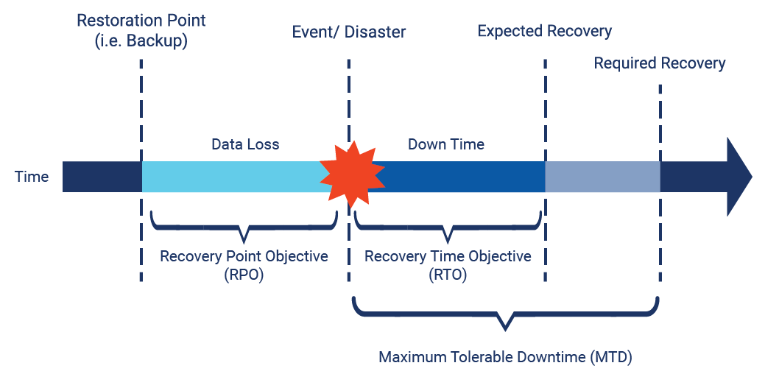
RDS Disaster Recovery: RTO & RPO
Recovery Time Objective (RTO)
RTO - can be understood as the amount of time after a disaster in which business operation is retaken, or resources are again available for use.
For example, if the RTO is 2 hours, then it means you want to resume delivery of products or services, or execution of activities, in 2 hours.
Recovery Point Objective (RPO)
RPO, can be understood the best if you ask yourself, for a given operation,
how much data loss can you afford in terms of time or in terms of amount of information.

Slide 20
RDS Disaster Recovery
Replica Lag - amount of time that replica is behind source DB
Replica lag can impact your recovery
Failover to an RDS Read Replica is a manual process
 | RTO | RPO | Cost | Scope
Automated backups | Good | Better | Low | Single Region
Manual snapshots | Better | Good | Medium | Cross-Region
Read replicas | Best | Best | High | Cross-Region

Slide 21
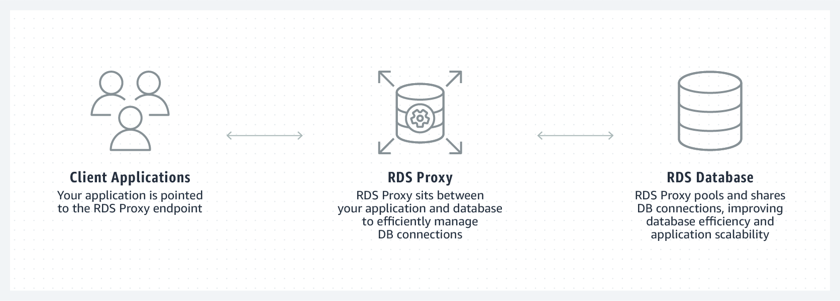
Amazon RDS Proxy
By using Amazon RDS Proxy, you can allow your applications to pool and share database connections to improve their ability to scale.
RDS Proxy makes applications more resilient to database failures by automatically connecting to a standby DB instance while preserving application connections.
By using RDS Proxy, you can also enforce AWS Identity and Access Management (IAM) authentication for databases, and securely store credentials in AWS Secrets Manager.
To protect a database against oversubscription, you can control the number of database connections that are created.
RDS Proxy queues or throttles application connections that can't be served immediately from the connection pool.

Slide 22
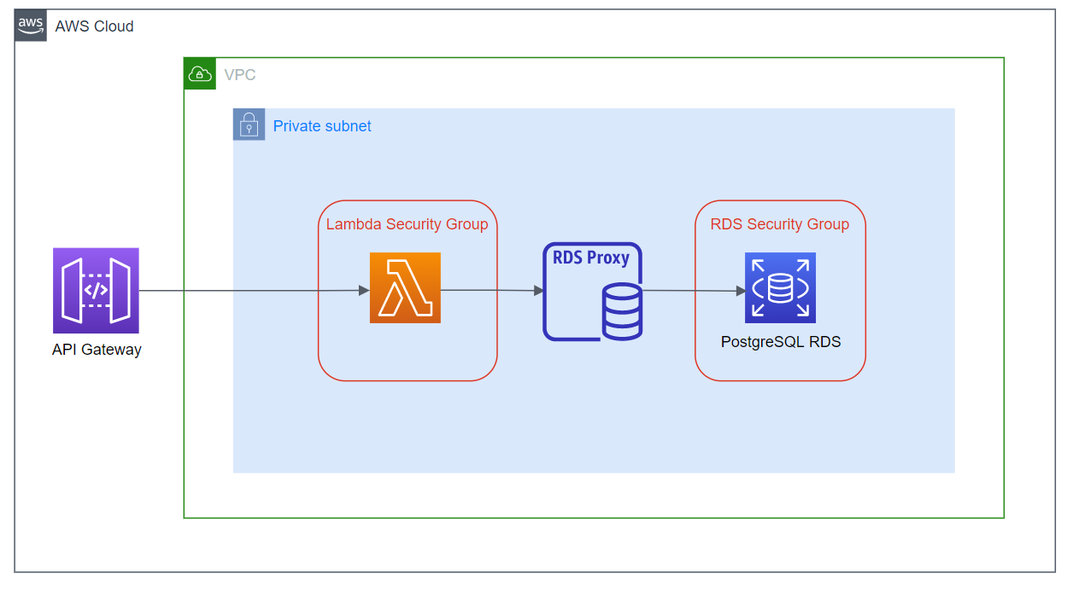
Amazon RDS Proxy for Lambdas

Slide 23
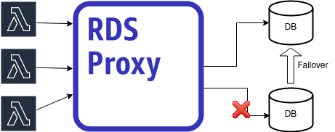
Amazon RDS Proxy for Lambdas Failure handling

Slide 24
Rds Hands on
How to create DB
How to create read Replica
How to make failover?

Slide 25
RDS take away
The Amazon RDS managed service includes the following:
Security and patching of the DB instances.
Automated backup for the DB instances.
Software updates for the DB engine.
Easy scaling for storage and compute.
Multi-AZ option with synchronous replication.
Automatic failover for Multi-AZ option.
Read replicas option for read heavy workloads.
You can have 5 read replicas of a production DB
IAM Authentication
When using encryption at rest the following elements are also encrypted:
All DB snapshots.
Backups.
DB instance storage.
Read Replicas.
You cannot encrypt an existing DB, you need to create a snapshot, copy it, encrypt the copy, then build an encrypted DB from the snapshot.
Multi AZ & Read Replicas
Engines:
Amazon Aurora.
MySQL.
MariaDB.
Oracle.
SQL Server.
PostgreSQL.

Slide 26
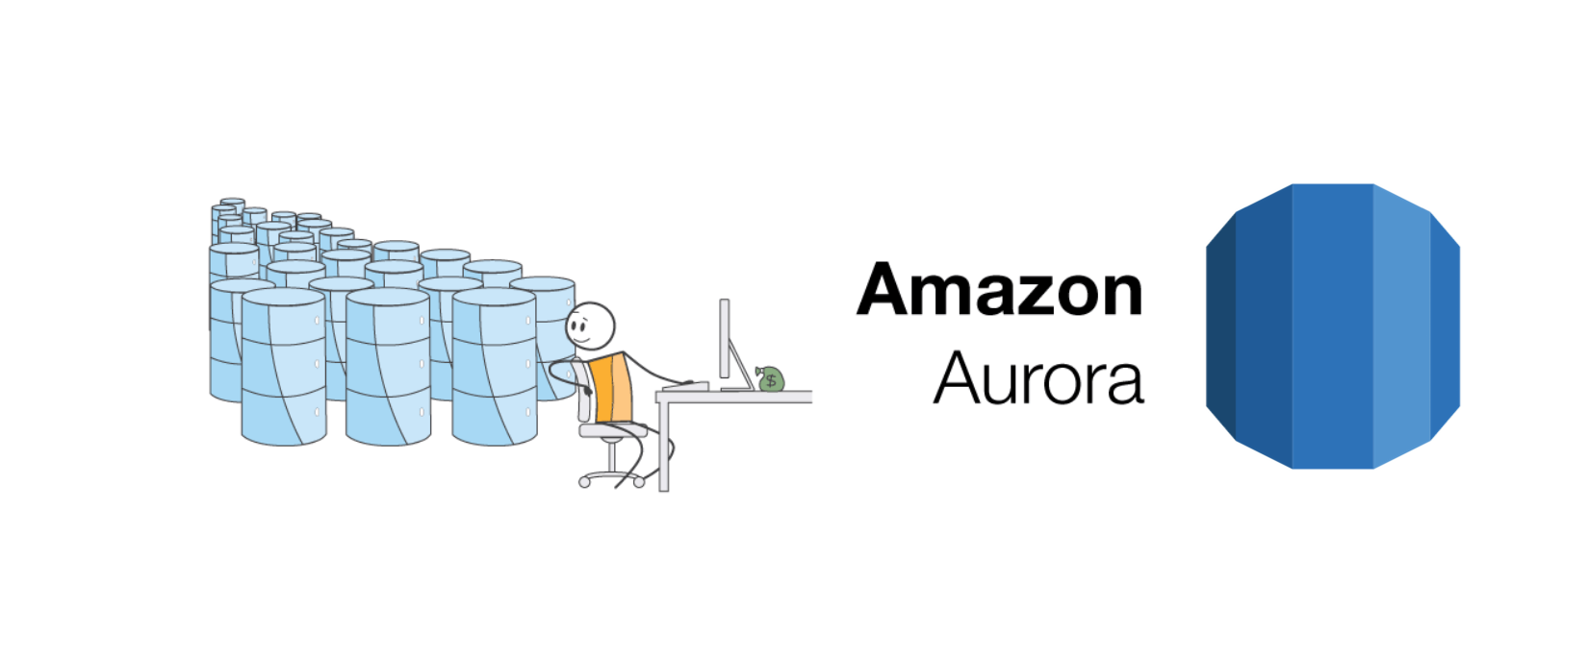
Amazon Aurora
Amazon Aurora is a relational database service that combines the speed and availability of high-end commercial databases with the simplicity and cost-effectiveness of open-source databases.
AWS proprietary database!
Fully managed service, high performance, low price.
Can handle the loss of up to two copies of data without affecting DB write availability and up to three copies without affecting read availability.
Aurora is “AWS cloud optimized” and claims 5x performance improvement over MySQL on RDS, over 3x the performance of Postgres on RDS
Aurora costs more than RDS (20% more) – but is more efficient.

Slide 27
Amazon Aurora DB clusters
An Amazon Aurora DB cluster consists of one or more DB instances and a cluster volume that manages the data for those DB instances.
An Aurora cluster volume is a virtual database storage volume that spans multiple Availability Zones, with each Availability Zone having a copy of the DB cluster data.
Two types of DB instances make up an Aurora DB cluster:
Primary DB instance – Supports read and write operations and performs all of the data modifications to the cluster volume. Each Aurora DB cluster has one primary DB instance.
Aurora Replica – Connects to the same storage volume as the primary DB instance and supports only read operations.
Maintain high availability by locating Aurora Replicas in separate Availability Zones.
Aurora automatically fails over to an Aurora Replica in case the primary DB instance becomes unavailable.

Slide 28
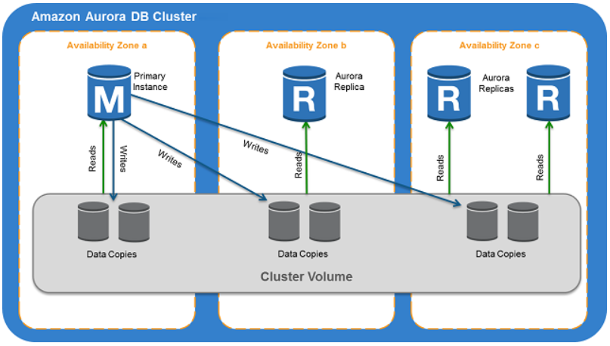
Amazon Aurora DB clusters
The following diagram illustrates the relationship between the cluster volume, the primary DB instance, and Aurora Replicas in an Aurora DB cluster.

Slide 29
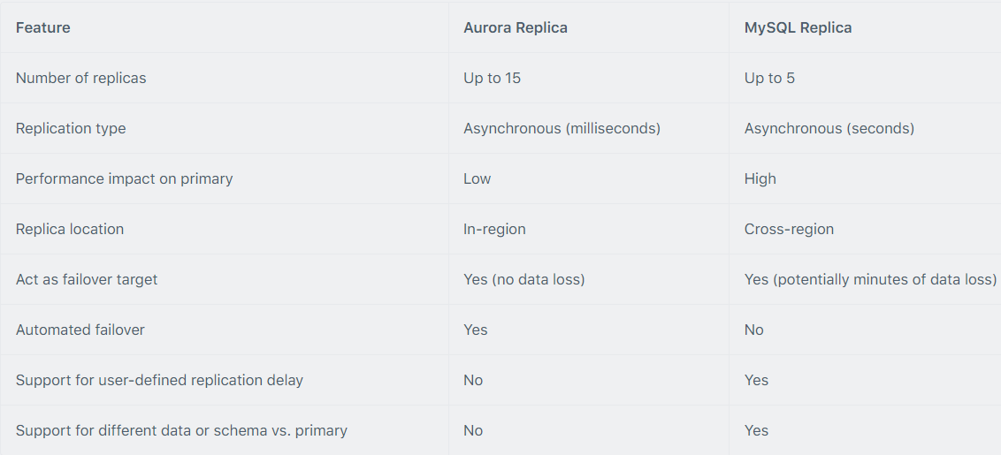
Aurora Replicas
There are two types of replication: Aurora replica (up to 15), MySQL Read Replica (up to 5).
You can create read replicas for an Amazon Aurora database in up to 5 AWS regions. This capability is available for Amazon Aurora with MySQL compatibility.
The table below describes the differences between the two replica options:

Slide 30
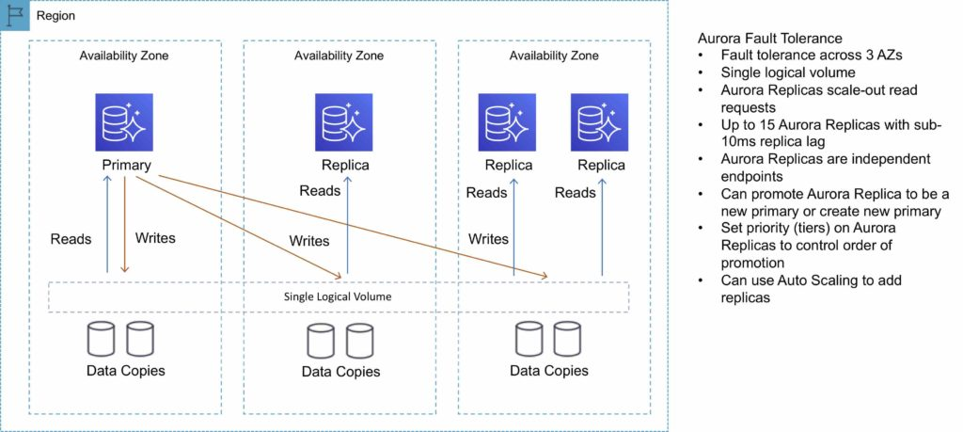
Aurora Replicas

Slide 31
Types of Aurora endpoints
A cluster endpoint (or writer endpoint) for an Aurora DB cluster connects to the current primary DB instance for that DB cluster.
This endpoint is the only one that can perform write operations.
Because of this, the cluster endpoint is the one that you connect to when you first set up a cluster or when your cluster only contains a single DB instance.
Each Aurora DB cluster has one cluster endpoint and one primary DB instance.
A reader endpoint for an Aurora DB cluster provides load-balancing support for read-only connections to the DB cluster.
Use the reader endpoint for read operations, such as queries. By processing those statements on the read-only Aurora Replicas, this endpoint reduces the overhead on the primary instance.
It also helps the cluster to scale the capacity to handle simultaneous SELECT queries, proportional to the number of Aurora Replicas in the cluster.
Each Aurora DB cluster has one reader endpoint.
A custom endpoint for an Aurora cluster represents a set of DB instances that you choose.
When you connect to the endpoint, Aurora performs load balancing and chooses one of the instances in the group to handle the connection.
You define which instances this endpoint refers to, and you decide what purpose the endpoint serves.

Slide 32
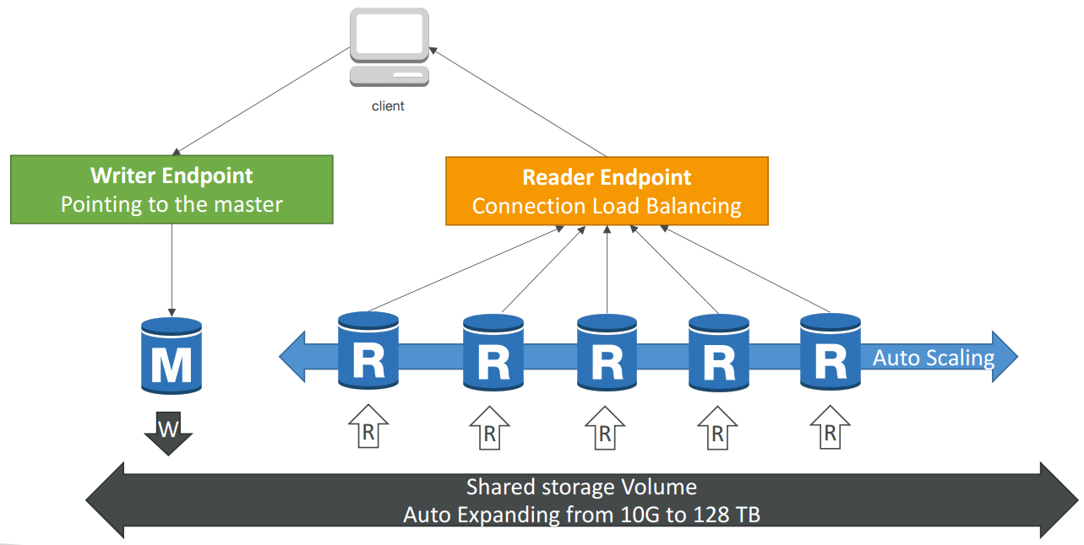
Aurora writer and reader endpoint

Slide 33
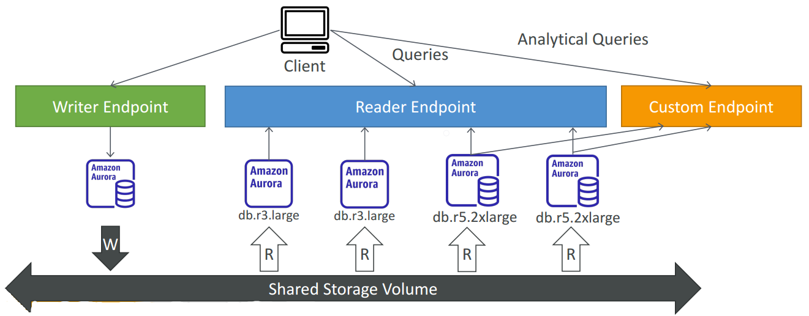
Custom endpoint

Slide 34
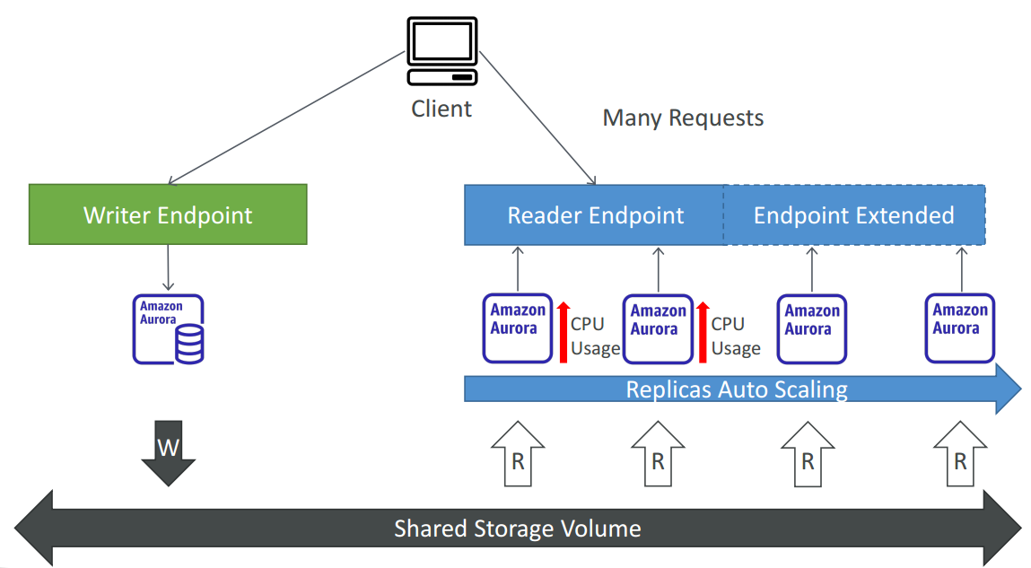
Aurora Replicas - auto scaling

Slide 35
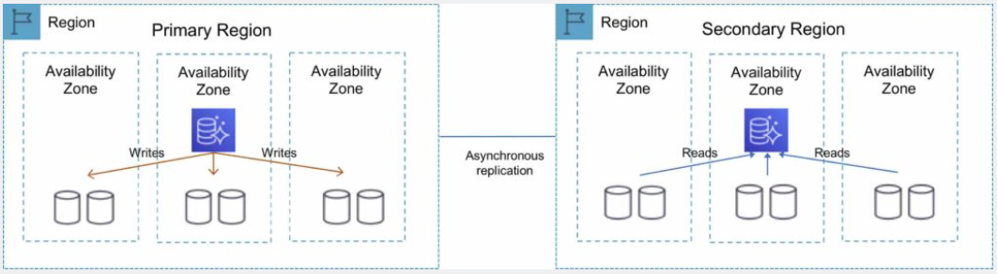
Amazon Aurora Global Database
Amazon Aurora Global Database is designed for globally distributed applications, allowing a single Amazon Aurora database to span multiple AWS Regions.
It replicates your data with no impact on database performance, enables fast local reads with low latency in each Region, and provides disaster recovery from Region-wide outages.
You can use a secondary region as a backup option in case you need to recover quickly from a regional degradation or outage.
A database in a secondary region can be promoted to full read/write capabilities in less than 1 minute.

Slide 36
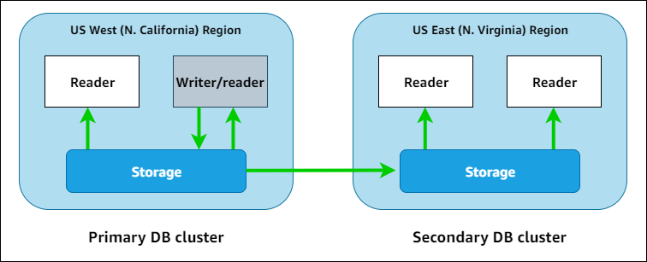
Amazon Aurora Global Database
Aurora Global Database (recommended):
1 Primary Region (read / write)
Up to 5 secondary (read-only) regions, replication lag is less than 1 second
Up to 16 Read Replicas per secondary region
Helps for decreasing latency
Promoting another region (for disaster recovery) has an RTO of < 1 minute
Typical cross-region replication takes less than 1 second

Slide 37
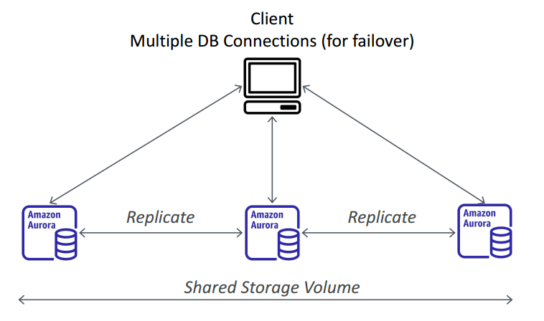
Amazon Aurora Multi-Master
Amazon Aurora Multi-Master is a new feature of the Aurora MySQL-compatible edition that adds the ability to scale out write performance across multiple Availability Zones, allowing applications to direct read/write workloads to multiple instances in a database cluster and operate with higher availability.
Aurora Multi-Master is designed to achieve high availability and ACID transactions across a cluster of database nodes with configurable read after write consistency.
Every node does R/W - vs promoting a RR as the new master.

Slide 38
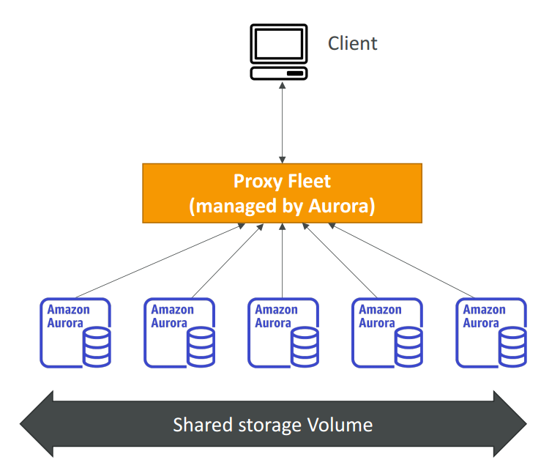
Aurora Serverless
Amazon Aurora Serverless is an on-demand, auto-scaling configuration for Amazon Aurora.
Available for MySQL-compatible and PostgreSQL-compatible editions.
The database automatically starts up, shuts down, and scales capacity up or down based on application needs.
It enables you to run a database in the cloud without managing any database instances. It’s a simple, cost-effective option for infrequent, intermittent, or unpredictable workloads.
You simply create a database endpoint and optionally specify the desired database capacity range and connect applications.
No capacity planning needed

Slide 39
Aurora Serverless v1
Amazon Aurora Serverless v1 (Amazon Aurora Serverless version 1) is an on-demand autoscaling configuration for Amazon Aurora.
An Aurora Serverless v1 DB cluster is a DB cluster that scales compute capacity up and down based on your application's needs.
This contrasts with Aurora provisioned DB clusters, for which you manually manage capacity.
Aurora Serverless v1 provides a relatively simple, cost-effective option for infrequent, intermittent, or unpredictable workloads.
It is cost-effective because it automatically starts up, scales compute capacity to match your application's usage, and shuts down when it's not in use.
For an Aurora Serverless v1 cluster, the cluster volume is always encrypted.
https://docs.aws.amazon.com/AmazonRDS/latest/AuroraUserGuide/aurora-serverless.html

Slide 40
Aurora Serverless v2 vs v1
Scaling Mechanism:
Aurora Serverless v1:
Scales the database automatically by adjusting the number of Aurora Capacity Units (ACUs) based on the actual workload.
This scaling process can take several minutes, leading to a brief interruption in database connectivity during scaling events.
Aurora Serverless v2:
Offers a more granular and rapid scaling mechanism.
It can adjust capacity in fine-grained increments and scale both up and down in a fraction of a second with no impact on database connections.
This means virtually no latency or interruption in database operations during scaling.
Billing Model:
v1: Charges are based on the number of ACUs used per hour. Each ACU is a combination of processing and memory capacity.
v2: Introduces a more granular billing model, charging for the capacity used per second. This allows for more cost-efficient usage, especially for workloads with frequent, small changes in required capacity.

Slide 41
Aurora Serverless v2 vs v1
Performance:
v1: Suitable for workloads with predictable scaling patterns, as it may struggle with rapid, unpredictable changes in workload.
v2: Designed to handle rapid workload changes. It's more suitable for highly variable workloads, offering faster response times during sudden increases in demand.
Use Cases:
v1: Ideal for applications with predictable traffic patterns, such as development, test databases, or applications with cyclical or scheduled usage spikes.
v2: Better suited for production workloads, applications with unpredictable workloads, microservices architectures, and real-time applications with fluctuating workloads.

Slide 42
Aurora Serverless v2 vs v1
Feature Support and Compatibility:
v1: Has some limitations in terms of features and compatibility compared to standard Aurora instances.
v2: Comes closer to the feature set and performance of provisioned Aurora clusters, offering broader compatibility and more features.
Read Replica Support:
v1: Does not support Aurora Read Replicas.
v2: Supports Aurora Read Replicas, enhancing read scaling and availability.

Slide 43
Aurora Serverless v2 Advantages
Simpler capacity management than provisioned – Aurora Serverless v2 reduces the effort for planning DB instance sizes and resizing DB instances as the workload changes. It also reduces the effort for maintaining consistent capacity for all the DB instances in a cluster.
Faster and easier scaling during periods of high activity – Aurora Serverless v2 scales compute and memory capacity as needed, with no disruption to client transactions or your overall workload. The ability to use reader DB instances with Aurora Serverless v2 helps you to take advantage of horizontal scaling in addition to vertical scaling. The ability to use Aurora global databases means that you can spread your Aurora Serverless v2 read workload across multiple AWS Regions. This capability is more convenient than the scaling mechanisms for provisioned clusters. It's also faster and more granular than the scaling capabilities in Aurora Serverless v1.
Cost-effective during periods of low activity – Aurora Serverless v2 helps you to avoid overprovisioning your DB instances. Aurora Serverless v2 adds resources in granular increments when DB instances scale up. You pay only for the database resources that you consume. Aurora Serverless v2 resource usage is measured on a per-second basis. That way, when a DB instance scales down, the reduced resource usage is registered right away.
Greater feature parity with provisioned – You can use many Aurora features with Aurora Serverless v2 that aren't available for Aurora Serverless v1. For example, with Aurora Serverless v2 you can use reader DB instances, global databases, AWS Identity and Access Management (IAM) database authentication, and Performance Insights. You can also use many more configuration parameters than with Aurora Serverless v1.
Reader DB instances – Aurora Serverless v2 can take advantage of reader DB instances to scale horizontally. When a cluster contains one or more reader DB instances, the cluster can fail over immediately in case of problems with the writer DB instance. This is a capability that isn't available with Aurora Serverless v1.
Multi-AZ clusters – You can distribute the Aurora Serverless v2 DB instances of a cluster across multiple Availability Zones (AZs). Setting up a Multi-AZ cluster helps to ensure business continuity even in the rare case of issues that affect an entire AZ. This is a capability that isn't available with Aurora Serverless v1.
Global databases – You can use Aurora Serverless v2 in combination with Aurora global databases to create additional read-only copies of your cluster in other AWS Regions for disaster recovery purposes.
RDS Proxy – You can use Amazon RDS Proxy to allow your applications to pool and share database connections to improve their ability to scale.
Faster, more granular, less disruptive scaling than Aurora Serverless v1 – Aurora Serverless v2 can scale up and down faster. Scaling can change capacity by as little as 0.5 ACUs, instead of doubling or halving the number of ACUs. Scaling typically happens with no pause in processing at all. Scaling doesn't involve an event that you have to be aware of, as with Aurora Serverless v1. Scaling can happen while SQL statements are running and transactions are open, without the need to wait for a quiet point.

Slide 44
Restoring a DB cluster to a specified time
You can restore a DB cluster to a specific point in time, creating a new DB cluster.
When you restore a DB cluster to a point in time, you can choose the default virtual private cloud (VPC) security group. Or you can apply a custom VPC security group to your DB cluster.
Restored DB clusters are automatically associated with the default DB cluster and DB parameter groups. However, you can apply custom parameter groups by specifying them during a restore.
Amazon Aurora uploads log records for DB clusters to Amazon S3 continuously.
To see the latest restorable time for a DB cluster, use the AWS CLI describe-db-clusters command and look at the value returned in the LatestRestorableTime field for the DB cluster.
You can restore to any point in time within your backup retention period.
To see the earliest restorable time for a DB cluster, use the AWS CLI describe-db-clusters command and look at the value returned in the EarliestRestorableTime field for the DB cluster.

Slide 45
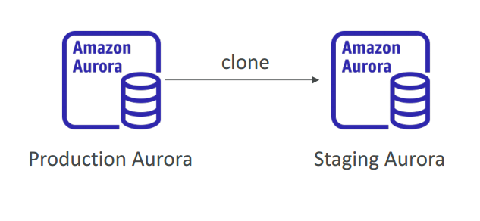
Aurora Cloning
By using Aurora cloning, you can create a new cluster that uses the same Aurora cluster volume and has the same data as the original.
The process is designed to be fast and cost-effective.
The new cluster with its associated data volume is known as a clone.
Creating a clone is faster and more space-efficient than physically copying the data using other techniques, such as restoring a snapshot.
The new DB cluster uses the same cluster volume and data as the original but will change when data updates are made
Useful to create a “staging” database from a “production” database without impacting the production database

Slide 46
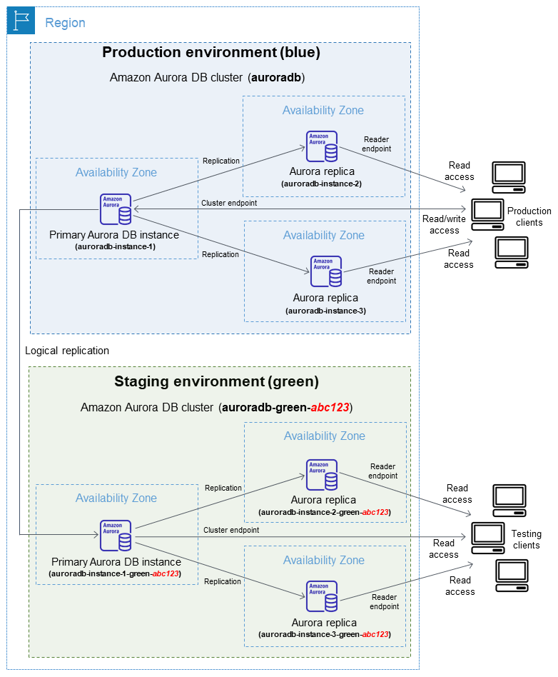
Aurora Blue green deployment

Slide 47
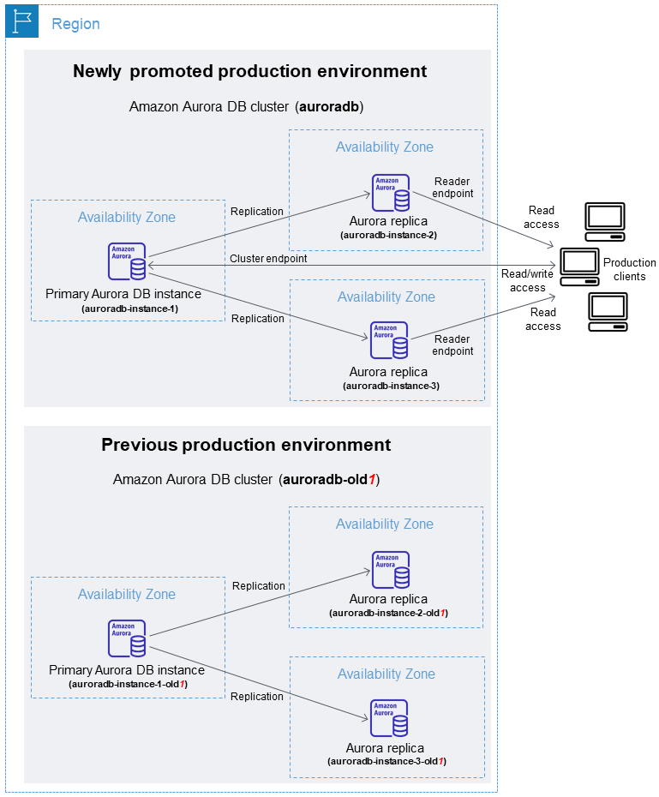
Aurora Blue green deployment After

Slide 48
Aurora take away
2 copies of data are kept in each AZ with a minimum of 3 AZ’s (6 copies).
Aurora replica (up to 15),
Cross-region read replicas allow you to improve your disaster recovery posture, scale read operations in regions closer to your application users, and easily migrate from one region to another.
For globally distributed applications you can use Global Database, where a single Aurora database can span multiple AWS regions to enable fast local reads and quick disaster recovery.
Aurora Auto Scaling dynamically adjusts the number of Aurora Replicas provisioned for an Aurora DB cluster using single-master replication.
Amazon Aurora Serverless is an on-demand, auto-scaling configuration for Amazon Aurora.
Available for MySQL-compatible and PostgreSQL-compatible editions.
The database automatically starts up, shuts down, and scales capacity up or down based on application needs.
Amazon Aurora’s backup capability enables point-in-time recovery for your instance. This allows you to restore your database to any second during your retention period, up to the last five minutes.
There are two methods to backup and restore RDS DB instances:
Amazon RDS automated backups.
User initiated manual backups

Slide 49
Aurora Hands On
How to create aurora cluster?
How to create serverless cluster?

