Slide 1
Amazon FSx
Launch, run, and scale feature-rich and highly-performant file systems with just a few clicks

Slide 2

Amazon FSx
Amazon FSx makes it easy and cost effective to launch, run, and scale feature-rich, high-performance file systems in the cloud.
Amazon FSx is built on the latest AWS compute, networking, and disk technologies to provide high performance and lower TCO.
And as a fully managed service, it handles hardware provisioning, patching, and backups -- freeing you up to focus on your applications, your end users, and your business.
You can choose between four widely-used file systems:
NetApp ONTAP
OpenZFS
Windows File Server
Lustre.

Slide 3
Amazon FSx offers three types of file systems
Amazon FSx for Windows File Server—designed for business applications.
Amazon FSx for Lustre—designed for compute-intensive workloads.
Amazon FSx for ONTAP—multiprotocol file and block storage access, with NetApp’s advanced data management system features and benefits.
Amazon FSx for OpenZFS -

Slide 4
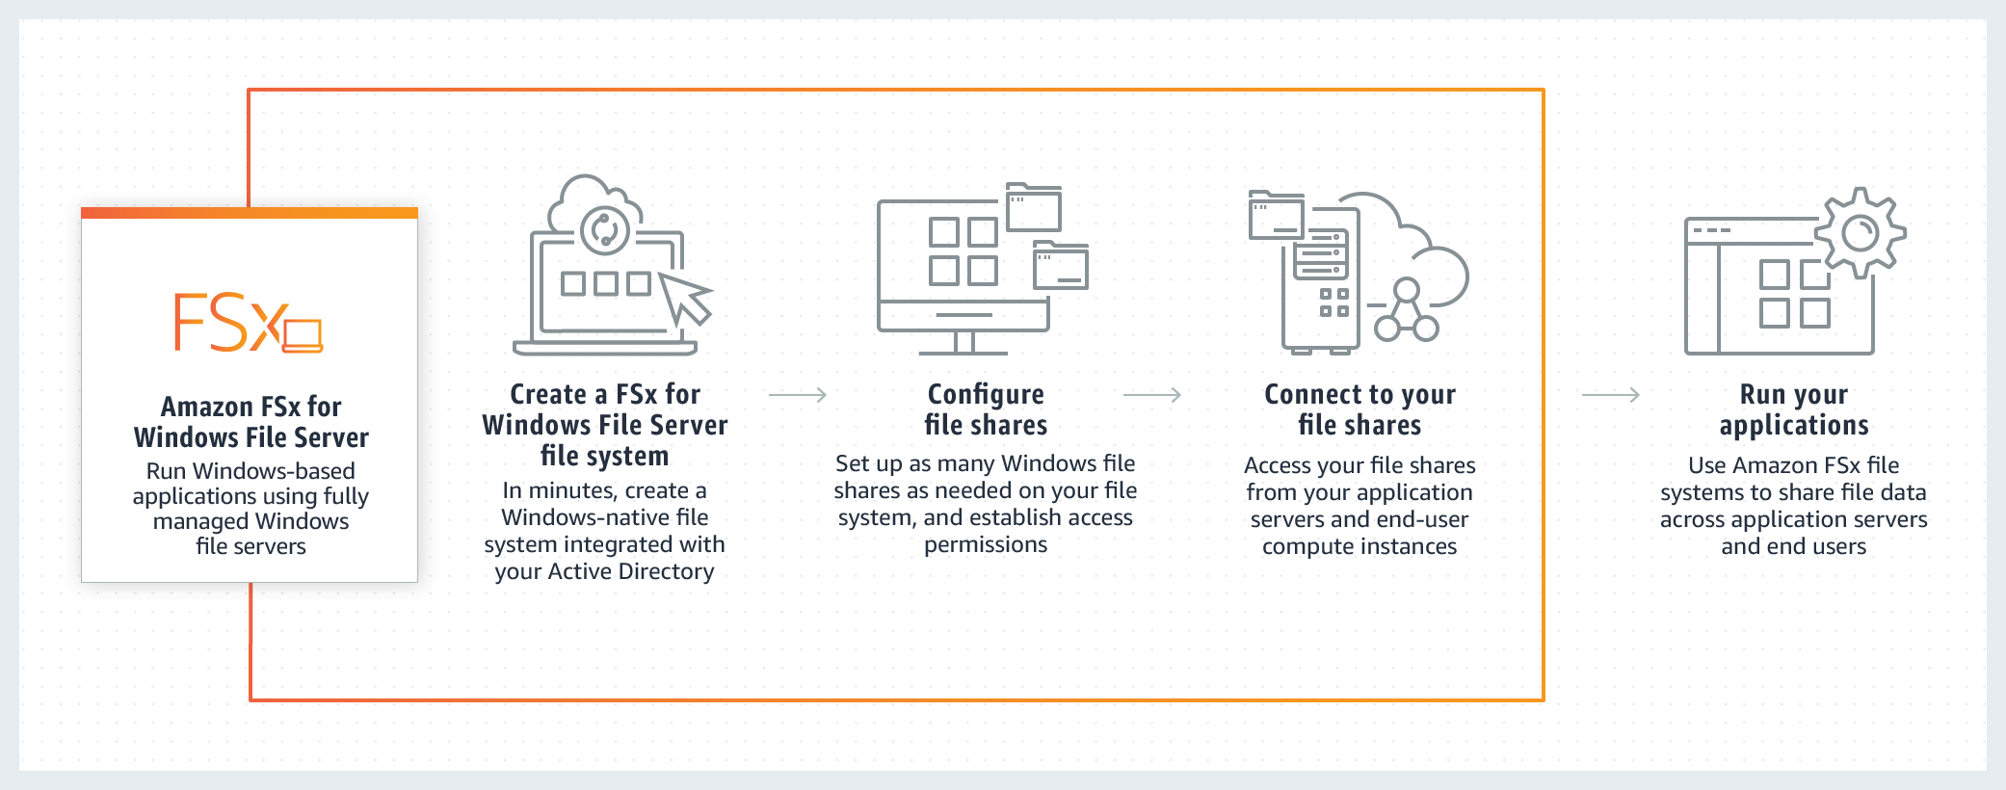
Amazon FSx for Windows

Slide 5
Amazon FSx for Windows
Amazon FSx for Windows File Server is a managed file storage solution.
It provides complete Windows file servers running a native Windows file system - this means organizations do not need to undertake the effort of setting up a file server.
The service also keeps Windows software up-to-date, can detect and address hardware failures, and can back up data and workloads.
A common use case is to move Windows applications as-is to the AWS cloud in a lift-and-shift model.
FSx for Windows can be used for mission critical business applications, web serving, home directories, content management, continuous integration (CI) workflows and data analytics.

Slide 6
Amazon FSx for Windows Benefits
Built on Windows Server
Amazon FSx for Windows offers user quotas, access control lists (ACLs) and end-user file restore.
The service integrates with on-premises AWS Microsoft Managed AD and Microsoft Active Directory (AD).
The service employs the SMB protocol to natively provide Windows-based applications with access to fully-compatible shared file storage.
Lowest-Cost SMB File Storage in the Cloud
Amazon FSx for Windows offers durable and highly available file storage from as little as $0.013 per GB-month.
You can use data deduplication features to remove redundant data and further optimize costs.
You can also scale throughput capacity and increase your file system storage.
Additionally, the service does not have any licensing fees or upfront costs.
Broadly Accessible
Amazon FSx for Windows employs the SMB protocol, letting you integrate with Amazon AppStream, Amazon EC2, Amazon WorkSpaces, VMware Cloud on AWS, Amazon ECS, and etc.
FSx for Windows supports all versions of Windows (from Windows 7 and Windows Server 2008).
It enables access to FSx for Windows file systems from local data centers via AWS VPN or Direct Connect, and fast access from multiple Amazon regions, accounts, or VPCs using AWS Transit Gateway.

Slide 7
Amazon FSx for Windows Perfomance
Your client compute instances, whether they exist in AWS or on-premises, access your file system through an elastic network interface (ENI).
This network interface resides in the Amazon VPC that you associate with your file system.
Behind the file system ENI is the Windows file server that is serving data over the network to the clients accessing the file system.
Amazon FSx provides a fast in-memory cache on the file server to enhance performance for the most frequently accessed data.
Behind the file server are the storage volumes, or disks, hosting your file system data.
Storage volumes can be hard disk drives (HDD) or solid state devices (SSD).
Can be mounted on Linux EC2.

Slide 8
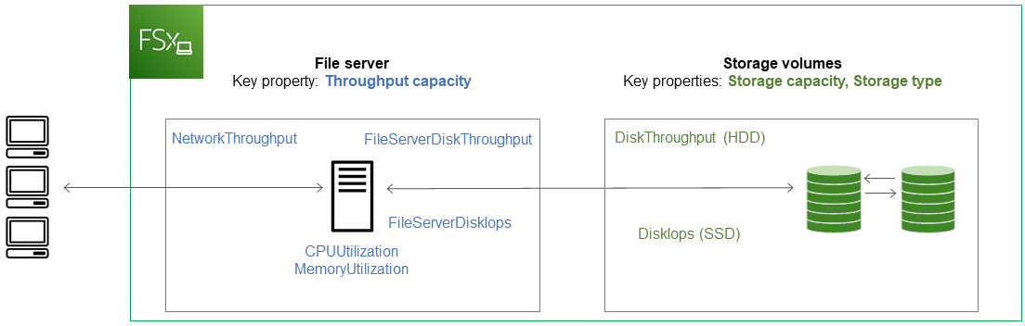
Amazon FSx under the hood

Slide 9
Amazon FSx for Windows Improve Perfomance
Improving network performance between FSx for Windows clients and the file server, for example by setting up a dedicated network connection between on-premises clients and AWS.
Adapting working sets to cache size, either by ensuring that the number of files transferred at any given time is smaller than the size of the available in-memory cache or increasing the size of the cache.
Improving disk performance by using faster storage and enabling higher throughput between the file server and storage volumes.

Slide 10
What is Lustre Storage?
Lustre® is an open-source file system that was developed in 1999 and released to general production in December 2003.
Lustre is a parallel file system
The open-source Lustre file system is for the use of Linux-based applications that demand large scale and fast storage—when you need your storage to keep pace with your compute.
Lustre was designed to deal with the issue of speedily and cheaply processing large data sets.
It is widely used in super computing and HPC projects

Slide 11
Amazon FSx for Lustre
Fsx for for Lustre is a fully managed service that makes Lustre easily accessible.
It lets organizations use Lustre for workloads on the AWS cloud, where storage speed is important.
Amazon FSx for Lustre avoids the traditional complexity of managing and setting up high-performance Lustre file systems.
It lets you spin up, scale, and run a reliable high-performance file system in minutes.
You can also use its multiple deployment features to optimize costs for your organization’s requirements.
Amazon FSx for Lustre integrates with Amazon S3, so you can process cloud data sets with the Lustre high-performance file system.
When connected to an S3 bucket, an FSx for Lustre file system transparently shows S3 objects as files and lets you write data modified by Lustre back to S3.

Slide 12
Amazon FSx for Lustre When should be used?
Machine Learning
Machine learning workloads rely on massive volumes of training data.
These workloads tend to use shared file storage, because multiple compute instances must process training datasets simultaneously.
Therefore, FSx for Lustre is suitable for machine learning workloads, providing shared file storage with consistent, low latency, and high throughput.
FSx for Lustre is integrated with Amazon SageMaker, letting you speed up your training tasks.
High Performance Computing
High Performance Computing (HPC) lets engineers and scientists solve compute-intensive, intricate problems.
HPC workloads like genome analysis and oil and gas discovery process huge volumes of data, requiring very fast access by multiple compute instances.
FSx for Lustre is suitable for scientific computing workloads and HPC.
It is a file system optimized to reduce cost and improve performance for high-performance workloads, which can be accessed by thousands of EC2 instances.
FSx for Lustre integrates with AWS Batch and AWS ParallelCluster, which makes it simpler to employ with HPC workloads.
Media Processing and Transcoding
Autonomous Vehicles
Big Data and Financial Analytics
Electronic Design Automation

Slide 13
Amazon FSx for Lustre
Each FSx for Lustre file system consists of the file servers that the clients communicate with, and a set of disks attached to each file server that store your data.
Each file server employs a fast, in-memory cache to enhance performance for the most frequently accessed data.
HDD-based file systems can also be provisioned with an SSD-based read cache to further enhance performance for the most frequently accessed data.
When a client accesses data that's stored in the in-memory or SSD cache, the file server doesn't need to read it from disk, which reduces latency and increases the total amount of throughput you can drive.
When you provision an HDD Lustre file system with an SSD cache, Amazon FSx creates an SSD cache that is automatically sized to 20 percent of the file system's HDD storage capacity.
Doing this provides sub-millisecond latencies and higher IOPS for frequently accessed files.

Slide 14
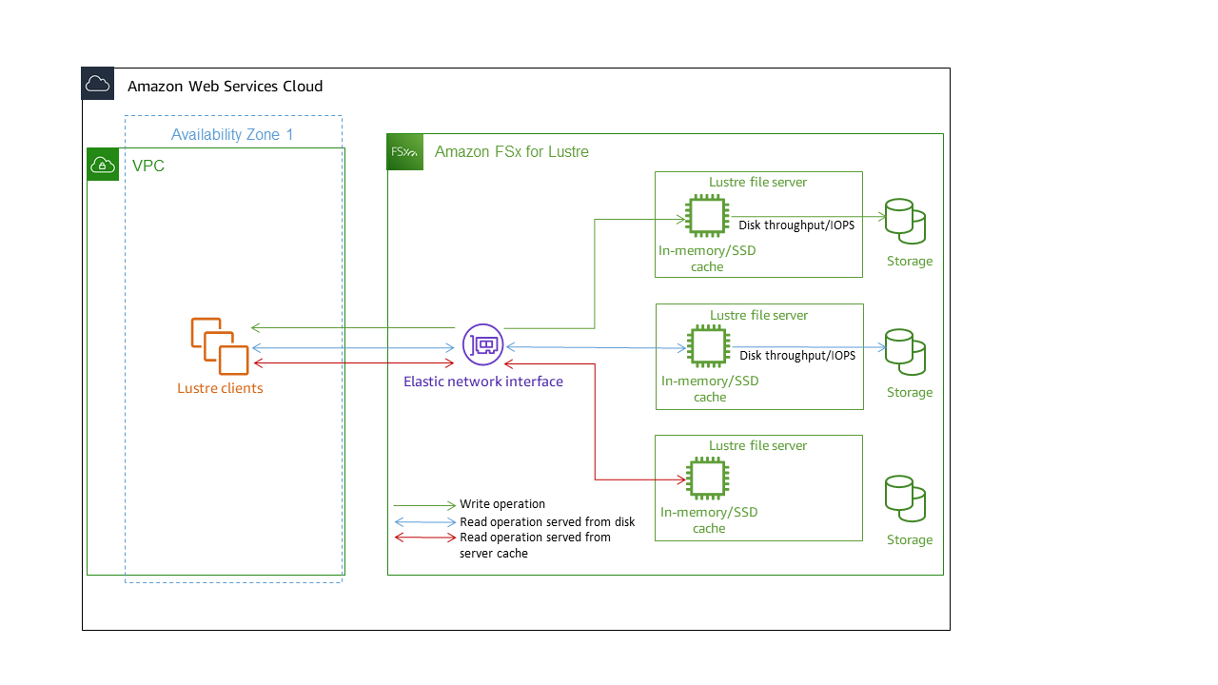
Amazon FSx for Lustre Under the Hood

Slide 15
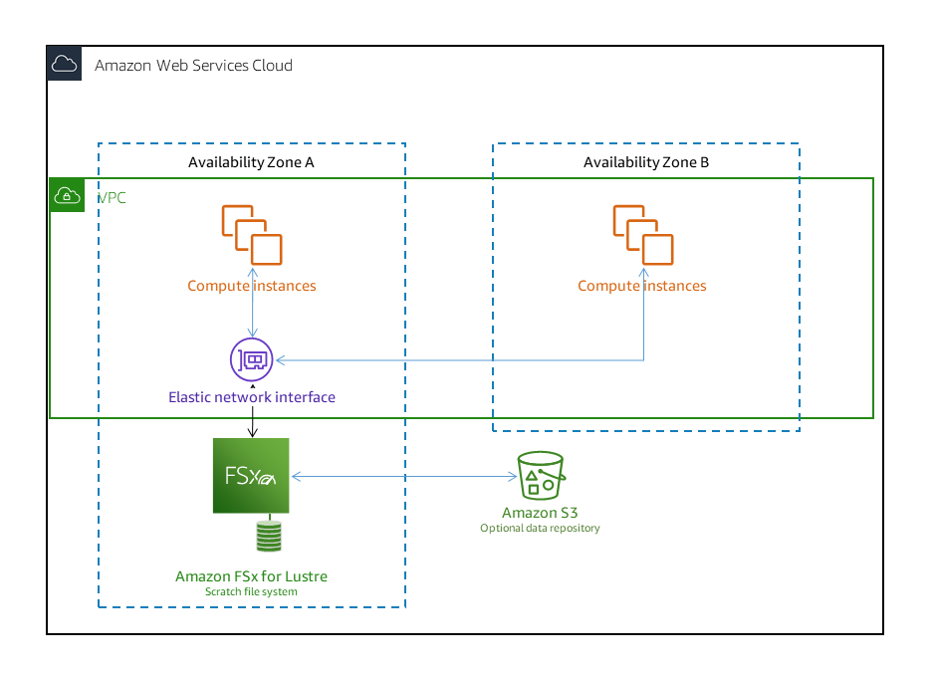
Amazon FSx for Lustre Scratch file systems
Scratch file systems are designed for temporary storage and shorter-term processing of data.
Data isn't replicated and doesn't persist if a file server fails.
Scratch file systems provide high burst throughput of up to six times the baseline throughput of 200 MBps per TiB of storage capacity
Use scratch file systems when you need cost-optimized storage for short-term, processing-heavy workloads.

Slide 16
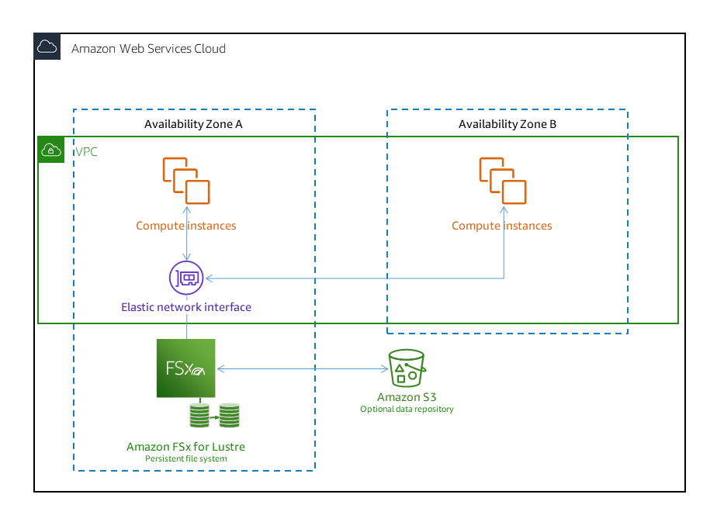
Amazon FSx for Lustre Persistent file systems
Persistent file systems are designed for longer-term storage and workloads.
The file servers are highly available, and data is automatically replicated within the same Availability Zone in which the file system is located.
The data volumes attached to the file servers are replicated independently from the file servers to which they are attached.
Amazon FSx continuously monitors persistent file systems for hardware failures, and automatically replaces infrastructure components in the event of a failure.
On a persistent file system, if a file server becomes unavailable, it's replaced automatically within minutes of failure.
Use persistent file systems for longer-term storage and for throughput-focused workloads that run for extended periods or indefinitely, and that might be sensitive to disruptions in availability.

Slide 17
Amazon FSx for NetApp ONTAP
Fully managed shared storage built on NetApp’s popular ONTAP file system
With FSx for ONTAP, you can achieve SSD levels of performance for your workload while paying for SSD storage for only a small fraction of your data.
NFS, SMB, iSCSI
Works with:
Linux, Windows, MacOS, VMware
Ec2,ECS, EKS, on prime, etc

Slide 18
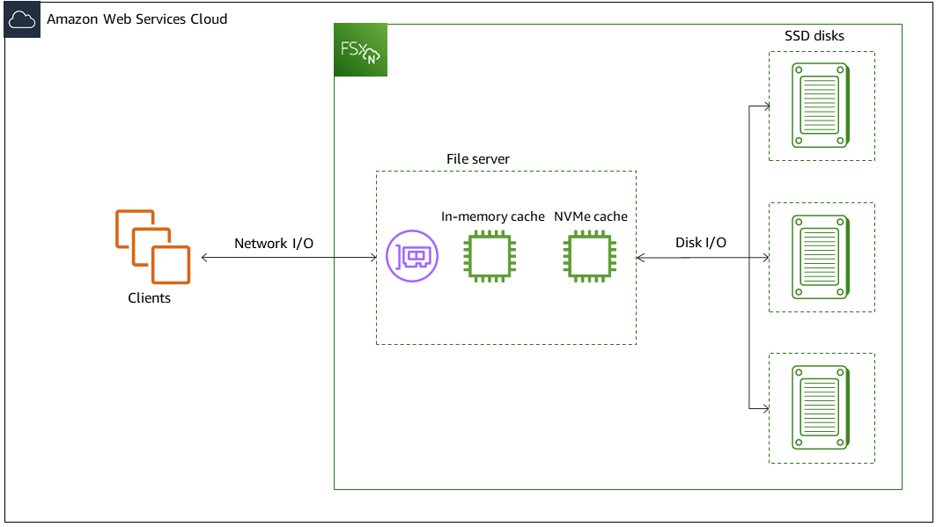
Amazon FSx for NetApp ONTAP
Your client compute instances, whether they exist in AWS or on-premises, access your file system through one or ENI.
Behind each file system ENI is an NetApp ONTAP file server that is serving data over the network to the clients accessing the file system.
Amazon FSx provides a fast in-memory cache and NVMe cache on each file server to enhance performance for the most frequently accessed data.
Attached to each file server are the SSD disks hosting your file system data.

Slide 19
Amazon FSx for OpenZFS
Fully managed shared storage built on the popular OpenZFS file system
Move workloads running on ZFS or other Linux-based file servers to AWS without modifying application code or how you manage data.
Power machine learning (ML), financial analytics, and other data-intensive applications with high-IOPS storage.
NFS (v3,v4,v4.1,v4.2
PITR cloning
Test changes efficiently by cloning application data in seconds, and reduce build times with fast storage for repositories and DevOps solutions, such as Git, Bitbucket, and Jenkins.

Slide 20
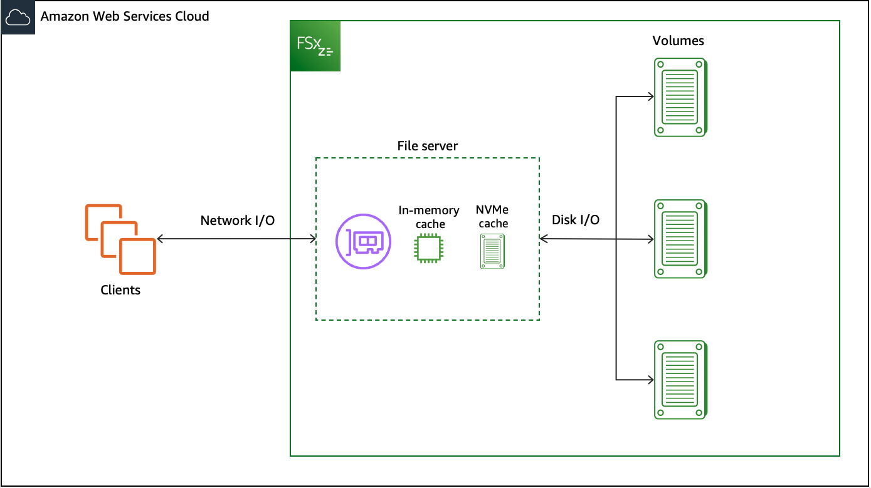
Amazon FSx for OpenZFS
File-based workloads are typically spiky, characterized by short, intense periods of high I/O with plenty of idle time between bursts.
To support spiky workloads, in addition to the baseline speeds that a file system can sustain 24/7, Amazon FSx provides the capability to burst to higher speeds for periods of time for both network I/O and disk I/O operations
Amazon FSx uses a network I/O credit mechanism to allocate throughput and IOPS based on average utilization — file systems accrue credits when their throughput and IOPS usage is below their baseline limits, and can use these credits when they perform I/O operations.

Slide 21
Amazon FSx Pricing
Storage capacity: The price of storage capacity depends on the deployment type (single-AZ or multi-AZ), and the storage type (SSD or HDD) you choose for your file system.
SSD IOPS: By default, 3 IOPS are included for every GB of SSD storage.
Throughput capacity: The price of throughput capacity depends on the deployment type (single-AZ or multi-AZ) you choose for your file system.
Backups: Backups—both automatic and user-initiated—incur backup storage charges.
Data transfer: Data transferred “in” to and “out” from Amazon FSx across AZs or VPC Peering connections in the same Region is charged at the rate for data transfer within the same Region.

Slide 22
AWS FSx vs EFS: What is the Difference?
AWS EFS is primarily utilized for Linux-based applications and supports NFS protocols, offering easy-to-use solutions with automatic scaling to accommodate growing file systems.
AWS FSx serves Windows-based environments optimally with FSx for Windows File Server, and high-performance computing workloads with FSx for Lustre, in addition to providing newer options supporting OpenZFS and ONTAP for enhanced data management and mixed OS environments.
The main difference between the two services comes down to the specific use case:
EFS for scalable file storage solution in Linux environments and FSx offering specialized solutions, including file storage for Windows environments and high-performance workloads, along with robust data management features with OpenZFS and ONTAP integrations.

Slide 23
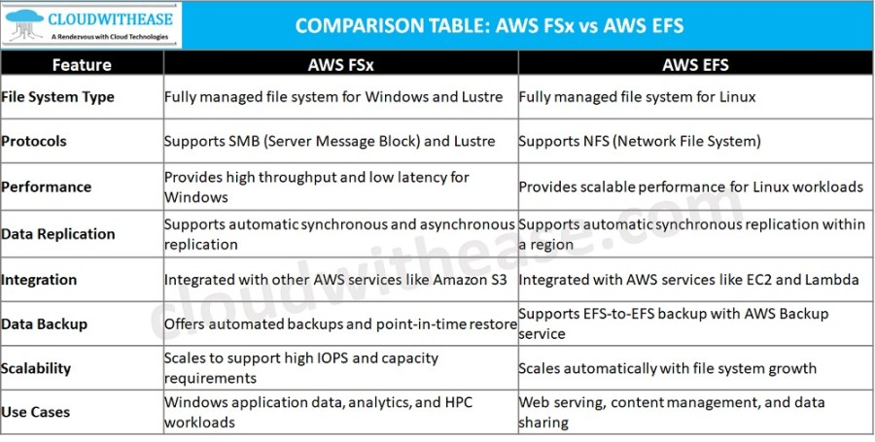
AWS FSx vs EFS: What is the Difference?

