Slide 1

AWS Elastic Beanstalk
With Elastic Beanstalk, you can quickly deploy and manage applications in the AWS Cloud without having to learn about the infrastructure that runs those applications.
Elastic Beanstalk reduces management complexity without restricting choice or control.
You simply upload your application, and Elastic Beanstalk automatically handles the details of capacity provisioning, load balancing, scaling, and application health monitoring.
Elastic Beanstalk supports applications developed in Go, Java, .NET, Node.js, PHP, Python, and Ruby.
When you deploy your application, Elastic Beanstalk builds the selected supported platform version and provisions one or more AWS resources, such as Amazon EC2 instances, to run your application.

Slide 2
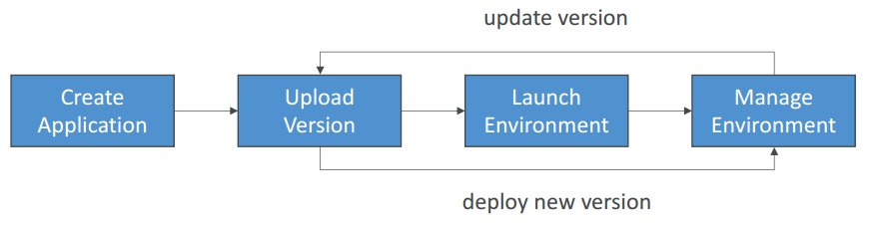
Elastic Beanstalk – Components
Application: collection of Elastic Beanstalk components (environments, versions, configurations, …)
Application Version: an iteration of your application code
Environment
Collection of AWS resources running an application version (only one application version at a time)
Tiers: Web Server Environment Tier & Worker Environment Tier
You can create multiple environments (dev, test, prod, …)

Slide 3
Elastic Beanstalk – Supported Platforms
Go
Java SE
Java with Tomcat
.NET Core on Linux
.NET on Windows Server
Node.js
PHP
Python
Ruby
Packer Builder
Single Container Docker
Multi-container Docker
Preconfigured Docker
If not supported, you can write your custom platform (advanced)

Slide 4
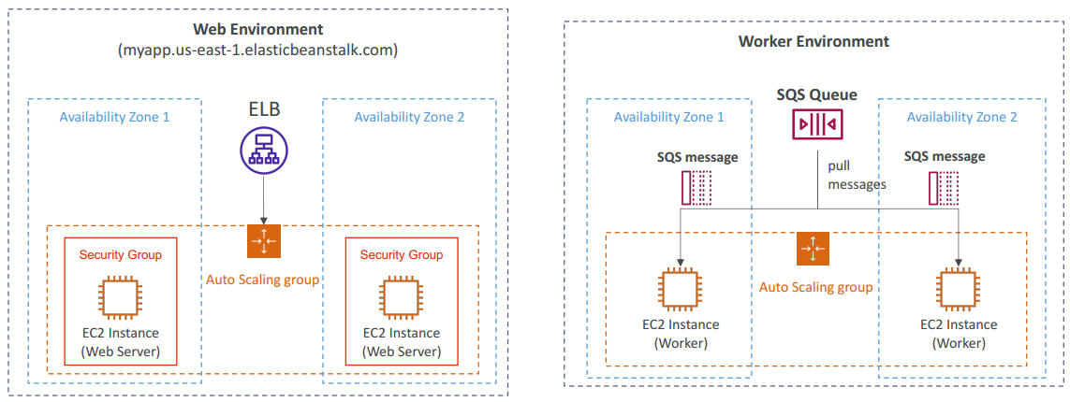
Web Server Tier vs. Worker Tier
Web servers are standard applications that listen for and then process HTTP requests, typically over port 80.
Workers are specialized applications that have a background processing task that listens for messages on an Amazon SQS queue.

Slide 5
Elastic Beanstalk - Deployment policies
The deployment policies are:
All at once
Rolling
Rolling with additional batch
Immutable
Additionally, Elastic Beanstalk supports blue/green deployment.

Slide 6
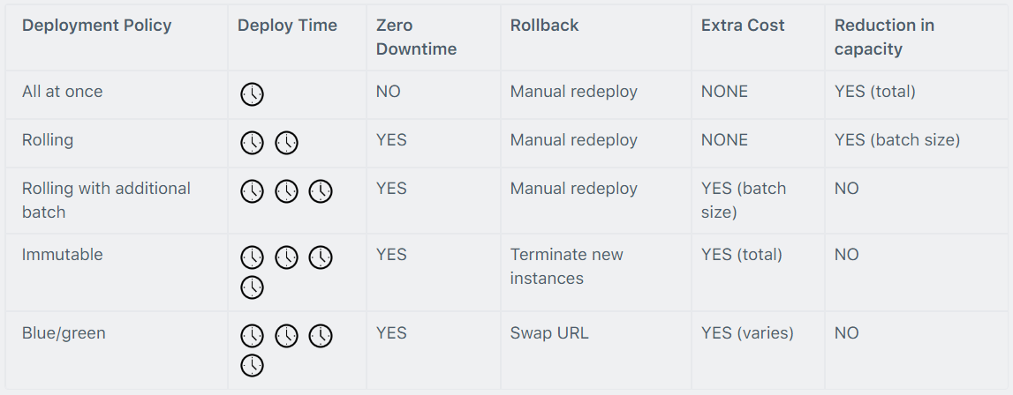
Elastic Beanstalk - Deployment policies summary

Slide 7
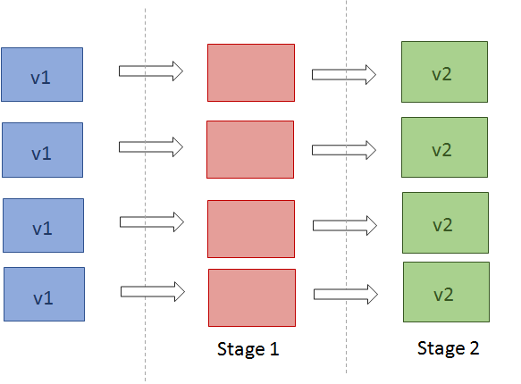
All at once

Slide 8
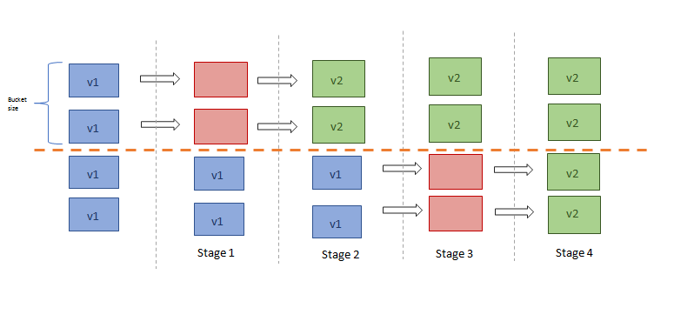
Rolling

Slide 9
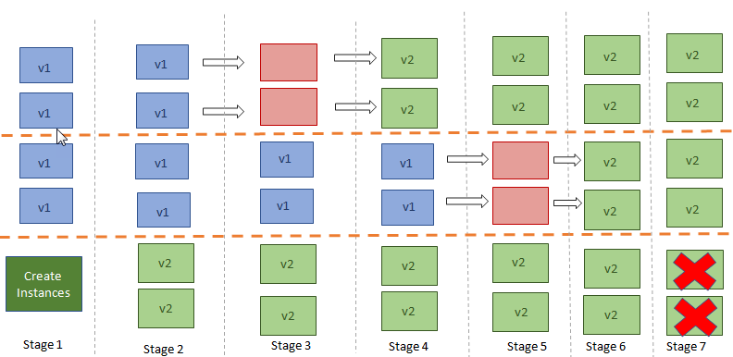
Rolling with Additional Batches

Slide 10
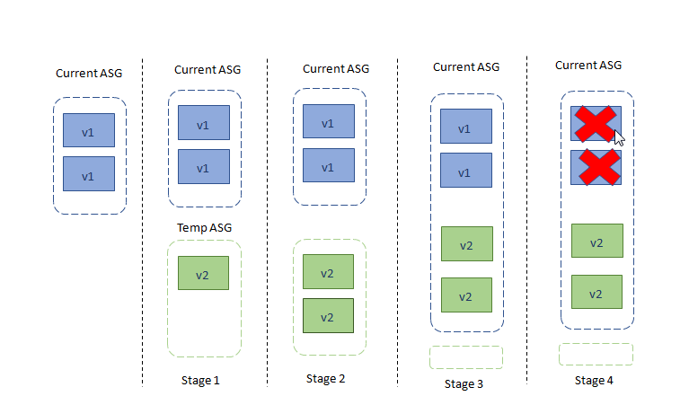
Immutable

Slide 11
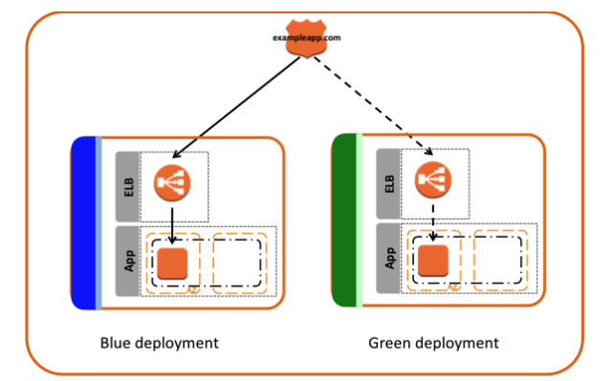
Blue Green

Slide 12
AWS Exam take away
Environment (Web Server Environment Tier & Worker Environment Tier)
Supported Platforms
Deployment policies
Advantages Configuration with Automation:
Saves time by handling dependencies, including the setup, configuration and provisioning of other AWS services like EC2, RDS, and Elastic Load Balancing to create a web service
Powerful Customization: It gives the opportunity to customise the configuration to suit your application’s needs including Software, Instance configuration, Capacity, Load Balancer, Deployment strategy, Security, Monitoring, Notification, Database and Networks all through a single configuration page.
Price and Flexibility: There’s no additional cost of Elastic Beanstalk except the resources needed for the application. It has a built-in auto-stalling functionality with easily configured metrics which used for saving cost.
Disadvantages Deployment Speed:
Sometimes deployment time took longer – from 5 minutes to 15 minutes for a site with just two front-ends.
Stack Upgrades: Elastic Beanstalk comes out with new stack versions all time and finding what was actually changed or upgraded is difficult.
Old Application Versions: With every deployment, EB archives the old application version in S3 and when the count reaches 500 your deployment will fail. You need to delete application version occasionally.

