Slide 1
AWS Database Comparison

Slide 2
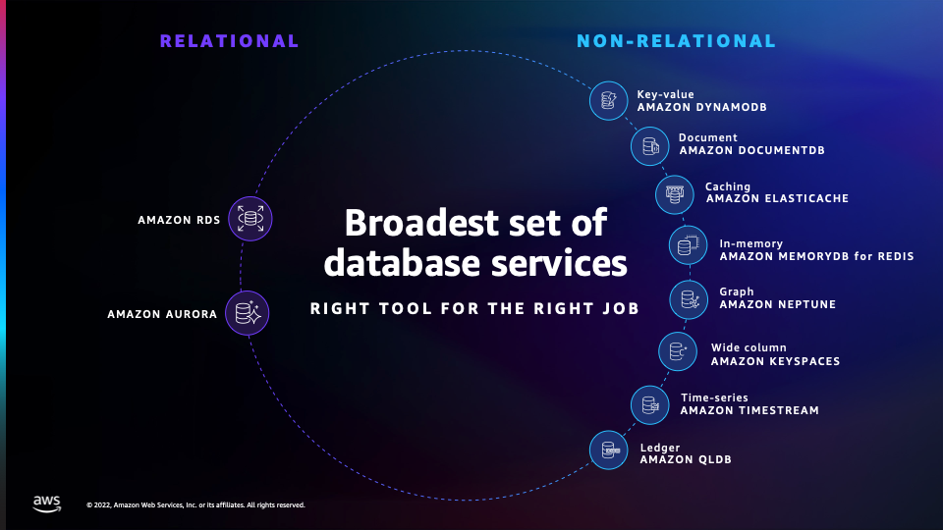
Databases

Slide 3
Database Comparison
Amazon RDS (Relational Database Service):
Use Case: Relational Databases
Choose RDS if your application requires a traditional relational database.
Supports popular databases such as MySQL, PostgreSQL, Oracle, SQL Server, and MariaDB.
Provides automated backups, patch management, and easy scalability.
Amazon Aurora:
Use Case: High-Performance Relational Databases
Choose Aurora for high-performance relational databases with compatibility for MySQL or PostgreSQL.
Provides the performance of commercial databases with the cost-effectiveness of open-source databases.
Fully managed, scalable, and offers automatic backups.
Amazon DynamoDB:
Use Case: NoSQL Databases
Choose DynamoDB for highly scalable, low-latency NoSQL databases.
Ideal for applications with variable and unpredictable workloads.
Fully managed, serverless, and offers seamless scaling.
Key-value data
Amazon DocumentDB (with MongoDB compatibility):
Use Case: MongoDB-Compatible Document Databases
Choose DocumentDB if you need a fully managed, scalable, and highly available MongoDB-compatible database.
Designed for applications using the MongoDB API.
Offers built-in security, automated backups, and easy scalability.
Semi structured data as JSON docs
Amazon Neptune:
Use Case: Graph Databases
Choose Neptune for graph databases, suitable for highly connected data.
Supports both Property Graph and RDF models.
Ideal for applications requiring graph analysis and traversal.

Slide 4
Database Comparison
Amazon ElastiCache:
Use Case: In-Memory Caching
Choose ElastiCache for in-memory caching to improve application performance.
Supports Redis and Memcached.
Ideal for reducing database load and accelerating data access.
Amazon Redshift:
Use Case: Data Warehousing
Choose Redshift for large-scale data warehousing and analytics.
Supports high-performance querying on large datasets.
Fully managed, scalable, and integrates with popular BI tools.
Amazon Timestream:
Use Case: Time-Series Data
Choose Timestream for ingesting, querying, and analyzing time-series data at scale.
Suitable for IoT applications, telemetry, and operational monitoring.
Fully managed and optimized for time-series data.
Amazon Keyspaces (for Apache Cassandra):
Use Case: Cassandra-Compatible Databases
Choose Keyspaces for a fully managed, serverless, and scalable Apache Cassandra-compatible database.
Ideal for applications with variable and unpredictable workloads.
Use for use cases like fraud detection, recommendation engines, and airline networks.
Amazon Quantum Ledger Database (QLDB):
Use Case: Ledger Databases
Choose QLDB for building transparent, immutable, and cryptographically verifiable transaction logs.
Ideal for applications requiring a centralized, tamper-resistant ledger.

Slide 5
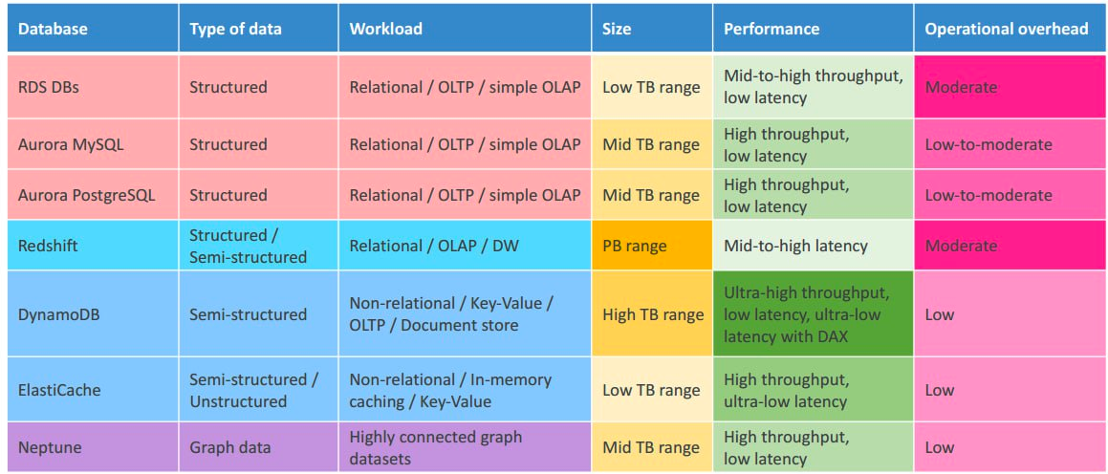
Databases Comparison

Slide 6
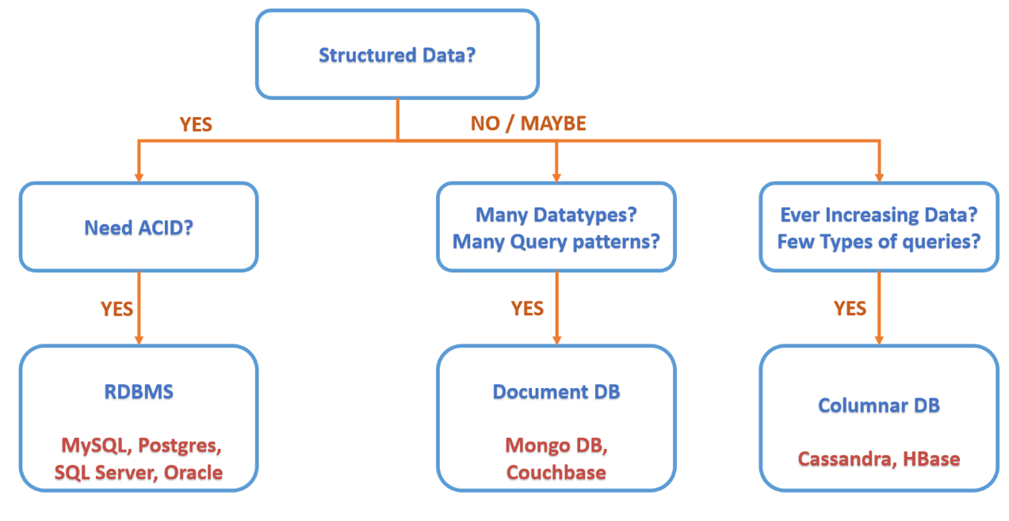
Choose database

Slide 7
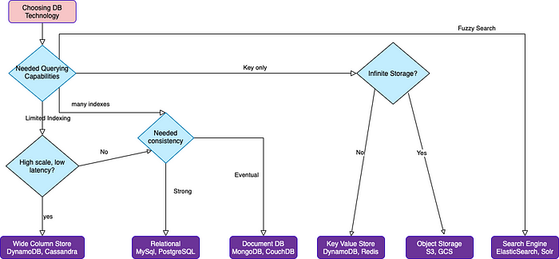
Choose database

Slide 8

Lets practice

Slide 9

Question
Your application involves structured data with complex relationships. You need to ensure ACID compliance for transactions. What database solution should you choose?

Slide 10
Question
Your application anticipates a high volume of traffic with complex query patterns. Scalability is a key consideration. Which database solution is suitable?

Slide 11
Question
Your project demands cost efficiency, especially for variable workloads. Which AWS database service is suitable for optimizing costs and resources?

Slide 12
Question
Your application requires an immutable ledger for traceability and auditing purposes. Which AWS database service is specifically designed for this use case?

Slide 13
Question
Your application deals with semi-structured data with dynamic schemas. Which AWS database service provides compatibility with MongoDB and supports flexible document structures?

Slide 14
Question
Your application experiences heavy read operations, and you want to accelerate these reads by utilizing an in-memory cache. Which AWS database service meets this requirement?

Slide 15
Question
Your application relies on Apache Cassandra for distributed, highly available databases. Which AWS database service offers a managed Apache Cassandra service?

Slide 16
Question
Your project involves analyzing and querying relationships between various entities. Which AWS database service is specifically designed for managing highly connected data?

Slide 17
Question
Your IoT application generates a massive amount of time-series data. Which AWS database service is optimized for storing and querying time-series data efficiently?

Slide 18
Question
Your application demands high performance and throughput for complex queries. Which AWS database service is a fully managed relational database engine designed for such demanding applications?

Slide 19
Question
Your application deals with both structured transactional data and unstructured user-generated content. Additionally, there's a requirement for graph-based analysis of user relationships. Propose a database solution that can handle both scenarios and discuss the tradeoffs.

Slide 20
Question
Your project involves collecting and analyzing real-time data for operational insights, but you also have a need for historical analytics on the same dataset. Propose a solution that balances real-time analytics and cost efficiency, and discuss the tradeoffs involved.

Slide 21
Question
Your company is expanding globally, and the application needs to provide low-latency access to data for users across different regions. Propose a hybrid database architecture that can scale globally and discuss the tradeoffs.

