Slide 1

Elastic Cache

Slide 2

Amazon ElastiCache
Amazon ElastiCache is a web service that makes it easy to set up, manage, and scale a distributed in-memory data store or cache environment in the cloud. It provides a high-performance, scalable, and cost-effective caching solution. At the same time, it helps remove the complexity associated with deploying and managing a distributed cache environment.
Fully managed implementations of two popular in-memory data stores – Redis and Memcached.
The in-memory caching provided by ElastiCache can be used to significantly improve latency and throughput for many read-heavy application workloads or compute-intensive workloads
Best for scenarios where the DB load is based on Online Analytics Processing (OLAP) transactions.
Helps reduce load off of databases for read intensive workload.

Slide 3
ElasticSearch Use cases
Apps requiring sub-millisecond latency
Real-time analytics
Gaming leaderboards
Session stores
Chat apps
Machine learning
Streaming media apps
Message queques

Slide 4
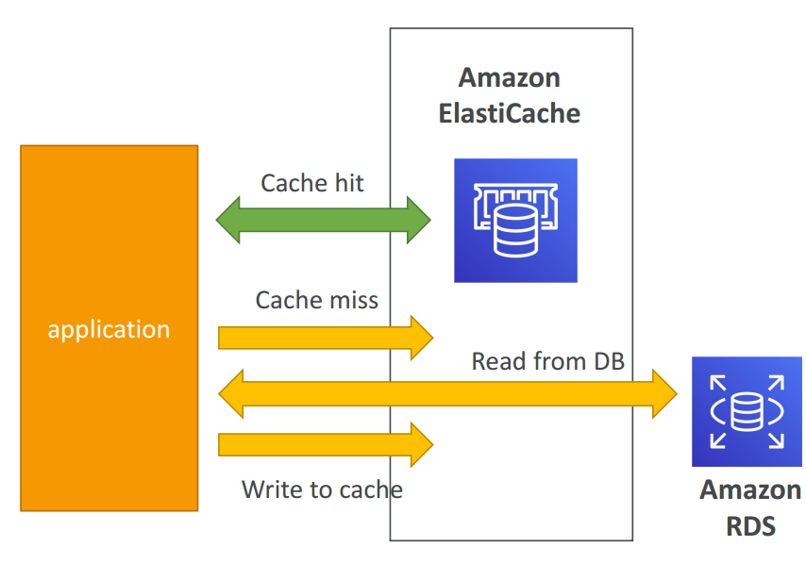
ElastiCache Solution Architecture - DB Cache
Applications queries ElastiCache, if not available, get from RDS and store in ElastiCache.
Helps relieve load in RDS
Cache must have an invalidation strategy to make sure only the most current data is used in there.

Slide 5
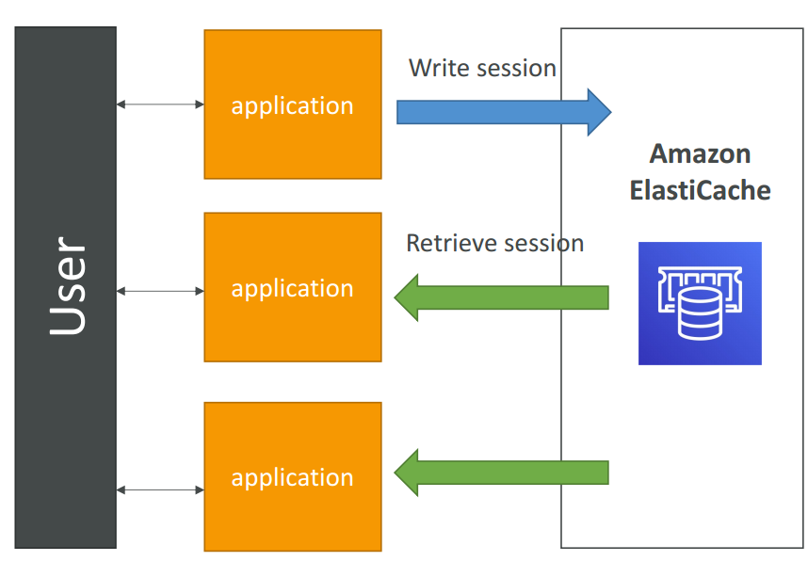
ElastiCache Solution Architecture – User Session Store
User logs into any of the application
The application writes the session data into ElastiCache
The user hits another instance of our application
The instance retrieves the data and the user is already logged in

Slide 6


Two types of ElastiCache engine:
Memcached – simplest model, can run large nodes with multiple cores/threads, can be scaled in and out, can cache objects such as DBs.
Multi-node for partitioning of data (sharding)
No high availability (replication)
Non persistent
No backup and restore
Multi-threaded architecture
Does not support encryption
Redis – complex model, supports encryption, master / slave replication, cross AZ (HA), automatic failover and backup/restore.
Multi AZ with Auto-Failover
Read Replicas to scale reads and have high availability
Data Durability using AOF persistence
Backup and restore features
Encryption in transit

Slide 7
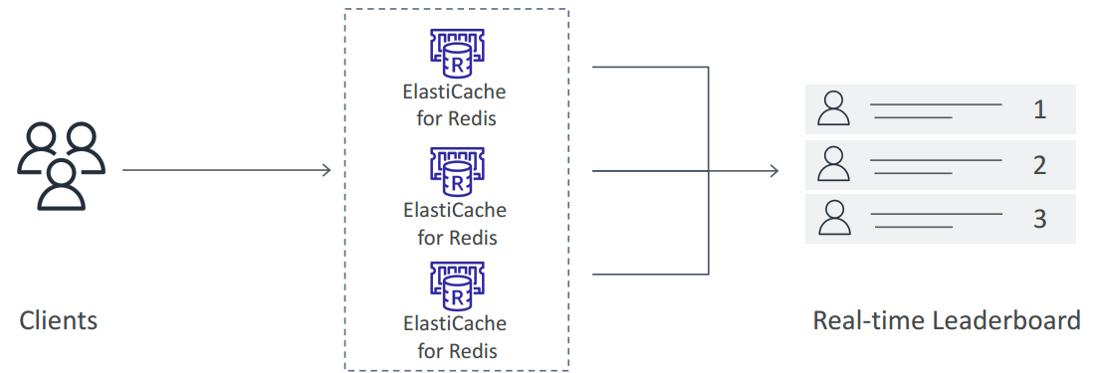
Use cases
Memcached
Cache the contents of a DB.
Cache data from dynamically generated web pages.
Transient session data.
High frequency counters for admission control in high volume web apps.
Redis
Gaming Leaderboards are computationally complex
Redis Sorted sets guarantee both uniqueness and element ordering
Each time a new element added, it’s ranked in real time, then added in correct order

Slide 8
Memcache use cases
Facebook:
Facebook is one of the most well-known users of Memcached. They have used it extensively to cache data and reduce the database load.
With billions of interactions every day, Facebook generates a massive amount of dynamic content.
Memcached helps in efficiently retrieving this content, like user profiles, news feeds, and more, by caching it in memory.
Facebook even made significant contributions to the development of Memcached to handle their unique scale and performance needs.
Twitter:
Twitter has used Memcached as part of its caching strategy to handle the large volume of tweets and timeline reads.
Memcached helped Twitter manage the high read-load and reduce the database queries, which is crucial for a platform with millions of active users and a substantial amount of real-time content.
YouTube:
YouTube has used Memcached for caching data like video metadata and user session information.
With millions of videos and an enormous number of views per day, caching is essential to deliver a smooth user experience.
Reddit:
Reddit, known for its dynamic and rapidly changing content, has utilized Memcached to cache story information and user sessions.
This has been crucial in handling the site's vast number of page views and user interactions.
Wikipedia:
Wikipedia uses Memcached to reduce the load on its database servers.
Given the vast amount of content and the high number of reads and edits on the site, Memcached plays a vital role in ensuring quick data retrieval.

Slide 9
Caching strategies

Slide 10
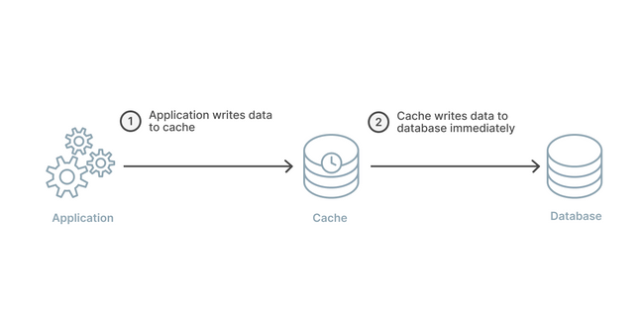
Caching strategies: Write Through
Write Through
When using a write-through strategy, the cache is updated whenever a new write or update is made to the underlying database.
Allows cache data to remain up to date.
This can add wait time to write operations in your application.
Without a TTL you can end up with a lot of cached data that is never read.

Slide 11
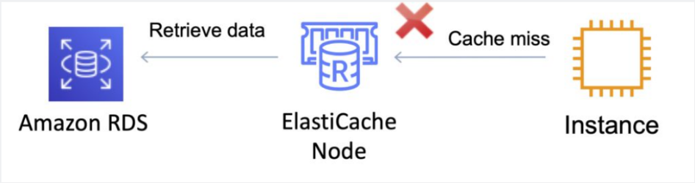
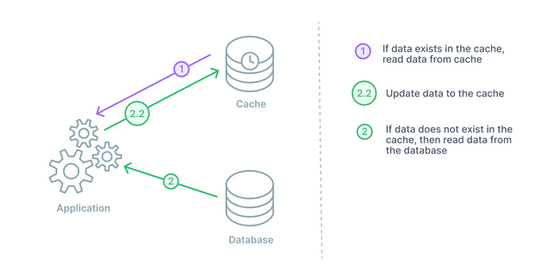
Caching strategies: Lazy Loading (Cache-Aside)
Lazy Loading
Loads the data into the cache only when necessary (if a cache miss occurs).
Lazy loading avoids filling up the cache with data that won’t be requested.
If requested data is in the cache, ElastiCache returns the data to the application.
If the data is not in the cache or has expired, ElastiCache returns a null.
The application then fetches the data from the database and writes the data received into the cache so that it is available for next time.
Data in the cache can become stale if Lazy Loading is implemented without other strategies (such as TTL).

Slide 12
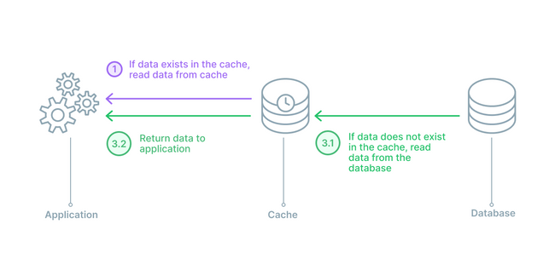
Caching strategies: Read Through
The main differences between read-through and cache-aside is that in a cache-aside strategy the application is responsible for fetching the data and populating the cache,
while in a read-through setup, the logic is done by a library or some separate cache provider.
A read-through setup is similar to a cache-aside in regards to potential data inconsistency between cache and database.
For any data writes, the application will still go directly to the database.

Slide 13
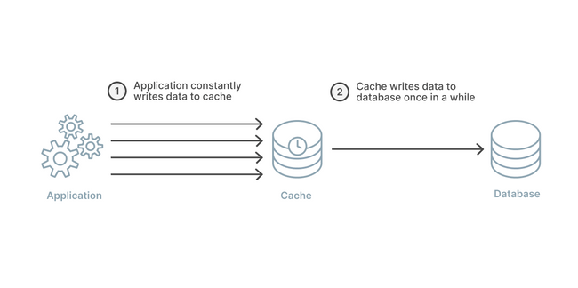
Caching strategies: Write Back
Write-back works almost exactly the same as the write-through strategy except for one key detail.
In a write-back strategy, the application again writes directly to the cache.
The cache does not immediately write to the database, and it instead writes after a delay.
The delay in cache to database writes can improve overall write performance and if batching is supported then also a reduction in overall writes

Slide 14
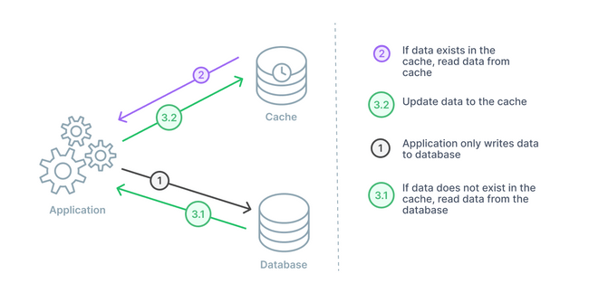
Caching strategies: Write around
A write-around caching strategy will be combined with either a cache-aside or a read-through.
In this arrangement, data is always written to the database and the data that is read goes to the cache.
If there is a cache miss, then the application will read to the database and then update the cache for next time.

Slide 15
Redis Cluster Mode Why?
Data Sharding:
Cluster mode enables horizontal scaling by partitioning data across multiple Redis nodes. This is known as sharding. Each shard or node holds a subset of the data, which helps in distributing the load and increasing the capacity of the cache.
The data is automatically partitioned across the shards based on hash slots, and each shard manages a specific subset of these slots.
Scalability:
With cluster mode, you can scale the Redis cluster horizontally by adding or removing shards. This scalability is crucial for handling growing data sets and fluctuating workloads.
It allows for a larger dataset than a single node can support and can handle more read and write operations per second.
High Availability and Failover:
Each shard in a Redis cluster can have one or more replica nodes. These replicas provide high availability and are used for failover if the primary node fails.
AWS ElastiCache automatically handles the failover process, promoting a replica to be the new primary node if the current primary node fails.
Multi-AZ Deployments:
Cluster mode supports Multi-AZ deployments for higher availability. This ensures that nodes and their replicas are placed in different Availability Zones, protecting the cluster against the failure of an entire data center.
Performance Benefits:
By distributing the data across multiple nodes, the cluster mode can significantly improve the performance for read-intensive applications. Read requests can be distributed across multiple shards.
However, it's important to note that for multi-key operations, all keys involved must reside in the same shard, or the operation won't be supported.
Management and Maintenance:
AWS ElastiCache provides management features for Redis clusters, including monitoring, backup and restore, and software patching.
The service manages the sharding and re-sharding processes, reducing the operational burden on users.
Use Cases Cluster mode is suitable for applications that require:
Large datasets that exceed the memory capacity of a single Redis node.
High throughput for read and write operations.
High availability and automatic failover across multiple zones.
Scalability to adjust to changing workload demands.

Slide 16
Redis Cluster Mode Disabled
Single Node or Replication Group:
In this mode, you can either have a standalone Redis instance (single node) or a primary node with one or more read replicas (replication group).
There is no sharding; the entire dataset resides on each node.
Use Cases:
Suitable for smaller datasets or applications where the dataset fits comfortably in a single node's memory.
Ideal for applications that require simpler cache management and straightforward replication.
Scalability:
While you can scale up (to a bigger node) or scale out (by adding read replicas), you cannot horizontally scale the dataset across multiple nodes (shards).
Scaling up requires a short downtime as the primary node is replaced with a larger one.
High Availability:
Supports Multi-AZ deployments for high availability. If the primary node fails, one of the replicas is promoted to the primary role.
Performance:
Performance is limited to the capacity of a single node. All read and write operations go to the primary node, although reads can be offloaded to replicas.

Slide 17
Redis Cluster Mode Enabled
Sharding (Partitioning Data):
Data is partitioned across multiple nodes (shards), each of which contains a subset of the data.
Allows for horizontal scaling of the dataset and throughput.
Use Cases:
Best suited for large datasets and high-throughput scenarios where the data and load need to be distributed across multiple nodes.
Essential for applications that require horizontal scaling beyond the capacity of a single Redis node.
Scalability:
Provides horizontal scaling by adding or removing shards. This can be done with minimal impact on the cluster's availability.
Allows for both scale-up (larger nodes) and scale-out (more nodes) approaches.
High Availability:
Each shard can have one or more replicas, providing high availability. Supports automatic failover within a shard.
Also supports Multi-AZ deployments for resilience against AZ failures.
Performance:
Can handle larger volumes of reads and writes by distributing the load across multiple shards.
Better suited for environments with high read/write operation rates.

Slide 18
Redis Cluster Mode Key Difference
Data Distribution: Cluster Mode enabled supports sharding, while Cluster Mode disabled does not.
Scalability: Cluster Mode enabled allows for horizontal scaling (adding/removing shards), whereas Cluster Mode disabled is limited to vertical scaling (resizing nodes) and adding read replicas.
Dataset Size: Cluster Mode enabled is more suitable for larger datasets that exceed the memory capacity of a single Redis node.
Operational Complexity: Cluster Mode disabled is simpler to manage due to the absence of sharding. Cluster Mode enabled requires more management overhead due to the presence of multiple shards.

Slide 19
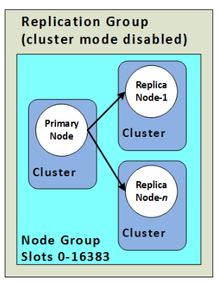
Redis Scaling
Cluster Mode Disabled
Vertical Scaling
Scale up/down node type
Minimal downtime
Horizontal scaling
add/remove replica nodes

Slide 20
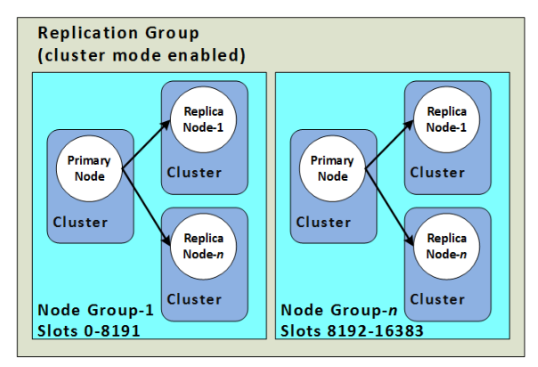
Redis Scaling
Cluster Mode Enabled
Vertical Scaling (Online)
Scale up/down node type
No downtime
Horizontal scaling
Allows partitioning across shards
add/remove/rebalance shards

Slide 21
Redis Replication
Cluster Mode Disabled
1 shard
0-5 replicas
0 replicas & primary fail -> total data loss
Multi Az supported
Supports scaling
Cluster Model Enabled
Up to 500 shards
0-5 replicas per shard
0 replicas & primary fail -> total data loss in That shard
Multi az required
Supports partitioning
https://docs.aws.amazon.com/AmazonElastiCache/latest/red-ug/Scaling-self-designed.html

Slide 22
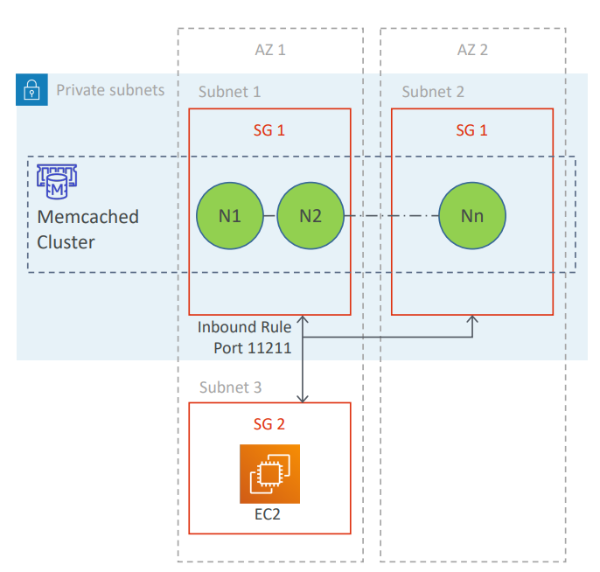
Memcached architecture
Memcached cluster is generally placed in private subnet
Accessed from EC2 instance placed in a public subnet in a VPC
Allows access only from EC2 network (apps should be hosted on whitelisted EC2 instances)
Whitelist using security groups
Up to 20 nodes per cluster
Data is distributed across the available nodes
Replicas are not supported
Node failure = data loss
Nodes can be deployed as Multi-AZ (to reduce data loss)

Slide 23
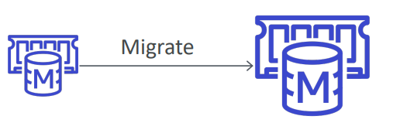
Memcached Scaling
Vertical scaling not supported
can resize by creating a new cluster and migrating your application
Horizontal scaling
allows you to partition your data across multiple nodes
up to 20 nodes per cluster and 100 nodes per region (soft limit)
no need to change endpoints post scaling (if you use auto -discovery)
must re -map at least some of your keyspace post scaling (evenly spread cache keys across all nodes)

Slide 24
Elastic Cache take away
ElastiCache is a web service that makes it easy to deploy and run Memcached or Redis protocol-compliant server nodes in the cloud.
ElastiCache EC2 nodes cannot be accessed from the Internet, nor can they be accessed by EC2 instances in other VPCs.
Can be on-demand or reserved instances too (but not Spot instances).
Each node runs an instance of the Memcached or Redis protocol-compliant service and has its own DNS name and port.
Memcached – simplest model, can run large nodes with multiple cores/threads, can be scaled in and out, can cache objects such as DBs.
Scales out/in (horizontally) by adding/removing nodes.
Scales up/down (vertically) by changing the node family/type.
Does not support multi-AZ failover or replication.
Does not support snapshots.
You can place nodes in different AZs.
Redis – complex model, supports encryption, master / slave replication, cross AZ (HA), automatic failover and backup/restore.
Redis is not multi-threaded.
Scales by adding shards, not nodes.
Supports master / slave replication and multi-AZ for cross-AZ redundancy.
Supports automatic failover and backup/restore.

Slide 25
Questions:

Slide 26
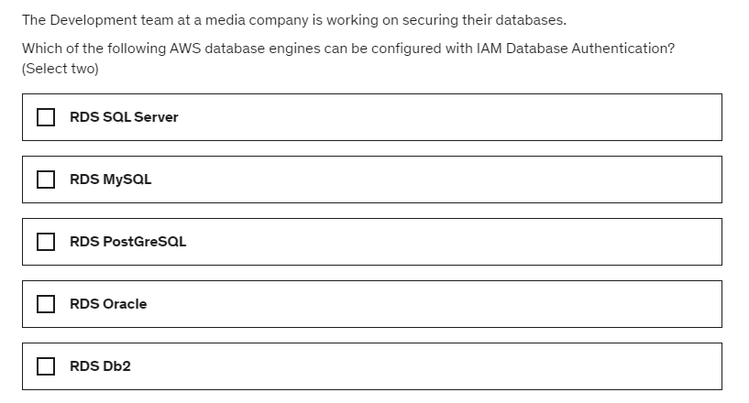

Slide 27
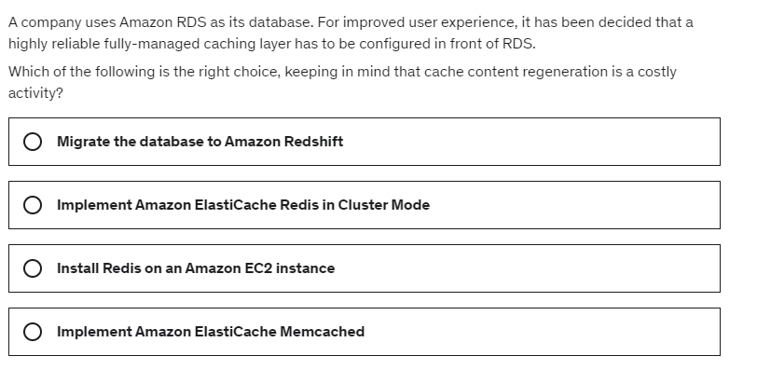

Slide 28
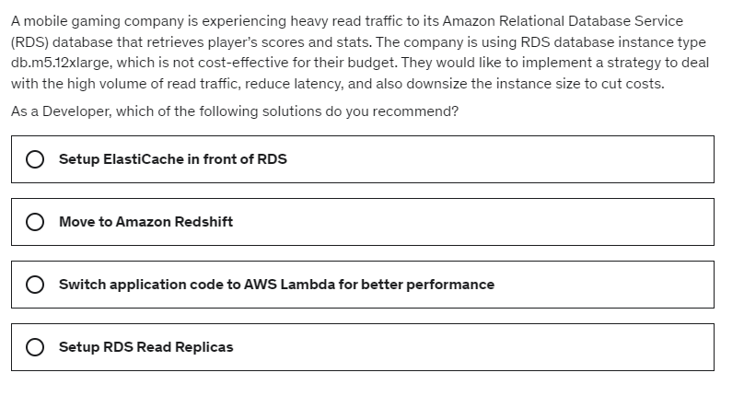

Slide 29
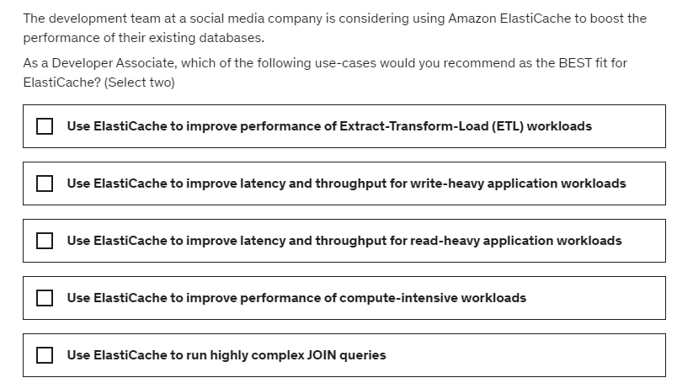

Slide 30
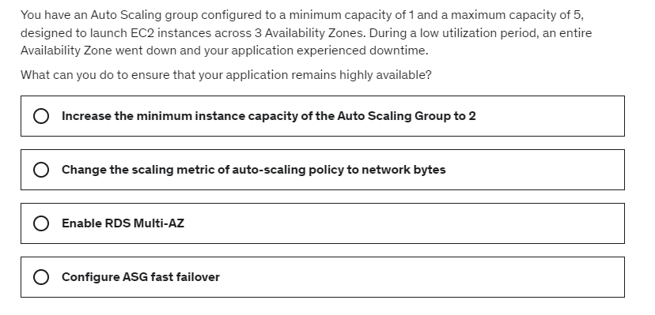

Slide 31
