Slide 1
AWS Nitro System

Slide 2
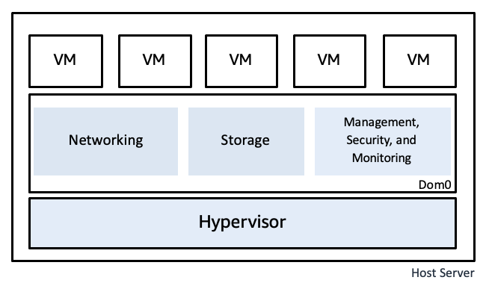
Traditional Virtualization
Virtualization, at a high level, enables a single physical computer system to run multiple operating systems at once.
virtualization system - “host”
virtualized operating systems - “guest”
Primary benefits of virtualization is the ability to make efficient use of a single powerful server by dividing its resources among multiple virtual machines each of which is allocated an amount of resources which is optimal for its assigned tasks.
Core component – Hypervisor (virtual machine monitor (VMM))
Hypervisors typically employ a general-purpose operating system to interface with a variety of system hardware, run device models, and run other management software for the virtualization system.
This operating system is commonly implemented as a special privileged virtual machine, examples:
XEN - dom0
Hyper-V root/parent partition

Slide 3
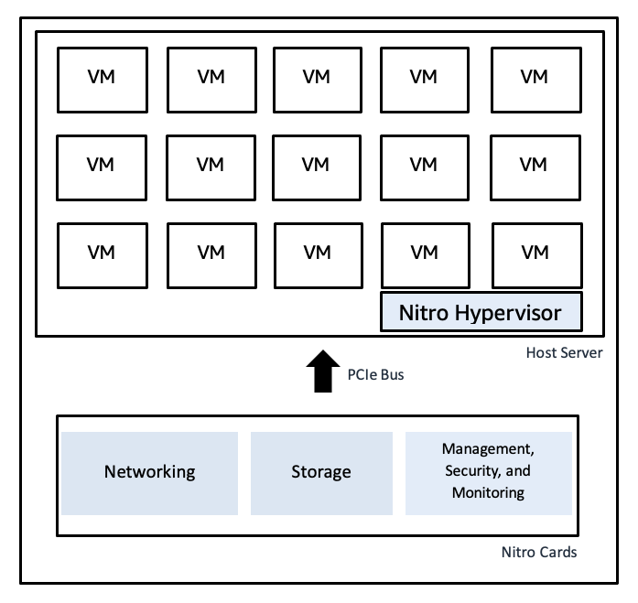
Introduction to AWS Nitro System
Illustrate the unique architecture: Differentiate between traditional virtualization and Nitro's approach.
Components explained: Dive into Nitro Cards for specific functions (e.g., VPC, EBS), the Nitro Security Chip for hardware security, and the lightweight Nitro Hypervisor for resource isolation.
Highlight architectural benefits: Enhanced resource optimization and reduced virtualization overhead.
FYI: Peripheral Component Interconnect Express (PCIe or PCI-E) is a serial expansion bus standard for connecting a computer to one or more peripheral devices. PCIe provides lower latency and higher data transfer rates than parallel busses such as PCI and PCI-X.

Slide 4
AWS Nitro Intro
Launched in November 2017
Hypervisor build for AWS
All new launches uses AWS Nitro
C5 instance type introduced in 2017 as a first Nitro based type

Slide 5
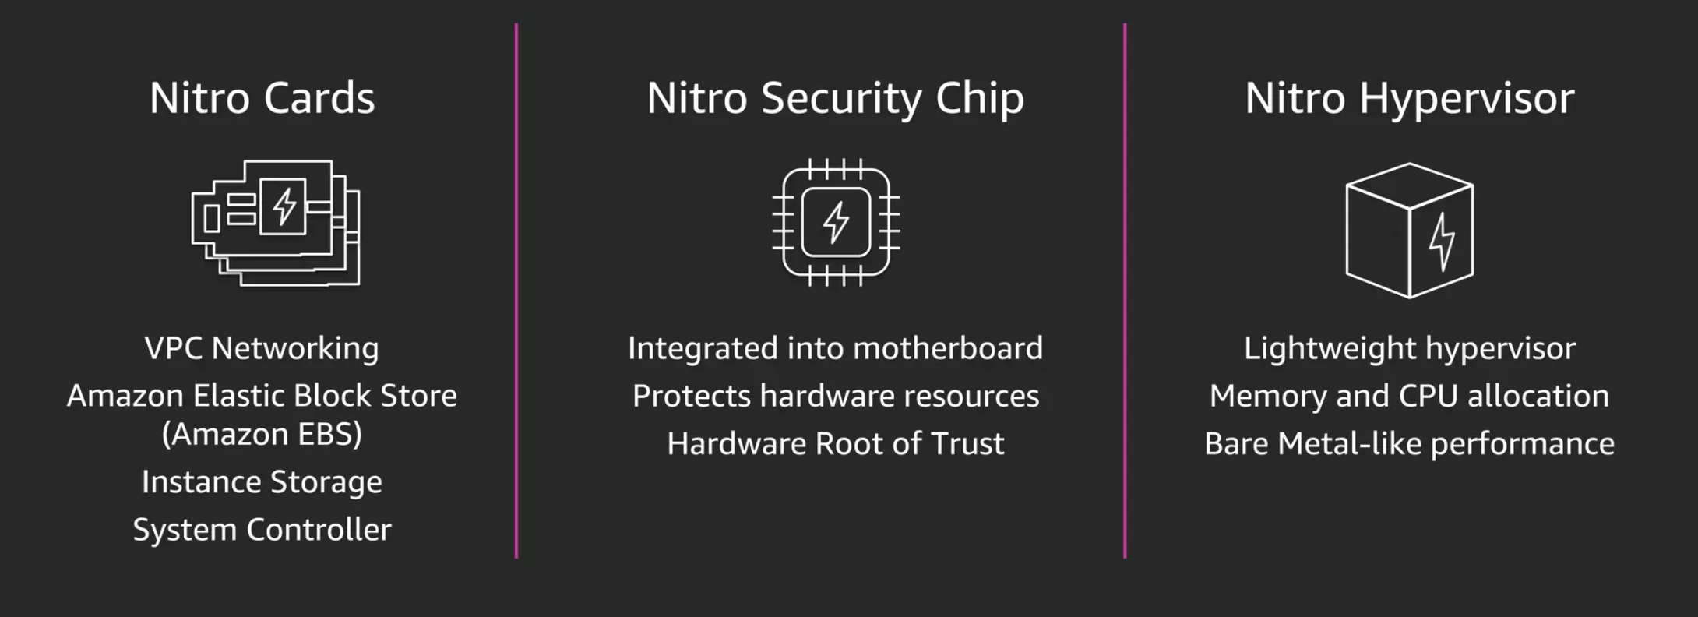
AWS Nitro Components

Slide 6
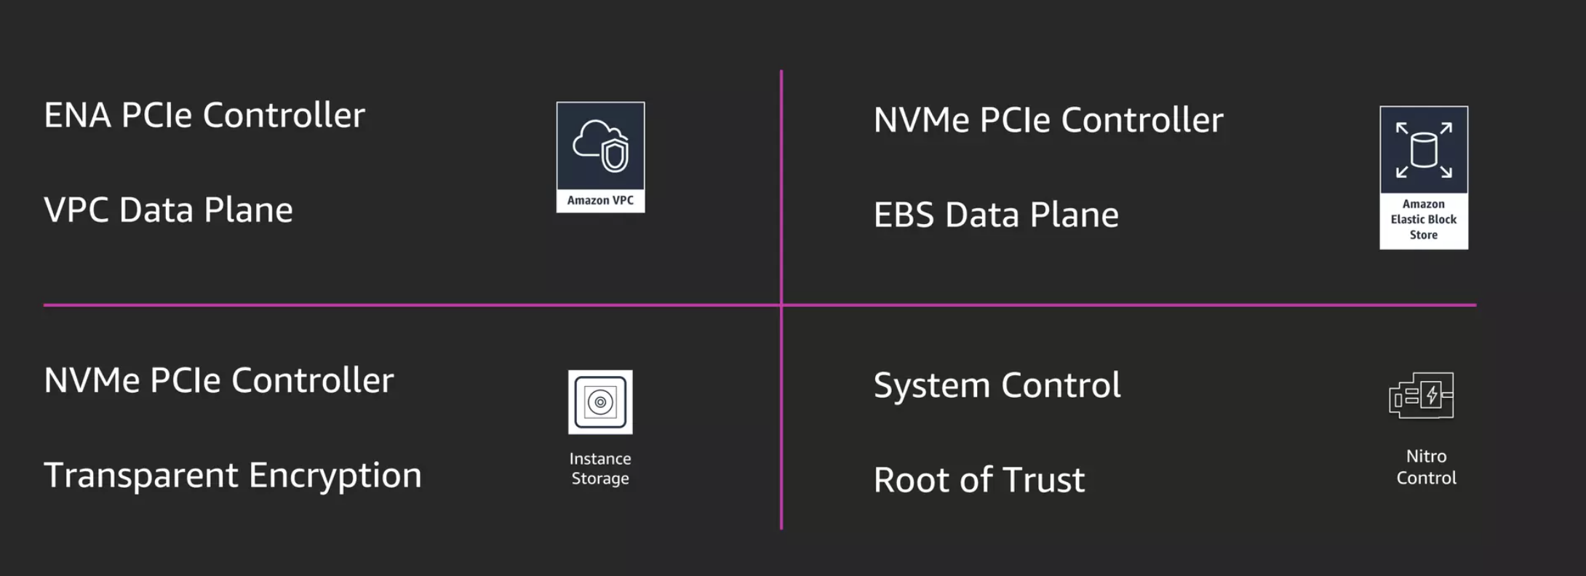
Nitro Cards

Slide 7
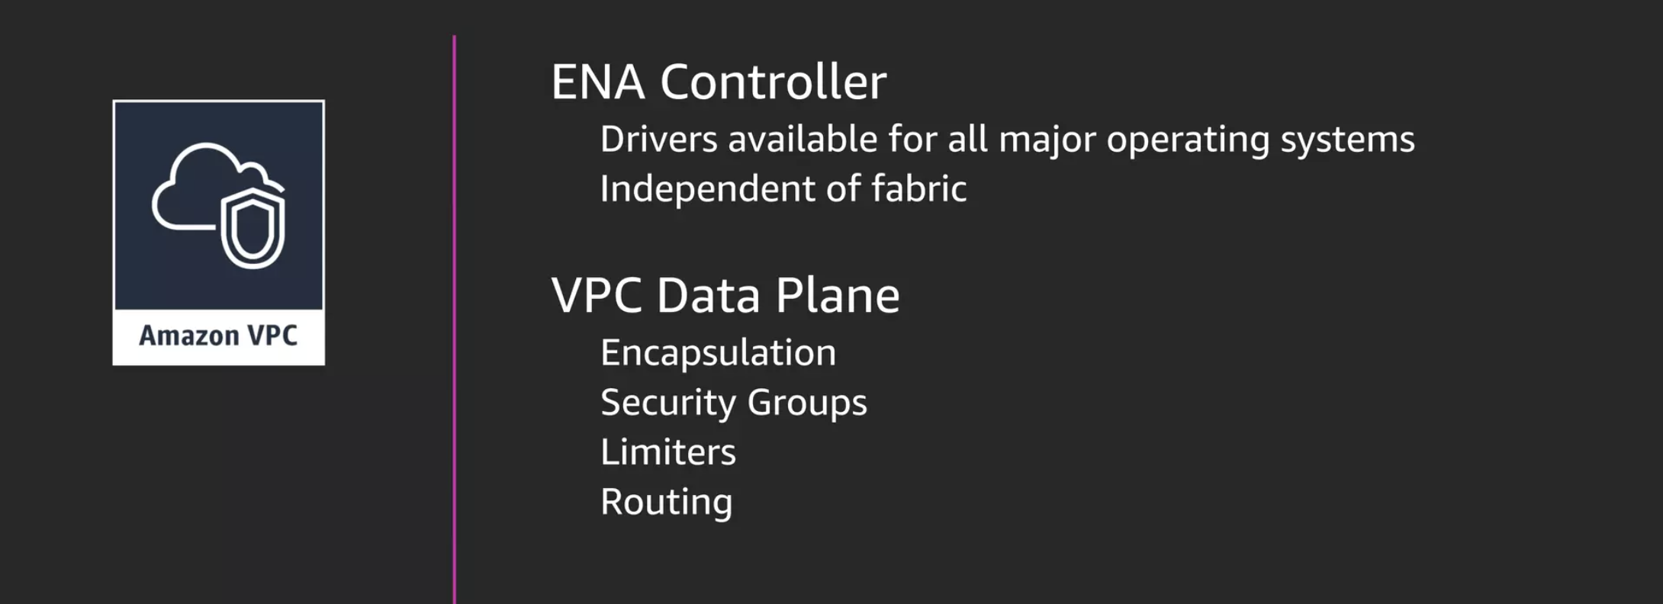
VPC Nitro Card

Slide 8
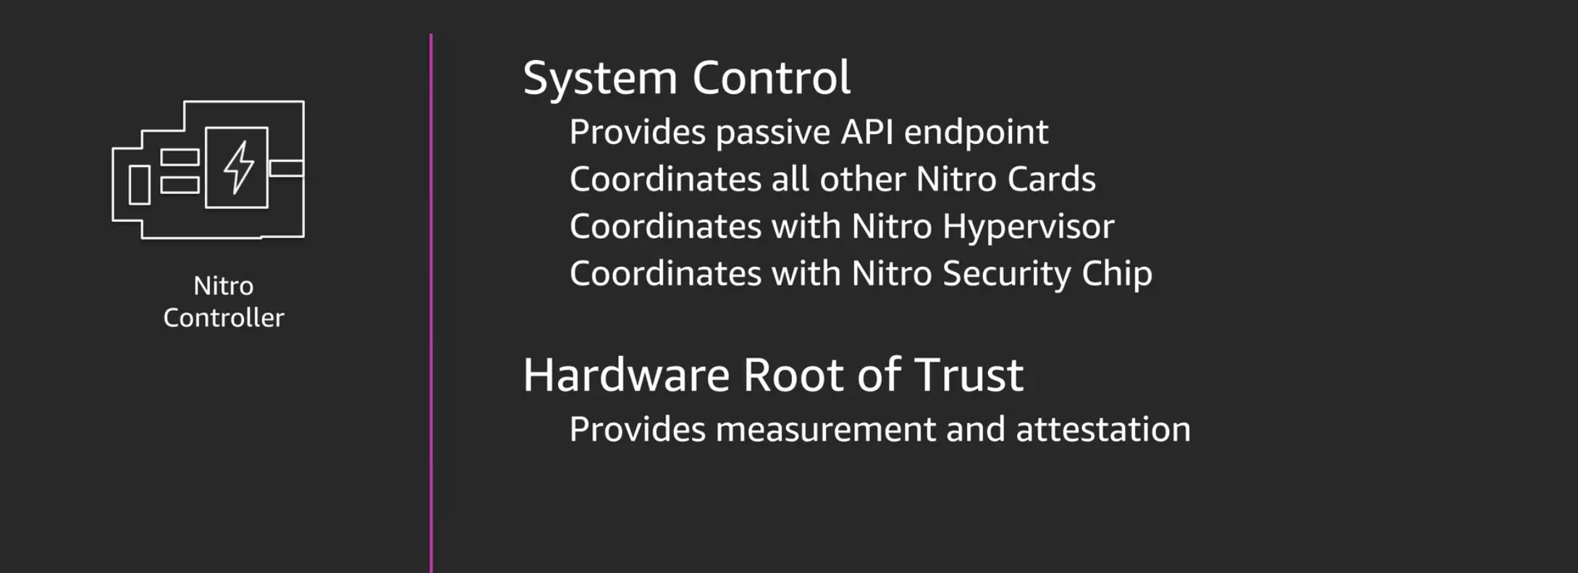
AWS Nitro Card Controller

Slide 9
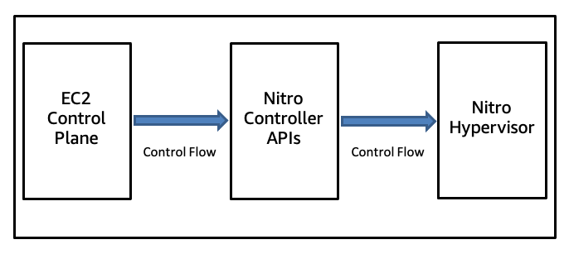
AWS Nitro Card Controller
The Nitro Controller presents to the dedicated EC2 control plane network a set of strongly authenticated and encrypted networked APIs for system management.
Every API action is logged and all attempts to call an API are cryptographically authenticated and authorized using a fine-grained access control model.
Each control plane component is authorized only for the set of operations needed for it to complete its business purpose.

Slide 10
AWS Nitro Use Cases
High-Performance Computing (HPC): AWS Nitro's enhanced CPU and memory performance make it ideal for HPC workloads. Its ability to deliver high throughput and networking performance is crucial for compute-intensive tasks like scientific modeling, big data analytics, and machine learning.
Secure Data Processing: With the Nitro Security Chip, AWS Nitro offers a secure environment for processing sensitive data. This is particularly beneficial for industries like finance and healthcare, where data security and compliance are paramount.
Enterprise Resource Planning (ERP) Systems: The improved I/O and network throughput capabilities of AWS Nitro are well-suited for ERP systems, which often require robust, scalable, and secure infrastructure to handle large volumes of transactions and data.
Gaming and Media Streaming: AWS Nitro's ability to provide consistent high performance and low latency benefits gaming and media streaming services. It ensures a smooth and responsive experience for users, even during peak demand times.
Machine Learning and AI Workloads: The enhanced computational power and efficiency of AWS Nitro are ideal for machine learning and AI workloads, enabling faster processing of large datasets and more efficient model training and inference.

