Slide 1
AWS IAM

Slide 2
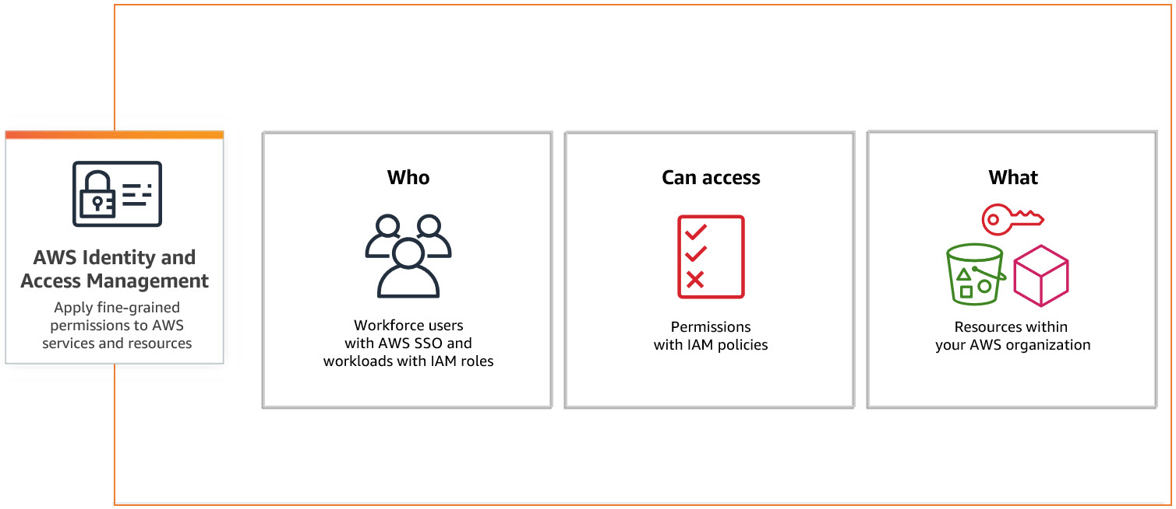
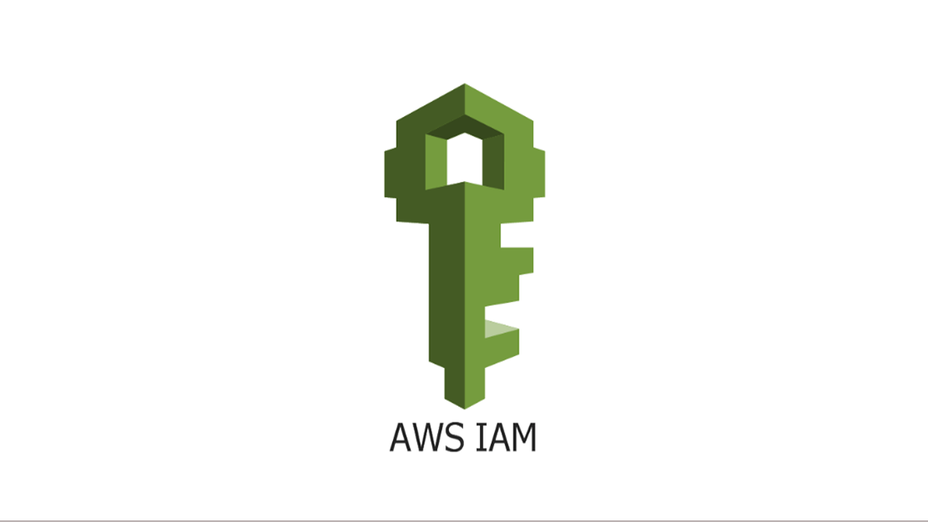
AWS IAM
Amazon Identity and Access Management (IAM) is a web service that helps you securely control access to Amazon resources. You use IAM to control who is authenticated (signed in) and authorized (has permissions) to use resources.
IAM features
Shared access to your Amazon account
Granular permissions
Secure access to Amazon resources for applications that run on Amazon EC2
Multi-factor authentication (MFA)
Identity federation
Identity information for assurance
PCI DSS Compliance
Integrated with many Amazon services
Eventually Consistent

Slide 3
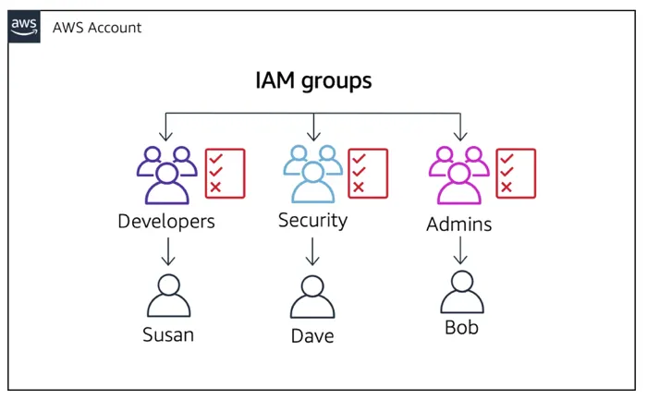
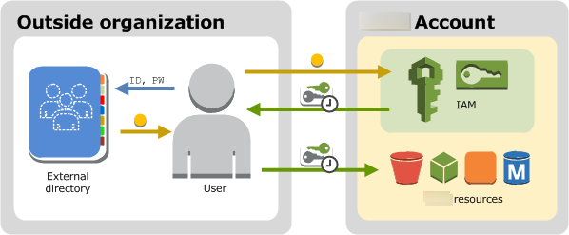
AWS IAM: Users & Groups
For greater security and organization, you can give access to your Amazon account to specific users — identities that you create with custom permissions.

Slide 4
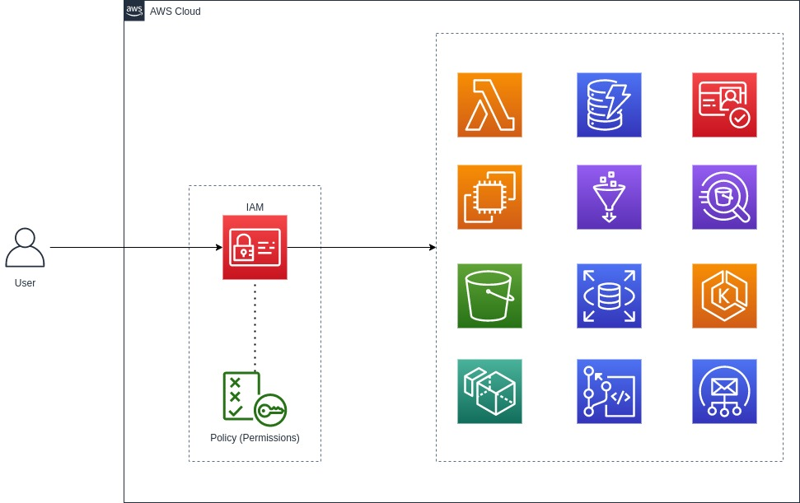
AWS IAM Roles Introduction
Role - An IAM identity that you can create in your account. Role has specific permissions.
You can use roles to delegate access to users, applications, or services that don't normally have access to your AWS resources.
For example, you might want to grant users in your AWS account access to resources they don't usually have, or grant users in one AWS account access to resources in another account.
Or you might want to allow a mobile app to use AWS resources, but not want to embed AWS keys within the app.

Slide 5
AWS IAM Roles
AWS service role for an EC2 instance
A special type of service role that an application running on an Amazon EC2 instance can assume to perform actions in your account. This role is assigned to the EC2 instance when it is launched. Applications running on that instance can retrieve temporary security credentials and perform actions that the role allows
AWS service role
A role that a service assumes to perform actions in your account on your behalf. When you set up some AWS service environments, you must define a role for the service to assume. This service role must include all the permissions required for the service to access the AWS resources that it needs. Service roles vary from service to service, but many allow you to choose your permissions, as long as you meet the documented requirements for that service.

Slide 6
AWS IAM Roles
AWS service-linked role
A unique type of service role that is linked directly to an AWS service. Service-linked roles are predefined by the service and include all the permissions that the service requires to call other AWS services on your behalf
Role chaining: Assume Role
Role chaining is when you use a role to assume a second role through the AWS CLI or API.
For example, RoleA has permission to assume RoleB.
You can enable User1 to assume RoleA by using their long-term user credentials in the AssumeRole API operation.
This returns RoleA short-term credentials.
With role chaining, you can use RoleA's short-term credentials to enable User1 to assume RoleB.

Slide 7
AWS IAM: how it works?
Terms
IAM Resources
IAM Identities
IAM Entities
Principals
Principal
A principal is a person or application that can make a request for an action or operation on an Amazon resource.
Request:
Actions or operations
Resources
Principal
Environment data
Resource data
Authorization
You must also be authorized (allowed) to complete your request.
During authorization, Amazon uses values from the request context to check for policies that apply to the request.
It then uses the policies to determine whether to allow or deny the request.
Most policies are stored in Amazon as JSON documents and specify the permissions for principal entities
Authentication
A principal must be authenticated using their credentials to send a request to Amazon. Some services, such as Amazon S3 and Amazon STS, allow a few requests from anonymous users
Actions or operations
After your request has been authenticated and authorized, Amazon approves the actions or operations in your request
Resources
After Amazon approves the operations in your request, they can be performed on the related resources within your account

Slide 8
AWS IAM: Policies
Identity-based and resource-based policies
Identity-based policies are permissions policies that you attach to an IAM identity, such as an IAM user, group, or role.
Resource-based policies are permissions policies that you attach to a resource such as an Amazon S3 bucket or an IAM role trust policy.
Identity-based policies control what actions the identity can perform, on which resources, and under what conditions. Identity-based policies can be further categorized:
Managed policies – Standalone identity-based policies that you can attach to multiple users, groups, and roles in your Amazon account. You can use two types of managed policies:
Amazon managed policies – Managed policies that are created and managed by Amazon. If you are new to using policies, we recommend that you start by using Amazon managed policies.
Customer managed policies – Managed policies that you create and manage in your Amazon account. Customer managed policies provide more precise control over your policies than Amazon managed policies. You can create, edit, and validate an IAM policy in the visual editor or by creating the JSON policy document directly. For more information, see Creating IAM policies and Editing IAM policies.
Inline policies – Policies that you create and manage and that are embedded directly into a single user, group, or role. In most cases, we don't recommend using inline policies.

Slide 9
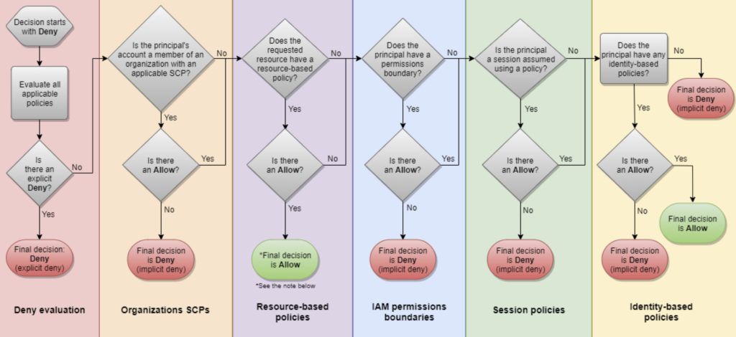
AWS IAM Policies Evaluation Logic

Slide 10
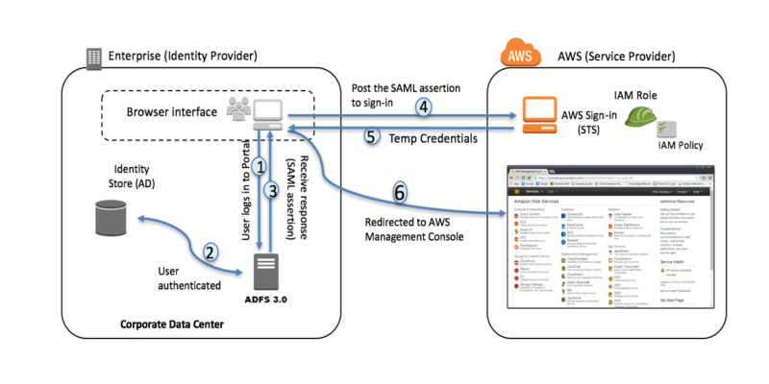
AWS IAM: Federated users
Federated users and roles
Federated users don't have permanent identities in your Amazon account the way that IAM users do.
To assign permissions to federated users, you can create an entity referred to as a role and define permissions for the role.
When a federated user signs in to Amazon, the user is associated with the role and is granted the permissions that are defined in the role

Slide 11
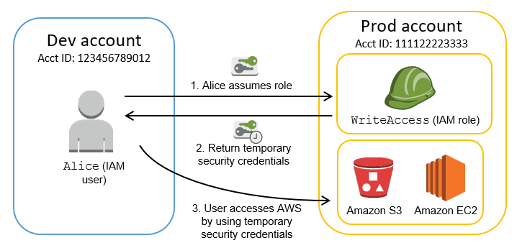
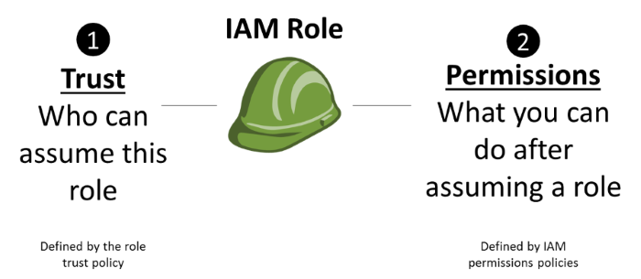
AWS IAM: Roles. Assume Role
Returns a set of temporary security credentials that you can use to access AWS resources.
These temporary credentials consist of an access key ID, a secret access key, and a security token. Typically, you use AssumeRole within your account or for cross-account access

Slide 12
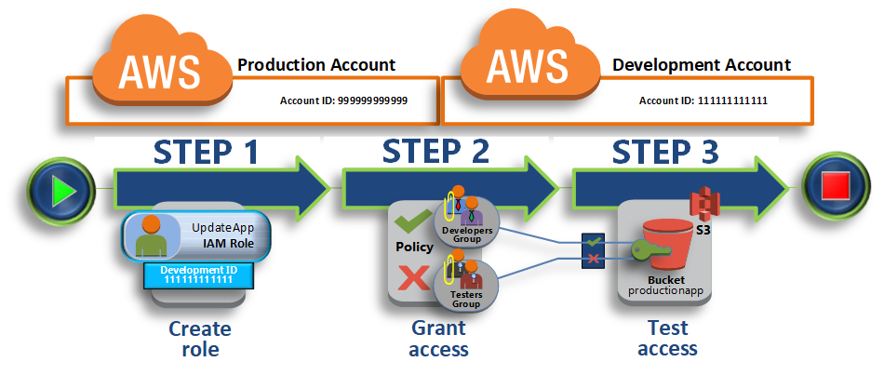
Delegate access across AWS accounts using IAM roles
To create a role in the production account that can be used by the Development account
To modify the Developers user group to allow them to switch to the UpdateApp role
To modify the testers user group to deny permission to assume the UpdateApp role
https://docs.aws.amazon.com/IAM/latest/UserGuide/tutorial_cross-account-with-roles.html

Slide 13
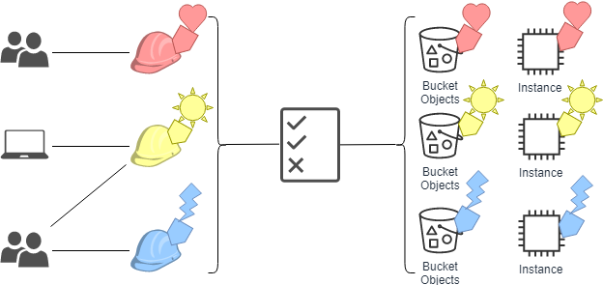
Attribute-based access control (ABAC) is an authorization strategy that defines permissions based on attributes. In Amazon, these attributes are called tags.
You can attach tags to IAM resources, including IAM entities (users or roles) and to Amazon resources.
You can create a single ABAC policy or small set of policies for your IAM principals.
These ABAC policies can be designed to allow operations when the principal's tag matches the resource tag.
What is ABAC for Amazon ?

Slide 14

ABAC vs RBAC
ABAC provides the following advantages over the traditional RBAC model:
ABAC permissions can scale.
It's no longer necessary for an administrator to update existing policies to allow access to new resources.
For example, assume that you designed your ABAC strategy with the access-project tag.
A developer uses the role with the access-project = Heart tag.
When people on the Heart project need additional Amazon EC2 resources, the developer can create new Amazon EC2 instances with the access-project = Heart tag. T
hen anyone on the Heart project can start and stop those instances because their tag values match.
ABAC requires fewer policies.
Because you don't have to create different policies for different job functions, you create fewer policies. Those policies are easier to manage.
Using ABAC, teams can change and grow quickly.
This is because permissions for new resources are automatically granted based on attributes.
For example, if your company already supports the Heart and Sun projects using ABAC, it's easy to add a new Lightning project.
An IAM administrator creates a new role with the access-project = Lightning tag. It's not necessary to change the policy to support a new project.
Anyone that has permissions to assume the role can create and view instances tagged with access-project = Lightning.
Additionally, a team member might move from the Heart project to the Lightning project.
The IAM administrator assigns the user to a different IAM role.
It's not necessary to change the permissions policies.
Granular permissions are possible using ABAC.
When you create policies, it's a best practice to grant least privilege.
Using traditional RBAC, you must write a policy that allows access to only specific resources.
However, when you use ABAC, you can allow actions on all resources, but only if the resource tag matches the principal's tag.
Use employee attributes from your corporate directory with ABAC.
You can configure your SAML-based or web identity provider to pass session tags to Amazon.
When your employees federate into Amazon, their attributes are applied to their resulting principal in Amazon.
You can then use ABAC to allow or deny permissions based on those attributes.

Slide 15



IAM MFA & Available Methods
FIDO security keys
AWS multi-factor authentication (MFA) is an IAM best practice that requires a second authentication factor in addition to username and password sign-in credentials.
You can enable MFA at the AWS account level and for root and IAM users you have created in your account.
Virtual authenticator apps
Hardware TOTP tokens
Hardware TOTP tokens for the AWS GovCloud (US) Regions

Slide 16
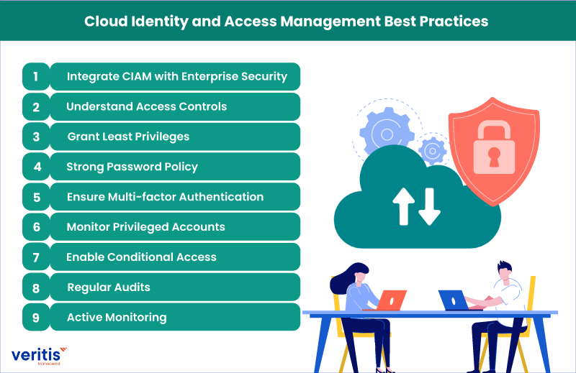
AWS IAM Best practice
Require workloads to use temporary credentials with IAM roles to access Amazon
Require multi-factor authentication (MFA)
Rotate access keys regularly for use cases that require long-term credentials
Safeguard your root user credentials and don't use them for everyday tasks
Apply least-privilege permissions
Regularly review and remove unused users, roles, permissions, policies, and credentials
Use IAM Access Analyzer to generate least-privilege policies based on access activity
Use permissions boundaries to delegate permissions management within an account

Slide 17
AWS Console: Login to account

