Slide 1
AWS AD

Slide 2
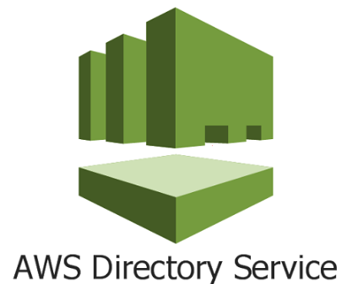
What is AWS Directory Services
AWS Directory Service provides multiple ways to use Microsoft Active Directory (AD) with other AWS services. Directories store information about users, groups, and devices, and administrators use them to manage access to information and resources.
AWS Directory Service provides multiple directory choices for customers who want to use existing Microsoft AD or Lightweight Directory Access Protocol (LDAP)–aware applications in the cloud. It also offers those same choices to developers who need a directory to manage users, groups, devices, and access.

Slide 3
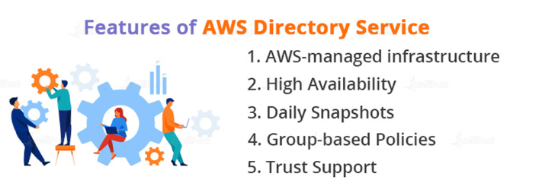
Features of AWS Directory Service
AWS-managed infrastructure: AWS Managed Services Microsoft Active Directory operates on AWS-managed infrastructure, with monitoring that automatically finds and replaces failed domain controllers.
High Availability: AWS Managed Microsoft AD is implemented with high availability and across several Aws Regions since directories are mission-critical infrastructure.
Daily Snapshots: AWS Managed Services Microsoft Active Directory has daily, automatic snapshots.
Group-based Policies: AWS Managed Microsoft Active Directory enables you to control users and devices by using native Active Directory Group Policy objects (GPOs).
Trust Support: Using AD trust relationships, you can simply combine AWS Managed Microsoft AD with your existing AD.

Slide 4
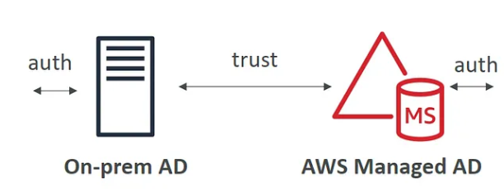
AWS Managed Microsoft AD
With AWS Managed Microsoft AD you can create your AD in AWS, manage users locally, and support MFA.
AWS Directory Service makes it easy to set up and run directories in the AWS Cloud or connect your AWS resources with an existing on-premises Microsoft Active Directory.
The users can authenticate on the right-hand side in on-premises AD or on the left-hand side in the AWS Cloud.
Best choice if you have more than 5000 users and/or need a trust relationship set up.
Includes software patching, replication, automated backups, replacing failed DCs and monitoring.
On-premises users and groups can access resources in either domain using SSO.
AWS Microsoft AD supports AWS applications including Workspaces, WorkDocs, QuickSight, Chime, Amazon Connect, and RDS for Microsoft SQL Server.

Slide 5
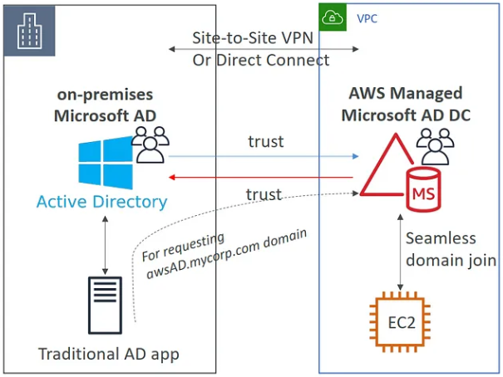
Connect between AWS Managed AD and on-premises AD
Ability to connect your on-premises AD to AWS Managed Microsoft AD. For this, you need to set up a Direct Connect or VPN connection between the two.
On the left side, you have our on-premises AD which manages its users on-premises, and on the right side you have AWS Manage AD, this going to also be managing its users on AWS. And so you can set up three kinds of forest trust:
One-way trust: AWS => on-premises.
One-way trust: on-premises => AWS.
Two-way forest trust: AWS <=>on-premises.

Slide 6
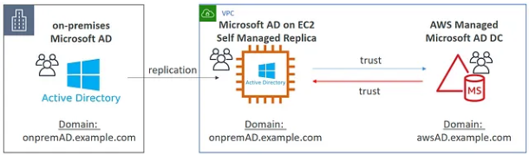
Active Directory Replication
You may want to create a replica of your on-premises AD on AWS to minimize the latency in case Direct Connect or VPN goes down.
To set up a replica, you need to deploy AD on an EC2 Windows instance, and you will have to set up a replication between on-premises AD and an EC2 Windows instance.
And finally, we can set up a two-way forest trust between our EC2 instance and AWS Manage AD.

Slide 7
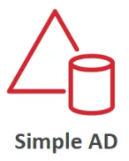
AWS Simple AD Features:
Simple AD provides a subset of the features offered by AWS Managed Microsoft AD, including the ability to manage user accounts and group memberships, create and apply group policies, and securely connect to Amazon EC2 instances, but it does not support MFA.
It cannot be joined with on-premises AD.
Supports joining EC2 instances, and managing users and groups.
Does not support MFA, RDS SQL Server, or AWS SSO.
Small: 500 users, large: 5000 users.
Powered by Samba 4, compatible with Microsoft AD.
Lower cost, low scale, basic AD compatible, or LDAP compatibility.
No trust relationship.

Slide 8
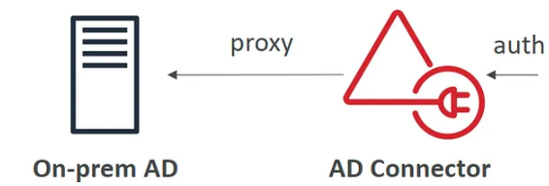
AWS Active Directory Connector Features:
AD Connector is a directory gateway with which you can redirect directory requests to your on-premises Microsoft Active Directory without caching any information in the cloud.
Best choice when you want to use an existing Active Directory with AWS services.
AD Connector comes in two sizes:
Small – designed for organizations up to 500 users.
Large – designed for organizations up to 5000 users.
The VPC must be connected to your on-premises network via VPN or Direct Connect.
When users log in to AWS applications AD connector forwards sign-in requests to your on-premises AD DCs.
You can also join EC2 instances to your on-premises AD through AD Connector.
You can also login to the AWS Management Console using your on-premises AD DCs for authentication.
Not compatible with RDS SQL.
You can use AD Connector for multi-factor authentication using RADIUS-based MFA infrastructure.

Slide 9
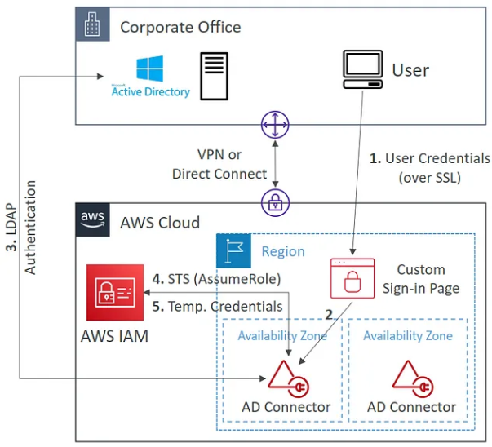
AWS Active Directory Connector Diagram

Slide 10
Use Cases of AWS Directory Service
Allow your on-premises AD users easy access to AWS:
AWS Managed Services and an Active Directory trust all of your users are free to utilize AWS as necessary to Microsoft AD’s ability to divide your on-premises and cloud directories.
Utilize Amazon RDS and Amazon FSx connections:
AWS Managed Microsoft AD makes it possible for your apps and services to utilize and merge Amazon FSx for Windows File Server and AWS Controlled data services such as MySQL, Amazon RDS for SQL Server, Oracle,, and PostgreSQL more effectively.
Allow single sign-on for AWS End User Computing services:
Secure authentication features for Amazon Workspaces and Amazon WorkDocs, two AWS End User Computing services.
Your customers may access these services from a computer that is connected to AWS Managed Microsoft AD without entering their login information individually thanks to Amazon WorkLink and Amazon AppStream 2.0.
Allow your on-premises AD users to access cloud business apps with a single click:
To provide your AWS Managed Microsoft Active Directory or trusted domains access to SAML identity provider (IdP) functionalities, combine AWS Managed Microsoft Active Directory with AWS IAM Identity Center (the replacement for AWS SSO).

Slide 11
Benefits of AWS Directory Service
Simple on-premises work transfer for directory-aware applications
It’s simple to expand domains that already existed.
From a single location, manage devices and application access in AWS.
Administration is made simpler by management services.

