Slide 1
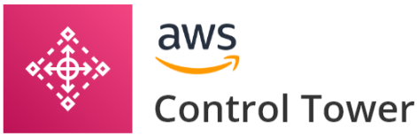
What is AWS Control Tower?
AWS Control Tower offers a straightforward way to set up and govern an AWS multi-account environment, following prescriptive best practices.
AWS Control Tower orchestrates the capabilities of several other AWS services, including AWS Organizations, AWS Service Catalog, and AWS IAM Identity Center (successor to AWS Single Sign-On), to build a landing zone in less than an hour.
Resources are set up and managed on your behalf.

Slide 2
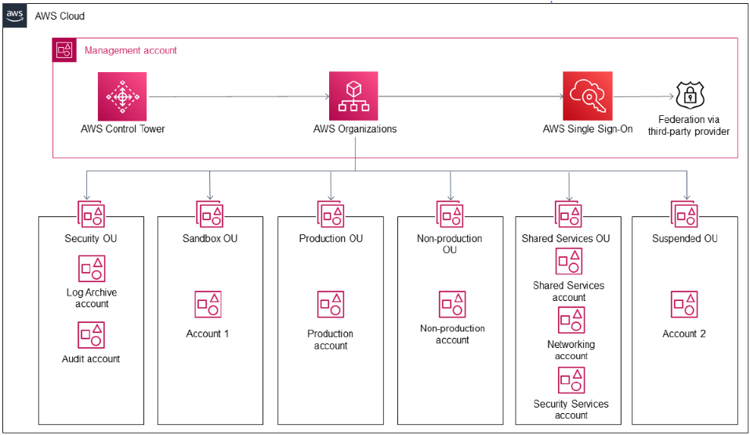
Architecture of the Control Tower
The Security OU has two accounts: the Log Archive Account and the Audit Account. The Log Archive Account acts as a central repository for all CloudTrail and AWS Config logs across the Landing Zone, which are securely saved in an S3 Bucket.
The Sandbox OU is configured to host testing accounts (Sandbox Accounts) that are safely segregated from any production workloads.
Production OU – This OU is responsible for hosting all of your production accounts and workloads.
Non-Production OU – This OU can be used as a pre-production environment for additional testing and development.
Suspended OU – This is a secure OU where you can move any deleted, reused, or compromised accounts. Permissions in this OU are tightly restricted, ensuring that it is a secure location.
Shared Services OU – Accounts in the Shared Services OU host services are shared by numerous other accounts.

Slide 3
AWS Control Tower features:
A landing zone is a well-architected, multi-account environment that's based on security and compliance best practices.
It is the enterprise-wide container that holds all of your organizational units (OUs), accounts, users, and other resources that you want to be subject to compliance regulation. A landing zone can scale to fit the needs of an enterprise of any size.
A control (sometimes called a guardrail) is a high-level rule that provides ongoing governance for your overall AWS environment.
It's expressed in plain language.
Three kinds of controls exist: preventive, detective, and proactive.
Three categories of guidance apply to controls:
mandatory,
strongly
recommended,
elective.
An Account Factory is a configurable account template that helps to standardize the provisioning of new accounts with pre-approved account configurations. AWS Control Tower offers a built-in Account Factory that helps automate the account provisioning workflow in your organization.
The AWS Control Tower dashboard provides you with real-time insight into your AWS environment. It also looks at the number of OUs and accounts that have been provisioned, as well as the number of guardrails that have been enabled, and compares the status of your OUs and accounts to those guardrails.

Slide 4
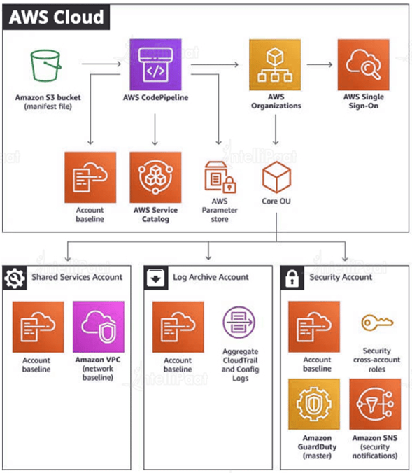
AWS Landing Zone Architecture
The Shared Services account is a starting point for developing infrastructure shared services like directory services. This account hosts AWS Managed Active Directory for AWS SSO integration by default in a shared Amazon Virtual Private Cloud (Amazon VPC) that may be automatically peered at with new AWS accounts created with Account Vending Machine (AVM).
The Log Archive account includes a central Amazon S3 bucket for keeping copies of all AWS CloudTrail and AWS Config log files in a log archive account.
The Security account adds auditor (read-only) and administrator (full-access) cross-account privileges to all AWS Landing Zone managed accounts. The goal of these positions is for a company’s security and compliance team to use them to audit or undertake emergency security operations in the event of an incident.

Slide 5
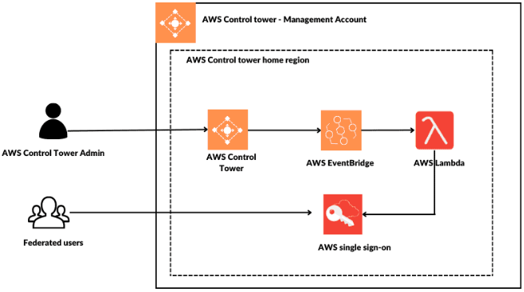
AWS Control Tower - Security
This is referred to as cloud security and cloud security in the shared responsibility model:
Security of the cloud – AWS is in charge of safeguarding the infrastructure that supports AWS services in the AWS Cloud. As part of the AWS compliance programs, third-party auditors regularly test and verify the effectiveness of our security.
Security in the cloud – The AWS services you use determine your liability. You are also accountable for other factors such as the sensitivity of your data, the requirements of your organization, and applicable laws and regulations.

Slide 6
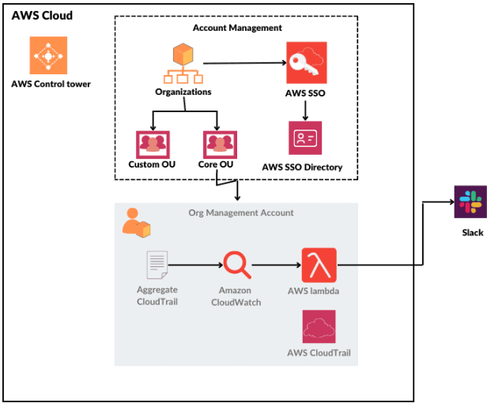
AWS Control Tower - Monitoring
Monitoring enables you to anticipate and respond to potential incidents. As a result, monitoring is an essential component of the well-designed nature of the AWS Control Tower. Because the outcomes of monitoring activities are saved in log files, logging and monitoring are closely related concepts.
One of the shared accounts created when you set up your landing zone is the log archive account, which is dedicated to collecting all logs centrally, including logs for all of your other accounts. These log files enable administrators and auditors to review previous actions and events.
It provides several tools for monitoring your landing zone’s resources and activity.

Slide 7

Benefits of AWS Control Tower
Quick Configuration – While many businesses spend weeks or months developing a management strategy for their AWS environments, Control Tower allows them to do so in hours.
Manage All Accounts – You can give each account its own set of permissions when creating it. This customization enables you to form teams for various tasks without fear of them interfering with the progress of others.
Apply Guardrails – Guardrails can be quickly added by selecting them from the dashboard. The guardrails can then be applied to any accounts you want.
Use Visual Indicators – Visual indicators on the Control Tower’s dashboard provide a good indication of the state of the AWS environment. These indicators can be used in conjunction with notifications to make controlling the Control Tower easier.

