Slide 1
AWS Data Exchange
AWS Data Exchange is a service that makes it easy for AWS customers to find, subscribe to, and use third-party data in the AWS Cloud.
As a subscriber, you can find and subscribe to thousands of products from qualified data providers. Then, you can use the AWS Data Exchange console or API to create, view, manage, and access data sets for use across a variety of AWS analytics and machine learning services.
For providers, AWS Data Exchange eliminates the need to build and maintain any data delivery, entitlement, or billing technology.
Providers in AWS Data Exchange have a secure, transparent, and reliable channel to reach AWS customers and grant existing customers their subscriptions more efficiently. The process for becoming an AWS Data Exchange provider requires a few steps to determine eligibility. For more information, see Providing data products on AWS Data Exchange.

Slide 2
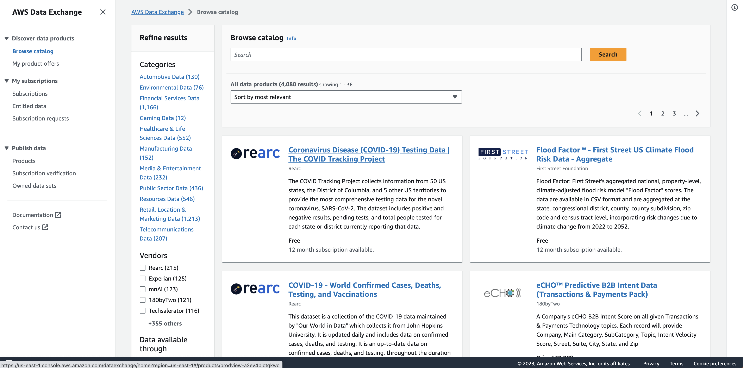
AWS Data Exchange

