Slide 1
Message-Oriented Middleware Message Broker

Slide 2
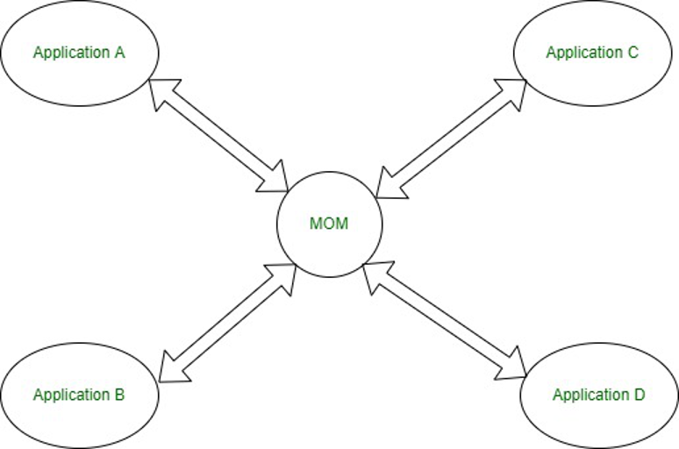
What is Message Oriented Middleware (MOM)?
Message-oriented middleware is a group of software products and applications that allows applications to communicate and exchange data or messages between distributed systems.
A message-oriented middleware system offers asynchronous communication and sends data to perform asynchronous operations.
The primary role of MOM is to ensure that messages are reliably and efficiently transported from one system to another

Slide 3
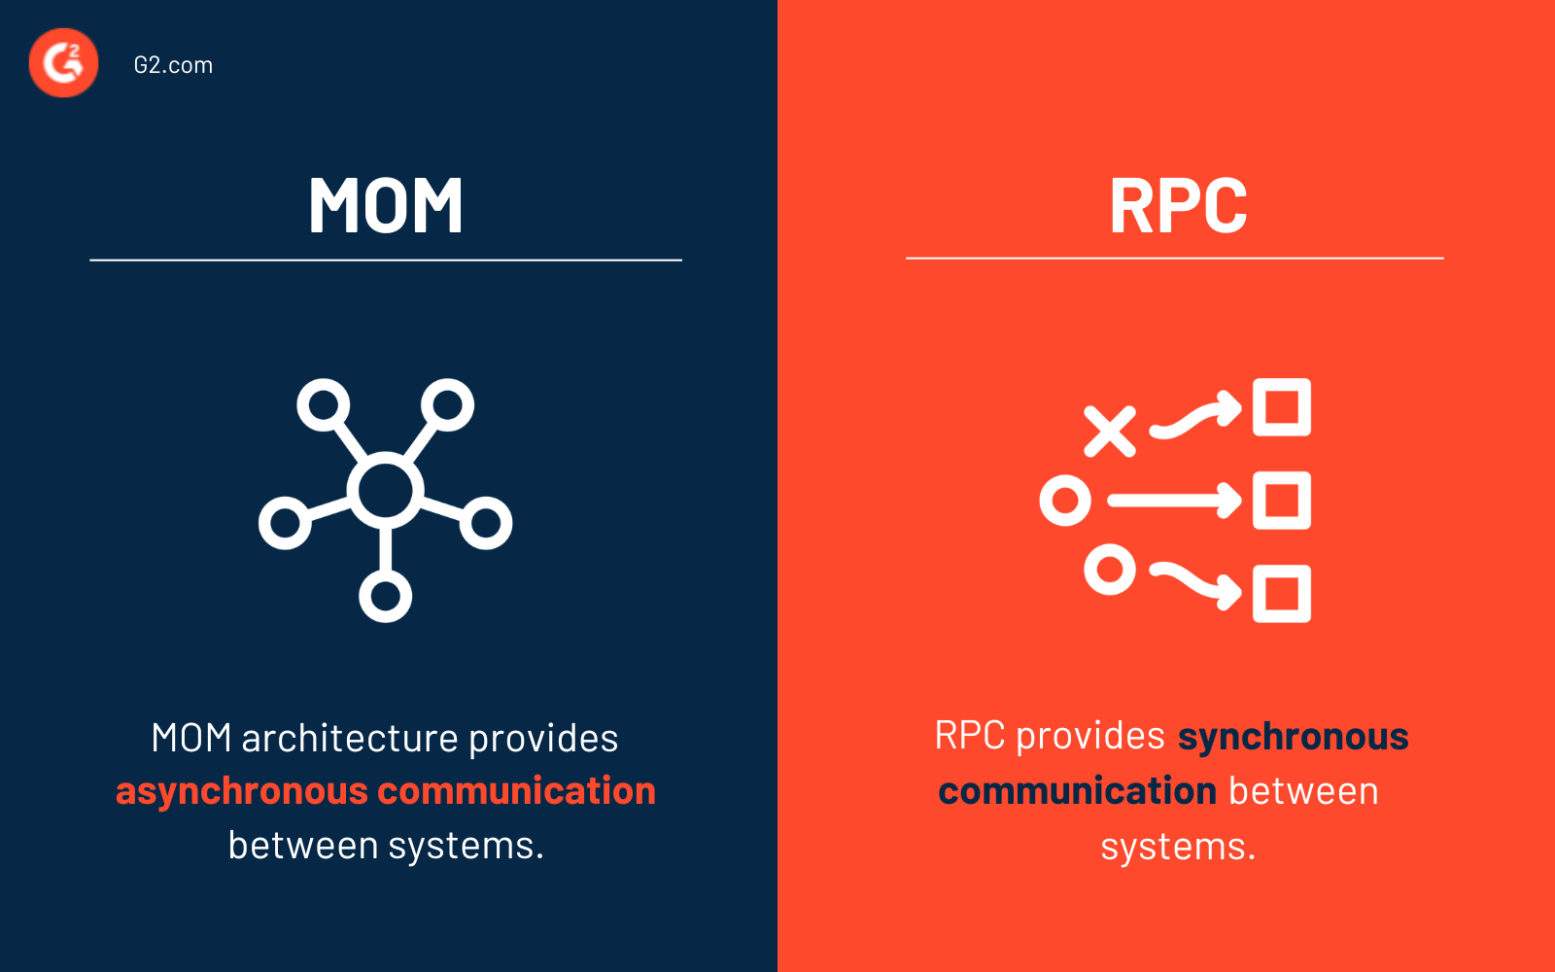
MOM vs RPC

Slide 4
Message Broker vs MOM
A Message Broker is a specific type of MOM.
Message Oriented Middleware (MOM):
Basic Function: It's like a postal system for computer applications. Just as the postal service allows people to send letters to each other, MOM lets different applications send messages back and forth.
Key Features: Ensures that messages get from one application to another. If one application sends a message, MOM takes care of delivering it to the intended recipient, even if there are network issues or if the recipient isn't ready to receive the message right away.
Usage: Used when applications need to exchange messages reliably. It doesn't care much about what's inside the messages or how they are used; it just focuses on delivery.
Message Broker:
Basic Function: This is like a highly specialized post office that does more than just deliver letters. It can read the letters, translate them if they're in a different language, or even decide which letters should be sent where based on their content.
Key Features: Apart from delivering messages (like MOM), it can change the message format, decide which recipient should get which message based on the message content, and manage different types of message formats or communication rules.
Usage: Used in more complex scenarios where you not only need to send messages between applications but also need to control, route, or transform these messages in sophisticated ways.
RabbitMQ, Apache Kafka, and ActiveMQ:
As Message Brokers: Each of these systems can also act as a Message Broker. This means they do more than just pass messages from one point to another; they can manage, route, and sometimes transform messages based on specific rules or content.
As MOM: These systems are indeed examples of Message Oriented Middleware. They provide the infrastructure for asynchronous message-based communication between distributed applications. This includes capabilities like message queuing, delivery assurance, and handling of various messaging patterns.

Slide 5
Message broker models
Point-to-point messaging:
This is the distribution pattern utilized in message queues with a one-to-one relationship between the message’s sender and receiver.
Each message in the queue is sent to only one recipient and is consumed only once.
Publish/subscribe messaging:
In this message distribution pattern, often referred to as “pub/sub,” the producer of each message publishes it to a topic, and multiple message consumers subscribe to topics from which they want to receive messages.
All messages published to a topic are distributed to all the applications subscribed to it.
This is a broadcast-style distribution method, in which there is a one-to-many relationship between the message’s publisher and its consumers.

Slide 6
Event-driven architecture (EDA)

Slide 7
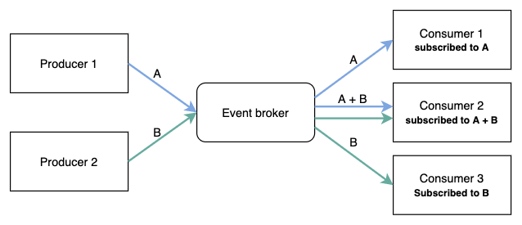
What is event-driven architecture?
Event-driven architecture is an integration model built around the publication, capture, processing, and storage (or persistence) of events.
Event-driven architecture enables a loose coupling between connected applications and services—they can communicate with each other by publishing and consuming events without knowing anything about each other except the event format.

Slide 8
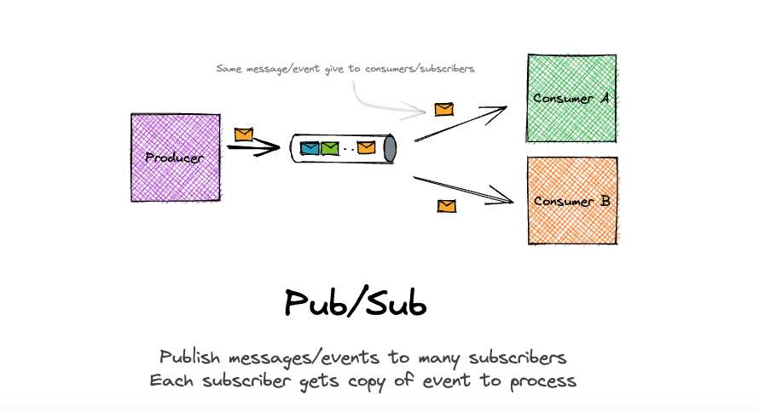
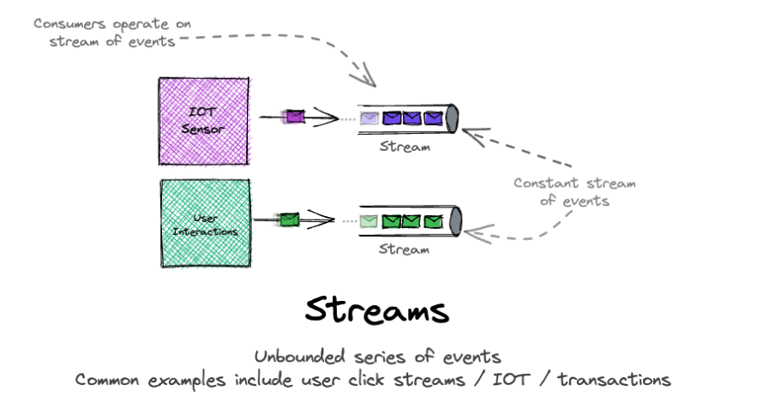
Event-driven architecture messaging models
Event streaming
Event persistence
Complex event processing
Event messaging or publish/subscribe

Slide 9
Challenges with events
Complexity and learning curve –
EDA requires a shift in thinking that requires time to put into practice
﻿﻿Consistency is impacted (CAP theorem) –
Need to follow eventual consistency pattern to deal with it
﻿﻿Duplication of events - events may be delivered more than once.
Need to implement idempotent processing to mitigate duplication risk
﻿﻿Schema evolution - handling changes in event schemas over time requires planning to ensure backward and forward compatibility
﻿﻿Event driven architecture is not a solution for all problems!
﻿﻿It should be used when it makes sense – asynchronous processing

Slide 10
Why use EDA?
System scaling
It is essential to foster horizontal scaling, instead of vertical scaling.
The number of consumers can be increased, allowing parallel processing
Improves performance
Doing asynchronous processing allows decoupling between systems/processes allowing faster responses on the main process, leaving others processes to happen "offline”
Better fault tolerance
Events are broadcasted using an event bus, in case of failure the event can be replayed without affecting upstream systems.
On top of that, the upstream system is not affected by the unavailability of downstream system.
Key principles ﻿﻿
"Near real time" events as they happen at the producer ﻿
﻿Push notifications
One way "fire-and-forget”
Immediate action at the consumer ﻿﻿
Informational ("this happened" rather than command based ("do this")

Slide 11
EDA Components
Message
A message is a self-contained data unit that typically represents a command. It is typically a point-to-point communication using a broker as communication layer.
Messages are normally used to trigger actions without tight coupling, allowing for scalable, flexible, and loosely-coupled system
Event
Discrete occurrence that took place at a specific moment in time, often within a system or software application.
They are used to signal, notify, or record these occurrences, allowing systems to respond to or process them in an event-driven
Event Sources
Event sources are the initial triggers or generators of events.
They can be internal or external to the organization and can encompass a wide range of entities, such as user interfaces, APIs (Internal or external), services and
Event broker
The event broker is a central component that acts as an event distribution system.
It receives events from producers and efficiently routes them to the appropriate event consumers based on predefined rules and subscriptions.
Event producers
Event producers are responsible for collecting events from a source and publishing them to an event broker.
They serve as intermediaries between event sources and the event broker.
Event consumers
Event consumers are services or components that subscribe to specific types of events from the event broker.
They are responsible for processing events and taking relevant actions based on the event content.

