Slide 1
AWS CDK
Cloud Development Kit

Slide 2
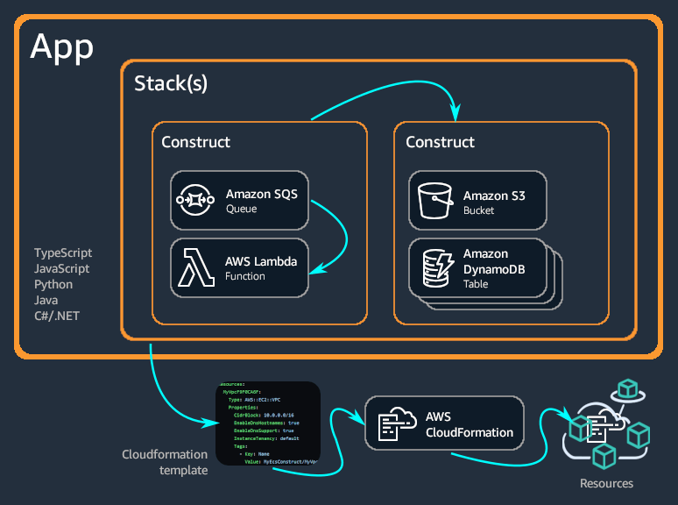
AWS CDK
The AWS Cloud Development Kit (AWS CDK) is an open-source software development framework for defining cloud infrastructure in code and provisioning it through AWS CloudFormation.
It allows developers to define their cloud resources using familiar programming languages, bringing the benefits of software development practices like version control, code review, and continuous integration/continuous deployment (CI/CD) to cloud infrastructure management.
Benefits:
Productivity: Write less code to define cloud resources.
Reusability: Share and reuse cloud patterns.
Safety and Security: Utilize the safety of statically typed languages.
Best Practices: Embed best practices into constructs.
Use Cases:
Ideal for managing complex cloud infrastructures, building reusable cloud components, and integrating cloud resources with application code.

Slide 3
AWS CDK Key Concepts
Infrastructure as Code (IaC):
The AWS CDK enables defining cloud infrastructure using code. This approach, known as Infrastructure as Code, allows for more repeatable, consistent, and scalable deployments.
Support for Multiple Languages:
The CDK supports several programming languages, including TypeScript, JavaScript, Python, Java, C#, and (in developer preview) Go. This allows developers to use a language they are comfortable with to define cloud resources.
Components of AWS CDK:
CDK Applications: The root construct representing an AWS CDK app. It's an entry point for your infrastructure definition.
Stacks: Logical units within a CDK application. Each stack represents a collection of AWS resources that are deployed as a single unit.
Constructs: Basic building blocks of AWS CDK applications. Constructs represent abstract cloud resources (like a virtual private cloud, a database, or a serverless function). They can be composed to define complex cloud infrastructures.
High-Level Constructs (L3):
AWS CDK provides high-level constructs known as L3 constructs, which offer pre-configured templates for commonly used cloud resources and patterns, simplifying the development process.
Reusable Components:
With the CDK, you can define custom reusable cloud components called constructs, which can encapsulate common cloud patterns and share them like any other software library.
Integration with AWS Services:
The CDK seamlessly integrates with a wide range of AWS services, allowing for the creation, configuration, and composition of any AWS resource that CloudFormation supports.
CDK CLI:
The AWS CDK comes with a command-line interface (CLI) tool that aids in interacting with CDK applications. It provides commands for synthesizing CloudFormation templates from CDK code, deploying stacks, and more.
Synthesis to AWS CloudFormation:
The CDK synthesizes your application into an AWS CloudFormation template. This means you can leverage the full power of CloudFormation, including change sets, drift detection, and rollbacks.

Slide 4
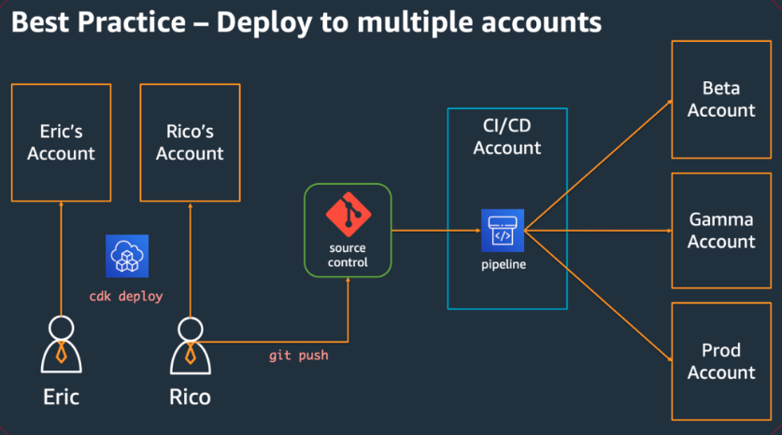
AWS CDK Deploy to multiple accounts

Slide 5
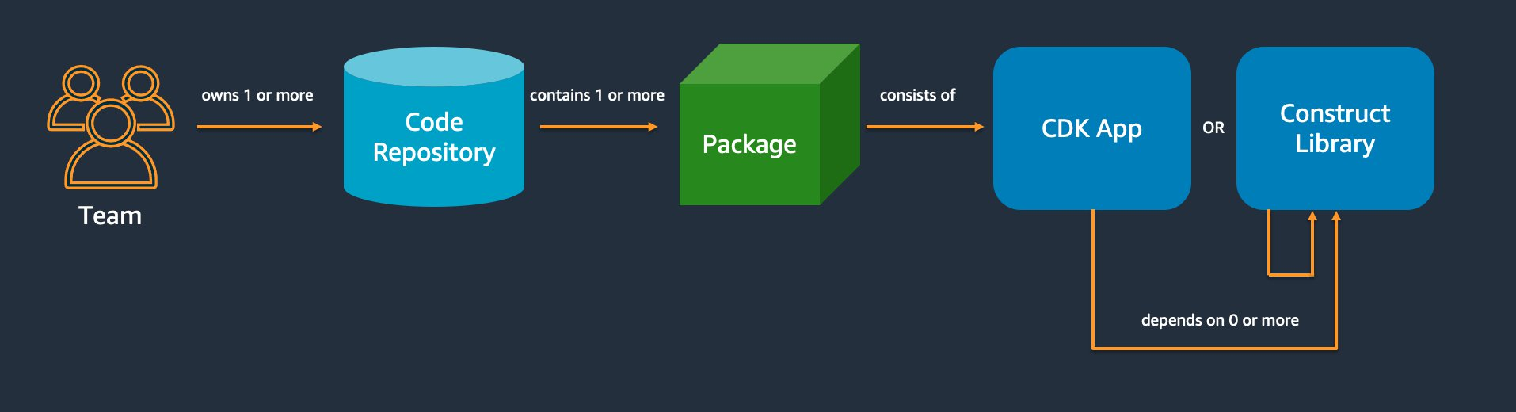
AWS CDK Deploy coding best practices

Slide 6
AWS CDK Exam Take Away
CDK constructs come in three levels of abstraction:
L1 constructs (also called CFN resources) are low-level constructs that map directly to components that are available in CloudFormation. For example, a security group, S3 bucket, or a DynamoDB table.
L2 constructs provide the same functionality as CloudFormation resources but with added convenience by including the default settings, repetitive code, and connecting logic that you would otherwise have to write with a native CloudFormation resource.
L3 constructs (also called patterns) define infrastructure that follows best practices and conventions, which can help you improve the structure and maintainability of your CDK apps. For example, you can easily build an API Gateway API backed by a Lambda function using the aws-apigateway.LambdaRestApi construct.
Stack drift
a feature that allows you to detect and compare the actual stack resources to the expected stack resources in your CloudFormation template.
AWS CDK at no extra cost, you will be billed for the AWS resources created by CDK in the same way as if you had created them manually.
It uses familiar programming languages such as TypeScript, JavaScript, Python, C#, .Net, Java, and Go and deploys everything as CloudFormation stacks.

Slide 7
AWS SDK
Software Development Kit

Slide 8
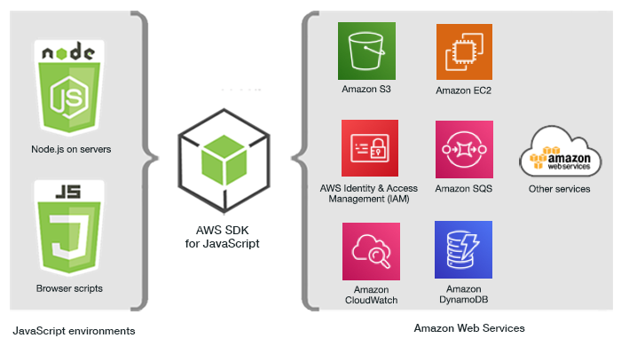
AWS SDK
The AWS SDK (Software Development Kit) is a collection of tools and libraries that enable developers to interact programmatically with AWS services.
These SDKs provide an abstracted way to access AWS resources and services, allowing developers to integrate their applications with AWS without having to deal with low-level API calls directly.
Key aspects of the AWS SDK include:
Language-Specific Libraries:
AWS provides SDKs for various programming languages and platforms, including Java, Python (Boto3), JavaScript (Node.js), .NET, Go, Ruby, PHP, C++, and others. This means developers can work with AWS services in their preferred programming environment.
Ease of Use:
The SDKs simplify the process of making API calls to AWS services by providing pre-built methods and classes. This abstracts away the complexity of directly handling API requests and parsing responses.
Functionality:
SDKs offer functionality across the entire AWS platform, covering services like Amazon S3 (Simple Storage Service), EC2 (Elastic Compute Cloud), DynamoDB, and more. They allow for operations such as creating and managing resources, querying services, and handling user authentication.
Efficient Development:
They facilitate efficient development practices by providing features like automatic retries, error handling, and pagination. This makes it easier to build robust and scalable applications.
Authentication and Authorization:
AWS SDKs integrate seamlessly with AWS IAM (Identity and Access Management), allowing developers to manage user authentication and authorization securely.

Slide 9
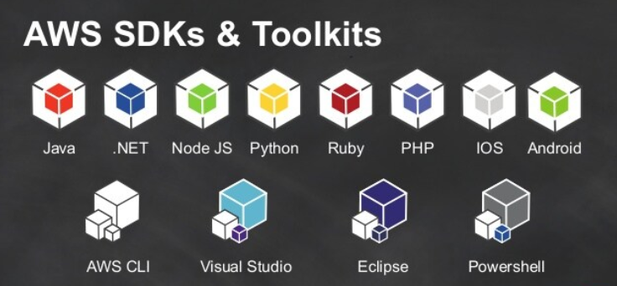
AWS SDK
AWS Service Integration:
The SDKs are designed to work with a wide range of AWS services, ensuring that applications can leverage the full breadth of AWS offerings, including newer services and features.
Resource Management:
They provide an easier way to manage resources, perform CRUD operations (Create, Read, Update, Delete), and execute service-specific tasks.
Community and Documentation:
AWS SDKs are well-documented with comprehensive guides, API references, and sample code. Many of the SDKs are open source, with active community contributions.
Mobile and IoT Specific SDKs:
Apart from general-purpose SDKs, AWS also offers SDKs specifically for mobile development (AWS Amplify, AWS Mobile SDK) and IoT.
Integration with Development Tools:
These SDKs can be integrated into popular IDEs (Integrated Development Environments) and are compatible with various build tools and platforms.

