Slide 1
Infrastructure as Code
CloudFormation

Slide 2
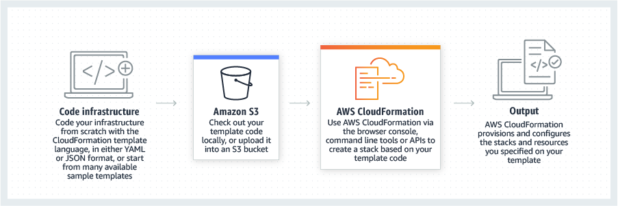
Aws CloudFormation
AWS CloudFormation lets you model, provision, and manage AWS and third-party resources by treating infrastructure as code.

Slide 3
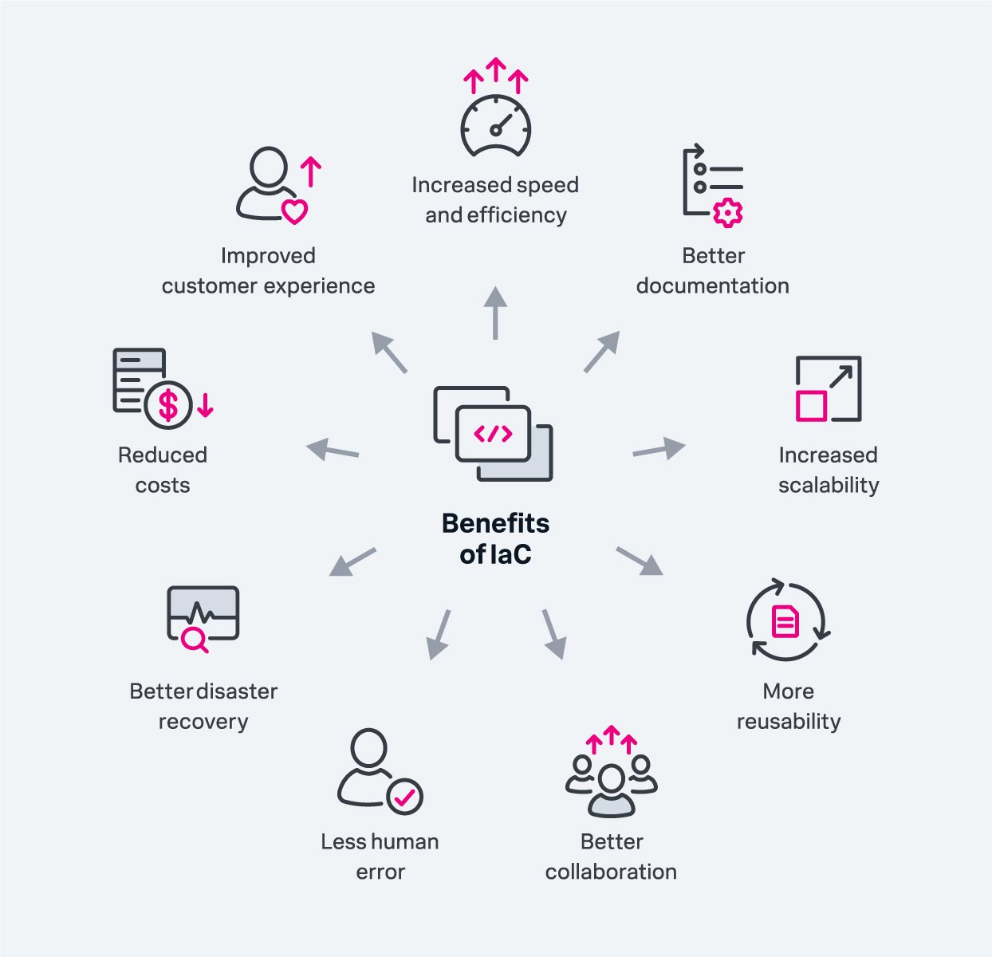
Infrastructure as code benefits

Slide 4
CloudFormation Key Concepts
Component | Description
Templates | The JSON or YAML text file that contains the instructions for building out the AWS environment
Stacks | The entire environment described by the template and created, updated, and deleted as a single unit
StackSets | AWS CloudFormation StackSets extends the functionality of stacks by enabling you to create, update, or delete stacks across multiple accounts and regions with a single operation
Change Sets | A summary of proposed changes to your stack that will allow you to see how those changes might impact your existing resources before implementing them
Templates | The JSON or YAML text file that contains the instructions for building out the AWS environment

Slide 5
CloudFormation CLI commands
Create a Stack: aws cloudformation create-stack --stack-name STACK_NAME --template-body file://template.json --parameters ParameterKey=Key,ParameterValue=Value
Update a Stack: aws cloudformation update-stack --stack-name STACK_NAME --template-body file://updated-template.json --parameters ParameterKey=Key,ParameterValue=Value
Delete a Stack: aws cloudformation delete-stack --stack-name STACK_NAME
Describe Stacks: aws cloudformation describe-stacks
List Stack Resources: aws cloudformation list-stack-resources --stack-name STACK_NAME
Validate a Template: aws cloudformation validate-template --template-body file://template.json
Get Stack Events: aws cloudformation describe-stack-events --stack-name STACK_NAME
Create Change Set: aws cloudformation create-change-set --stack-name STACK_NAME --change-set-name CHANGE_SET_NAME --template-body file://template.json --parameters ParameterKey=Key,ParameterValue=Value
Execute Change Set: aws cloudformation execute-change-set --change-set-name CHANGE_SET_NAME --stack-name STACK_NAME 1
List Change Sets: aws cloudformation list-change-sets --stack-name STACK_NAME
Cancel Update Stack: aws cloudformation cancel-update-stack --stack-name STACK_NAME
Detect Drift: aws cloudformation detect-stack-drift --stack-name STACK_NAME

Slide 6
CloudFormation Functions
Fn::Base64
Fn::FindInMap
Fn::GetAtt
Fn::GetAZs
Fn::ImportValue
Fn::Join
Fn::Select
Fn::Split
Fn::Sub
Fn::Transform
Fn::Ref
Fn::And
Fn::Equals
Fn::If
Fn::Not
Fn::Or
Fn::Cidr
Fn::Transform
Fn::FindInMap
Fn::GetAtt
Fn::GetAZs

